Slide 1
MACGEAR · INTERNAL UPDATE
3PL Portal
A customer visibility portal and automated billing engine for our new third-party logistics service.
Live on NetSuite production · First customer: Mova · August 2026

Slide 2
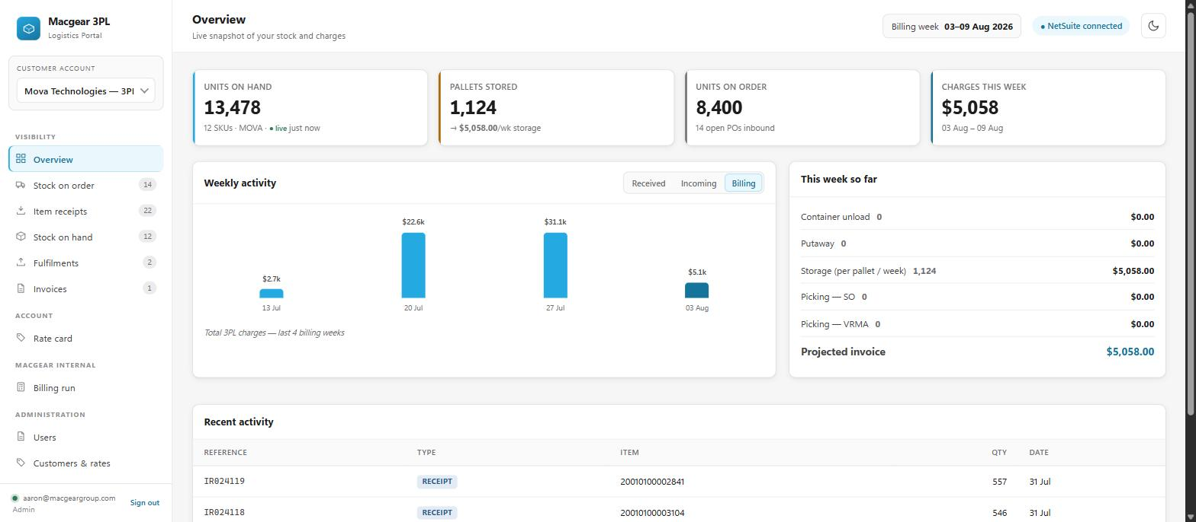
What we built, and why
We now store and handle stock we don't own, and charge for it. That created two jobs nobody had a system for: showing the customer their stock, and billing them accurately every week.
The customer can see their own stock, live
No more emailed spreadsheets or "can you check how many we have?"
Weekly charges calculate themselves
Five manual saved searches replaced by one reviewed draft invoice.
NetSuite stays the single source of truth
The portal reads from it and writes drafts back to it. No parallel system.
The customer's landing page — stock, pallets, inbound and charges at a glance.
Built to take on more customers
Mova is first. Adding the next one is filling out a form, not a rebuild.
2

Slide 3
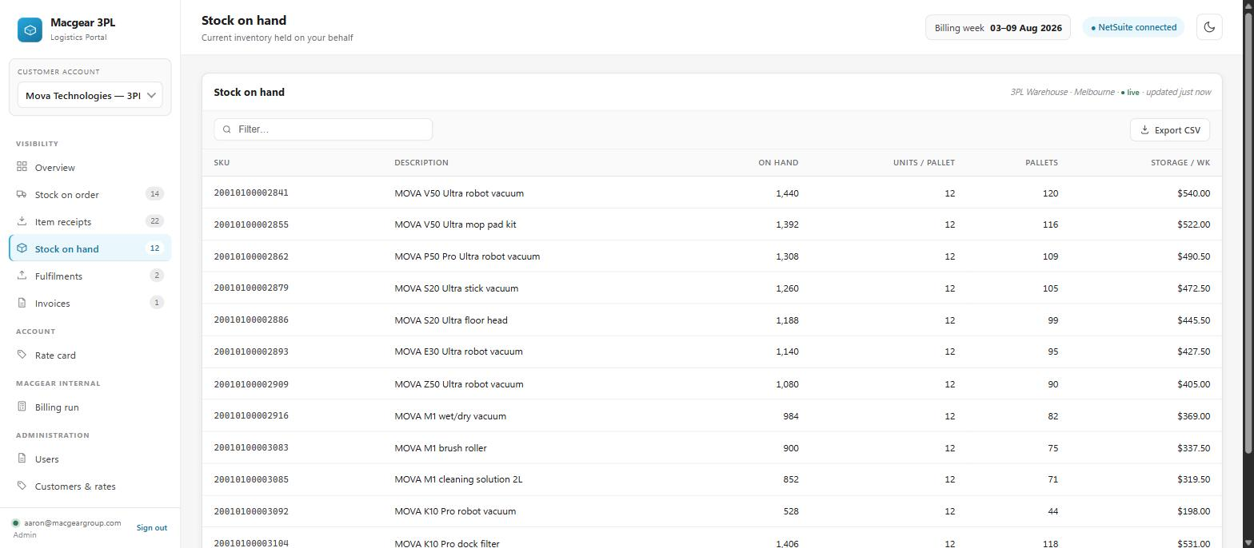
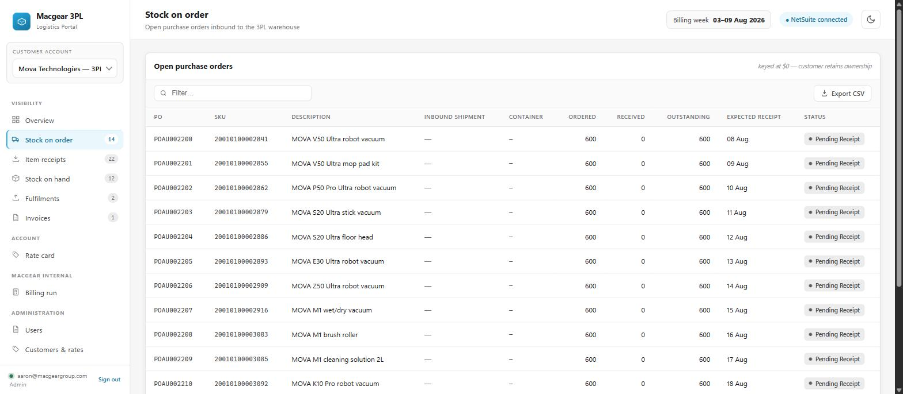
What the customer can see
Six views, all fed from NetSuite. Stock on hand refreshes every 15 minutes.
Stock on hand — units, pallets and what storage is costing, per SKU.
Stock on order — what's on the water, container by container.
Stock on order
Item receipts
Stock on hand
Fulfilments
Invoices
Rate card
open POs inbound
what landed, and when
live, every 15 min
what went out
charges, with the week billed
the agreed rates
3

Slide 4
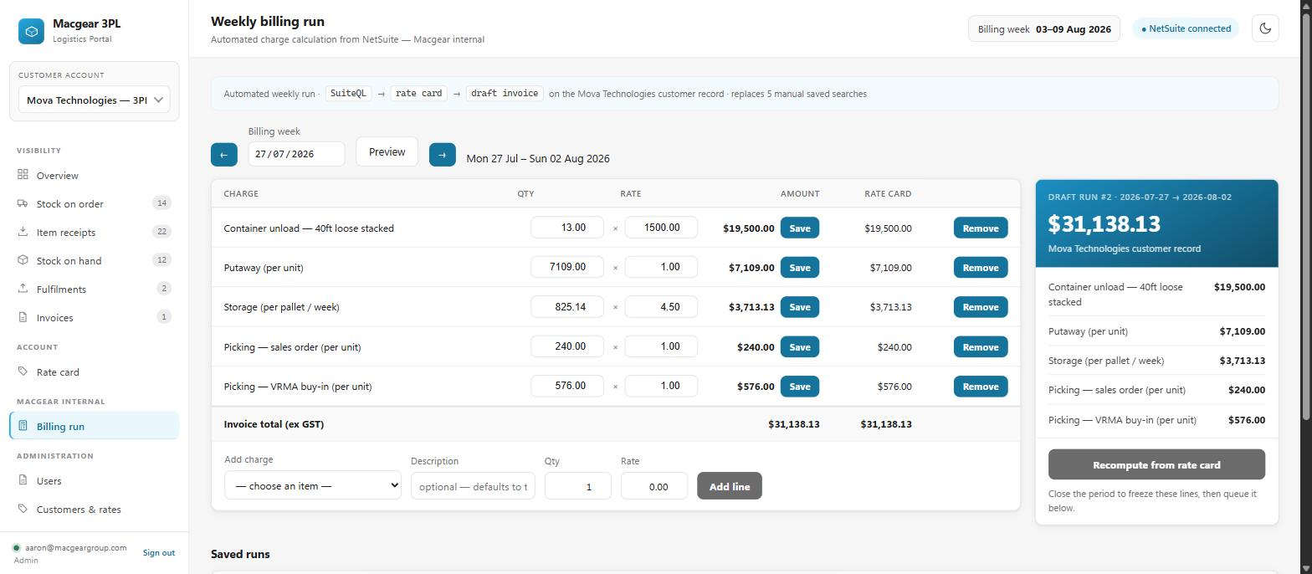
The part that saves real time
Every Monday the portal drafts the previous week's invoice by itself — containers unloaded, units put away, pallets stored, units picked — priced off the agreed rate card. Someone reviews it and presses a button.
Nothing is ever invoiced automatically
It creates a DRAFT in the portal. A person always approves it.
The draft can be edited before it goes
Adjust a line, or add ad-hoc charges like labour, kitting or freight.
A week's draft, ready for review — every line traceable to its source documents.
Under-billing is flagged, not hidden
A container with no charge against it says so, in red, before you send.
Replaces five saved searches, run by hand, every week.
The risk it removes matters more than the time: a missed container is $1,500 nobody notices.
Changes made in NetSuite flow back
Edit the invoice there and the portal shows the difference.
4

Slide 5
Where it's up to
LIVE NOW
Version 2.0
Running on NetSuite production
Customer generated orders
All six customer views populated
Customer own team management.
Real movements sync'd every 15mins
Tracking and shipping info
** Not required for Mova left for v2
Stock on hand live every 15 min
Basic reporting and Alerts
Weekly billing drafts generating
Payment integration
Built in-house, no licence cost, no new supplier. It runs alongside the tools we already have and uses the NetSuite data we already keep.
Happy to walk anyone through it — Aaron
5

