Slide 1
Contract Monthly Claim System
By: Ashley Spiwe Machakaire
Student number: ST10443342
Module: Programming 2B (PROG6212)

Slide 2
Project Introduction and Objectives
The Problem: Manual, inefficient, and error-prone process for Independent Contractor (IC) lecturers to submit and get claims approved.
POE Objective: To design, develop, and enhance a .NET web-based application that automates this entire workflow.
Project Parts:
Part 1: Project Planning & Prototype Design (Non-functional UI, UML, Plan).
Part 2: Functional Prototype Implementation (Core features, testing).
Part 3: Application Enhancement & Automation (Advanced features, reporting).

Slide 3
Part 1: The Foundation- Planning and Design
Documentation & Rationale: Detailed design choices for a multi-role system (Lecturer, Coordinator, Manager, Admin). Justified a clean, intuitive UI for ease of use.
UML Class Diagram: Designed a comprehensive diagram outlining the core entities:
ApplicationUser (inherits from IdentityUser), Claim, Document, Notification, Message.
Clearly defined relationships (e.g., User has many Claims, Claim has many Documents).
Project Plan: A realistic timeline and task breakdown for the prototype development phase.
GUI Prototype: Developed a front-end prototype in ASP.NET Core MVC, establishing the navigation structure and page layouts for all user roles.

Slide 4
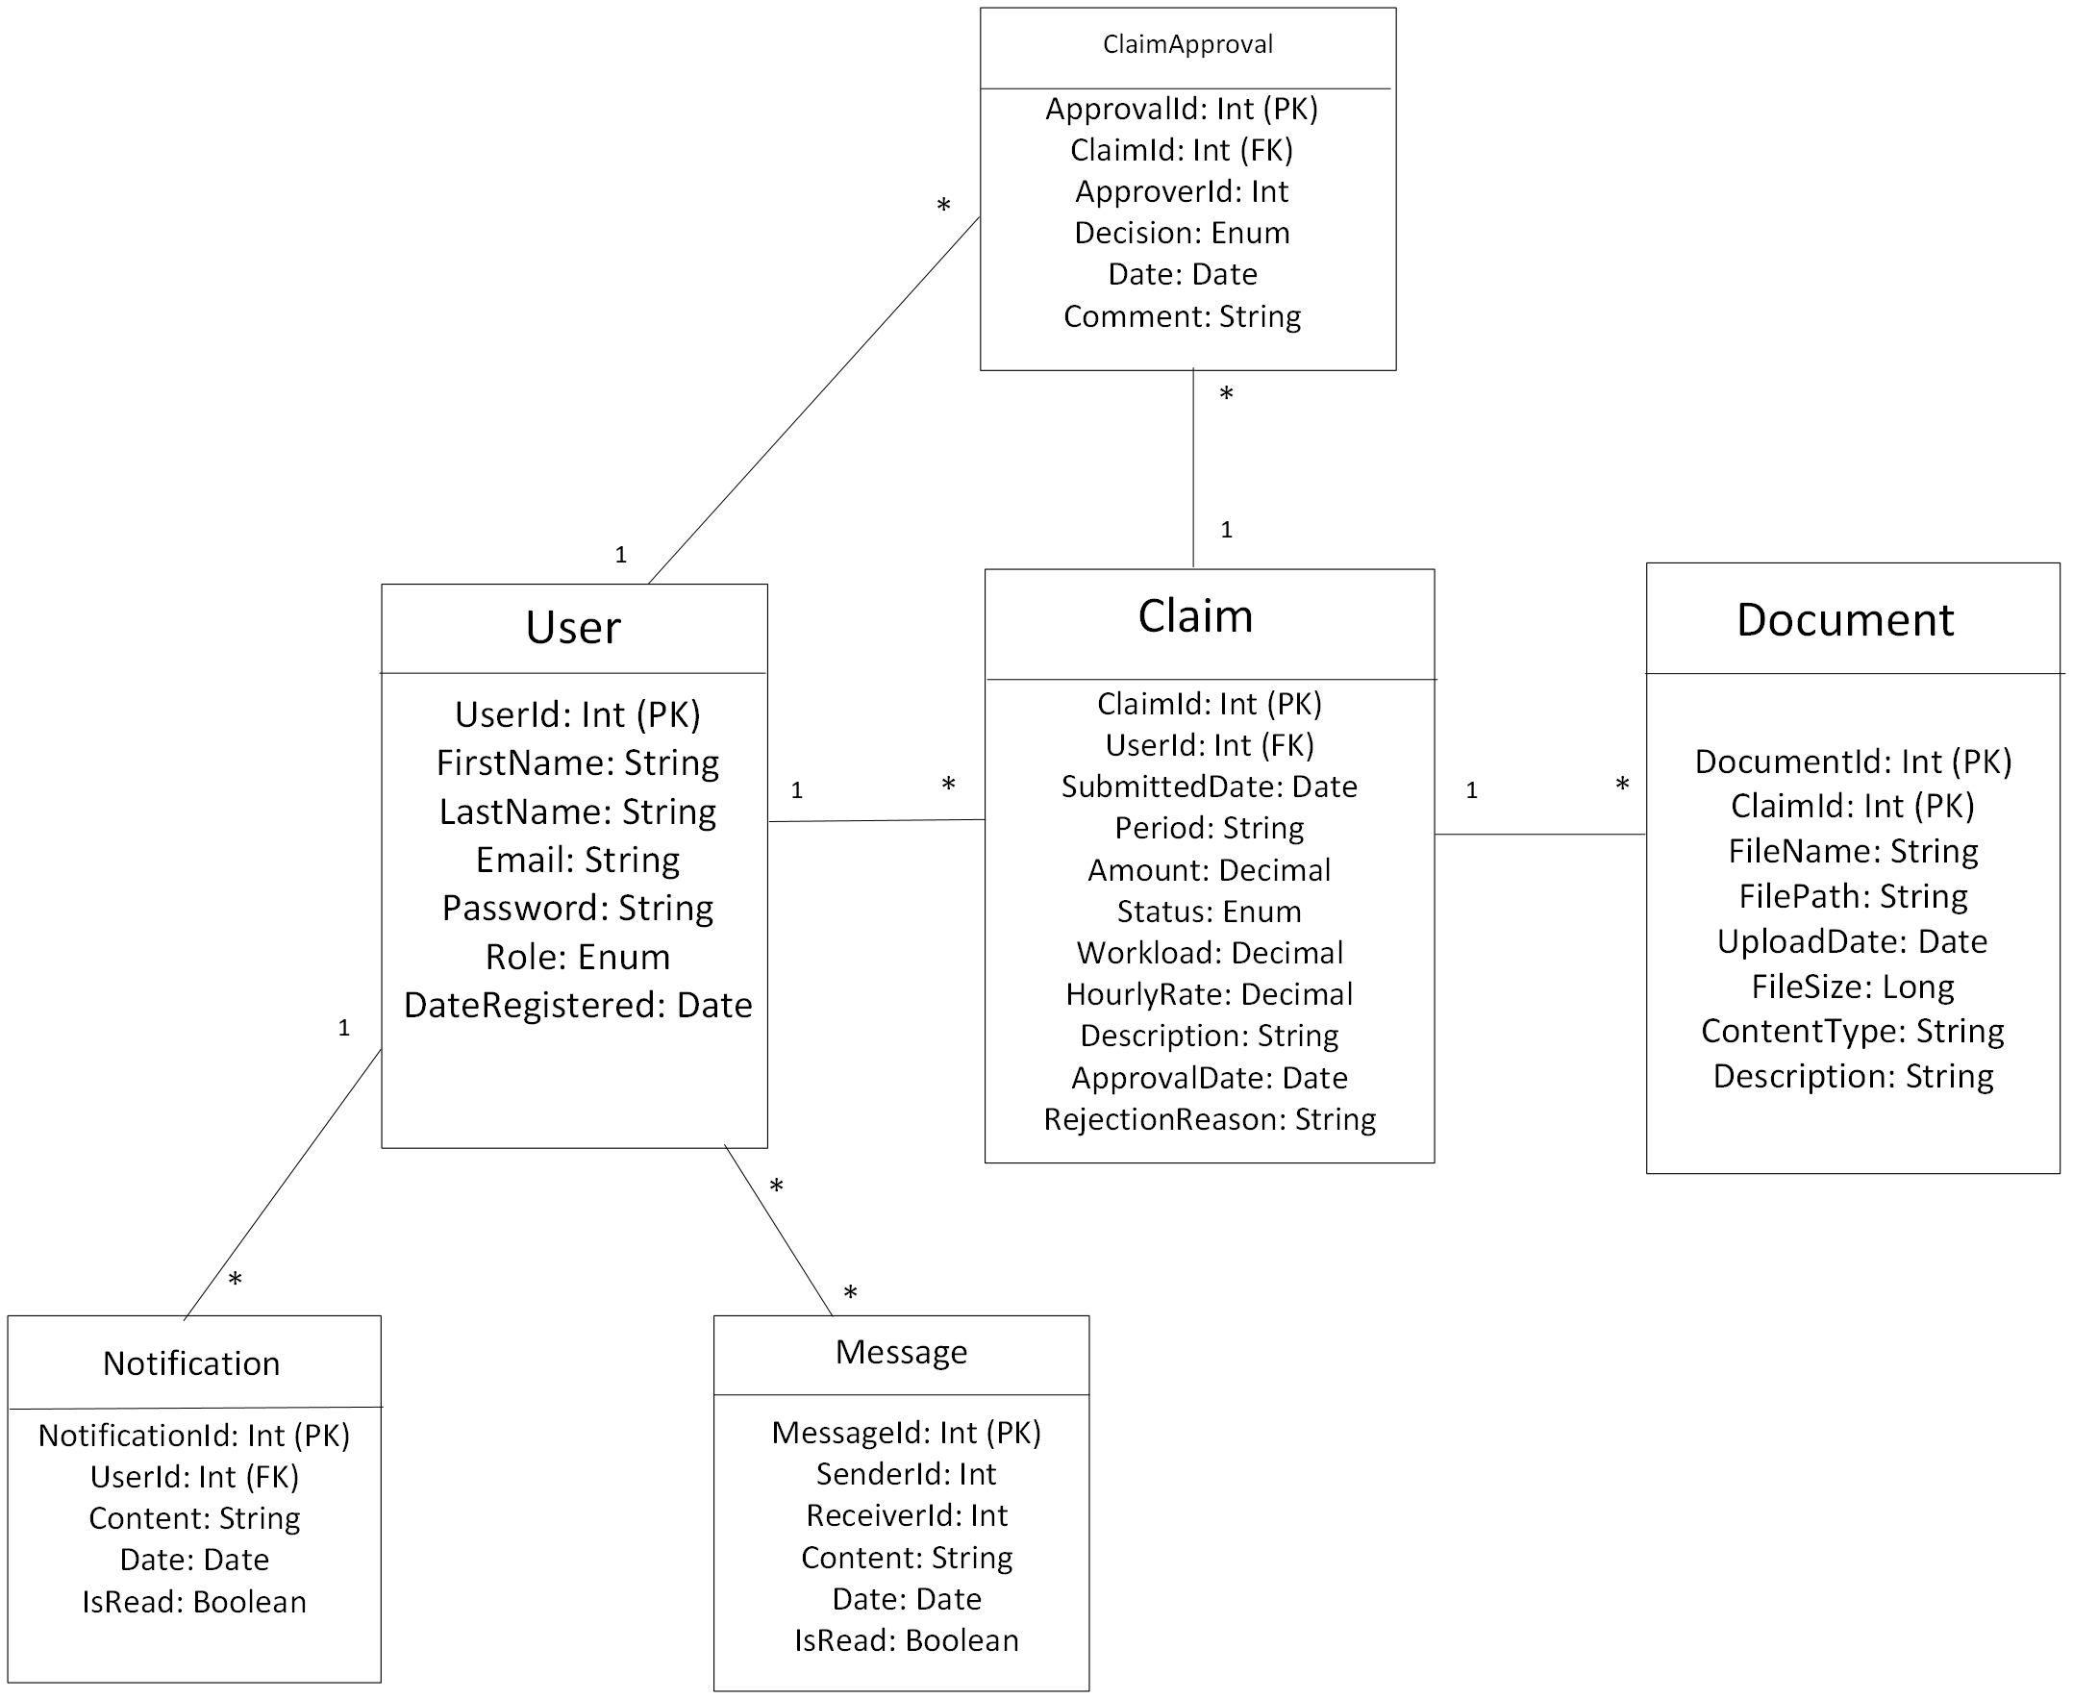
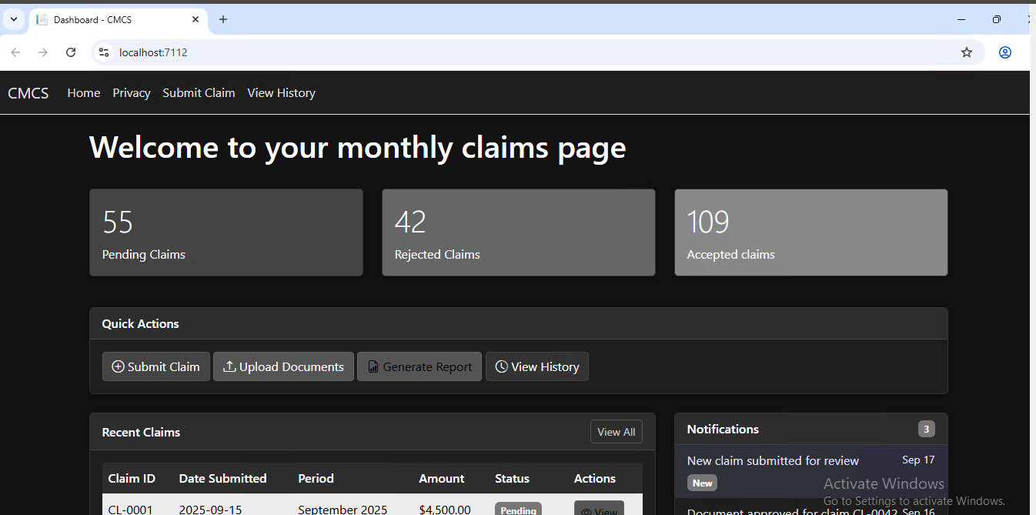
INITIAL DASHBOARD
Initial uml CLASS dIAGRAM

Slide 5
Part 2: Implementing Core Functionality
This phase focused on implementing the core features as per the POE requirements:
  Lecturer Claim Submission: A simple, intuitive form with fields for period, workload, and description.
  Coordinator/Manager Views: Separate dashboards to display pending claims with 'Approve'/'Reject' functionality.
  Document Upload: Secure file upload with type and size validation, linked directly to claims.
  Status Tracking: A transparent system using status badges (Pending, Approved, Rejected) and a timeline view.
  Reliability: Implemented basic error handling and data validation to ensure consistent information.

Slide 6
Part 2: Exemplary Feature: Claim Status Tracking
  Requirement: "The claim status can be tracked transparently until it is settled."
  Our Implementation:
    Real-time Status Badges: Color-coded badges (badge-pending, badge-approved, badge-rejected) provide instant visual status.
    Detailed Status View: The Claims/Details view features a visual timeline showing the claim's journey from "Submitted" -> "Under Review" -> "Approved/Rejected".
    Transparency: Users always see the current status and who processed their claim (ProcessedByUser).
  Result: Exceeds basic requirements by providing both a high-level overview and a detailed, user-friendly audit trail.

Slide 7
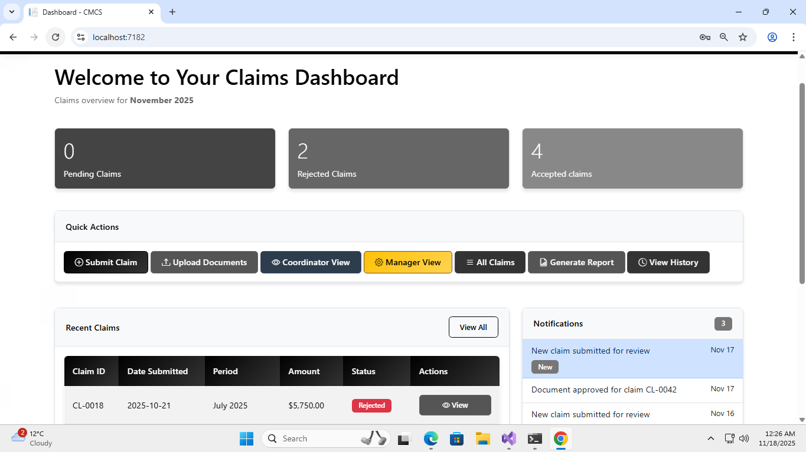
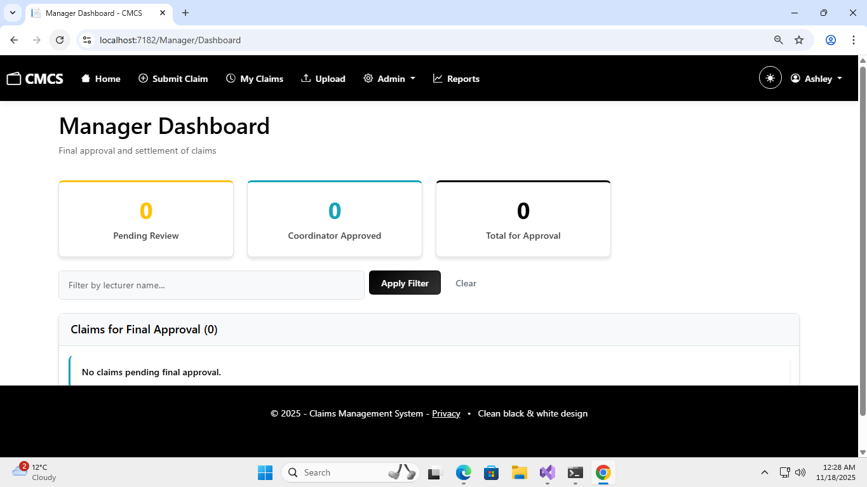
Lecturer view
Manager View

Slide 8
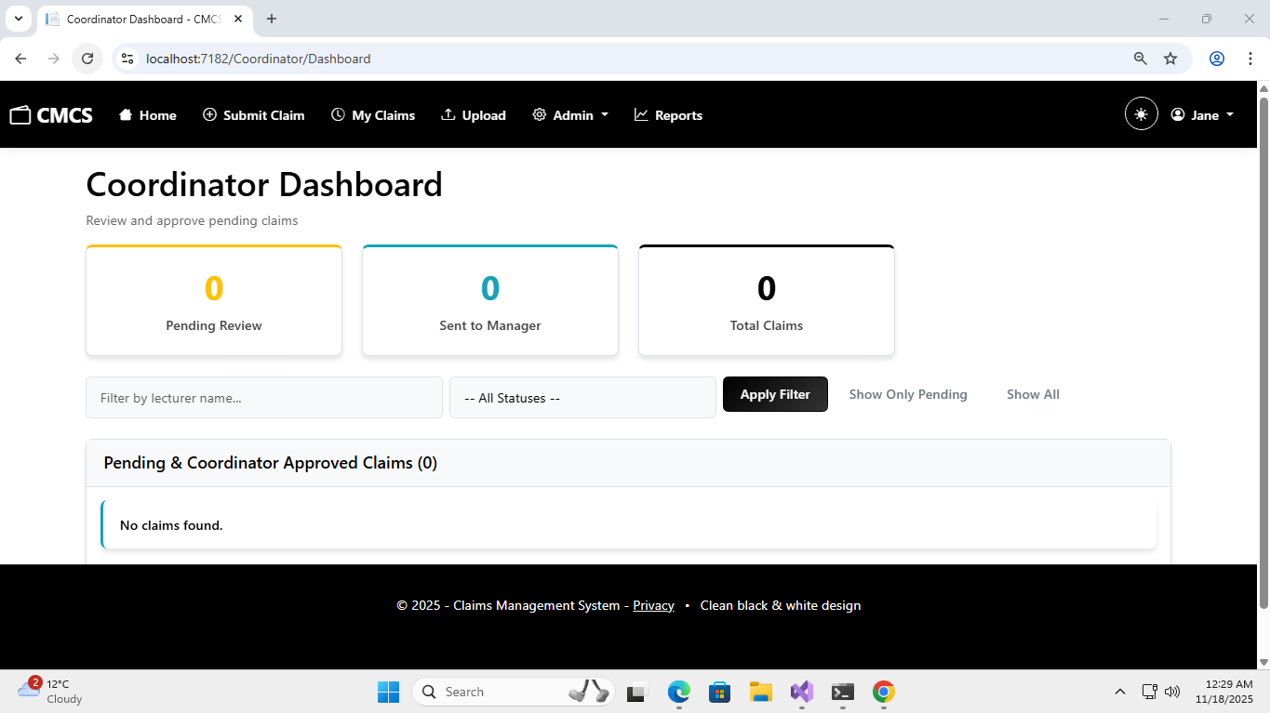
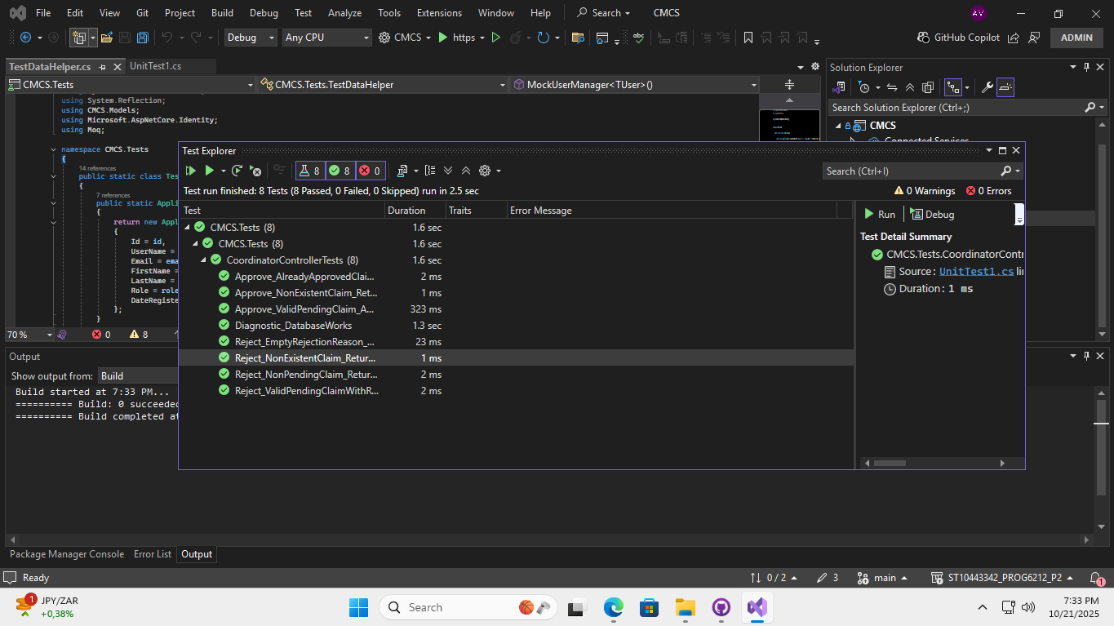
Coordinator view
Unit Test

Slide 9
Part 3: Enhancing Efficiency with Automation
Part 3 focused on moving from a functional system to an intelligent, automated one, implementing features that "greatly exceed the required standard."
  Lecturer View: Auto-calculation and advanced validation checks.
  Coordinator View: Automated verification against business rules.
  Manager View: Final approval workflow with additional checks.
  HR View: Automated report generation and lecturer data management.

Slide 10
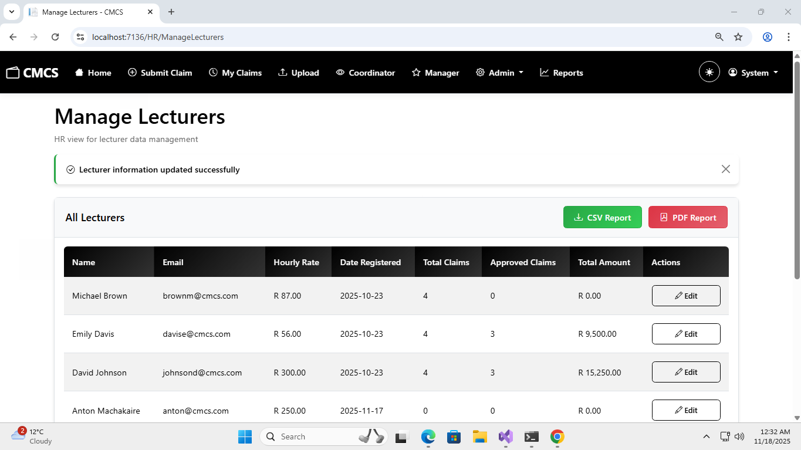
HR View

Slide 11
Automation: Smart Claim Submission
Feature 1: Auto-Calculation
  How it works: JavaScript on the SubmitClaim view automatically calculates Total Amount = Workload * Hourly Rate in real-time as the user types.
  Code Highlight: calculateTotal() function in the SubmitClaim.cshtml.
Feature 2: Validation Checks
  How it works: Client-side (jQuery) and server-side (Data Annotations) validation.
  Examples: Workload range (0.1-180 hours), file type/size validation.
  Code Highlight: [Range(0.1, 180)] attribute on the Workload property.
Benefit: Eliminates calculation errors and ensures data integrity upon submission.

Slide 12
Automation: Coordinator view
Feature: Automated Verification & Approval Workflow (POE Requirement Met)
  How it works: The CoordinatorController.Approve() action calls VerifyClaimAgainstCriteria(). This method automatically checks claims against predefined business rules:
    Workload is within limits (0-180 hours).
    Hourly rate is valid.
    Total amount is calculated correctly.
    Supporting documents are attached.
  Automated Workflow: Upon approval, the claim status automatically transitions from Pending to CoordinatorApproved, pushing it to the Manager's dashboard.
Benefit: Ensures policy compliance and standardizes the initial review process.

Slide 13
Automation: Manager View
Feature: Final Verification & Settlement
  How it works: The Manager's dashboard aggregates claims from both Pending and CoordinatorApproved statuses. The FinalApprove action performs a final check (PerformFinalVerification), such as flagging claims over R10,000.
  Streamlined Processing: Provides a single view for all claims requiring final authority.
Benefit: Provides managerial oversight and ensures a seamless, error-free transition to "Approved" status for payment.

Slide 14
Automation: HR/Admin View
Feature 1: Lecturer Data Management
  How it works: The HRController.ManageLecturers() view provides a central list. A modal-based form allows HR/Admins to update personal information seamlessly.
Feature 2: Automated Report Generation
  How it works: The GeneratePaymentReport() action uses LINQ to query approved claims. It dynamically generates and downloads a CSV or PDF file for payroll processing.
Benefit: Eliminates manual data compilation and reduces administrative effort.

Slide 15
System Architecture and Technology
Frontend: ASP.NET Core MVC (Razor Pages), Bootstrap 5, JavaScript/jQuery
Backend: C#, ASP.NET Core 8+
Database: SQL Server with Entity Framework Core (Code-First)
Authentication & Authorization: ASP.NET Core Identity (Administrator, Coordinator, Manager, Lecturer)
Key Features:
  Role-Based UI: Dynamic navigation bar that changes based on user role.
  Repository Pattern: Implied through the use of ApplicationDbContext and services.
  Dependency Injection: Used throughout for UserManager, DbContext, and custom services like INotificationService.

Slide 16
Design and User Experience
Clean & Consistent GUI: A professional black & white theme with high contrast, developed from the initial prototype and refined through all parts.
User-Friendly Navigation: Dynamic, role-based navigation bar.
Responsive Design: Built with Bootstrap for all device sizes.
Enhanced UX Features:
  Theme Toggle: Light/Dark mode.
  Status Badges & Stats Cards: For instant visual recognition and dashboard overviews.
  Action Buttons: Consistent and clear layouts.

Slide 17
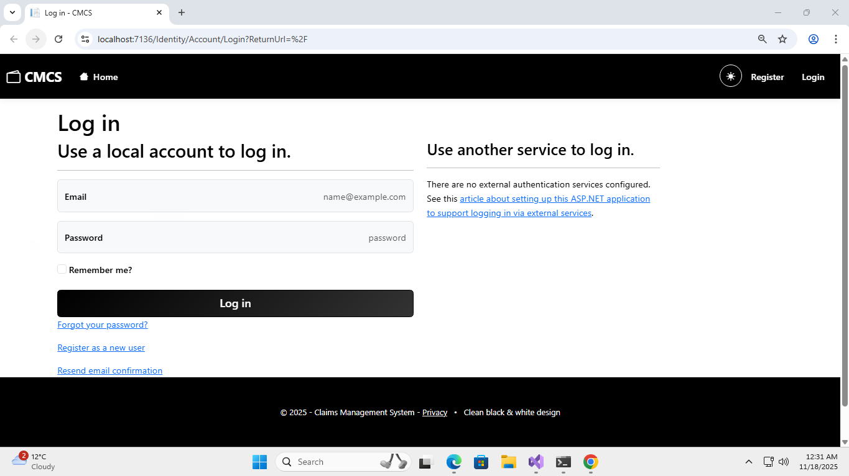
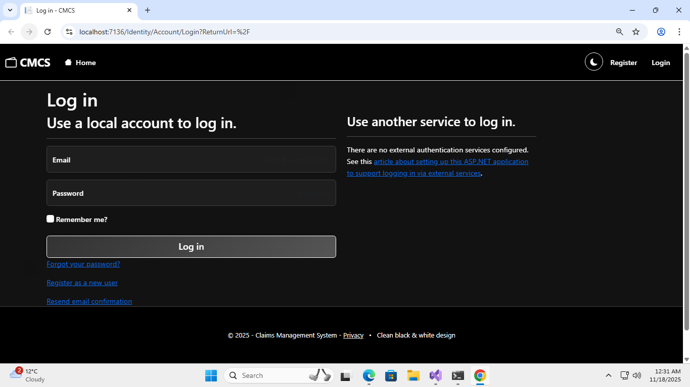
Light Mode
Dark Mode

Slide 18
Version Control
Version Control with GitHub: The entire project was developed using Git, with a repository containing the complete history from Part 1 to Part 3.
Commit Strategy: Far exceeded the POE requirements with 10+ commits per part, each with messages outlining the tasks that has been completed.
  Benefit: Demonstrates a professional, traceable, and iterative development process.

Slide 19
The Impact of CMCS
Operational Efficiency: Drastically reduces claim processing time.
Accuracy & Compliance: Automated checks eliminate errors and enforce policies.
Transparency & Visibility: Real-time tracking for lecturers and clear workflows for staff.
Data-Driven Decisions: Instant reporting for HR and management.
Scalability & Security: Role-based system ensures security and is built to grow.

Slide 20
Conclusion and Future Enhancements
Conclusion: The CMCS successfully evolved from a basic prototype to a fully-automated, robust web application that meets and exceeds all POE requirements across all three parts.
Learning Outcomes: Mastered ASP.NET Core MVC, Entity Framework, Identity Management, UI/UX Design, and the implementation of complex business logic and automation.
Future Work:
  Email/SMS notifications for status updates.
  Advanced analytics dashboard with charts.
  Integration with financial systems for direct payment processing.

Slide 21
References
Microsoft (2025) ASP.NET Core documentation. Available at: https://learn.microsoft.com/en-us/aspnet/core/.
Microsoft (2025) Entity Framework Core documentation. Available at: https://learn.microsoft.com/en-us/ef/core/.
.NET Foundation (2025) .NET Core documentation. Available at: https://docs.microsoft.com/en-us/dotnet/core/.
Bootstrap Team (2025) Bootstrap 5 documentation. Available at: https://getbootstrap.com/docs/5.3/ .
jQuery Foundation (2025) jQuery API documentation. Available at: https://api.jquery.com/.

