Slide 1
Firebase
Mr. Sunanda Das
Assistant Professor, Dept. of CSE, KUET

Slide 2
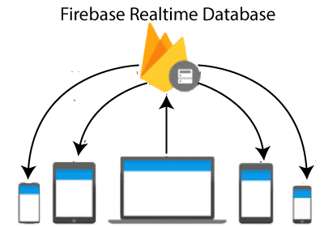
Firebase: Realtime Database
The Firebase Realtime Database is a cloud-hosted database in which data is stored as JSON.
The data is synchronized in real-time to every connected client.
All of our clients share one Realtime Database instances and automatically receive updates with the newest data,
When our users go offline, the Real-time Database SDKs use local cache on the device for serving and storing changes. The local data is automatically synchronized, when the device comes online.

Slide 3
Important Key Capabilities
Realtime: Instead of typical HTTP requests, the Firebase Realtime Database uses data synchronization—every time data changes, any connected device receives that update within milliseconds. Provide collaborative and immersive experiences without thinking about networking code.
Offline: The Firebase Database SDK persists our data to disk, and for this reason, Firebase apps remain responsive even when offline. The client device receives the missed changes, once connectivity is re-established.

Slide 4
Accessible from Client Devices: The Firebase Realtime Database can be accessed directly from a mobile device or web browser; there’s no need for an application server. Security and data validation are available through the Firebase Realtime Database Security Rules, expression-based rules that are executed when data is read or written.
Scaling across multiple databases: With the Firebase Real-time Database on Blaze Pricing Plan, we can support the data needs of our app by splitting our data across multiple database instances in a single Firebase project.

Slide 5
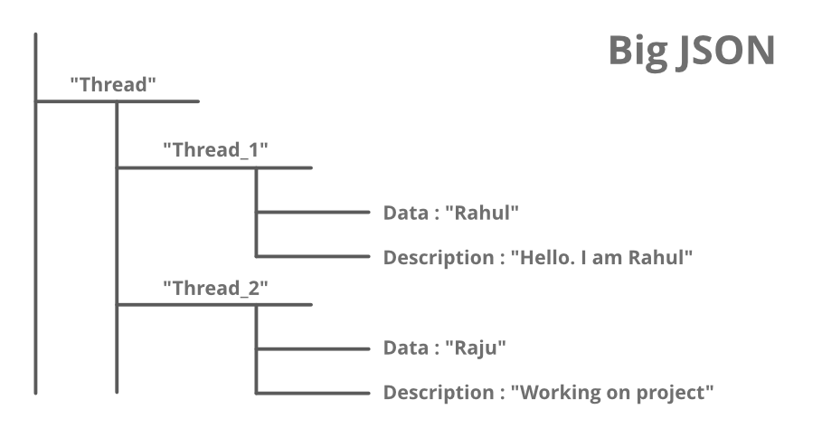
Features
This feature mainly includes backend services that help developers to build and manage their applications in a better way. Services included under this feature are :
Realtime Database: The Firebase Realtime Database is a cloud-based NoSQL database that manages your data at the blazing speed of milliseconds. In simplest term, it can be considered as a big JSON file.

Slide 6
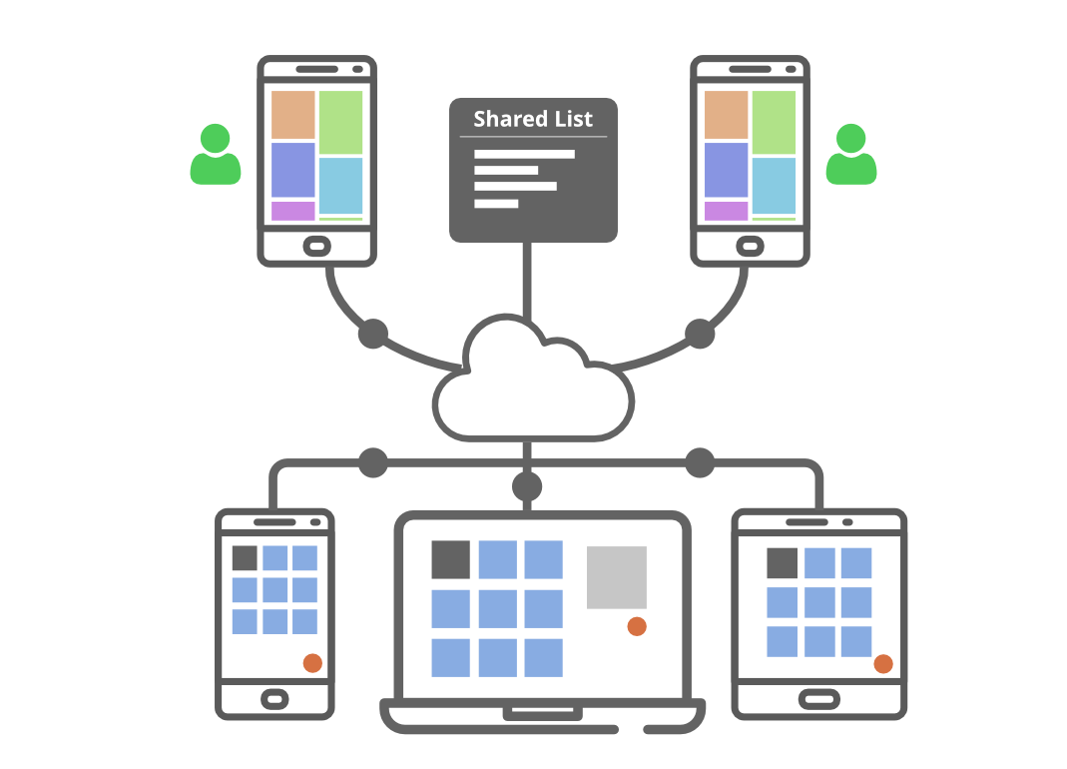
Cloud Firestore: The cloud Firestore is a NoSQL document database that provides services like store, sync, and query through the application on a global scale. It stores data in the form of objects also known as Documents. It has a key-value pair and can store all kinds of data like, strings, binary data, and even JSON trees.

Slide 7
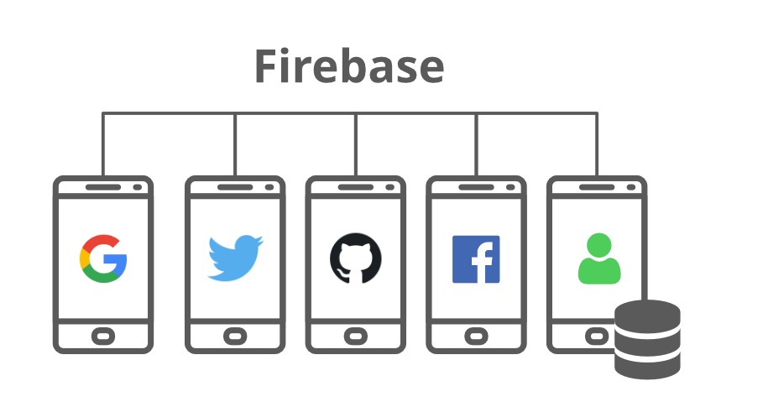
Authentication: Firebase Authentication service provides easy to use UI libraries and SDKs to authenticate users to your app. It reduces the manpower and effort required to develop and maintain the user authentication service. It even handles tasks like merging accounts, which if done manually can be hectic.

Slide 8
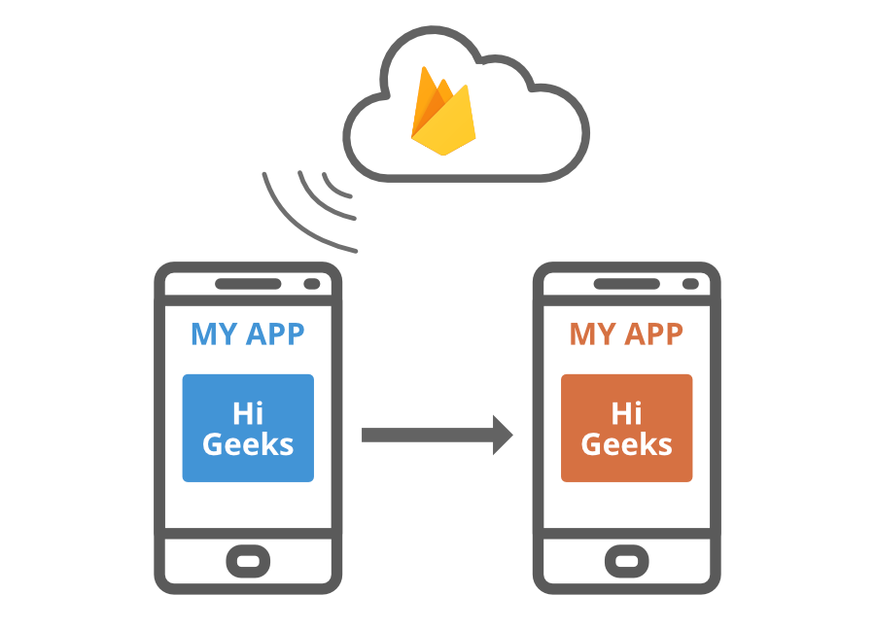
Remote Config: The remote configuration service helps in publishing updates to the user immediately. The changes can range from changing components of the UI to changing the behavior of the applications. These are often used while publishing seasonal offers and contents to the application that has a limited life.

Slide 9
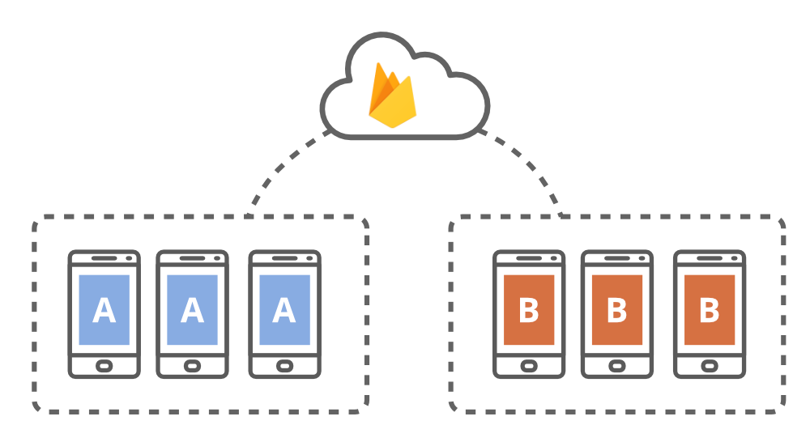
Hosting: Firebase provides hosting of applications with speed and security. It can be used to host Stati or Dynamic websites and microservices. It has the capability of hosting an application with a single command.
Firebase Cloud Messaging(FCM): The FCM service provides a connection between the server and the application end users, which can be used to receive and send messages and notifications. These connections are reliable and battery-efficient.

Slide 10
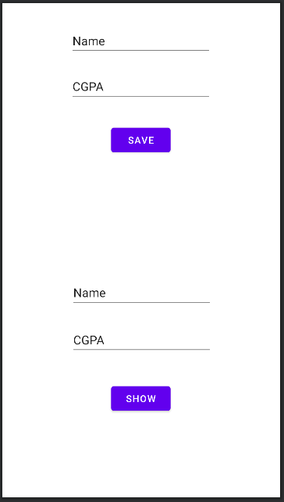

Slide 11
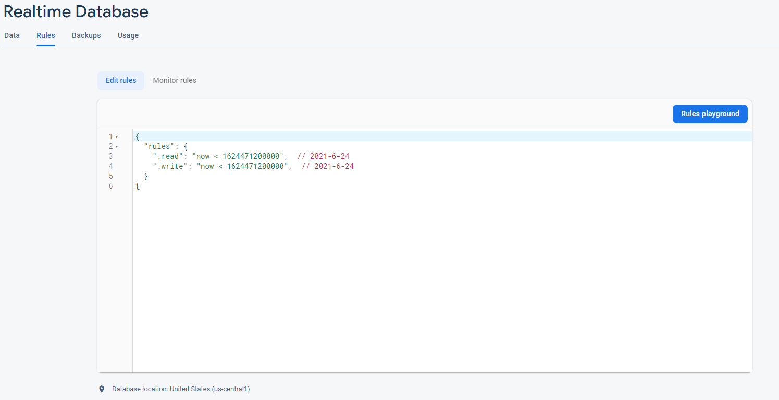

Slide 12
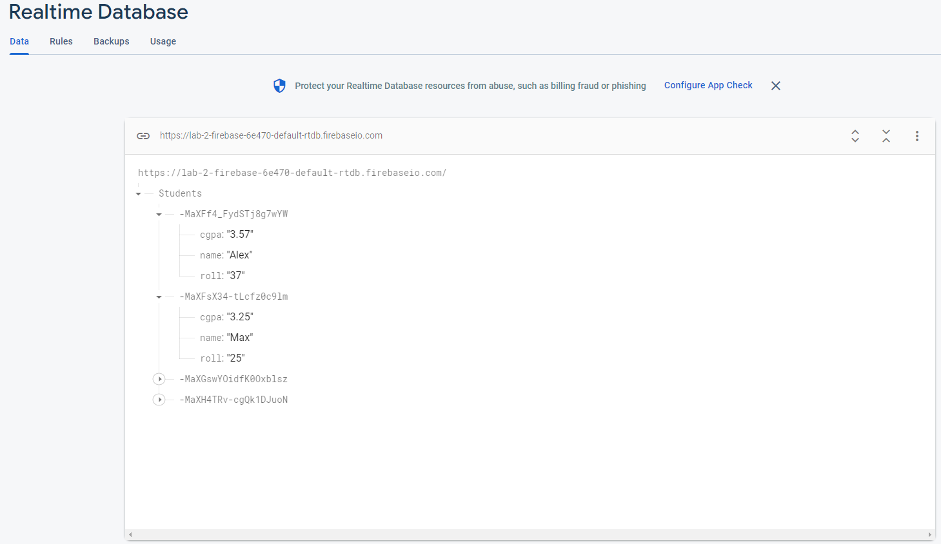

Slide 13
DatabaseReference reff;
Students students;
students = new Students();
reff = FirebaseDatabase.getInstance().getReference().child("Students");

Slide 14
DatabaseReference reff;
Students students;
long maxID = 0;
students = new Students();
reff = FirebaseDatabase.getInstance().getReference().child("Students");
reff.addValueEventListener(new ValueEventListener() {
@Override
public void onDataChange(@NonNull DataSnapshot snapshot) {
if(snapshot.exists())
{maxID = (snapshot.getChildrenCount());}}
@Override
public void onCancelled(@NonNull DatabaseError error) { }
});

Slide 15
my_button.setOnClickListener(new View.OnClickListener() {
@Override
public void onClick(View view) {
String name_val = my_name.getText().toString().trim();
Float cgpa_val = Float.parseFloat(my_cgpa.getText().toString().trim());
students.setC_name(name_val);
students.setC_cgpa(cgpa_val);
// reff.push().setValue(students);
// reff.child("student1").setValue(students);
reff.child(String.valueOf(maxID+1)).setValue(students);
Toast.makeText(MainActivity.this, "new student added", Toast.LENGTH_SHORT).show();
}

Slide 16
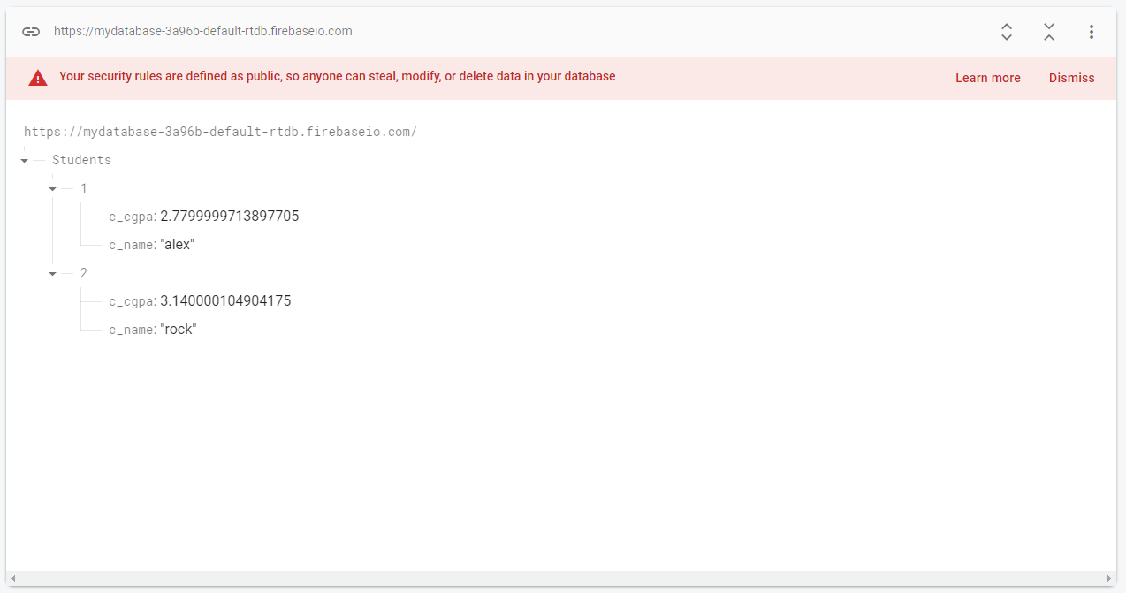

Slide 17
public class Students {
private String c_name;
private Float c_cgpa;
public Students() { }
public String getC_name() {
return c_name; }
public void setC_name(String c_name) {
this.c_name = c_name;
}
public Float getC_cgpa() {
return c_cgpa;}
public void setC_cgpa(Float c_cgpa) {
this.c_cgpa = c_cgpa;}
}

Slide 18
Display
my_button2.setOnClickListener(new View.OnClickListener() { @Override public void onClick(View view) { reff = FirebaseDatabase.getInstance().getReference().child("Students").child("1"); reff.addValueEventListener(new ValueEventListener() { @Override public void onDataChange(@NonNull DataSnapshot snapshot) { String name = snapshot.child("c_name").getValue().toString(); String val = snapshot.child("c_cgpa").getValue().toString(); editText1.setText(name); editText2.setText(val); } @Override public void onCancelled(@NonNull DatabaseError error) {} }); } });

