Slide 1
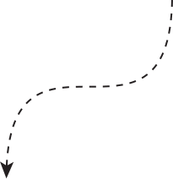




By Group 6
Creating a Dynamic OpenGL Banner – JKUAT ROCKS!”

Slide 2


The Assignment Brief
Client wants a banner that says: "JKUAT ROCKS"
Text color requirements:
JKUAT in Green
ROCKS in Red
Brown background
Should allow font resizing on user input
“May be ugly but the client is always right”

Slide 3





🧰 Tools We Used
Text rendering:
FTGL for C++ using TrueType fonts
Pyglet text labels with dynamic positioning
C++ + OpenGL + FTGL: For real-time rendering
Python + Pyglet: Alternative with similar output

Slide 4
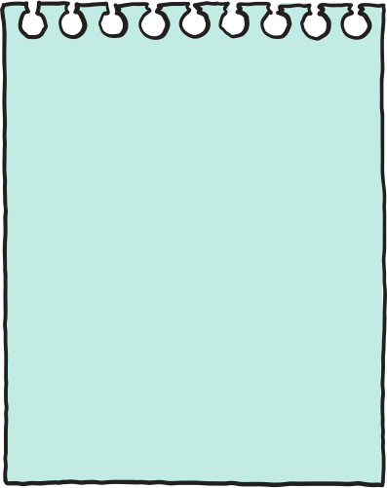


🧠 Our Strategy
1
Dynamically calculate label positions to center the banner text
2
Separate label rendering for "JKUAT" and "ROCKS"
3
Use keyboard input to interactively resize
4
Adjust text placement based on font size and spacing
5
Provide info text to help users understand controls

Slide 5
Font Configuration
Display Function
Initializes font size and sets platform-specific font file path.
Clears screen and centers colored "JKUAT ROCKS" text.
implementation
Font Initialization
Keyboard Input Handling
C++
Uses FTGLTextureFont to load and apply font settings.
Listens for key inputs to adjust font size or spacing.
Text Rendering
Dynamic Layout Calculations
renderText() sets color, position, and renders provided text.
Calculates centering using font size and adjustable spacing.

Slide 6

PYTHON IMPLEMENTATION
Initial font size, spacing, and OS-specific font selection.
Responds to +, -, A, S keys to adjust font size and spacing.
Font Configuration
Keyboard Input Handling
All labels added to a pyglet.graphics.Batch() for efficient rendering.
update_labels() creates, sizes, positions, and colors all text labels.
Label Update Function
Drawing with Batch
Automatically repositions labels when window dimensions change.
Measures text widths and centers "JKUAT ROCKS" horizontally.
Text Centering Logic
Dynamic Window Resize

Slide 7
THANK
YOU!
www.reallygreatsite.com

