Slide 1
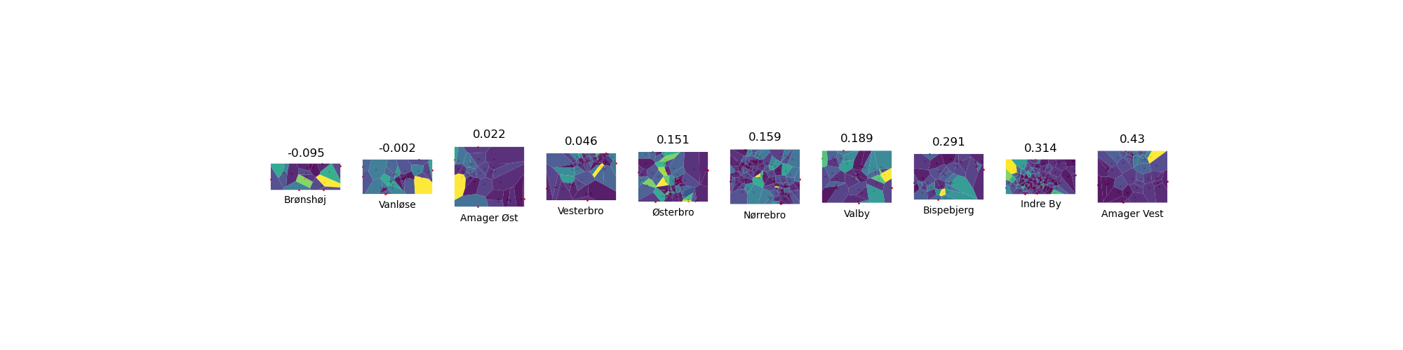

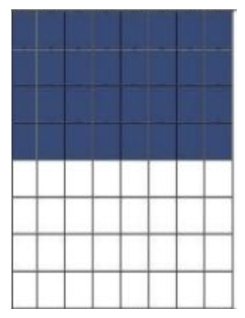
Bike closeness in the districts of Copenhagen (Moran’s I)
I = -1 … … I = 1

Slide 2
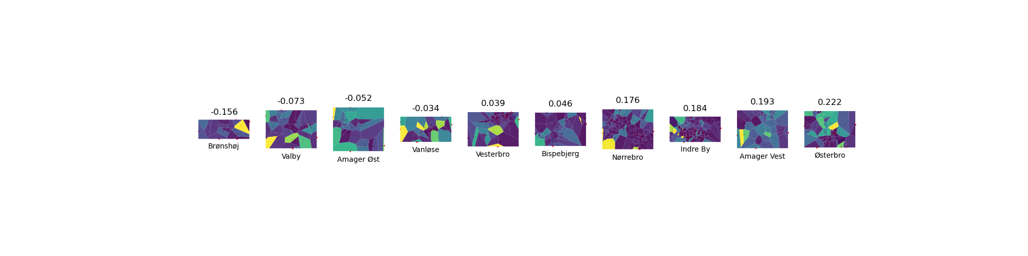
Car closeness in the districts of Copenhagen (Moran’s I)
I = -1 … … I = 1

