Slide 1
Google Play-store data-set

Slide 2
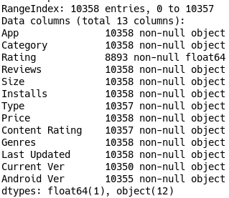
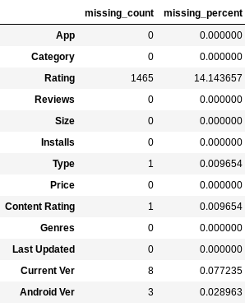
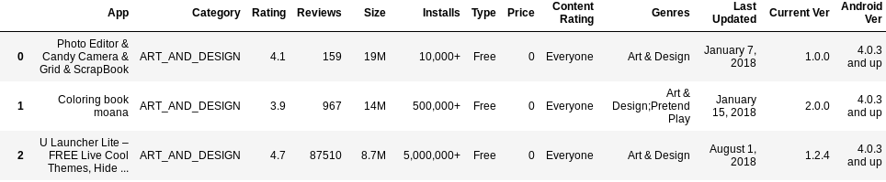
Data Description

Slide 3
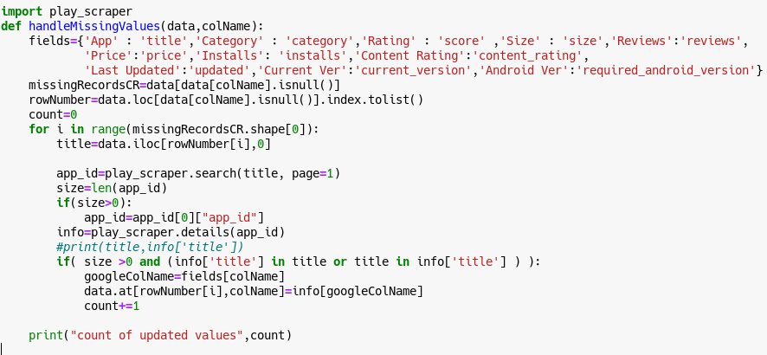
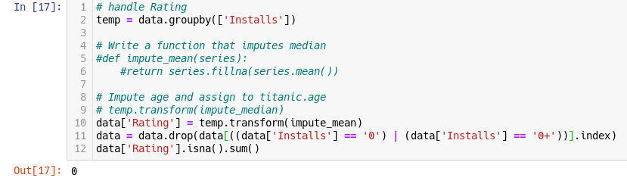

Data Cleaning
Deleting duplicates
Scraping Google Play Store for missing Category values
Imputing missing Rating values with mean grouped by Installs
Drop records with no Installs
Drop remaining records with null values

Slide 4
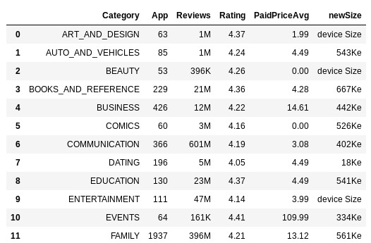
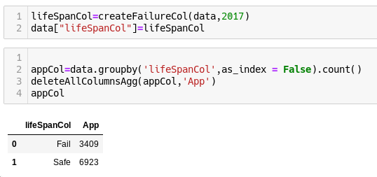
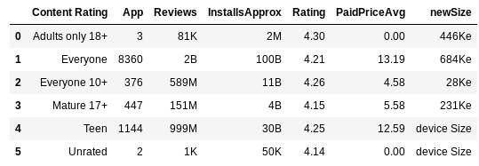
Some stats
Application lifespan identity

Slide 5
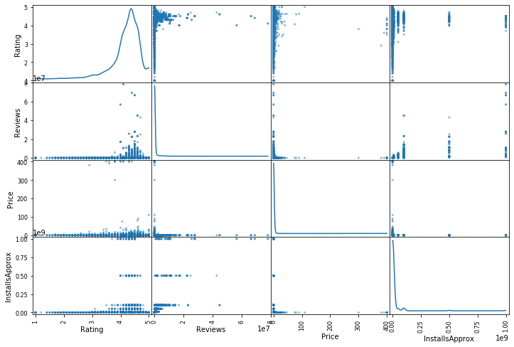
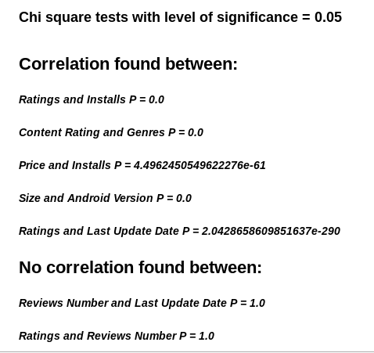
Correlations
No correlations between numerical values

