Slide 1

Merry Christmas!!! :-)

Slide 2
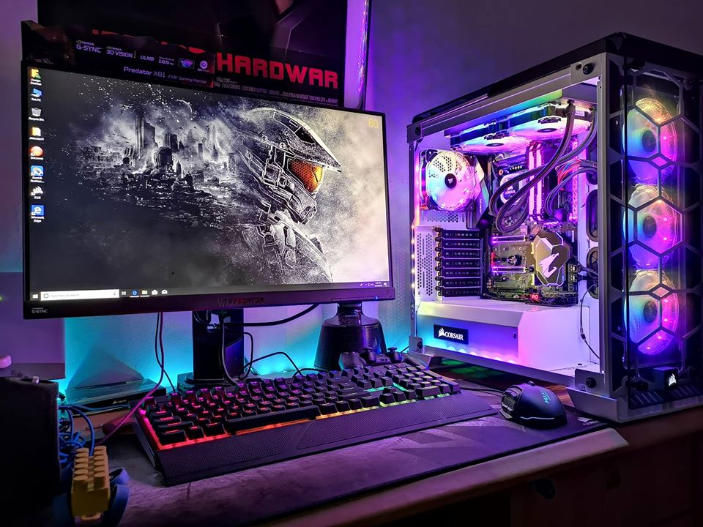
Let's build a "Gaming" Computer!

