Slide 1

Twitter Analysis for Marketing Pizza
Team 2

Slide 2
Use Case Description
Pizza shop searching for marketing strategies to increase sales
Explore sentiment related to purchasing pizza
Identify specific motivations/associations for target marketing
Examples: association with game watching or beer

Slide 3
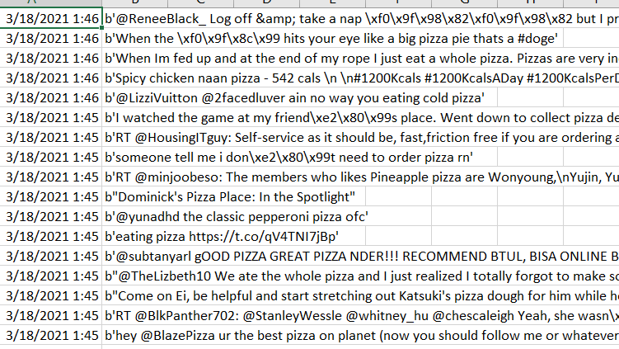
Data Collection
Twitter API #pizza

Slide 4
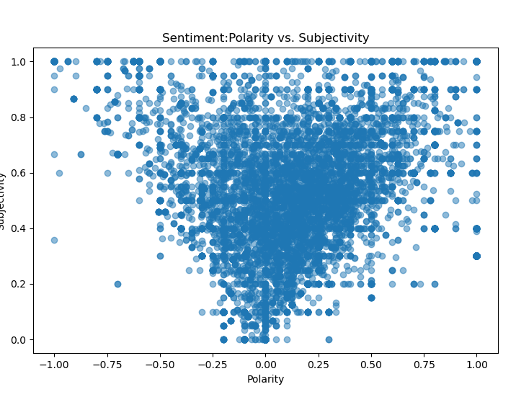
Polarity vs. Subjectivity
Textblob sentiment
Subjectivity- scored between 0 (objective) to 1 (subjective)
Polarity- scored between -1 (negative) and 1 (positive). Score of 0 is neutral
Results skewed toward positive and subjective.

Slide 5
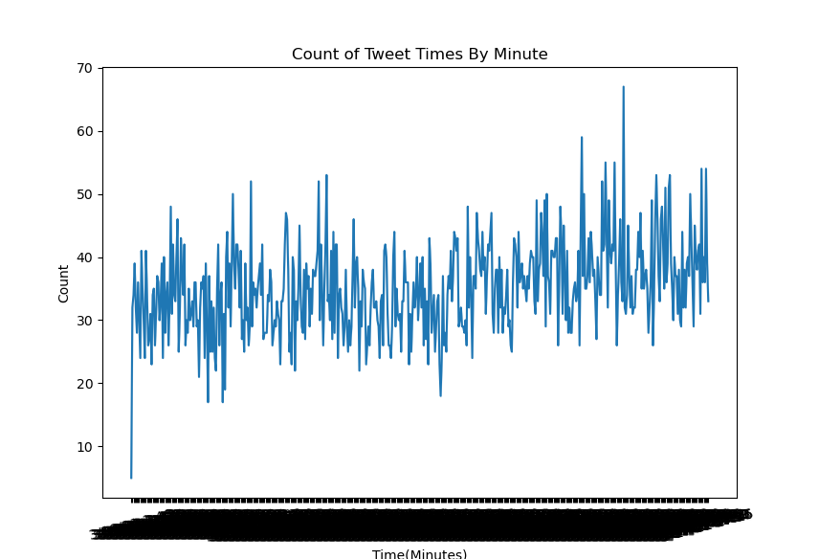
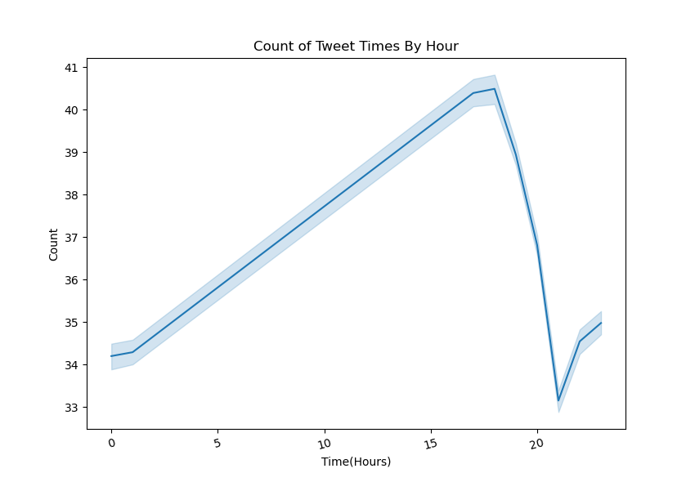
#pizza Tweets vs Time

Slide 6
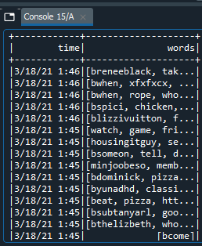
Cleaning the Data
Tokenize Data
Remove stop words
Stem the words
Remove @mentions, URLs, and RT/Retweet, unnecessary characters, etc.
Remove words with < 3 characters and > 9 characters

Slide 7
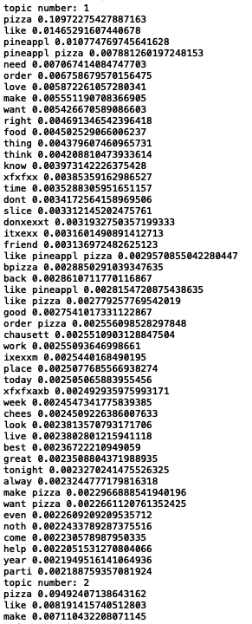
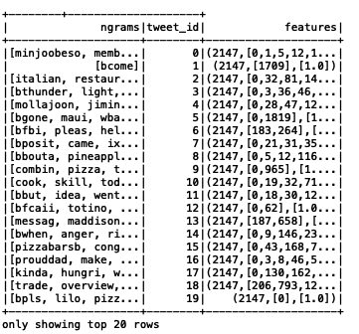
Processing the data
NGrams
Count Vectorizer
LDA Model

Slide 8
Machine Learning Model - Latent Dirichlet Allocation (LDA)
Clustering algorithm
Unsupervised
Three-level hierarchical Bayesian model
In Spark, takes a dense vector
Identifies topics that best describe a set of documents
"Using a probabilistic Latent Dirichlet Allocation (LDA) topic model to discern the most popular topics in the Twitter data is an effective way to analyze a large set of tweets to find a set of topics in a computationally efficient manner."
Yang, Sidi & Zhang, haiyi. (2018). Text Mining of Twitter Data Using a Latent Dirichlet Allocation Topic Model and Sentiment Analysis.

Slide 9
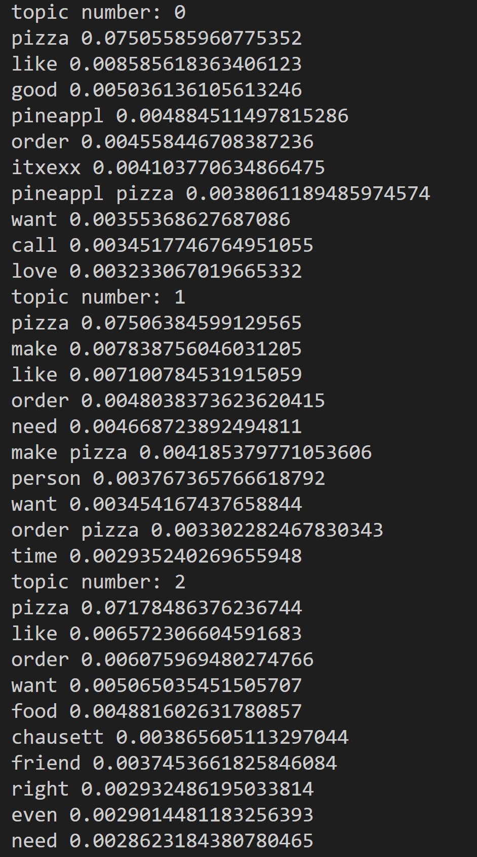
LDA results
PINEAPPLE PIZZA
ORDER/CALL
Topics
MAKE PIZZA
ORDER/TIME
FOOD WITH FRIENDS
ORDER

Slide 10
Business Recommendations
Product Development
Perform cross selling with pineapple pizza as the base
Include a DIY pizza kit as part of the new product offerings
Marketing
Campaign featuring a pineapple pizza combo
Campaign with friends or couples making pizza from the kit
Customer Experience
Improve delivery experience by making it faster and seamless
PINEAPPLE PIZZA
MAKE PIZZA
FOOD WITH FRIENDS
ORDER/CALL/TIME

Slide 11
Shortcomings & Improvements
Problem
Possible solution
Non-English words and non-words
Similarities between words in topics
No events found
Pivoted due to lack of native multidimensional scaling in Spark
Use another Tweet extraction method
Filter only English language
Add hashtags that would include events
Sample a more comprehensive time frame
Include location information
Remove "pizza" as a stop-word

Slide 12

Thank you!

