Slide 1

Twitter Analysis for Marketing Pizza
Team 2

Slide 2
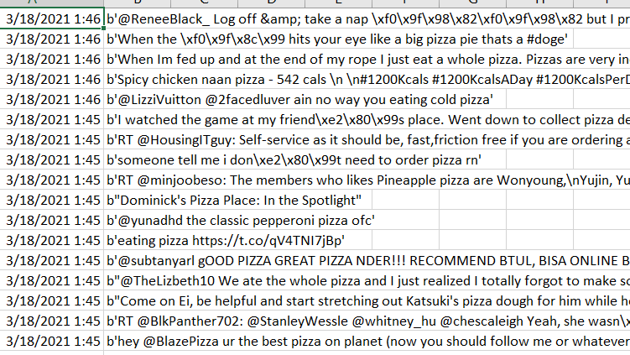
Data Collection
Twitter API #pizza

Slide 3
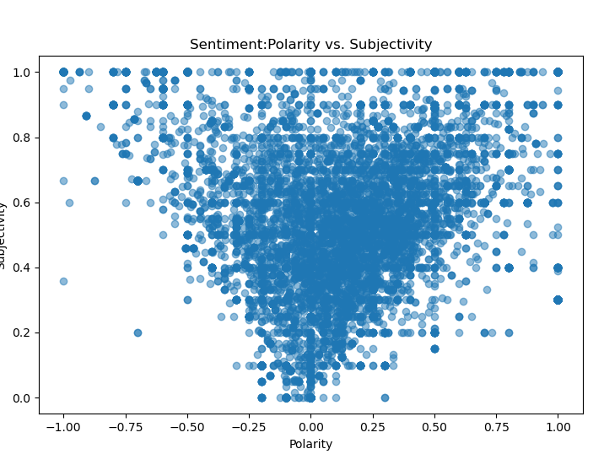
Polarity vs. Subjectivity
Textblob sentiment
Subjectivity- scored between 0 (objective) to 1 (subjective)
Polarity- scored between -1 (negative) and 1 (positive). Score of 0 is neutral
Results skewed toward positive and subjective.

Slide 4
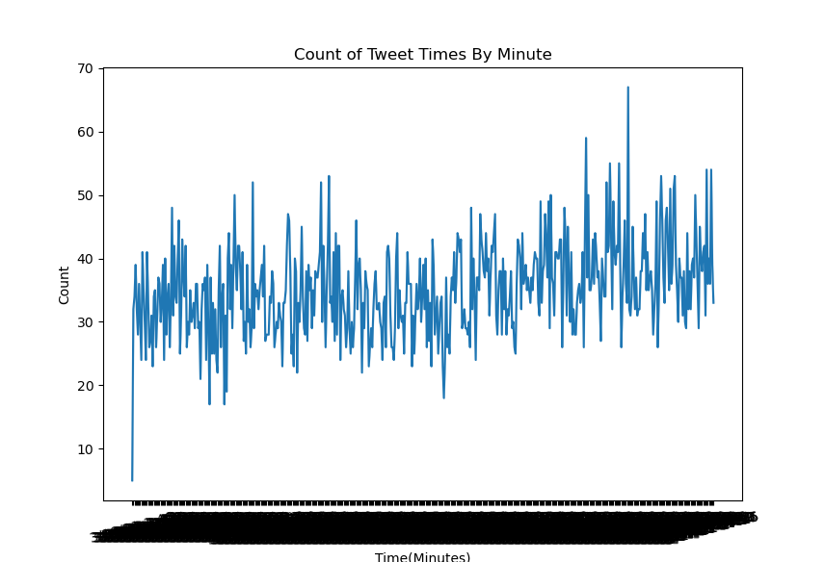
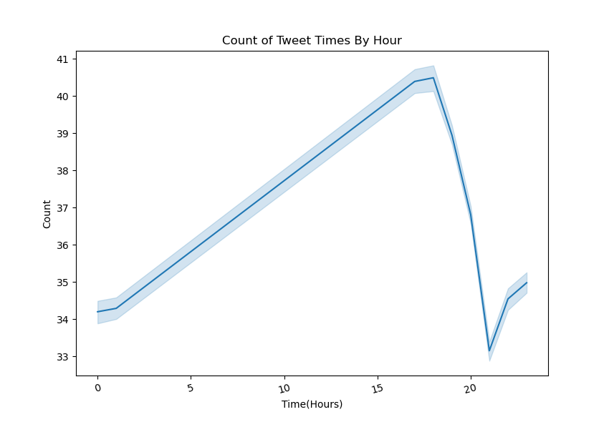
#pizza Tweets vs Time

Slide 5
Next Steps …
Tokenize Data (Textblob)
Clean Data - remove non-english tweets, remove stop words, stem the words, remove @mentions, URLs, and RT/Retweet, unnecessary characters, etc.
Add n-grams, to examine two word and three word combinations.

Slide 6
Next Steps …
Map coordinates with Multidimensional scaling (MDS)
Use K-means clustering to identify words associated with top clusters
Optimize results and make marketing recomendation.

