Slide 1

Twitter Analysis for Marketing Pizza
Team 2

Slide 2
Use Case Description
Pizza shop searching for marketing strategies to increase sales
Explore sentiment related to purchasing pizza
Identify specific motivations for target marketing
Examples: association with game watching or beer

Slide 3
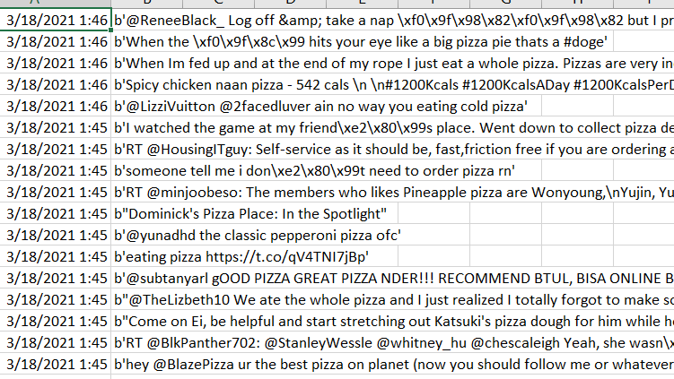
Data Collection
Twitter API #pizza

Slide 4
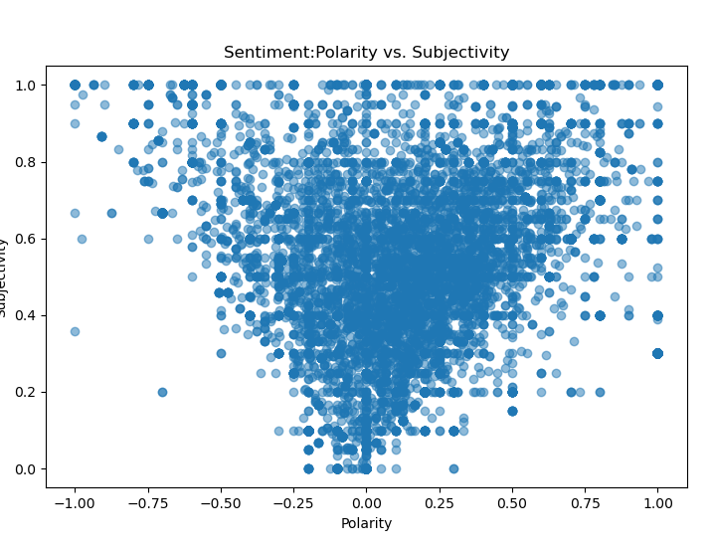
Polarity vs. Subjectivity
Textblob sentiment
Subjectivity- scored between 0 (objective) to 1 (subjective)
Polarity- scored between -1 (negative) and 1 (positive). Score of 0 is neutral
Results skewed toward positive and subjective.

Slide 5
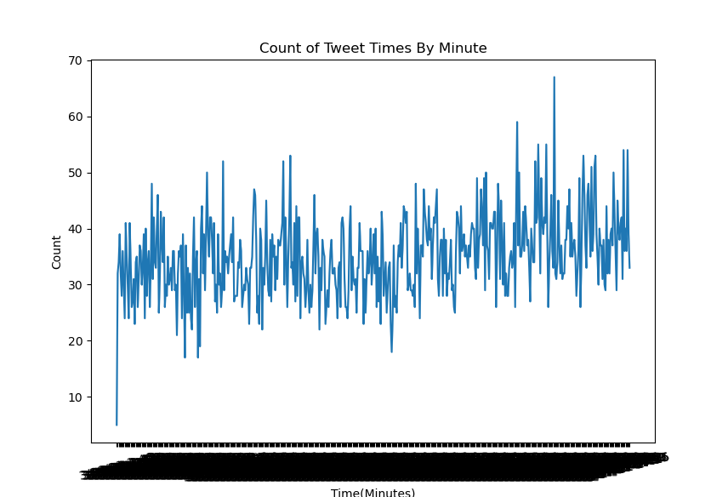
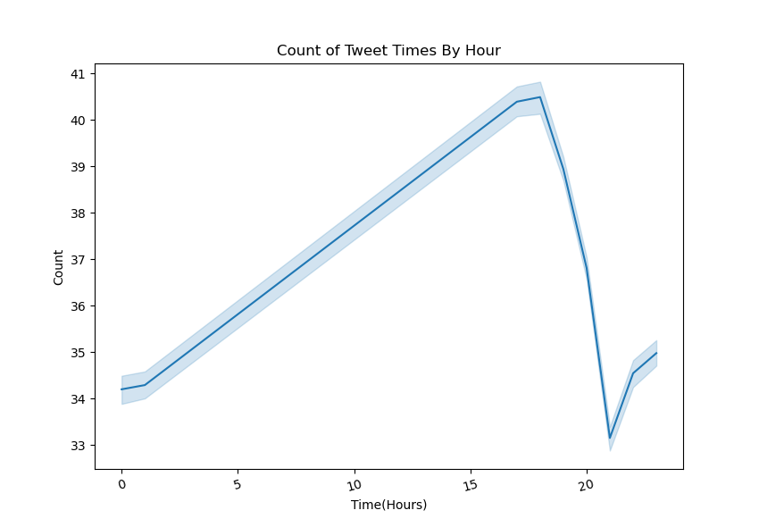
#pizza Tweets vs Time

Slide 6
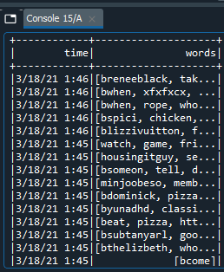
Cleaning the Data
Tokenize Data
Remove stop words
Stem the words
Remove @mentions, URLs, and RT/Retweet, unnecessary characters, etc.

Slide 7
Next Steps …
Add n-grams, to examine two word and three word combinations.
Map coordinates with Multidimensional scaling (MDS)
Use K-means clustering to identify words associated with top clusters
Optimize results and make marketing recomendation.

