Slide 1
Stock Price Prediction based on Historical Data
Team 9
Bowei Wang, Qichu Zhao, You Li

Slide 2
Goals of the project
Process historical stock data sets to make analysis for predicting stock price and trend
Utilize data from Kaggle and Real-Time Quote API
Visualize the difference between the prediction and the actual stock prices and meet the acceptance criteria

Slide 3
Use cases
Users select one stock and one timeframe (1 day/1 week/1 month) at a time. System runs data model and predict the following trend (up/down) based on time scale. System displays whether the price trend is up or down of the prediction and actual history trend.
Users select one stock and one timeframe (1 day/1 week/1 month) at a time. System runs data model and predict the following closing price based on time scale. System displays a line chart of price trend with the predict closing price and actual history price.
Notes:
Hypothetical Customers: Fund Management Company, Research Institution and Individual Investors.

Slide 4
Methodology
Focus on some main factors that will influence the price and get relevant dataset. (Date, Open price, Close price, Low, High, Volume)
Clean data using Scala
Train the data science models and pick the best one based on performance
Visualization using Zeppelin

Slide 5
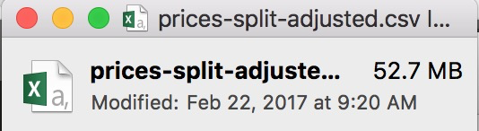
Data sources
New York Stock Exchange S&P 500 Companies historical prices with fundamental data: https://www.kaggle.com/dgawlik/nyse
Sample of price data:
Size: Daily stock prices of year 2010-2016
851,265 lines and 52.7 MB CSV file

Slide 6
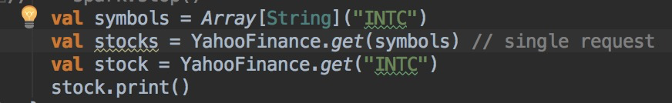
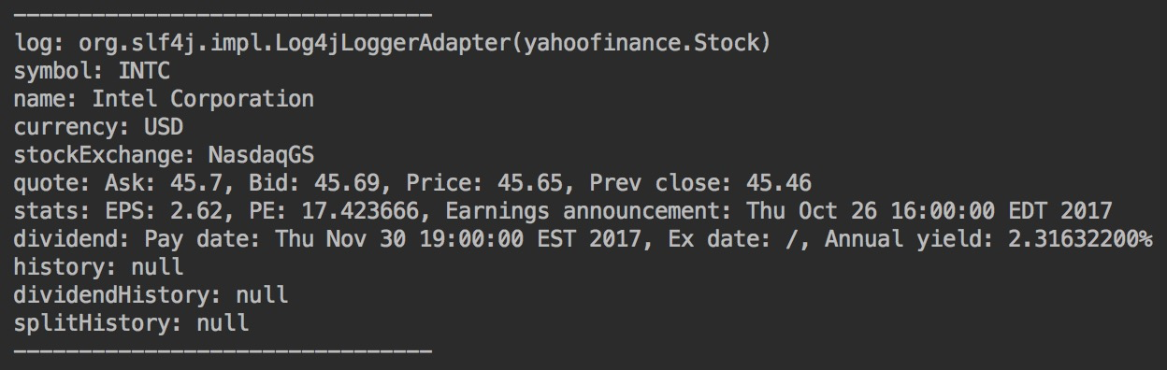
Data sources
2. Quote API for Yahoo Finance:
https://financequotes-api.com/#singlestock-easy
Input:
Output:

Slide 7
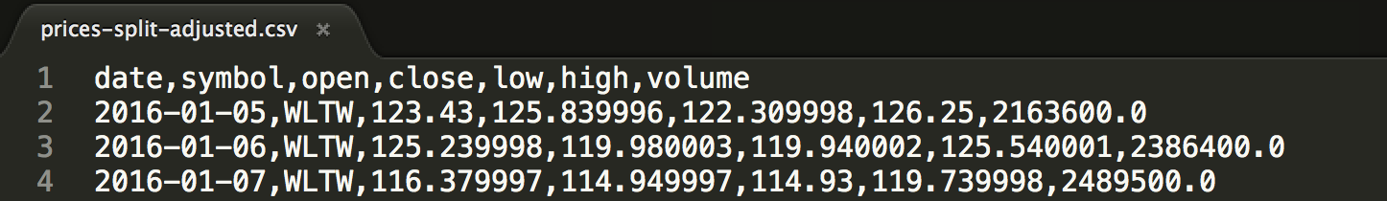
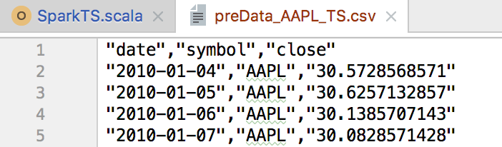
Model 1: Time-Series Forecasting
Tool: Spark-TS package
Steps:
Clean and ingest data using Scala, select by symbol name, generate results in csv file
Create DataFrame based on the output of Step a, and sort by timestamp
Here, date is our timestamp, symbol is the key and price is the value

Slide 8
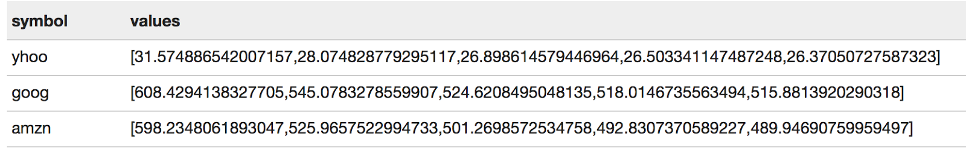
Model 1: Time-Series Forecasting
c. Based on the formatted data, create TimeSeriesRDD
d. Spark-ts package provides various algorithms for time series implementation including AR, MA, ARIMA, Holt-Winters etc. Here we use ARIMA (Autoregressive Integrated Moving Average model) for forecasting the price of next selected days (take 5 business days as an example)

Slide 9
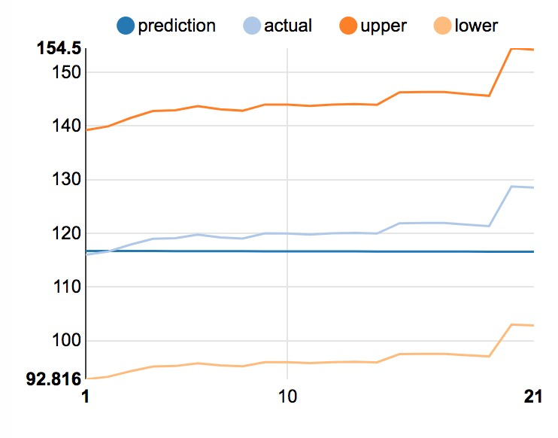
Model 1: Time-Series Forecasting
And here comes the hilarious result: (AAPL for a month in Jan 2017)
AAPL, [116.7228308884726,116.71566913239886,116.70851771682706,116.70137662682707,116.69424584749031,116.68712536392972,116.68001516127977,116.67291522469634,116.66582553935677,116.65874609045981,116.65167686322557,116.6446178428955,116.63756901473236,116.6305303640202,116.6235018760643,116.61648353619115,116.60947532974846,116.60247724210507,116.59548925865093,116.58851136479713,116.58154354597579]

Slide 10
Model 2: Long Short Term Memory networks
LSTMs is one kind of Recurrent Neural Networks
Data for RNNs are time series
Input data has shape [numExamples, inputSize, timeSeriesLength]
Output data has shape [numExamples, outputSize, timeSeriesLength]
Implements the standard DataSetIterator from Deeplearning4J
Input and target INDArrays from N-Dimensional Arrays for Java
GravesLSTM -> GraveLSTM -> DenseLayer -> RNNOutputLayer

Slide 11
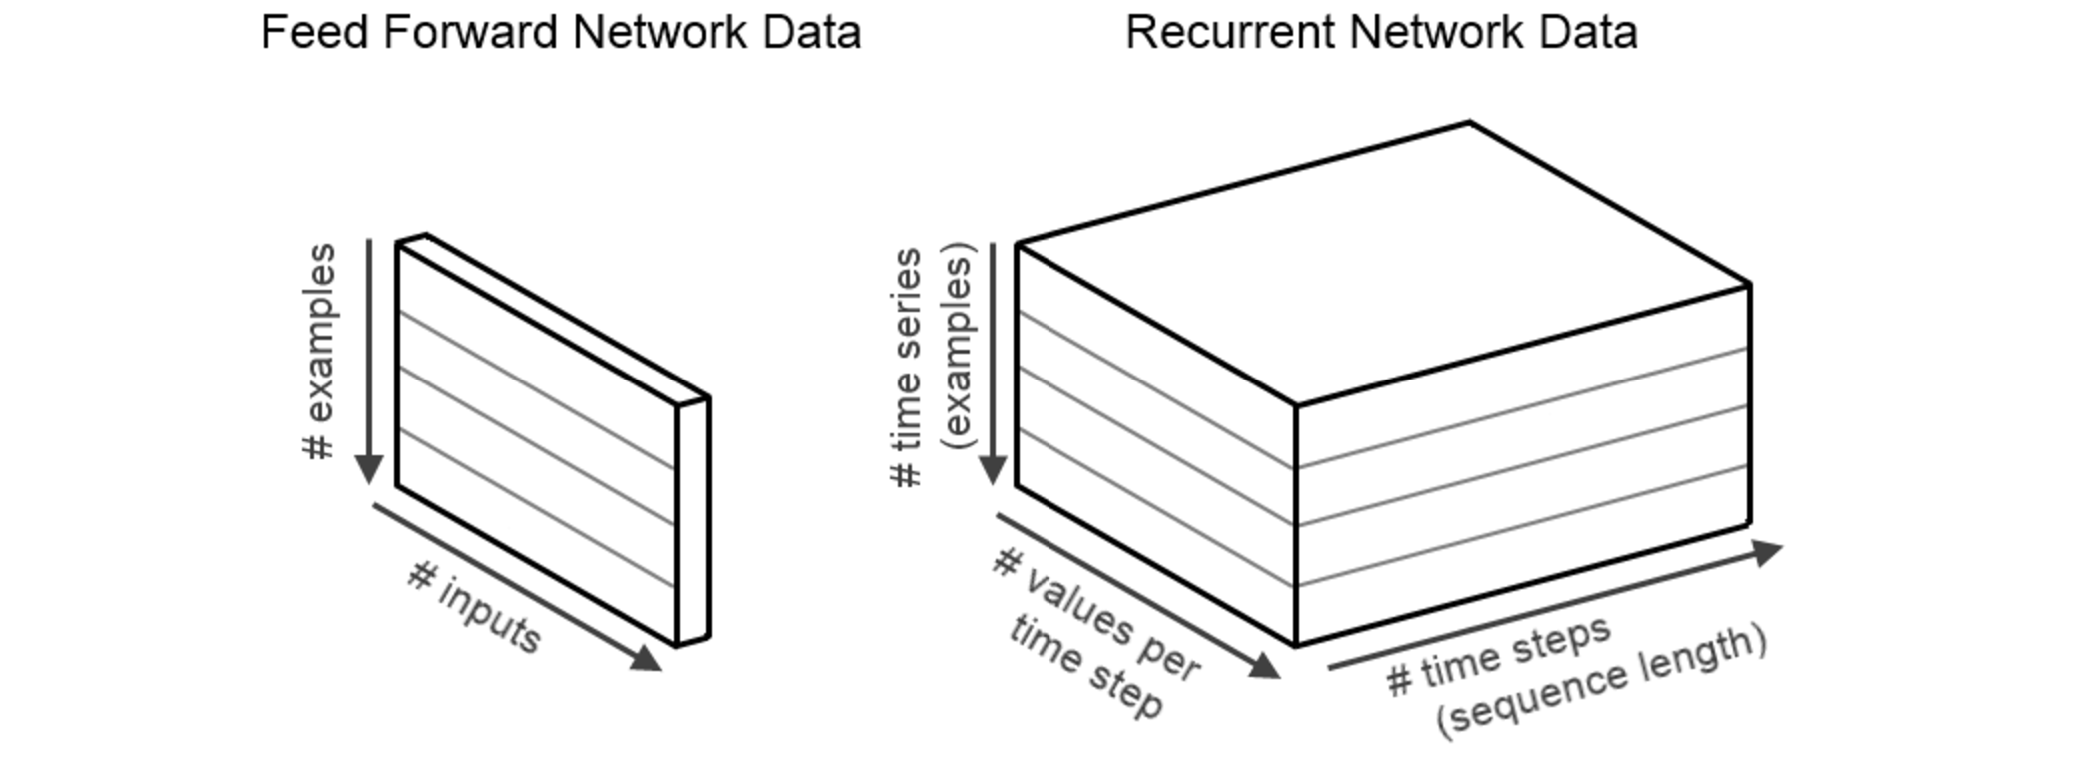
Model 2: Long Short Term Memory networks

Slide 12
Acceptance criteria
For user case 1, randomly choose 100 10 stocks for each time scale scenario (1 day/1 week/1 month) and compare each predictive trends (up/down) with historical trends, the accuracy rate of prediction model should be at least 60%.
Actual: 1 day -- 70%, 1 week -- 80%, 1 month -- 90%
For user case 2, randomly choose 100 10 stocks for each time scale scenario (1 day/1 week/1 month) and compare each predictive closing price with historical price, the average difference between the two should be at most 20%.
Actual: See Zeppelin line chart on next slides

Slide 13
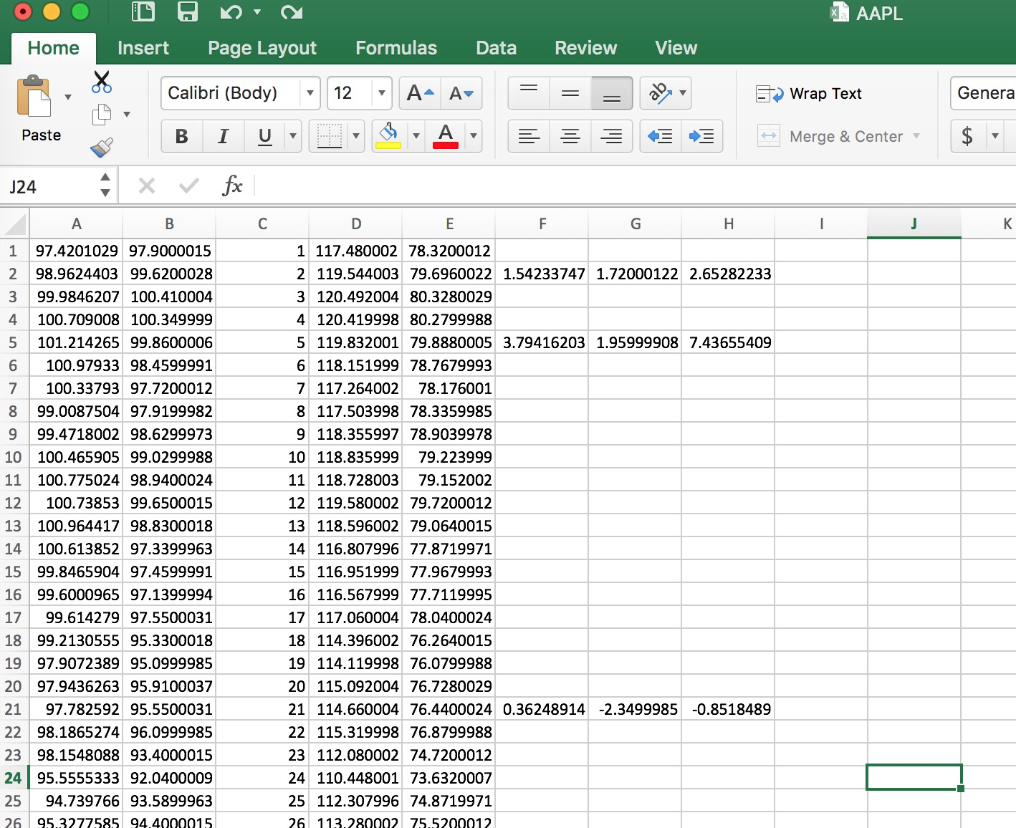
Example: Apple Inc. Criteria for price trend

Slide 14
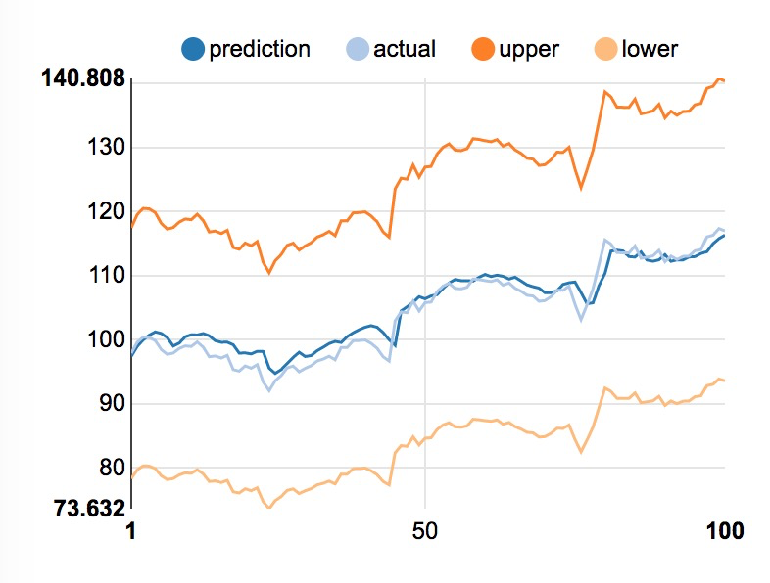
Apple Inc.

Slide 15
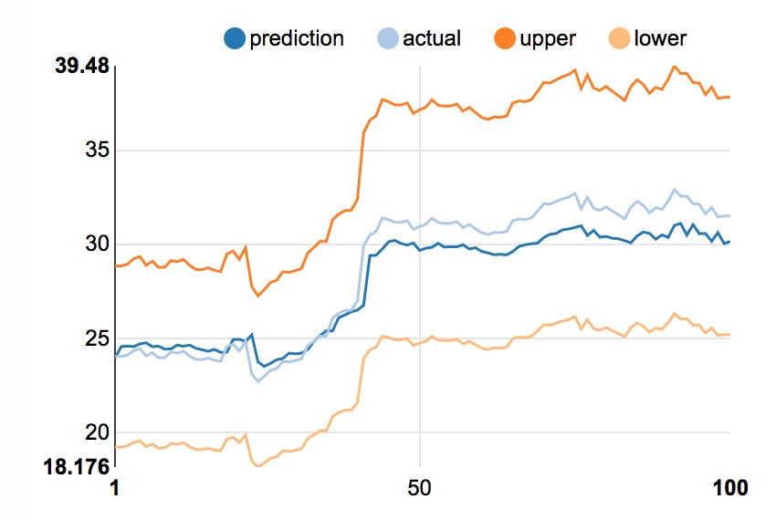
Ebay

Slide 16
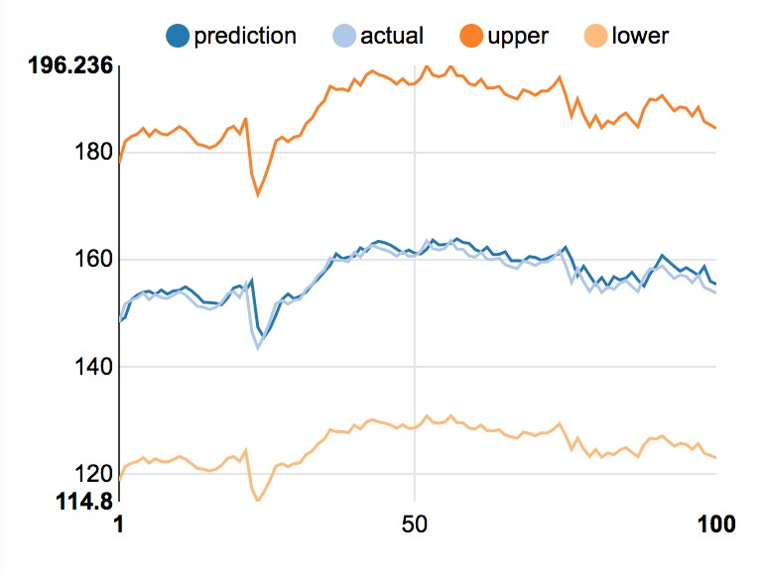
International Business Machines Corporation

Slide 17
Reference
Stock Price Prediction (Time-Series Forecasting) using Apache Spark
http://www.technippet.com/2017/01/stock-price-prediction-time-series.html
Plain Stock Close-Price Prediction via LSTM
https://isaacchanghau.github.io/2017/07/26/Plain-Stock-Close-Price-Prediction-via-LSTM-Initial-Exploration/

Slide 18
Q & A
Thank you !

