Slide 1
WEEK
Teaching two kinds of features
to share one vote
02
A 30-minute session for the HIMLT undergraduate research training program
Introduction to HMAF
Shemonti Barua
Department of Computer Science
Kennesaw State University, Marietta, GA
Hybrid Modality Attention Fusion
Based on Barua et al., ICSC 2026 · Supported by NSF Grant No. 2409704
Shemonti Barua @ Kennesaw State University / 2026
Notes:
[~1 minute] Good morning, everyone, and welcome to week two. Last week Deepthi walked you through whole-slide images and gave you a tour of HIMLT — what the tool is, what it does, and where the pieces sit. Today we are going one level down, into one specific component of that tool: the part that decides how to combine two completely different descriptions of the same cell. That component is called HMAF — Hybrid Modality Attention Fusion. It comes from a paper our group published at the International Conference on Semantic Computing earlier this year, and it is the fusion step that sits inside HIMLT. Before we start, I want to set your expectations, because there are equations coming and I do not want anyone to panic when they appear. By the end of this half hour, there is exactly one sentence I want you to be able to say back to me in your own words: the model decides how much to trust each kind of feature separately, for every single nucleus. That is it. That is the whole contribution. Everything else on these slides — the projections, the softmax, the pipeline — is machinery in service of that one idea. So if the notation gets ahead of you at any point, do not worry about it. Hold on to the sentence. Stop me whenever something does not land. [Move on without pausing for questions — questions come naturally from slide 2.]

Slide 2
Where We Left Off Last Week
Week 1 ended with one sentence that hid all the interesting machinery
“The two feature sets are mathematically fused so the classifier sees both human-defined structure and machine-learned abstraction.”
Week 1, slide 8
Hand-crafted features
?
Classifier
decides what kind of cell
this nucleus is
Deep-learned features
today's 30 minutes
Today we open that box — and it turns out to be three small steps, not one big mystery.
Shemonti Barua @ Kennesaw State University / 2026
Notes:
[~2 minutes] Let me start by connecting back to where Deepthi left you. At the end of last week you saw this sentence, or something close to it. Two feature sets are mathematically fused, so the classifier sees both human-defined structure and machine-learned abstraction. [Read the quote out loud, then pause.] Now, that is a perfectly good sentence for a paper. But notice what it is doing. The word "fused" is carrying an enormous amount of weight, and it explains nothing. It is a placeholder where the actual method should be. So look at the diagram. On the left, two things going in — hand-crafted features and deep-learned features. On the right, a classifier that has to decide what kind of cell this is. And in the middle, this dashed box with a question mark in it. Last week that box was closed. Today we open it. Before I show you what is inside, I want to hear your instinct. You have two lists of numbers describing the same nucleus. One list has twenty-four numbers in it. The other has two hundred and fifty-six. How would you combine them so a classifier can use both? [Take two or three answers. Do not correct anyone. Almost every group says some version of "stick them together" — that is the right first instinct and we come back to it on slide eight. If someone says "weight them" or "average them," flag it now: hold that thought, you are about to be right.] Good. Keep those answers in your head, because we are going to test them. The honest summary of today is that this box turns out to contain three fairly small steps. Not one big mystery. Three steps, and each one you could implement yourself in about ten lines of code. But before we can open the box, we need to be precise about what those two inputs actually are. So let us spend a few minutes on each.

Slide 3
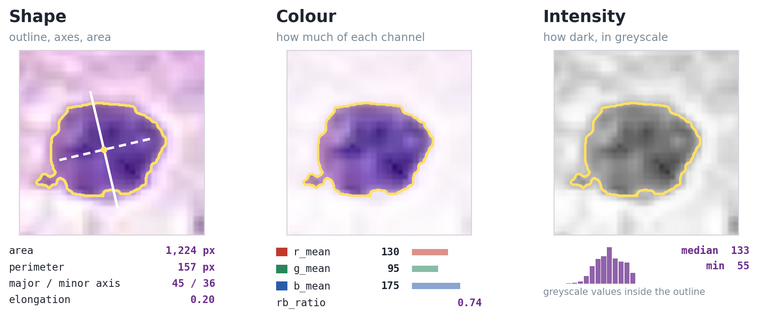
Feature Type 1: Hand-crafted
One nucleus, looked at three different ways — because each way measures something different
The same nucleus from a CoNSeP tile. Yellow outline is the segmentation. Values measured directly from this crop.
24 features total
7 shape · 14 colour · 3 intensity
Every one has a name
so a pathologist can check it
59 → 24: an ANOVA F-test keeps the features that differ most between cell types.
Shemonti Barua @ Kennesaw State University / 2026
Notes:
[~2.5 minutes] Feature type one: hand-crafted features. The name tells you most of it. At some point a human being looked at a nucleus and asked: what about this thing can I actually measure? And then wrote code to measure it. [Point at the figure.] This is one real nucleus, cropped out of one of the annotated CoNSeP images. The same nucleus, three times. And I want you to notice that we are not showing you three different cells — we are showing you the same cell looked at in three different ways, because each way is measuring something the others cannot see. Left panel, shape. The yellow line is the segmentation boundary — that is the model's answer to "where does this nucleus end." Once you have that boundary, geometry falls out of it for free. Area, one thousand two hundred and twenty-four pixels: literally count the pixels inside. Perimeter, one hundred and fifty-seven: walk around the edge. The solid white line is the major axis, the longest way across; the dashed line is the minor axis, perpendicular to it. Their ratio gives you elongation, which here is zero point two — this nucleus is slightly oval, not a circle and not a spindle. Everything in the shape family depends on that yellow outline. Hold on to that, because it becomes the crux of the whole session later. Middle panel, colour. Now we ignore geometry entirely and only look at pixels inside the outline. Average red, average green, average blue. Look at the numbers: blue one seventy-five, red one thirty, green ninety-five. That is exactly what you would expect from haematoxylin, which stains nuclei purple-blue. And ratios between channels, like rb-ratio, matter because they are more stable than raw values — if a slide is stained a bit heavier, everything shifts up together but the ratio holds. Right panel, intensity. Throw away colour completely, convert to greyscale, and ask how dark this nucleus is. The little histogram is every greyscale pixel inside the outline. Median one thirty-three, minimum fifty-five. That spread is chromatin texture — dense clumped chromatin gives you dark pixels and a wide spread, and that is one of the things a pathologist genuinely looks for when grading. [Pause.] So: three views, three families, twenty-four numbers in total. Seven shape, fourteen colour, three intensity. And here is the property I want you to carry forward, because it matters a lot in about five minutes. Every single one of those numbers has a name, and the name means something. If I tell you elongation is zero point two, you can look at the picture and disagree with me. You can say: no, your segmentation clipped the bottom edge, that number is wrong. The number is checkable. Remember that word. [Bottom right, briefly.] Last thing. We started with fifty-nine of these and cut to twenty-four using an ANOVA F-test. In one sentence: for each feature, it asks how differently that feature behaves between cell types compared to how much it varies within a single cell type. A feature that looks the same for every kind of cell is not helping you classify anything, so it goes. [If asked why not keep all fifty-nine: the paper tested both. Fifty-nine did slightly better overall; twenty-four is faster and more interpretable. Both are reported.]

Slide 4
Feature Type 2: Deep-learned
Numbers a neural network invented on its own
1
Cut the patch
2
Push it through
ResNet-50
3
Take the pooling
layer output
Crop each nucleus and resize
it to 224 × 224 pixels
A network pre-trained on
ImageNet — 1.2M everyday photos
Stop before the classifier.
Read off 2048 numbers
Why a network trained on cats and cars is useful on cells
The early layers of ResNet-50 learned edges, curves, blobs and textures — the vocabulary of images in general, not of ImageNet in particular. Those same building blocks describe a nucleus perfectly well. This is transfer learning: we borrow the eyes, not the opinions.
The catch: 2048 numbers per nucleus × 24,332 nuclei is slow, and most of those numbers repeat each other. Next slide: how we shrink it.
Shemonti Barua @ Kennesaw State University / 2026
Notes:
[~2.5 minutes] Feature type two: deep-learned features. And this is a completely different philosophy. Nobody decided what to measure here. We handed the image to a neural network and read off whatever it produced. Three steps, left to right. First, we crop out each nucleus and resize that little patch to two hundred and twenty-four by two hundred and twenty-four pixels — that is just the input size the network expects. Second, we push it through ResNet-50, which is a convolutional network pre-trained on ImageNet. Third — and this is the trick — we stop early. We do not let it classify anything. We cut off the final classification layers and read the output of the global average pooling layer instead, which is two thousand and forty-eight numbers. Now the question I always get here, and it is a good one: ImageNet is photographs. Cats, cars, umbrellas, mushrooms. Why on earth would a network trained on that be useful for cells? [Pause. Let someone try to answer.] The answer is in the box at the bottom, and it is worth internalising because it applies far beyond this project. The early layers of a convolutional network do not learn "cat." They learn edges. Curves. Corners. Blobs. Textures. Gradients. That is the vocabulary of images in general, not of ImageNet in particular. And a nucleus is made of edges and curves and textures just like everything else is. The way I remember it: we borrow the eyes, not the opinions. We take the part of the network that learned how to see, and we throw away the part that learned what to think about cats. That is transfer learning, and it is doing a lot of work in modern computer vision. It is also why we did not need to train a network from scratch, which would have required far more annotated pathology data than we have. One detail worth stating because people assume otherwise: ResNet-50 is frozen here. We never fine-tune it. It is a fixed feature extractor. Same weights for every nucleus. And then the catch, at the bottom. Two thousand and forty-eight numbers, times twenty-four thousand nuclei. That is a lot of arithmetic, and — this is the important part — most of those numbers are telling you the same thing as each other. So the next slide is about shrinking that down.

Slide 5
Shrinking 2048 Numbers: PCA
Principal Component Analysis — keep the directions the data actually varies in
The idea in one line
If two features always move together, one of them is nearly free to throw away. PCA finds the directions that carry real variation and drops the ones that don't.
What we actually did
Tested 256, 128 and 64 components
256 keeps ≈ 95% of the variance
Fitted on training data only — otherwise the test set leaks into the transform
Remember this distinction — it comes back on slide 10
PCA makes ONE feature vector shorter. It is unsupervised, fitted once, and never sees the labels. It is not the same thing as the projection inside HMAF, which makes TWO different vectors comparable.
Shemonti Barua @ Kennesaw State University / 2026
Notes:
[~3 minutes] This is PCA. Principal Component Analysis. Some of you will have met it; some of you will not, so I am going to do it from scratch. Watch the animation while I talk. [Let the loop run. Do not click through it.] Start with the picture on the left. Every dot is one nucleus, plotted against two of its features. Notice the shape of that cloud — it is a stretched-out diagonal blob. It is not round. What does that shape tell you? It tells you those two features are not independent. When one goes up, the other tends to go up too. Which means if I told you a nucleus's value on the horizontal axis, you could make a pretty decent guess at the vertical one. There is redundancy in there. So PCA asks a simple geometric question: which direction does this data actually spread out in? Not the direction my axes happen to point — the direction the data itself cares about. That direction is called the first principal component, PC one. And then it finds the direction perpendicular to that, PC two, which in this case carries almost no spread at all. Now watch what happens. The cloud rotates so PC one lies flat. And then PC two collapses. Every point drops onto that line. And here is the point — look at how much you lost. Almost nothing. The points are still spread out in essentially the same pattern. You went from describing each nucleus with two numbers to describing it with one, and you kept the structure. That is PCA. Find the directions with real variation, keep those, throw away the rest. In our case the numbers are bigger but the idea is identical. Two thousand and forty-eight dimensions in, two hundred and fifty-six out, and those two hundred and fifty-six retain about ninety-five per cent of the total variance. We tested two-fifty-six, one-twenty-eight and sixty-four; the paper reports all three. One methodological point that matters if you ever do this yourselves. We fit PCA on the training data only. Never on the full dataset. If you fit it on everything, information about your test set leaks into the transformation, and your results come out looking better than they really are. That is a real and very common mistake. [Now the bottom box — slow down here.] Last thing, and I want you to actually remember this one, because it comes back in about ten minutes and it is the single most common confusion in this material. PCA makes ONE vector shorter. It is unsupervised — it never looks at the labels. It happens once, before training starts. In a few slides you will see HMAF also do something that looks like resizing. It is not the same operation. Different purpose entirely. When we get there I am going to ask you to tell me the difference, so hold this.

Slide 6
The Same Nucleus, Described Twice
One of these you can argue with. The other you cannot.
Hand-crafted · 24 values
Deep-learned · 256 values
area
412.0
PC 1
0.4127
perimeter
78.3
PC 2
-1.8830
elongation
0.31
PC 3
0.0094
equivalent_diameter
22.9
PC 4
2.2015
r_mean
168.2
PC 5
-0.7768
g_median
141.7
PC 6
0.3391
intensity_median
152.4
PC 7
-0.1204
rb_ratio
1.18
PC 8
1.0567
… and 16 more, every one of them named
… and 248 more. Nobody can tell you what PC 4 measures.
This is what “interpretable” means in practice: a clinician can point at a row and ask “is that right?” Neither column is good enough alone — which is why we fuse them.
Shemonti Barua @ Kennesaw State University / 2026
Notes:
[~2 minutes] Alright. Same nucleus. Described both ways. Side by side. On the left, the hand-crafted description. Area, four hundred and twelve. Perimeter, seventy-eight point three. Elongation, zero point three one. And so on for twenty-four rows. On the right, the deep description after PCA. PC one, zero point four one. PC two, minus one point eight eight. PC four, two point two zero. [Pause here. Let them actually look.] Now tell me what PC four measures. [Genuinely wait. Someone will say "I don't know."] Nobody knows. That is not a gap in my preparation — it is not a knowable thing. PC four is a direction in a space that ResNet-50 invented while learning to tell photographs apart, and then PCA rotated. It does not correspond to anything you could point at on a cell. It is not "roundness," it is not "darkness." It is just a coordinate. Compare that to the left column, where every single row is a claim a pathologist could dispute. This is what people mean when they say a model is interpretable, and I want you to have a concrete image for that word rather than a vague sense of it. Interpretable means a clinician can point at a row and ask "is that right?" On the left, they can. On the right, there is nothing to point at. And this is exactly why we are here today. If the deep features were interpretable, we would just use those — they perform well and they require no feature engineering. If the hand-crafted features were sufficient on their own, we would use those — they are cheap and readable. Neither is good enough alone. Each one has precisely what the other is missing. That is the entire motivation for fusion. [Note: the specific values on this slide are illustrative — say so if anyone asks.]

Slide 7
The Dataset: CoNSeP
Colorectal Nuclear Segmentation and Phenotypes — and a problem hiding inside it
41
H&E-stained image tiles
24,332
manually annotated nuclei
1000×1000
pixels per tile, at 40×
7
cell types labelled
Fibroblast has 4,765 examples. Endothelial has 40. That is a 119× gap. A classifier can score 97% accuracy on Endothelial by never predicting it at all — which is why we report F1, not accuracy, and why SMOTE appears on slide 14.
Careful — two meanings of “tile”
Week 1: a zoom-level piece the IIP server streams. Here: a fixed 1000×1000 region someone annotated.
Shemonti Barua @ Kennesaw State University / 2026
Notes:
[~2.5 minutes] Quick word on the data, because there is something hiding in it that shapes several decisions later. CoNSeP — Colorectal Nuclear Segmentation and Phenotypes. It is public, it comes from the HoVer-Net paper, and it is one of the standard benchmarks in this area. Forty-one tiles of H and E stained colorectal adenocarcinoma. Each tile is a thousand by a thousand pixels, scanned at forty times magnification. Twenty-four thousand three hundred and thirty-two nuclei, every one of them annotated by hand. Seven cell types. [Stop here and deal with the word "tile" — flag it before anyone gets confused.] One warning about vocabulary, because this word is overloaded and you met it last week meaning something else. Last week Deepthi talked about tiles in the context of the viewer. A whole-slide image is gigapixel-scale, so it gets stored at multiple zoom levels and the IIP server streams only the tiles you are currently looking at. That is a display tile. It exists so your browser does not have to load ten billion pixels. It has no fixed size in any meaningful sense — it depends on zoom level. A CoNSeP tile is a different thing entirely. It is a fixed thousand-by-thousand-pixel region that a human being sat down and annotated. It is a unit of dataset, not a unit of streaming. There are exactly forty-one of them and they never change. Same word, two jobs. If you see "tile" in a paper, check which one is meant. Twenty-four thousand hand-annotated nuclei is an enormous amount of human labour. Worth appreciating that when you use a public dataset. Now look at the chart, because this is the part that matters. [Point at it. Give them a second.] Fibroblast, four thousand seven hundred and sixty-five training examples. Endothelial — bottom of the chart — forty. Forty. That is a hundred and nineteen times fewer. So here is a question. Suppose I build a classifier to detect endothelial cells, and my classifier is the following brilliant piece of engineering: it always says "not endothelial." Never predicts the class at all. How accurate is it? [Let them work it out.] Over ninety-seven per cent. Because it is right about everything except the forty cells it was supposed to find. That is why accuracy is a dangerous number on imbalanced data, and it is why everything from here on reports F1-score as well. F1 combines precision and recall, so a model that never predicts a class gets punished for it properly. You will see this play out very concretely on the last slide, and it is dramatic. This imbalance also explains two things coming later: why SMOTE shows up in the pipeline, and why the paper breaks a seven-class problem into a series of binary ones. [If asked: those counts are the training split specifically. The paper also merges some of the seven types into broader groups for the binary tasks — flag that so nobody is confused comparing this to the results table.]

Slide 8
The Obvious Answer: Just Stack Them
Concatenation — and the three reasons it disappoints
Concatenation
It treats every number as equally important
Put the 24 hand-crafted numbers and the 256 deep numbers end to end. One vector of 280. Nothing transformed, nothing lost.
1
Feature 3 and feature 200 get the same say, whether or not either is useful for this particular cell.
24
256
It gets big, and big invites overfitting
2
280 dimensions per nucleus, most of them redundant. The model starts memorising noise instead of learning shape.
To be fair to it
Concatenation does help — it beats either feature type on its own for most tasks, and the paper reports it as the baseline to beat. The question is whether we can do better than treating every number as equally important.
It is fixed for every nucleus
3
Problem 3 is the one HMAF actually fixes.
The same recipe is applied to a crisp round cell and a cell buried in dense tissue — even though those two need different evidence.
Shemonti Barua @ Kennesaw State University / 2026
Notes:
[~2.5 minutes] Right. Back to the question I asked at the start. Two lists of numbers, twenty-four and two hundred and fifty-six. How do you combine them? Most of you said some version of this: just stick them together. And that is correct, that is a real method, it is called concatenation, and the paper tests it as the baseline. You put the twenty-four hand-crafted numbers end to end with the two hundred and fifty-six deep numbers, and you get one vector of two hundred and eighty. Nothing transformed. Nothing lost. Feed that to the classifier. And — see the box on the left — it genuinely works. Concatenation beats either feature type on its own for most of the tasks in our study. It is not a straw man. It is a decent method. But there are three problems with it, and I want to go through them because the third one is the hinge for everything after this. Problem one. It treats every number as equally important. Feature three and feature two hundred get exactly the same say, whether or not either of them is useful for the cell in front of you. Problem two. It gets big, and big invites overfitting. Two hundred and eighty dimensions per nucleus, most of them redundant. Given enough dimensions and not enough examples, a model starts memorising noise instead of learning shape. And remember, for endothelial cells we have forty training examples and two hundred and eighty dimensions. That is a bad ratio. Problem three, and this is the one. [Slow down.] The recipe is fixed for every nucleus. Exactly the same treatment gets applied to a crisp, round, perfectly segmented cell sitting on its own, and to a cell buried in dense overlapping tissue where you can barely find the boundary. But those two cells are not offering you the same evidence. For the clean one, shape is fantastic — the measurements are reliable and they tell you a lot. For the messy one, the shape measurements are close to garbage, because the segmentation is unreliable, and you would be much better off trusting learned texture instead. Concatenation cannot express that. It has one recipe. So the fix is not a cleverer fixed recipe. The fix is letting the recipe change depending on the cell. And that is what the rest of this session is about.

Slide 9
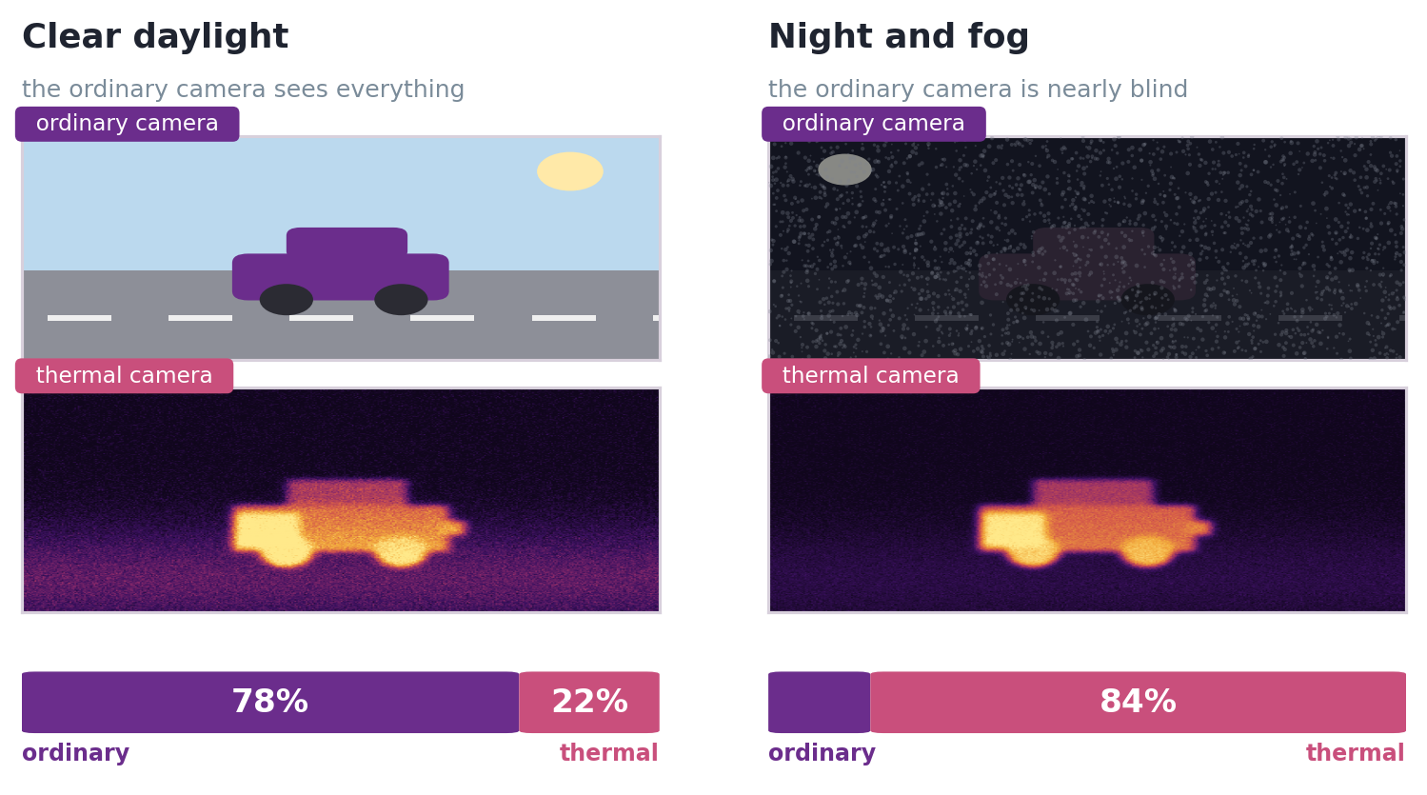
First, What Does “Attention” Mean?
No equations yet — the idea first, in a setting with nothing to do with cells
A self-driving car has both
In daylight the ordinary camera is far richer, so the system leans on it. At night it is close to useless and the thermal camera carries the decision. Nobody hard-coded a 50/50 rule — the split follows the conditions.
Now swap the words
ordinary camera
→
hand-crafted features
thermal camera
→
deep-learned features
lighting conditions
→
this particular nucleus
Same road. Same car. Same two cameras. Only the conditions changed.
Score
rate how useful each source
looks right now
Normalise
force the two ratings to
add up to exactly 1
Blend
multiply each by its share
and add them together
Shemonti Barua @ Kennesaw State University / 2026
Notes:
[~3 minutes] Before any equations, I want everyone to have the intuition, because every symbol from here on is just this slide written in notation. The word is "attention." If you have heard it before, it was probably about transformers and large language models. Set that aside — it will make this harder, not easier. What we are doing is a simpler and older idea, and it has a different name in the literature: modality gating. So let us leave pathology completely for two minutes. [Point at the figure.] A self-driving car has two cameras looking at the same road. An ordinary colour camera, and a thermal camera that sees heat instead of light. Left column, clear daylight. Look at what each one gives you. The ordinary camera has everything — colour, sharp edges, lane markings, the shape of the vehicle. The thermal camera sees a warm blob with a hot engine. It is not wrong, it is just far less informative. In these conditions the system should lean heavily on the ordinary camera. Right column, night and fog. Now look again. The ordinary camera is close to blind — dark, noisy, and you can barely tell there is a car there at all. But the thermal camera is completely unbothered. Heat does not care about light. That car is just as visible as it was in daylight. [Pause.] So which camera should the system trust? [Take answers. Somebody will say "it depends," which is exactly right — say so.] It depends on the conditions. And notice what did not happen: nobody hard-coded a fifty-fifty rule. Nobody even hard-coded "use thermal at night." The system evaluates, for the frame in front of it right now, how reliable each source looks, and allocates its trust accordingly. That is attention. That is genuinely the whole concept. And this is not an analogy I invented to make you feel better — it is how this family of methods is described in the literature. There is a body of work on condition-guided fusion that does exactly this, because imaging conditions change which sensor is reliable, and fixed-weight fusion breaks down when one sensor is compromised. [Now the mapping card. Slow down — this is the transfer.] Now swap three words and you have our problem exactly. The ordinary camera becomes the hand-crafted features — rich and readable when conditions are good. The thermal camera becomes the deep-learned features — less directly interpretable, but robust when the other source degrades. And the lighting conditions become the nucleus itself. A crisp, well-segmented nucleus sitting on its own is daylight: the shape measurements are reliable and highly informative. A nucleus buried in dense overlapping tissue is night and fog: the boundary is unreliable, area and circularity cannot be trusted, and the model is better off going on learned texture. Same structure. Same solution. [Then the three steps along the bottom, quickly — they map onto equations three through six.] Three moves. Score each source. Normalise so the two shares add to exactly one — a fixed budget, so they are in competition. Then blend in those proportions. And the thing to hold on to: this decision is made separately for every single nucleus. Twenty-four thousand three hundred and thirty-two nuclei, twenty-four thousand three hundred and thirty-two separate decisions. Not one weighting learned for the whole dataset. A fresh judgement per cell. If that landed, the rest of today is bookkeeping.

Slide 10
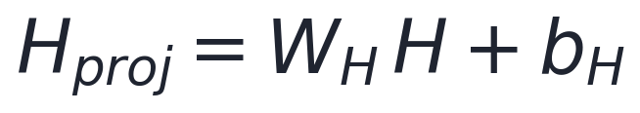
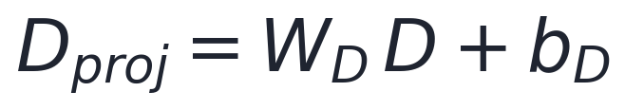
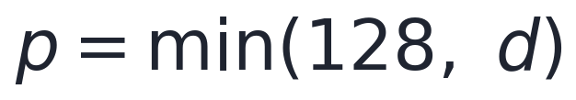
HMAF Step 1: A Shared Space
You cannot weigh 24 numbers against 256 numbers until they are the same length
Two learned linear layers
W and b are learned during training, exactly like any other layer. Both outputs come out with width p.
So p = 128 whenever the deep vector is 128 or larger, and p = d when it is smaller.
Why this is not just more PCA
PCA compresses one vector, unsupervised, before training ever starts. This projection aligns two different vectors, and its weights are learned alongside the classifier. One is about size; this one is about making a comparison possible at all.
Shemonti Barua @ Kennesaw State University / 2026
Notes:
[~3 minutes] Step one of three. And it is the least glamorous one, but you cannot skip it. Here is the problem. We want to weigh the hand-crafted features against the deep features. But one of them is a vector of twenty-four numbers and the other is a vector of two hundred and fifty-six. You cannot combine those directly — they are not even the same length. There is no meaningful way to add them together. The analogy I like: you cannot ask whether three kilometres is more than five kilograms. The question is not hard, it is malformed. You need to get both quantities into the same units before comparison even means anything. So step one converts the units. Watch the animation. [Let it play.] We take each vector and pass it through a linear layer that maps it to a common width. Those are equations one and two. H projected equals W-H times H plus b-H. Same form for the deep side. If that looks familiar, it should — that is just a standard fully connected layer. W is a weight matrix, b is a bias vector, both learned during training along with everything else in the model. There is nothing exotic here. The output width is called p, and it is set as the minimum of one hundred and twenty-eight and d, where d is the deep feature dimension. So in practice: if the deep vector is one twenty-eight or larger, p is one twenty-eight. If it is smaller — say sixty-four — then p is sixty-four. The reasoning is in the paper: cap it at one twenty-eight for larger inputs to avoid carrying redundancy, but match d for smaller ones so you do not artificially inflate. The result is two vectors of exactly the same width, living in the same space. Now a comparison is possible. [Now the bottom box. This is the payoff for slide five.] And here is where I said I would come back. Somebody tell me: how is this different from the PCA we did earlier? Both of them took a vector and changed its size. [Genuinely wait for an answer. Push if you need to: what was PCA's job? What is this one's job?] Three differences. PCA operates on one vector; this operates on two and makes them compatible with each other. PCA is unsupervised and fitted once before training; this is learned during training, alongside the classifier, tuned for the actual task. And PCA's goal is compression — make it smaller. This one's goal is alignment — make a comparison possible. Same-looking operation. Completely different job. If you conflate them, step one looks pointless, and it is not.

Slide 11
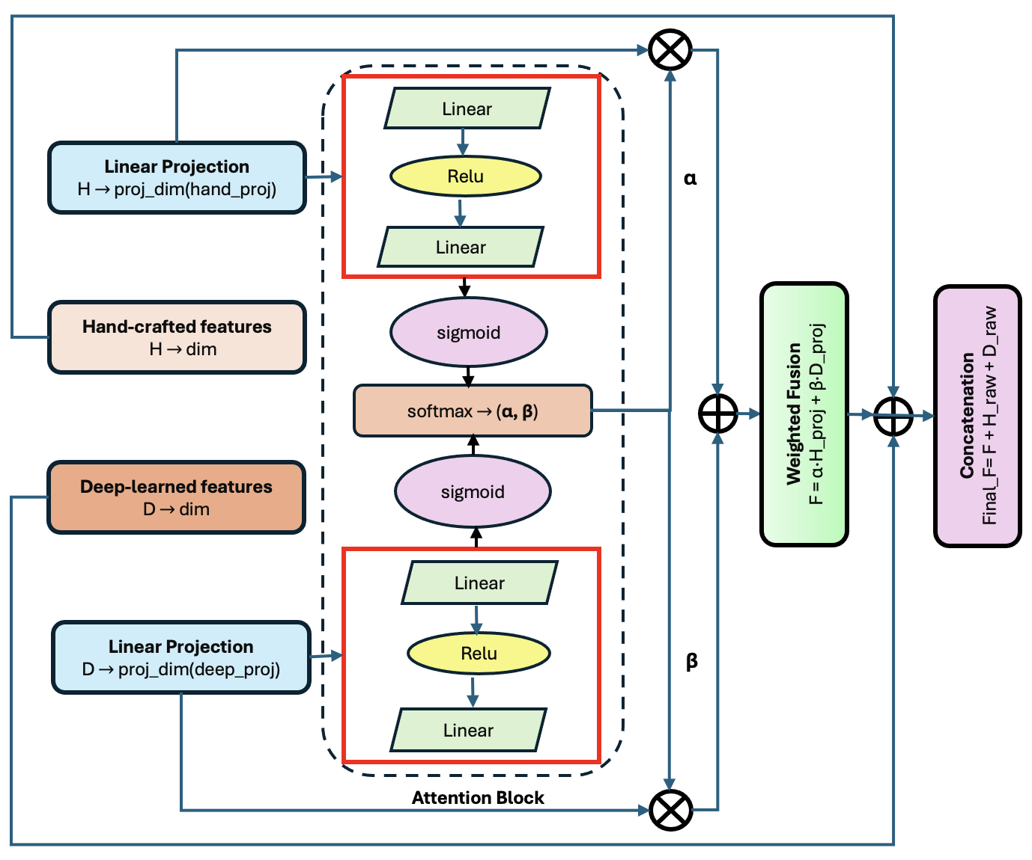
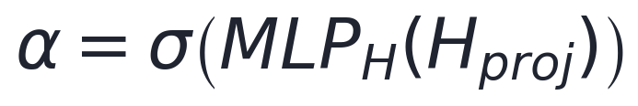
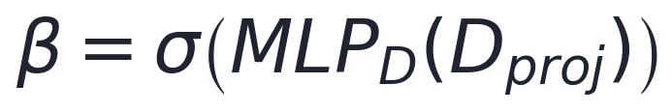
HMAF Step 2a: Score Each Side
A tiny neural network reads each projected vector and returns a single number
Inside one attention branch
Linear layer: p → h
ReLU: keeps the positives, zeroes the rest
Linear layer: h → 1 single number
Sigmoid: squashes it into the range 0 to 1
α is the raw score for the hand-crafted side, β for the deep side. There are two of these little networks, one per modality, and they are trained together with everything else.
HMAF architecture (Barua et al., ICSC 2026)
Hidden width is h = p / 2 — so 64 when p = 128
Shemonti Barua @ Kennesaw State University / 2026
Notes:
[~3 minutes] Step two, part one. We have two vectors in the same space. Now we need to decide how much to trust each one. Look at the architecture diagram on the left — this is figure one from the paper. Find the two red boxes. One in the upper half, one in the lower half. Those are the two attention branches, one per feature type. Let me trace what happens inside one of them, on the right. The projected vector goes into a linear layer, which maps it from width p down to a hidden width h. Then a ReLU activation, which does something very simple: keeps positive values as they are, sets negatives to zero. Then a second linear layer that maps from h all the way down to one. A single number. And finally a sigmoid, which squashes that number into the range zero to one. So: a whole vector goes in, one number comes out. That number is the model's answer to the question "how much do I trust this feature type, for this particular cell." For the hand-crafted branch that number is alpha, equation three. For the deep branch it is beta, equation four. [Point back at the diagram.] Notice these networks are genuinely tiny. One twenty-eight, to sixty-four, to one. The hidden width is p over two. Students usually expect the attention mechanism to be some enormous thing, and it is about two hundred parameters. That is a feature, not a limitation — it means fusion adds almost nothing to training cost. Two of them, one per modality, and their weights are learned jointly with everything else. Nobody hand-tunes these. The model figures out on its own what a trustworthy-looking hand-crafted vector looks like, because that is what minimises the loss. [Common questions:] [Why sigmoid? To bound the score. Raw unbounded scores would be harder to normalise sensibly, and — as you will see on the next slide — the bound has a nice consequence.] [Why not one network taking both? Then the two scores could not be computed independently before being compared. Separate branches keep the modalities symmetric.] Alpha and beta are the raw scores. They are not yet the weights — they do not add up to anything in particular. Making them into shares is the next slide.

Slide 12
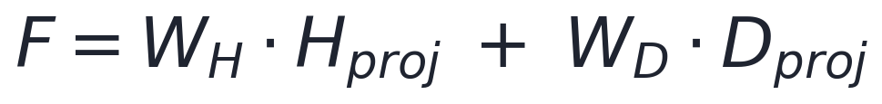
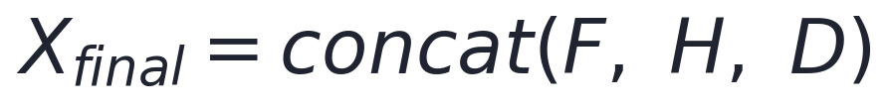
HMAF Step 2b: Split the Budget, Then Blend
This is the slide that matters — the split is recomputed for every nucleus
Softmax turns two scores into two shares
Then the two vectors are blended in those proportions
Finally, nothing is thrown away
The fused vector F is concatenated back with the original H and D, so the classifier sees the blend and the raw ingredients.
A consequence worth noticing
Because softmax is applied to two sigmoid outputs, the weights can never leave roughly 0.27 to 0.73. Neither modality can ever be switched off completely — the architecture guarantees both keep a voice.
Shemonti Barua @ Kennesaw State University / 2026
Notes:
[~4 minutes — the most important slide in the deck. Do not rush it.] Step two, part two. This is the heart of it. We have alpha and beta, two raw scores between zero and one. We need shares that add up to one. The tool for that is softmax — equation five. Softmax takes a set of numbers and turns them into proportions that sum to one, while preserving their order: whichever was bigger stays bigger. Here it is applied to just two values, so it is about as simple as softmax ever gets. Out come W-H and W-D, the two attention weights. And now they are genuinely in competition. If one goes up, the other must come down. Fixed budget. Then equation six does the actual fusion. Take the projected hand-crafted vector, multiply by its weight. Take the projected deep vector, multiply by its weight. Add them. That is F, the fused representation. Now watch the animation, because this is where the idea becomes concrete. [Let it loop. Narrate over the top of it — do not talk about the animation, talk about the cells.] First cell — small, round, high circularity, clean boundary, sitting on its own. Shape is extremely informative here. Seventy-one per cent of the weight goes to hand-crafted. Second — a spindle cell, elongated, clear axis ratio. Still shape-driven, sixty-three, thirty-seven. Third — a nucleus buried in dense overlapping tissue. Boundary is ambiguous, the segmentation is unreliable, so the shape measurements cannot be trusted. Thirty-four, sixty-six. The model leans on learned texture instead. Same trained model. Same weights. Three completely different decisions. [Pause and let that sit.] That is the thing concatenation could not do. Remember problem three from slide eight — one fixed recipe for every cell. This is the fix. Then equation seven, which is easy to overlook but worth a sentence. The fused vector F gets concatenated back together with the original H and D. So the classifier ends up seeing the intelligent blend AND the raw ingredients. Nothing is discarded. If the attention mechanism makes a bad call on some cell, the original information is still sitting right there. [Finally, the bottom box.] One consequence worth noticing, and this is a nice bit of design. Because softmax is being applied to two sigmoid outputs, and sigmoid outputs are always between zero and one, the weights can never leave the range of roughly zero point two seven to zero point seven three. Work it out: the most extreme case is one score at one and the other at zero, and e to the one over e-to-the-one plus e-to-the-zero is about zero point seven three. So neither modality can ever be switched off completely. The architecture structurally guarantees that both keep a voice, even when it strongly prefers one. That is not an accident, and it is part of why fusion is robust. [The specific percentages in the animation are illustrative pending real values from the trained model — say so.]

Slide 13
One Nucleus, All the Way Through
Illustrative numbers — the shapes and the arithmetic are real
Nucleus A — round, crisp boundary
H 24-d
Hproj 128
F = 0.71·Hproj + 0.29·Dproj
71%
29%
D 256-d
Dproj 128
W_H
W_D
Shape is decisive, so the hand-crafted side takes most of the budget.
Nucleus B — buried in dense tissue
H 24-d
Hproj 128
F = 0.34·Hproj + 0.66·Dproj
34%
66%
D 256-d
Dproj 128
W_H
W_D
Boundary is unreliable, so the model leans on learned texture instead.
Same model. Same weights. Different answer — because the input was different.
Shemonti Barua @ Kennesaw State University / 2026
Notes:
[~3.5 minutes] Let us walk one nucleus all the way through, end to end, so you can see the whole thing as arithmetic rather than symbols. [Trace it with your finger, left to right, slowly.] Nucleus A. Round, crisp boundary, clean segmentation. We start with two things: H, the twenty-four hand-crafted measurements, and D, the two hundred and fifty-six deep components after PCA. Step one — both get projected to width one hundred and twenty-eight. H projected, D projected. Now they are comparable. Step two — each projected vector goes through its little attention network. Two scores come out, softmax turns them into shares. Seventy-one per cent to hand-crafted, twenty-nine to deep. Why that split for this cell? Because the boundary is clean, so area and circularity and elongation are all reliable and all informative. Shape is doing the work. Step three — fuse. F equals zero point seven one times H projected, plus zero point two nine times D projected. One vector, one hundred and twenty-eight numbers, weighted toward the evidence that is actually good here. Now the second row. Nucleus B. Buried in dense tissue. Exactly the same model. Exactly the same weights — nothing has been retrained, nothing has changed. Same two steps. Thirty-four, sixty-six. It flipped. [Pause.] And that is the whole point of this session, in one comparison. Same model, same parameters, different answer — because the input was different. The model looked at this nucleus, saw that the shape evidence was unreliable, and reallocated its trust. [If you want to push the room, ask:] What would concatenation have done with these two cells? [Answer: exactly the same thing to both. It has no mechanism to notice they are different.] [Values are illustrative — flag it once, here.] Any questions on the mechanism before we move on? Because from this point forward it is all standard pipeline and results — the interesting idea has now been fully covered.

Slide 14
What Happens After Fusion
The fused vector still has to get to a classifier — four more steps
SelectKBest
Rank the fused features by how well they separate classes; keep the top 150 or 100.
SMOTE
Synthesise new minority-class examples so Endothelial's 40 nuclei are not drowned out.
OvO / OvR
Break the 7-class problem into binary ones: each pair against each other, or each class against all the rest.
5-fold CV
Stratified, so every fold keeps the same class mix. Report accuracy and F1.
Four classifiers were tried on the fused features
Logistic Regression
SVM (RBF)
Random Forest
XGBoost
XGBoost won every single configuration — all six tasks, all feature combinations.
Shemonti Barua @ Kennesaw State University / 2026
Notes:
[~2 minutes — keep this brisk, it is not the contribution] Fusion gives us a vector. That vector still has to reach a classifier, and there are four more steps in between. I will do these quickly because they are standard tools, not the novel part. SelectKBest. After fusion the vector is quite long, so we rank the features by how well they separate the classes and keep the top one hundred and fifty, or one hundred, depending on the configuration. Same idea as the ANOVA F-test from slide three, applied further down the pipeline. SMOTE. This is the answer to that imbalance chart from earlier. Synthetic Minority Over-sampling Technique. Rather than duplicating the forty endothelial examples, it generates new synthetic ones by interpolating between existing minority examples in feature space. So the classifier is not overwhelmed by fibroblasts. One-versus-one and one-versus-rest. Instead of solving all seven classes at once, we break it into binary problems. One-versus-one pits each pair against each other. One-versus-rest pits each class against everything else combined. Doing it this way isolates exactly which distinctions are hard — and you will see on the next slide that some pairs are much harder than others. Multiclass is listed as future work in the paper. Stratified five-fold cross-validation. Split the data five ways, train on four, test on one, rotate. Stratified means each fold keeps the same class proportions — which matters enormously here, because with forty endothelial cells a random split could easily give you a fold with almost none. And four classifiers were tried on the fused features: logistic regression, SVM with an RBF kernel, random forest, and XGBoost. XGBoost won every single configuration. All six tasks, every feature combination. Which is worth knowing as a practical matter — on tabular feature data, gradient-boosted trees are very often the right first thing to try.

Slide 15
Did It Work?
Inflammatory vs. all other classes — the hardest, most imbalanced task in the study
Read the grey bars first
Hand-crafted features score 97% accuracy and an F1 of 0.50. Both numbers are correct. The model is simply predicting “not inflammatory” almost every time and being right by default.
What HMAF changed
F1 goes from 0.55 to 0.98. Concatenation had all the same information and could not use it — the gain comes from weighting, not from extra data.
But it does not win everywhere
On Inflammatory vs. Spindle, hand-crafted features alone reached F1 = 0.9659 and beat every fusion variant. Sometimes shape really is enough, and the honest version of this result is more useful to you than a clean sweep would be.
Shemonti Barua @ Kennesaw State University / 2026
Notes:
[~3.5 minutes] So. Did it work? This is the inflammatory-versus-all-other-classes task. I picked it deliberately: it is the hardest and most imbalanced task in the study, which makes it the most informative. Four approaches along the bottom. Hand-crafted alone, deep alone, concatenation, and HMAF. Two bars each — light grey is accuracy, purple is F1. Now, before I tell you what happened, look at the first pair of bars and tell me what is wrong. [Wait. Point at it if you need to. Someone will spot the gap.] Hand-crafted features alone: ninety-seven per cent accuracy. And an F1-score of zero point five zero. Both of those numbers are correct. They are describing the same model. How? [Let them answer — this is the callback to slide seven, and most of the room will get there.] Because the model is almost never predicting "inflammatory." It says "not inflammatory" nearly every time, and since most cells genuinely are not inflammatory, it is right ninety-seven per cent of the time while being completely useless for the actual task. If you only ever look at accuracy, you would ship that model. This is the single most practical thing on this slide, and it applies far beyond pathology. On imbalanced data, accuracy will lie to you. Now compare the rest. Deep features alone: worse accuracy, better F1. It is at least trying. Concatenation: F1 of zero point five five. Barely better than hand-crafted alone. HMAF: zero point nine eight. [Let that gap sit for a second.] And here is what I want you to take from that. Concatenation had access to exactly the same information as HMAF. Identical features, identical inputs, nothing extra. It simply could not use them, because it had to treat every number as equally important for every cell. The gain comes from weighting. Not from more data, not from a bigger model, not from better features. From deciding, per nucleus, what to trust. [Now the bottom box — do not skip this, it matters.] One more thing, and I am including it deliberately. HMAF does not win everywhere. On inflammatory versus spindle, hand-crafted features on their own reached an F1 of zero point nine six six and beat every fusion variant we tried. Why? Because inflammatory cells are small and round and spindle cells are long and thin, and shape alone separates them almost perfectly. There was nothing left for the deep features to contribute, and the added complexity cost a little. I am telling you that because it is true, and because a result that wins on absolutely everything should always make you slightly suspicious. Knowing where your method does not help is more useful to you as researchers than a clean sweep would be. [Presenter note — do not say this out loud: the paper's prose quotes 0.9815 and 98.12% for the hand-crafted inflammatory-versus-spindle result, but Table I shows 0.9659 and 95.65%. Those 0.9815 figures actually belong to inflammatory-versus-others under HMAF. Teach from the table.]

Slide 16
References & Where to Go Next
The paper this session is based on
S. Barua, S. Yellu, S. C. Koganti, J. Yun, S. Lee — “HMAF: Hybrid Modality Attention for Fusing Hand-Crafted and Deep-Learned Features.” ICSC 2026, IEEE, pp. 124–127.
The dataset
S. Graham et al. — “HoVer-Net: Simultaneous segmentation and classification of nuclei in multi-tissue histology images.” Medical Image Analysis, vol. 58, 2019. (CoNSeP is released with this paper.)
The deep feature extractor
K. He, X. Zhang, S. Ren, J. Sun — “Deep residual learning for image recognition.” CVPR 2016, pp. 770–778.
Related attention-based fusion in pathology
P. Goel, S. Kapse, P. Pati, P. Prasanna — “CoCa-MIL: Attention-based handcrafted-deep feature fusion in computational pathology.” ISBI 2024.
Next week: Setting up IMNS — bring a laptop with Docker installed. Everything we covered today is what the fusion step in HIMLT is actually doing under the hood.
Shemonti Barua @ Kennesaw State University / 2026
Notes:
[~1.5 minutes] That is the material. Let me leave you with where to read more, and what happens next. The paper this session is based on is the first one — Barua and colleagues, ICSC 2026. It is short, seven pages, and now that you have seen the ideas you will find it very readable. I would genuinely encourage you to read it; it is a good first paper to read closely, and it is ours, so you can ask me about any line in it. The dataset comes from the HoVer-Net paper — that is where CoNSeP was released, and it is worth skimming if you are curious how those twenty-four thousand annotations were produced. The third is the original ResNet paper. Enormously influential, very clearly written, and the source of the deep features we used. And the fourth is related work — other people doing attention-based fusion in pathology, so you can see where our method sits relative to the field. Next week is Deepthi again, setting up IMNS. That is hands-on, so bring a laptop, and if you can install Docker beforehand it will save you time in the session. One last thing to connect it back. Everything we did today is what the fusion step inside HIMLT is actually doing. When you click on a nucleus in that tool and it retrains in half a second, this is the machinery underneath — the projection, the attention weights, the blend. You have now seen inside it. So — what questions do you have? [Leave real time here. If nobody speaks, prompt with: tell me in your own words what makes HMAF different from just sticking the two feature sets together. That usually starts it.]

