Slide 1
NMF versus PCA on the Olivetti faces
STOR 565 · FALL 2026 · FINAL PROJECT
Can you build a face just by adding patterns, and what does that cost compared with PCA?
Person 1 · Person 2 · Person 3 · Person 4
Notes:
[0:20, total 0:20] Hi everyone. Today we compare NMF with PCA on the Olivetti face images. NMF builds a face only by adding patterns together, while PCA uses components that can be added or subtracted. We want to know what that costs in accuracy and what it gives us in readability.

Slide 2
The question
DATA
Olivetti faces
400 photos of 40 people (10 each), 64 × 64 pixels, brightness between 0 and 1
BASELINE FROM CLASS
PCA
Components can be positive or negative, added to a mean face
NEW METHOD
NMF
Every pattern is nonnegative, and a face is built only by adding them
If a face can only be built by adding, how much accuracy do we lose compared with PCA, and are the patterns easier to read?
Notes:
[0:45, total 1:05] Quick setup. The data are 400 small grayscale faces, 40 people with 10 photos each. PCA is our baseline from class. NMF is new to the class, so the next slides explain it. The whole talk is about one question: if a face can only be built by adding, how much accuracy do we lose, and do the patterns get easier to read?

Slide 3
A fair comparison
320 training and 80 test images, fixed (8 + 2 per person)
Both methods are fit on the training images only and rebuild the same 80 test images
Error is the mean squared error per pixel (MSE), computed on unclipped reconstructions
Both get the same number of components k (mostly k = 40)
We never use the person labels, except to check the split
CAVEAT
Test photos are of people we trained on
Every person has 8 photos in training and 2 in test, so this says nothing about people the model has never seen.
Notes:
[0:55, total 2:00] This slide is about making the comparison fair. We split the data once: 320 images for training and 80 for testing, 8 and 2 per person. Both methods are fit on the training images only, and both reconstruct the same 80 test images. We measure the mean squared error per pixel, without clipping the reconstructions, and both methods get the same number of components, mostly 40. One caveat: every person is in both training and test, so we test on new photos of people the model has seen, not on new people.

Slide 4
The NMF model
X ≈ W H, with W ≥ 0 and H ≥ 0
X: 320 × 4096
training images, one per row
W: 320 × 40
how much each image uses each pattern
H: 40 × 4096
the 40 patterns; each row is one image
So a face is a weighted sum of the 40 patterns, and nothing gets subtracted. The 40 is just the size we picked. It has nothing to do with the 40 people.
We minimize ½ ‖X − W H‖², the sum of squared pixel errors.
Notes:
[1:10, total 3:10] NMF writes the data matrix X as W times H, and both W and H have to be nonnegative. X is our 320 training images. H holds the 40 patterns, one per row. W says how much each image uses each pattern. So a face is a weighted sum of the 40 patterns and nothing is subtracted. The 40 is a number we chose, it has nothing to do with the 40 people. The goal is to make the sum of squared pixel errors as small as possible.

Slide 5
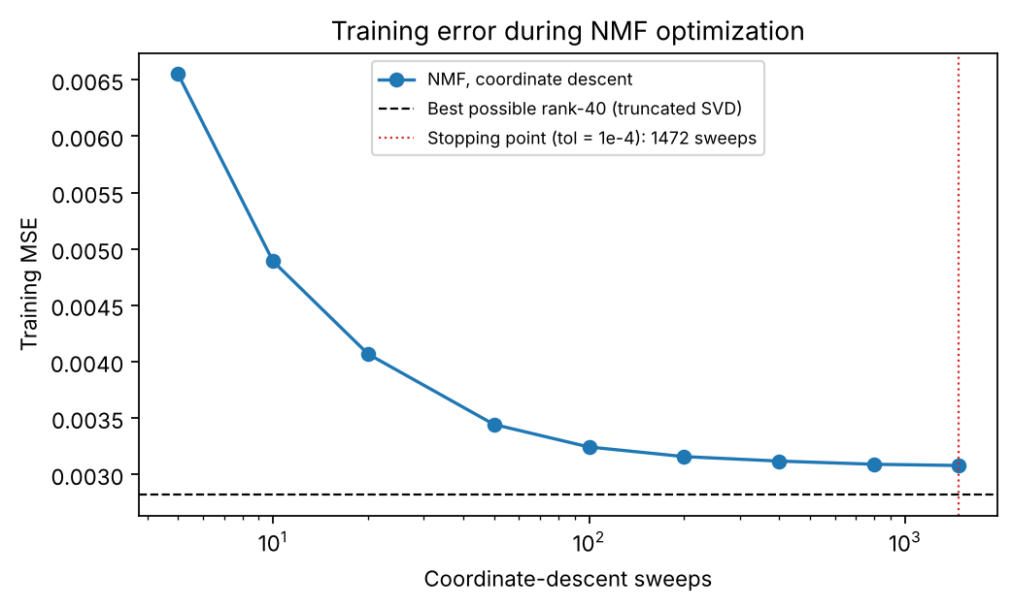
How the patterns are learned
For fixed H the problem is convex in W, and the other way around, but it is not convex in both together
We update one entry at a time: W[i, r] ← max(0, W[i, r] − gradient / a_r), where a_r is the sum of squares of row r of H
Exact NMF is NP-hard, so nothing guarantees a global optimum
For a test face we keep H fixed and solve for nonnegative weights. An exact solver gives the same test MSE, 0.00394635
The error drops quickly and then slowly. It stays above the best possible rank-40 error (dashed line).
Notes:
[1:15, total 4:25] For a fixed H the problem is convex in W, and the other way around, but it is not convex in both at once. So we update one entry at a time, which is what scikit-learn's coordinate descent does, and we end up in a local solution. Exact NMF is NP-hard, so there is no guarantee we find the best one. The curve shows the error dropping fast in the first hundred sweeps and slowly after that. It stops at the tolerance after 1472 sweeps. For test images we keep the patterns fixed and only solve for the weights. We checked this against an exact nonnegative least-squares solver and the test MSE is the same.

Slide 6
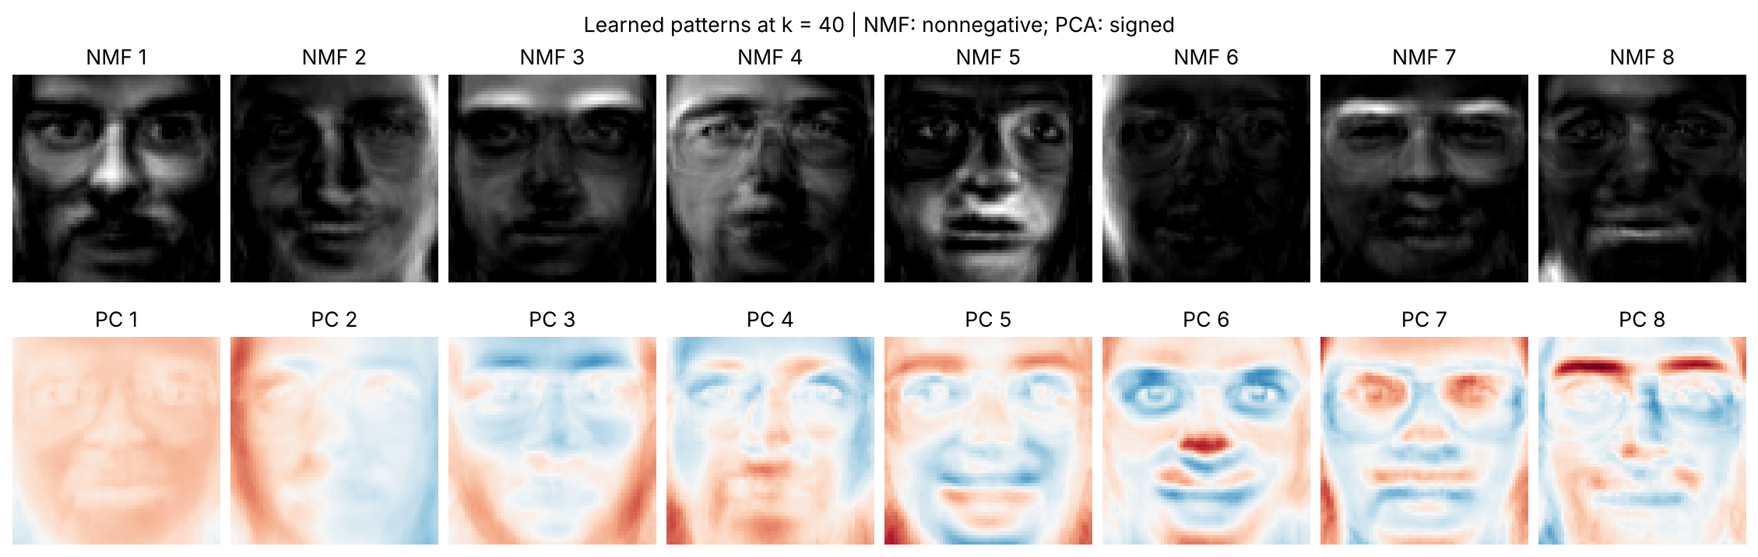
What the NMF patterns look like
0.317 vs 0.221
29.8 of 40
Broad patterns
Hoyer sparsity of the NMF patterns vs. PCA's absolute loadings (0 = flat, 1 = a single pixel)
patterns used by a typical training image
they overlap and look like faces; none is a lone eye, nose or mouth
Notes:
[0:55, total 5:20] These are the first eight patterns of each method. The NMF ones are nonnegative images that overlap and still look like faces. The PCA ones have both signs, red and blue here. We measured how sparse the NMF patterns are with Hoyer's measure: 0.317 on average, a bit above PCA's 0.221, and still far from 1, which would be a single pixel. A typical training image uses 29.8 of the 40 patterns. So the patterns are additive, but they are not separate parts like an eye or a nose.

Slide 7
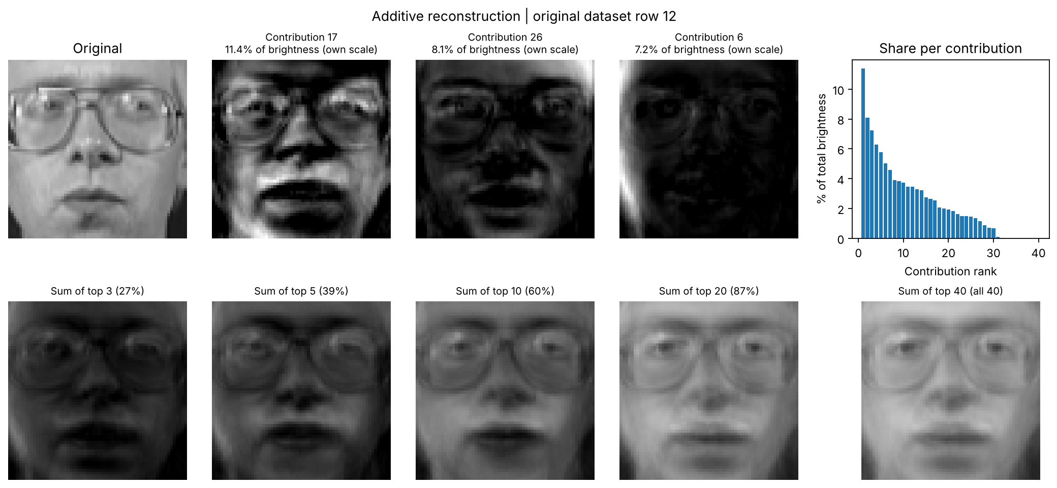
One face as a sum of contributions
Test image (dataset row 12). The biggest of the 40 contributions gives 11.4% of the brightness and the top 20 give 87%, so no single pattern dominates.
Notes:
[0:50, total 6:10] This is what additive means for one face. We took the first test image, row 12, before looking at any results. Its reconstruction is the sum of 40 nonnegative pieces. The biggest piece gives 11.4% of the brightness and the top 20 give 87%. The partial sums look dark because we only add some of the pieces. The order here is just by total brightness, it does not say which pattern matters more.

Slide 8
Reconstruction at 40 components
Method | Test MSE | vs. PCA
PCA, 40 components + mean | 0.003658 | —
PCA, 39 components + mean | 0.003696 | +1.0%
Uncentered SVD, 40, no mean | 0.003658 | −0.005%
NMF, 40 components | 0.003946 | +7.9%
+7.9%
NMF's test MSE is higher than PCA's
74 of 80
The missing mean is not the reason. PCA without a mean (uncentered SVD) does no better, and PCA with 39 components + mean, which stores as many images as NMF, still wins.
test images where PCA has the lower error
Notes:
[1:10, total 7:20] Now the numbers at 40 components, same split, same 80 test images. PCA gets 0.003658 and NMF gets 0.003946, so NMF is 7.9% worse. Two extra rows help us find the cause. The uncentered SVD has no mean term and matches PCA, so the missing mean is not the reason. PCA with 39 components plus the mean stores as many images as NMF and still wins. Image by image, PCA is better on 74 of the 80 test images. The mean difference is 0.000288, with a 95% bootstrap interval from 0.000233 to 0.000344. That interval only reflects which test images we have.

Slide 9
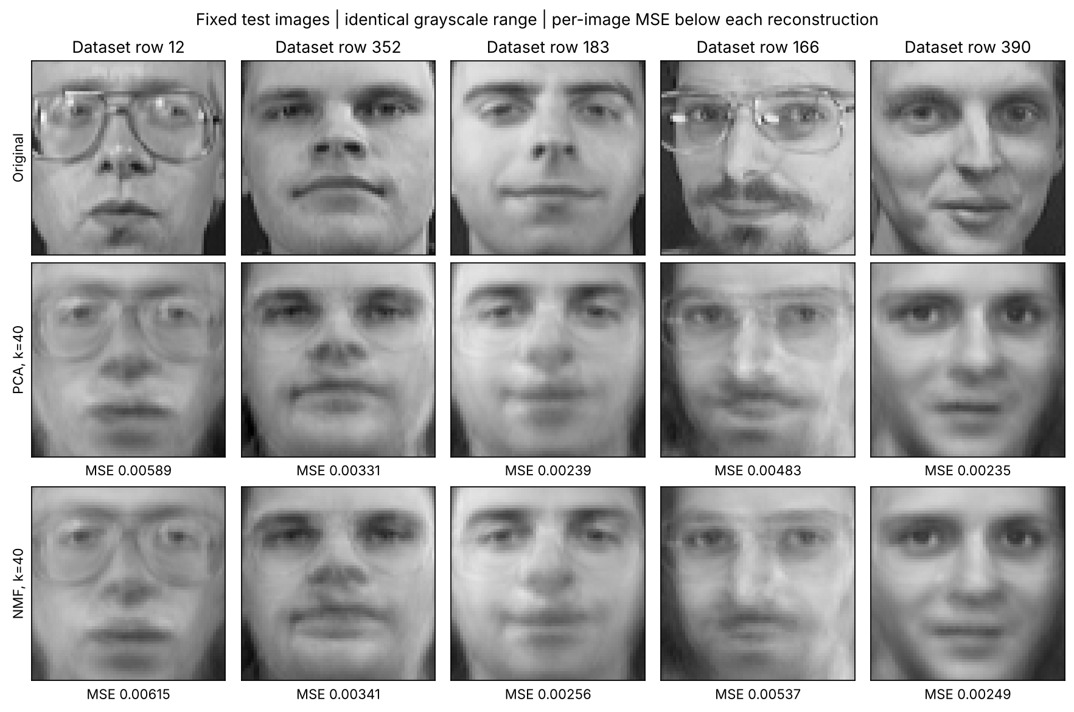
Same faces, two reconstructions
At first glance the two look almost the same
The biggest gap is row 166, the face with glasses and a moustache: NMF is 11.2% worse
Lower MSE only means closer pixels. We did not test recognition.
Notes:
[0:35, total 7:55] We picked these five test images in advance, not because they look good. The two methods look very close, and the error under each picture gives the numbers. NMF's gap is biggest for row 166, the face with glasses and a moustache, and smallest for row 352, at 3.2%.

Slide 10
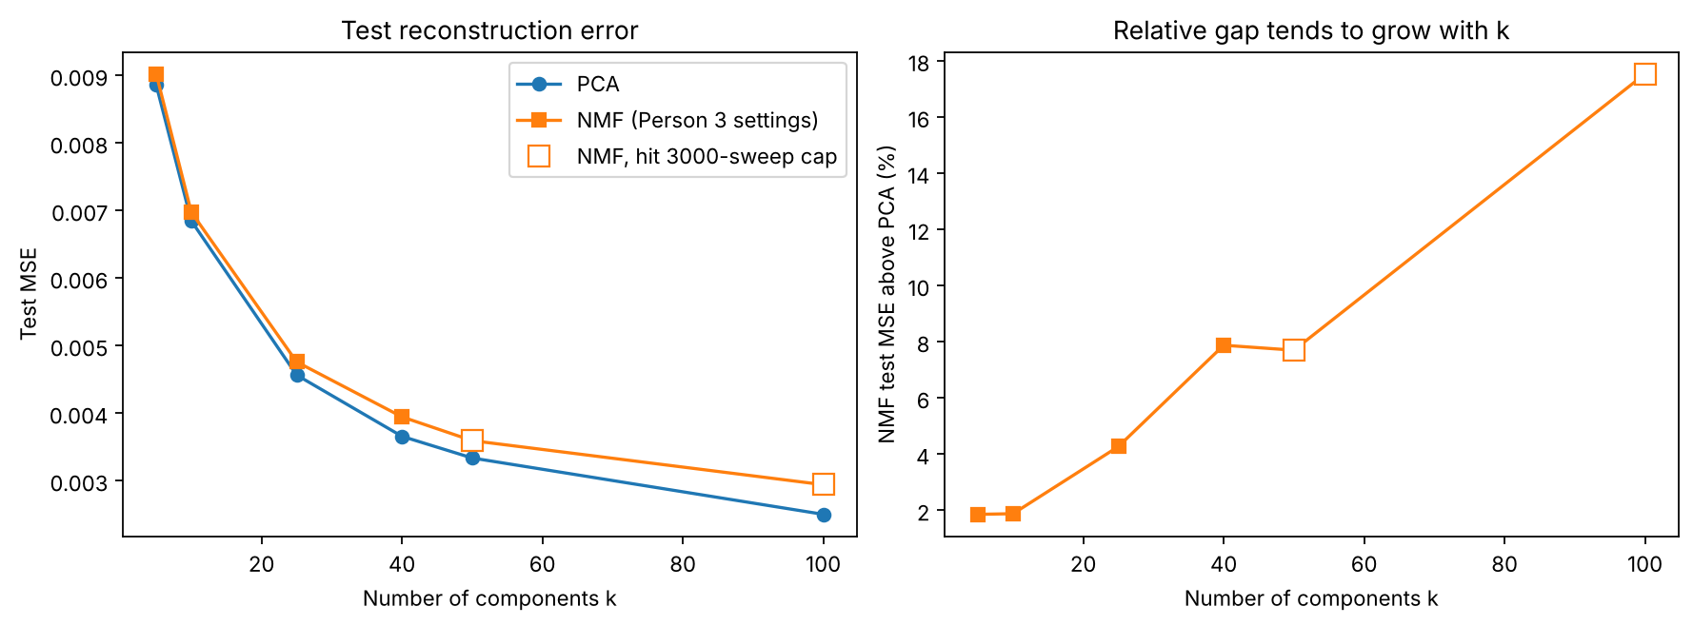
Does the gap hold up?
+1.9% to +17.5%
+5.5% to +7.9%
NMF's error above PCA's for k = 5 to 100. The two largest k stopped at the iteration limit, so those gaps are upper bounds
gap at k = 40 with other initializations and tolerances. PCA is lower in every variant
Notes:
[1:10, total 9:05] On the left, NMF is above PCA for every number of components we tried. On the right, the gap tends to grow with k, from about 2% at k = 5 to 17.5% at k = 100. The hollow points hit the 3000-sweep limit, so read those as a rough direction. At k = 40 we also tried a stricter tolerance and five random initializations. The gap moves between 5.5% and 7.9%, and our main run is the largest of them, so we report a range.

Slide 11
Why is NMF worse?
Theory
By Eckart–Young, no rank-40 factorization X ≈ WH fits the training data better than the truncated SVD.
NMF's training MSE is 0.003079 and the SVD bound is 0.002820, so the nonnegativity constraint costs some accuracy.
Optimization
NMF only finds a local solution, so some of the gap may come from the optimizer and not from the model.
Other starting points and a stricter tolerance move the gap between 5.5% and 7.9%, but never close it.
So the gap comes from the nonnegativity constraint and from imperfect optimization. The missing mean is not the cause.
Notes:
[0:55, total 10:00] There are two reasons. First, a bound: among all rank-40 factorizations of the training data, the truncated SVD has the smallest training error. NMF is one of those factorizations with extra constraints, so it cannot beat it. NMF's training error is 0.003079 and the bound is 0.002820. Second, the optimizer: the problem is not convex and we only get a local solution, so part of the distance to the bound may come from that. We cannot split the gap exactly between the two. What we can say is that the missing mean is not the cause, and that the gap does not go away in any variant we tried.

Slide 12
Limits
We used one split. The interval only covers variation across the 80 test images, not other splits or other people.
We only measured pixel error, not recognition, clustering or anything built on top of it.
It is one small dataset of aligned faces and one loss, squared error.
NMF only reaches local solutions. Other optimizers or initializations might shrink the gap, which is why we report a range.
Sparsity is measured, but whether a pattern is a meaningful part is our judgment from looking at the images.
Notes:
[0:45, total 10:45] We would rather tell you the limits ourselves. The 80 test images come from the same 40 people as the training images, so this does not tell you how the methods compare on new people. Reconstruction error is the only thing we measured. The sparsity numbers describe the patterns, but whether a pattern counts as a meaningful part is our judgment from looking at the images.

Slide 13
Take-aways
NMF writes a face as a sum of nonnegative patterns. PCA cannot, because its components have both signs.
That costs accuracy: at 40 components NMF is 7.9% worse, and PCA wins on 74 of 80 test images.
The mean term does not explain the gap, and the gap stays in every variant we tried. What we get for the lost accuracy is a reconstruction that is a plain sum of patterns.
Code, data script and results: github.com/MachineWJQ6657/pca-vs-nmf
Notes:
[0:55, total 11:40] Three things to remember. One: NMF builds a face by adding nonnegative patterns, although here the patterns are broad and not separate parts. Two: that costs accuracy, 7.9% at 40 components. Three: the mean term does not explain the gap, and it holds up across the variants we tried. Thank you, we are happy to take questions. The backup slide has short answers to the ones we expect.

Slide 14
Backup: likely questions
Question | Short answer
Why does NMF not win at its own objective? | The SVD is the best rank-40 fit with no constraints, so NMF's training error cannot go below it (0.003079 vs. 0.002820).
Could better optimization close the gap? | Maybe part of it. A stricter tolerance and five random starts move the gap between 5.5% and 7.9%, and PCA stays lower.
Is it the missing mean? | No. PCA without a mean gives the same test error as centered PCA, and PCA with 39 components + mean still beats NMF.
How do you encode a test face in NMF? | H stays fixed and we solve a nonnegative least-squares problem for each face's weights. An exact solver gives the same test MSE.
What does the interval mean? | It is a paired bootstrap over the 80 test images (10,000 resamples). It does not cover other splits or other people.
Notes:
Backup slide, not part of the 12 minutes. Each row is a question we expect, with a short answer.

