Slide 1
Plant disease classification
Fresh views and three paired seeds
Can crop and color augmentation improve field performance?
COMP 664 · Topic 2 · Fall 2026
1
Notes:
Question: how much clean-to-field performance is lost, and can crop/color augmentation reduce it? The main comparison now consists of six independently trained models. The legacy two-fixed-view single-seed result is retained as a reference.
Sources:
PlantVillage: https://doi.org/10.3389/fpls.2016.01419; https://github.com/spMohanty/PlantVillage-Dataset
Cropped-PlantDoc: https://doi.org/10.1145/3371158.3371196; https://github.com/pratikkayal/PlantDoc-Dataset (CC BY 4.0)
MobileNetV3: https://arxiv.org/abs/1905.02244
New experiment: results/fresh_views/protocol.json, events.jsonl, per_seed_metrics.csv, summary.csv and training_audit.csv. Legacy results remain separately in results/.

Slide 2
Data and split integrity
Dataset | Purpose | Images
PlantVillage | Training | 12,036
PlantVillage | Validation | 1,364
PlantVillage | Clean test | 3,351
PlantDoc | External test | 742
Nine test classes; mosaic virus has no validation examples.
PlantDoc never enters optimization or checkpoint selection.
2
Notes:
The source split is unchanged. Source validation only uses documented training leaf IDs and supports eight classes, while both tests support nine. 4,280 training and 1,060 clean-test images lack documented leaf IDs. Exact-byte checks cannot rule out all same-leaf identities or near-duplicates.
Sources:
PlantVillage: https://doi.org/10.3389/fpls.2016.01419; https://github.com/spMohanty/PlantVillage-Dataset
Cropped-PlantDoc: https://doi.org/10.1145/3371158.3371196; https://github.com/pratikkayal/PlantDoc-Dataset (CC BY 4.0)
MobileNetV3: https://arxiv.org/abs/1905.02244
New experiment: results/fresh_views/protocol.json, events.jsonl, per_seed_metrics.csv, summary.csv and training_audit.csv. Legacy results remain separately in results/.

Slide 3
Six newly trained models
Three seeds × ordinary / strong augmentation × eight epochs.
Fresh per-image transformation draws every epoch.
Only deterministic RGB resize is cached.
Same ImageNet MobileNetV3-Small, trainable blocks, AdamW,
batch size 96 and 1,008 steps per model.
All six checkpoints selected on source validation
before either test set is scored.
3
Notes:
Three fixed seeds: 664, 665, 666. Both conditions start from identical weights within seed and use the same shuffled indices. No field-based run selection. Training uses deterministic CUDA algorithms with TF32 disabled, PyTorch 2.7.1+cu128 and torchvision 0.22.1+cu128.
Sources:
PlantVillage: https://doi.org/10.3389/fpls.2016.01419; https://github.com/spMohanty/PlantVillage-Dataset
Cropped-PlantDoc: https://doi.org/10.1145/3371158.3371196; https://github.com/pratikkayal/PlantDoc-Dataset (CC BY 4.0)
MobileNetV3: https://arxiv.org/abs/1905.02244
New experiment: results/fresh_views/protocol.json, events.jsonl, per_seed_metrics.csv, summary.csv and training_audit.csv. Legacy results remain separately in results/.

Slide 4
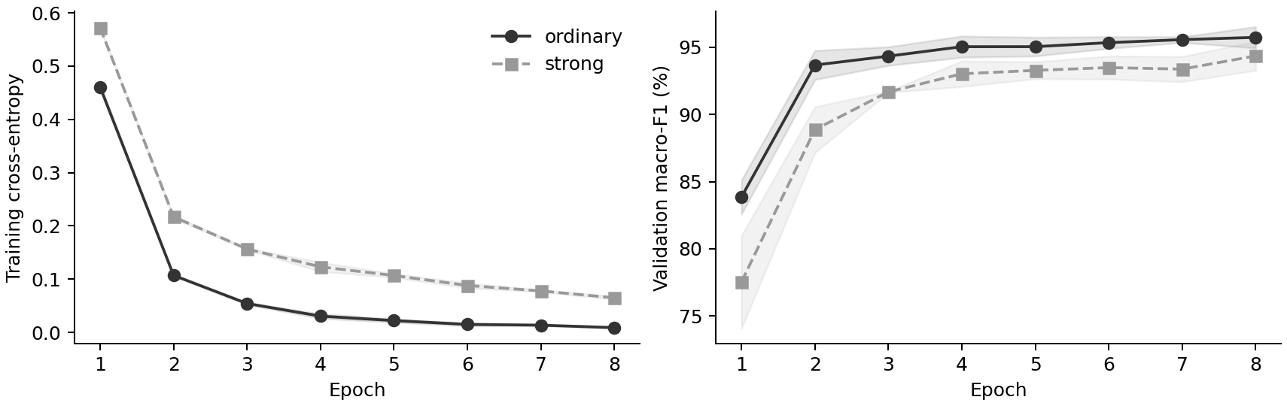
Training and validation history
48 completed epochs · 6,048 optimizer steps · 577,728 image presentations
4
Notes:
Means over the three seeds; shading is sample SD. Supported validation macro-F1 covers eight classes. Each model selects its first maximum independently. Training loss is cross-entropy. The training logs record all 48 epochs, not merely saved predictions.
Sources:
PlantVillage: https://doi.org/10.3389/fpls.2016.01419; https://github.com/spMohanty/PlantVillage-Dataset
Cropped-PlantDoc: https://doi.org/10.1145/3371158.3371196; https://github.com/pratikkayal/PlantDoc-Dataset (CC BY 4.0)
MobileNetV3: https://arxiv.org/abs/1905.02244
New experiment: results/fresh_views/protocol.json, events.jsonl, per_seed_metrics.csv, summary.csv and training_audit.csv. Legacy results remain separately in results/.

Slide 5
Mean test results across three seeds
Metric (%) | Ordinary | Crop + color
Clean accuracy | 97.26 ± 0.16 | 96.66 ± 0.58
Field accuracy | 18.78 ± 1.10 | 20.13 ± 0.74
Clean macro-F1 | 96.32 ± 0.18 | 95.71 ± 0.50
Field macro-F1 | 7.76 ± 0.83 | 9.16 ± 0.73
Mean ± sample SD over seeds 664, 665 and 666.
Same 3,351 clean images and 742 field images for every run.
5
Notes:
Each number is mean ± sample SD in percent. The three models are evaluated on the same images, so seed replication does not triple test-set sample size. All selected checkpoints are included. Strong augmentation improves field metrics on average, while source metrics fall modestly.
Sources:
PlantVillage: https://doi.org/10.3389/fpls.2016.01419; https://github.com/spMohanty/PlantVillage-Dataset
Cropped-PlantDoc: https://doi.org/10.1145/3371158.3371196; https://github.com/pratikkayal/PlantDoc-Dataset (CC BY 4.0)
MobileNetV3: https://arxiv.org/abs/1905.02244
New experiment: results/fresh_views/protocol.json, events.jsonl, per_seed_metrics.csv, summary.csv and training_audit.csv. Legacy results remain separately in results/.

Slide 6
Every field result, with selected epochs
Seed | Training | Epoch | Accuracy (%) | Macro-F1 (%)
664 | Ordinary | 8 | 19.54 | 8.43
664 | Crop + color | 8 | 19.27 | 8.37
665 | Ordinary | 8 | 17.52 | 6.83
665 | Crop + color | 8 | 20.62 | 9.30
666 | Ordinary | 6 | 19.27 | 8.02
666 | Crop + color | 5 | 20.49 | 9.82
Selected epochs use PlantVillage validation only.
6
Notes:
Epochs are chosen from source-validation macro-F1, never field scores. This slide displays every one of the six new models. There is no best-field-seed selection or ensemble reported as a substitute for individual results.
Sources:
PlantVillage: https://doi.org/10.3389/fpls.2016.01419; https://github.com/spMohanty/PlantVillage-Dataset
Cropped-PlantDoc: https://doi.org/10.1145/3371158.3371196; https://github.com/pratikkayal/PlantDoc-Dataset (CC BY 4.0)
MobileNetV3: https://arxiv.org/abs/1905.02244
New experiment: results/fresh_views/protocol.json, events.jsonl, per_seed_metrics.csv, summary.csv and training_audit.csv. Legacy results remain separately in results/.

Slide 7
Paired field changes vary by seed
Seed | Accuracy change (pp) | Macro-F1 change (pp)
664 | -0.27 | -0.06
665 | +3.10 | +2.47
666 | +1.21 | +1.79
Mean ± SD | +1.35 ± 1.69 | +1.40 ± 1.31
Two seed pairs improve; one declines slightly.
The mean gain is modest and not consistent across all seeds.
7
Notes:
Each row is strong minus ordinary within the same seed, in percentage points. Two seeds improve on both metrics and one declines slightly. Three paired observations are insufficient for a universal benefit or equivalence claim. Per-seed paired image bootstrap intervals remain in the data package and condition on each fitted pair.
Sources:
PlantVillage: https://doi.org/10.3389/fpls.2016.01419; https://github.com/spMohanty/PlantVillage-Dataset
Cropped-PlantDoc: https://doi.org/10.1145/3371158.3371196; https://github.com/pratikkayal/PlantDoc-Dataset (CC BY 4.0)
MobileNetV3: https://arxiv.org/abs/1905.02244
New experiment: results/fresh_views/protocol.json, events.jsonl, per_seed_metrics.csv, summary.csv and training_audit.csv. Legacy results remain separately in results/.

Slide 8
Mean per-class field recall
Class | Field n | Ordinary (%) | Strong (%) | Change (pp)
Healthy | 63 | 0.5 | 0.5 | +0.0
Early blight | 88 | 34.8 | 26.5 | -8.3
Bacterial spot | 109 | 0.0 | 0.6 | +0.6
Late blight | 111 | 85.9 | 86.5 | +0.6
Mosaic virus | 54 | 0.0 | 0.0 | +0.0
Yellow leaf curl | 75 | 1.3 | 1.3 | +0.0
Leaf mold | 91 | 0.7 | 0.7 | +0.0
Septoria | 149 | 7.6 | 18.3 | +10.7
Spider mites | 2 | 0.0 | 0.0 | +0.0
8
Notes:
Three-seed mean recall in percent. Delta is strong minus ordinary in percentage points. The two spider-mite images are related multi-panel illustrations; seeds do not create additional independent examples. Per-class clean-minus-field gaps and F1 are in the report and CSVs.
Sources:
PlantVillage: https://doi.org/10.3389/fpls.2016.01419; https://github.com/spMohanty/PlantVillage-Dataset
Cropped-PlantDoc: https://doi.org/10.1145/3371158.3371196; https://github.com/pratikkayal/PlantDoc-Dataset (CC BY 4.0)
MobileNetV3: https://arxiv.org/abs/1905.02244
New experiment: results/fresh_views/protocol.json, events.jsonl, per_seed_metrics.csv, summary.csv and training_audit.csv. Legacy results remain separately in results/.

Slide 9
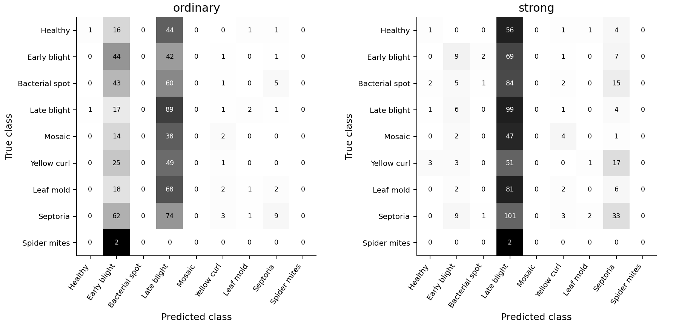
Field confusion matrices for seed 664
Seed 664 was fixed for illustration before field scoring.
9
Notes:
The illustrative seed 664 was specified before viewing new test metrics. Cell text is a count, shading is within-row proportion. Both models overpredict late blight; averaging this pattern across seeds does not remove class imbalance. The all-seed prediction counts are in results/fresh_views/predicted_class_counts.csv.
Sources:
PlantVillage: https://doi.org/10.3389/fpls.2016.01419; https://github.com/spMohanty/PlantVillage-Dataset
Cropped-PlantDoc: https://doi.org/10.1145/3371158.3371196; https://github.com/pratikkayal/PlantDoc-Dataset (CC BY 4.0)
MobileNetV3: https://arxiv.org/abs/1905.02244
New experiment: results/fresh_views/protocol.json, events.jsonl, per_seed_metrics.csv, summary.csv and training_audit.csv. Legacy results remain separately in results/.

Slide 10
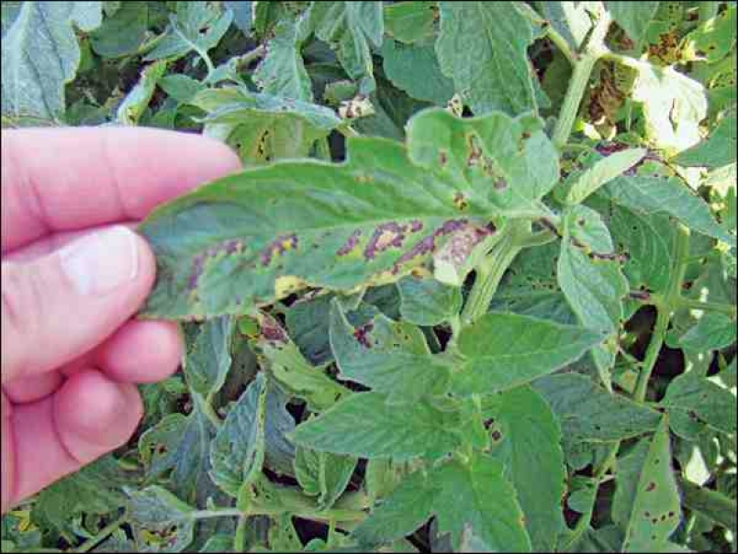
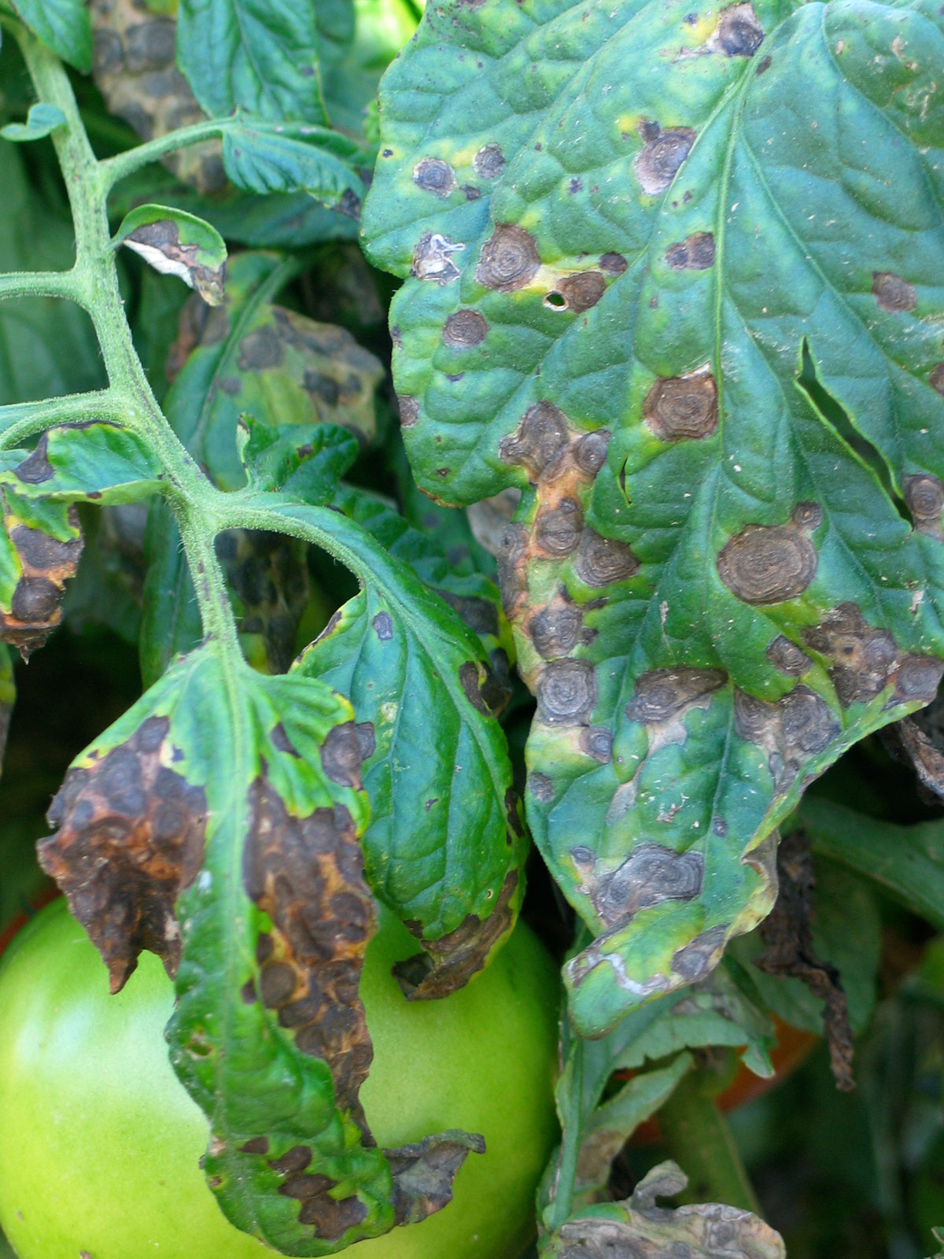
Fixed demonstration photographs
Label: Early blight
Ordinary: Late blight
Strong: Late blight
Label: Early blight
Ordinary: Early blight
Strong: Late blight
10
Notes:
Both labels are early blight. These two examples were fixed during legacy analysis before new training and were not reselected based on fresh-model performance. Predictions below are from the new seed-664 checkpoints. Exact source paths: examples/credits.csv, field.jpg and field_second.jpg.
Sources:
PlantVillage: https://doi.org/10.3389/fpls.2016.01419; https://github.com/spMohanty/PlantVillage-Dataset
Cropped-PlantDoc: https://doi.org/10.1145/3371158.3371196; https://github.com/pratikkayal/PlantDoc-Dataset (CC BY 4.0)
MobileNetV3: https://arxiv.org/abs/1905.02244
New experiment: results/fresh_views/protocol.json, events.jsonl, per_seed_metrics.csv, summary.csv and training_audit.csv. Legacy results remain separately in results/.

Slide 11
Conclusion and remaining limitations
Mean field accuracy and macro-F1 improve modestly;
the benefit varies across the three seeds.
Remaining limits: missing validation class and leaf IDs,
near-duplicates, only two spider-mite field images.
A stronger next study needs independent field labels
and a predefined target-development/test separation.
11
Notes:
Observed conclusion: Strong augmentation improved both field metrics on average, but the paired improvements were not consistent across all three seeds. The follow-up was designed after the legacy test results were inspected, so this is exploratory evidence on an already examined benchmark. Field labels never enter optimization or checkpoint selection. The old CPU single-seed comparison is not a pure ablation of fresh views because RNG and environment also changed.
Sources:
PlantVillage: https://doi.org/10.3389/fpls.2016.01419; https://github.com/spMohanty/PlantVillage-Dataset
Cropped-PlantDoc: https://doi.org/10.1145/3371158.3371196; https://github.com/pratikkayal/PlantDoc-Dataset (CC BY 4.0)
MobileNetV3: https://arxiv.org/abs/1905.02244
New experiment: results/fresh_views/protocol.json, events.jsonl, per_seed_metrics.csv, summary.csv and training_audit.csv. Legacy results remain separately in results/.

Slide 12
Notebook and reproducibility evidence
Open Tomato_Project.ipynb for code, figures and saved outputs.
New method: experiment_fresh.py
Aggregate and audit: summarize_fresh.py
Six checkpoints, complete training histories, all test probabilities
and the unchanged original experiment are included.
12
Notes:
The executed Notebook independently recomputes all seed results, class metrics and paired intervals, then loads real new checkpoints for example inference. Its default run does not repeat training. Fresh actual training evidence: protocol.json, events.jsonl, seed completion records, all_history.csv, checkpoint hashes in selection_locked.json and aggregate_verification.json. Original weights and predictions remain separate.
Sources:
PlantVillage: https://doi.org/10.3389/fpls.2016.01419; https://github.com/spMohanty/PlantVillage-Dataset
Cropped-PlantDoc: https://doi.org/10.1145/3371158.3371196; https://github.com/pratikkayal/PlantDoc-Dataset (CC BY 4.0)
MobileNetV3: https://arxiv.org/abs/1905.02244
New experiment: results/fresh_views/protocol.json, events.jsonl, per_seed_metrics.csv, summary.csv and training_audit.csv. Legacy results remain separately in results/.

