Slide 1
AVIATION PROJECT ANALYSIS
BRIAN KIMATHI M
machingabrian@gmail.com

Slide 2
Overview
This project evaluates aviation accident data to identify risk patterns
Focus: Help stakeholders decide which aircraft types are safest to invest in

Slide 3
Business Understanding
Problem: Company is expanding into aviation but lacks risk visibility
Goal: Identify low-risk aircraft types and risky flying conditions

Slide 4
Business Questions
1.Which aircraft types are most involved in fatal accidents?
2.Which flight phases pose higher risks?
3.How does weather and time affect accident severity?

Slide 5
Data Understanding
The data used is from the National Transportation Safety Board that includes aviation accident data from 1962 to 2023 about civil aviation accidents and selected incidents in the United States and international waters.

Slide 6
Data Analysis
The data as cleaned (i.e.; the columns were standardized , rows with null values(empty) were removed and duplicate values were removed)
The data analysis made use of python(pandas, seaborn, matplotlib)
Visualizations to represent the data

Slide 7
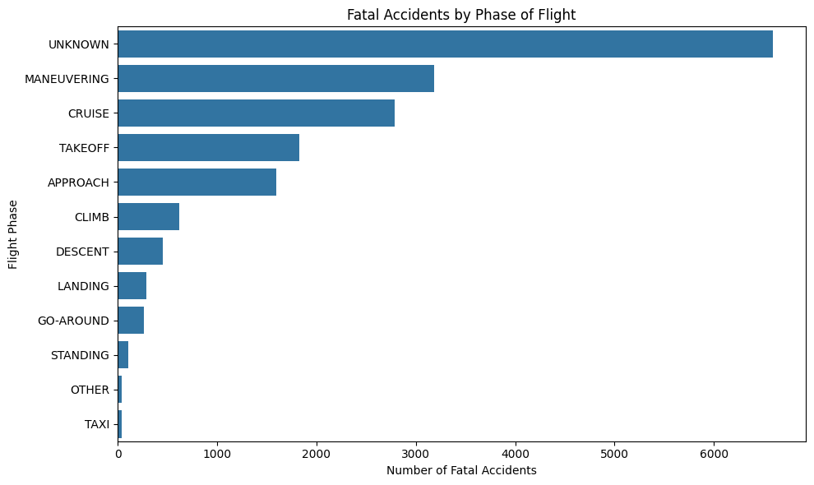
Fatal Accidents by Phase of Flight
Insights:
• UNKNOWN phase dominates — data quality issue
• MANEUVERING has the most known fatal accidents
• CRUISE and TAKEOFF also show high fatality rates

Slide 8
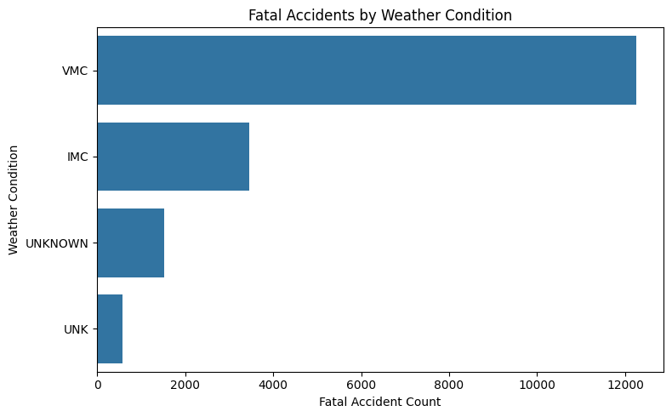
Fatal Accidents by Weather Condition
Insights:
• Most fatal accidents occur in VMC (clear weather)
• IMC also poses significant risk
• UNKNOWN weather data is still present

Slide 9
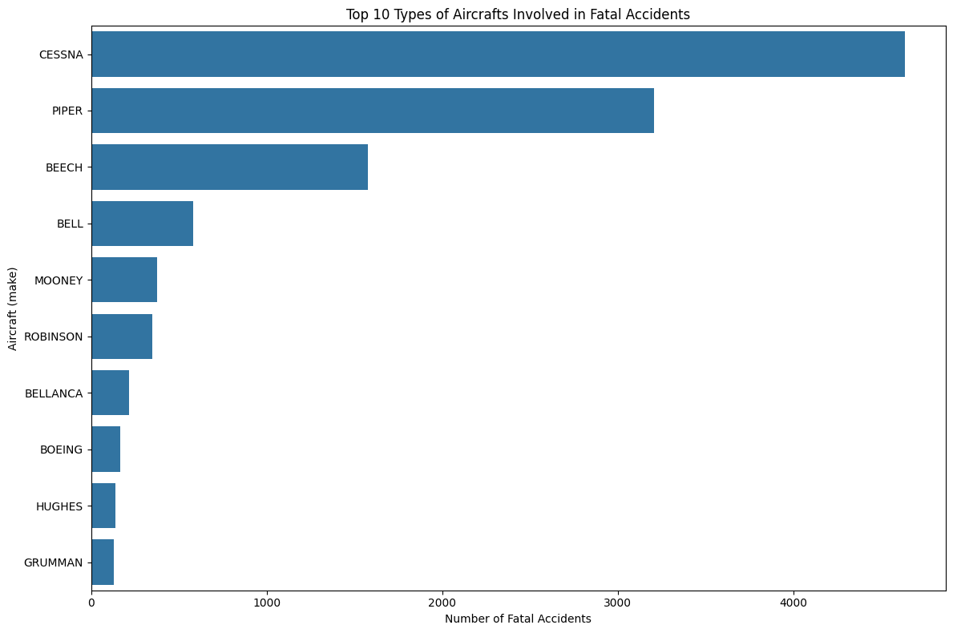
Top Aircraft Types in Fatal Accidents
Insights:
• CESSNA, PIPER, and BEECH dominate fatal accident counts
• These are common general aviation makes
• Commercial makes like BOEING appear less

Slide 10
Business Recommendations
Acquire new planes therefore avoiding high usage frequency planes prone to accidents
Pilot training programmes to be given more attention as it affects their decision-making skills in both good and bad conditions
Invest highly in safety measures of the new airline business as this has played a key role in reducing accidents occurrence over the years

Slide 11
THANK YOU!
Any question is welcomed..

