Slide 1
A Synaptogenesis Model with Chinese character set as input
Yixuan Qian

Slide 2
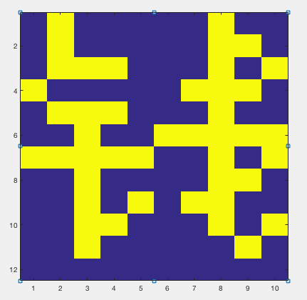
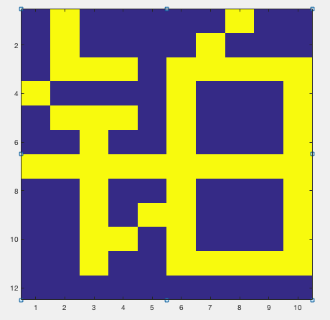
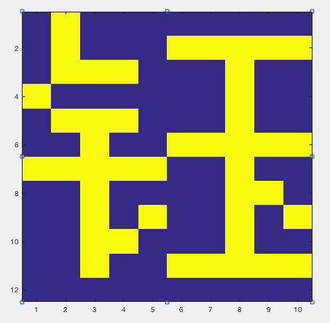
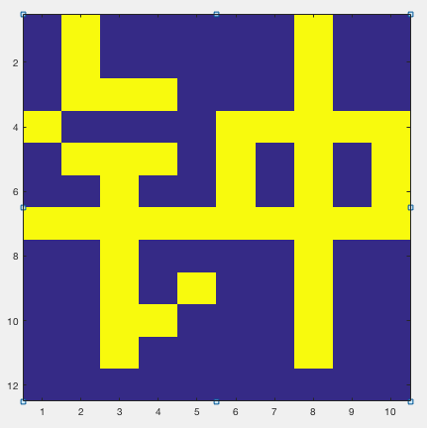
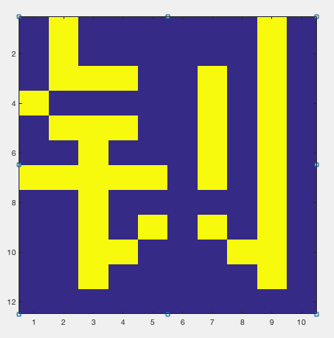
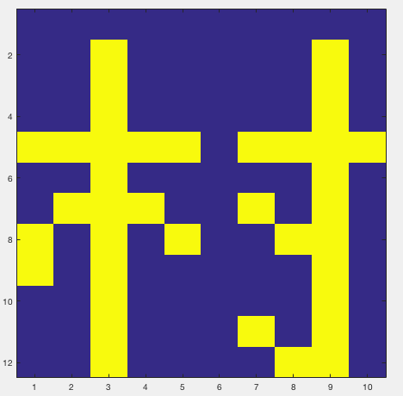
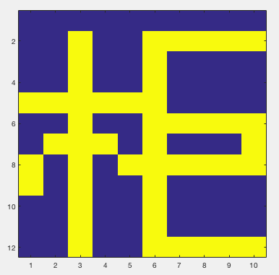
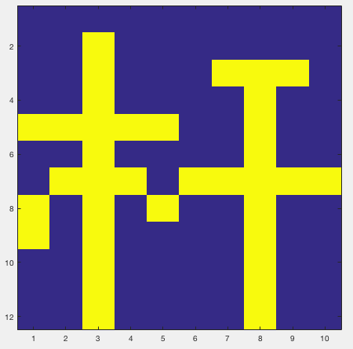
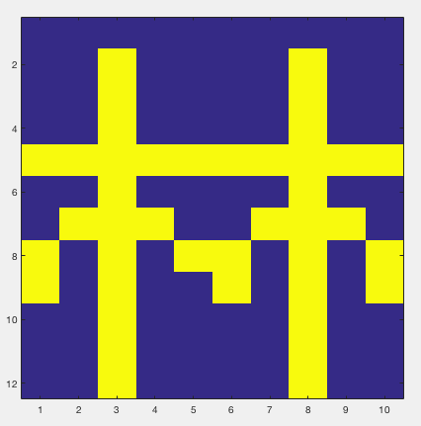
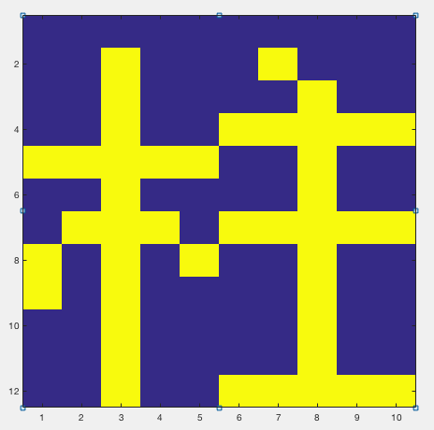
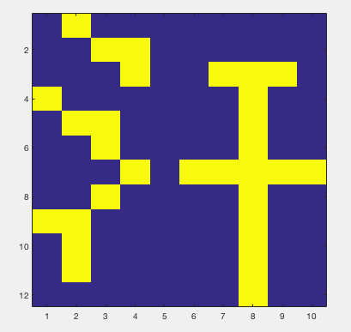
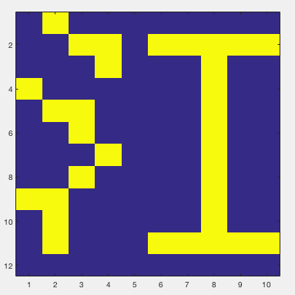
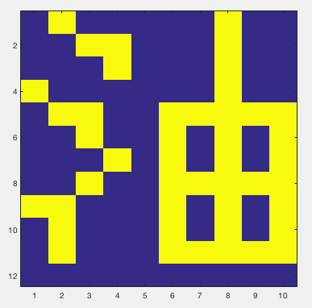
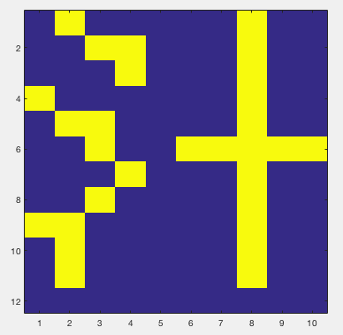
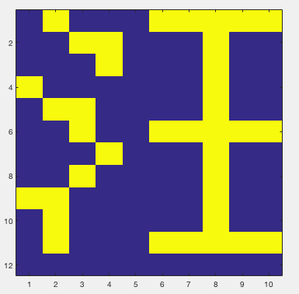

Slide 3
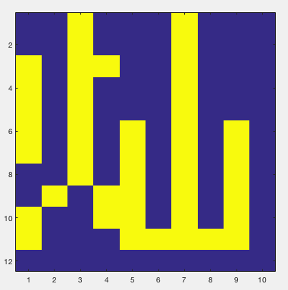
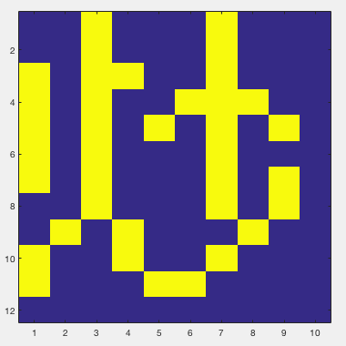
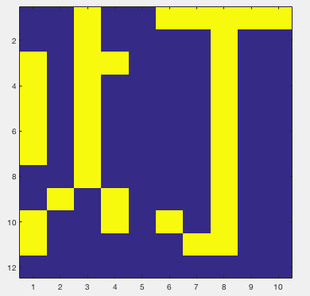
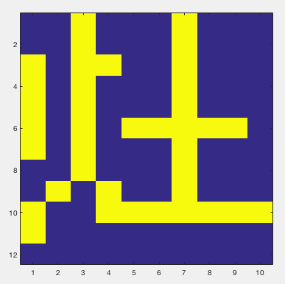
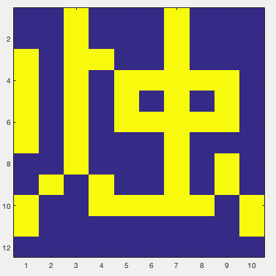
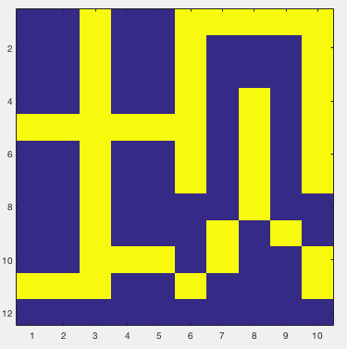
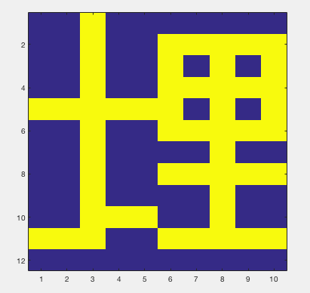
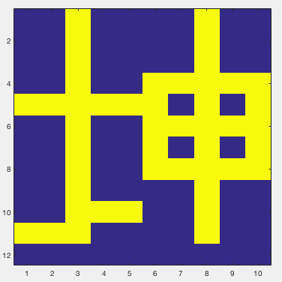
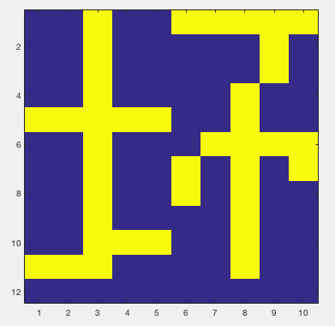
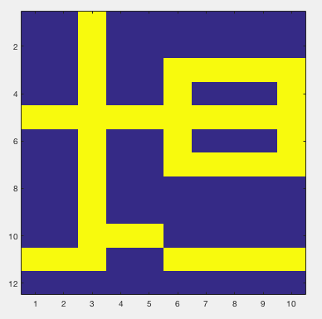

Slide 4
5 Chinese radicals: 钅 (gold) P = 0.1
木 (wood) P = 0.3
氵 (water) P = 0.2
火 (fire) P = 0.1
土 (earth) P = 0.3
Notes:
I created an input list of 200 characters, repeating the ones that I want the network to be exposed to multiple times.

Slide 5
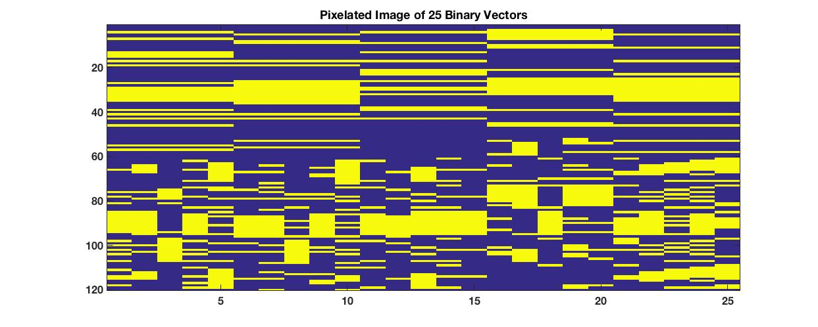

Slide 6
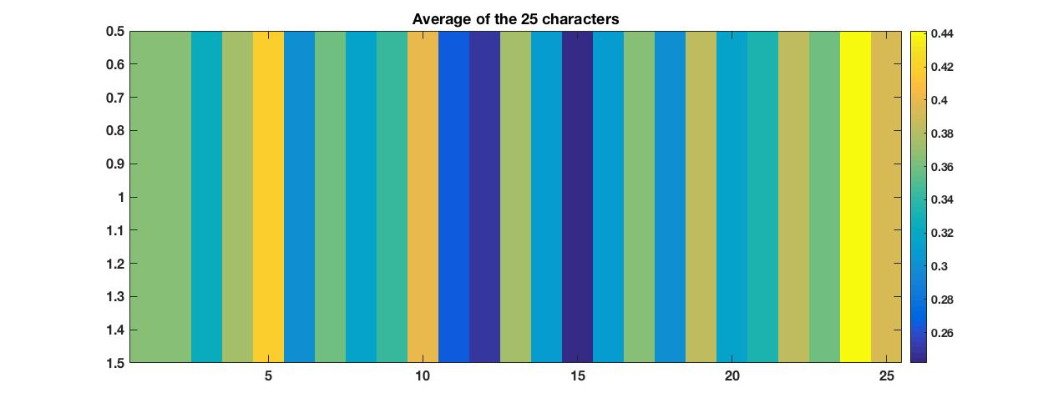
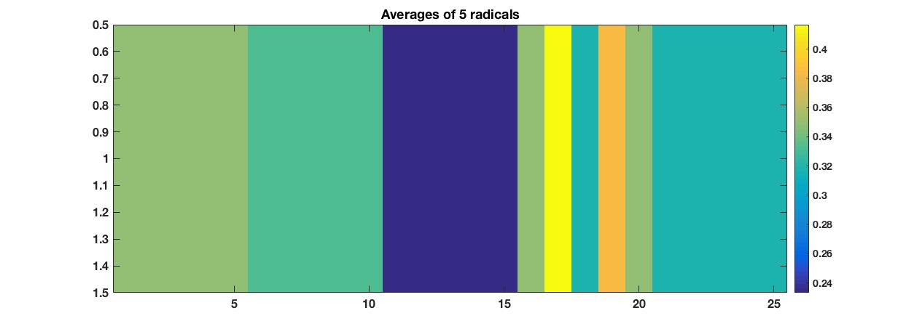

Slide 7
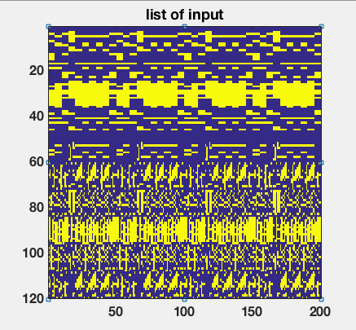

Slide 8
The entropy of the set of 25 characters:
H(S) = sum(-P(S) .* log2(P(S))) = 4.4929 bits
Assume the desired activity level is 0.1:
H(0.1) = 0.4690 bits per neuron
Thus the number of output neurons I need is:
4.4929/0.4690 = 10 neurons
The sum of the bit entropies of the input:
H(Y) = sum(-P(Y) .* log2(P(Y))-(1-P(Y)) .* log2(1-P(Y))) = 79.6663 bits

Slide 9
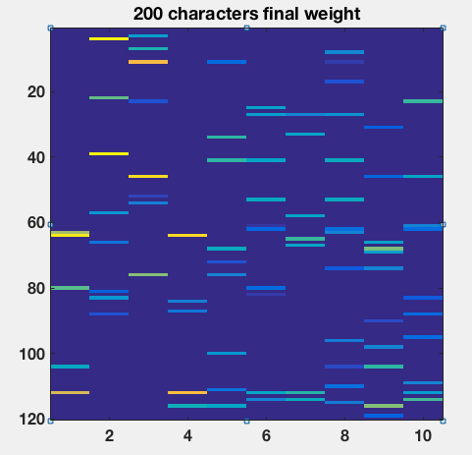

Slide 10
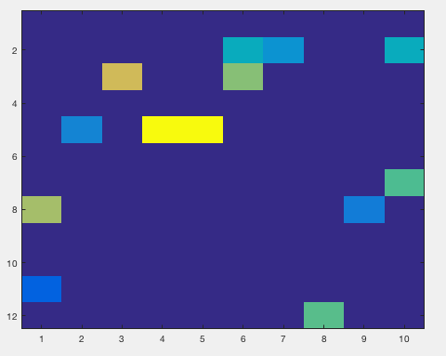

Slide 11
After running the model with the input set:
H(Z) = 3.2032
Unique output = 13
Statistical dependence of X:
SD(X) = sum(H(X)i) – H(X) = 38.8317
Statistical dependence of Z:
SD(Z) = sum(H(Z)i) – H(Z) = 1.6055

Slide 12
Thank You

