Slide 1
NLP Final Project:
A Spelling Checker with a LM
Adding a trigram language model to improve the previously implemented spelling checker
Matt Cotter

Slide 2
So what's the problem?
People often misspell words / typos happen.
People like good recommendations.
'rain' is a real word, but it doesn't mean 'ran'.

Slide 3
Method
Find corpora
Create a language model
Method for Tokenization
  This had to preserve formatting
Keyboard map for substitution costs
Make a spell checker
…
Profit.

Slide 4
Corpora
Training:
  Gutenber
    18 texts, 2M words
  Reuters
    1.3M words, 10k news documents, categorized
  Brown
    15 genres, 1.15M words, tagged, categorized
Testing:
  Holbrook

Slide 5
The actual Checking
Candidate selection
  Based off of first letter dictionary
  Everything in the trigrams
Scoring
  Cins, Cdel, Csub = 3, 3, 5.5 (see chart)
  str_dist - 575 * prob

Slide 6
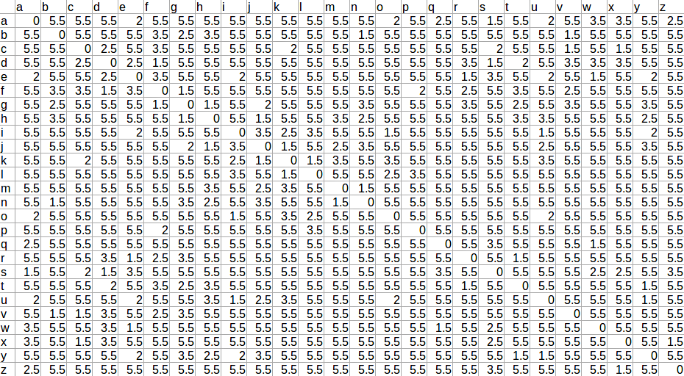
The chart...

Slide 7
Results (forthcoming)
Classifications | Correct Word in ten suggestions | Correct Word not in suggestions
Word was marked 'wrong' | Correction | Couldn't Fix
Word was not marked | Double Check | Unwanted Removal

Slide 8
Demonstration
“Thta man run quickly. I thjnk he was in a hurry.
Today is the day before finals. I am extremly afraid fo having to take mine. Computer Science will be espeically hard. I don't know how I will make ti through.”

Slide 9
Questions?

