Slide 1

Simple Grain Growth Cellular Automaton
Classes 1
Akademia Górniczo-Hutnicza im. Stanisława Staszica w Krakowie
AGH University of Science and Technology
17.01.2020
Maciej Skórski

Slide 2
The aim of the first classes was to create a simple grain growth model using cellular automaton algorithm with possible to visualize it within the gui.

Slide 3
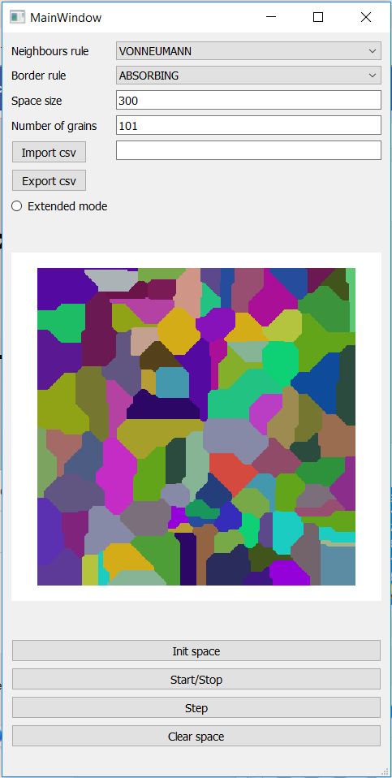
For this project, programming language that was used is Python with the Numpy and PyQt5 modules as main libraries used for array generation and gui creation.
On the attached picture there is an example simulation of grain growth, using VonNeumann neighborhood and absorbing boundary conditions.
Number of random grains that was used is 101. It means that we created a list of 101 colors and choose randomly 101 grains from the list.

Slide 4
The main encountered problem was the gui lock when simulation was running. To avoid this kind of issues, asynchronous function has been used to control the cellular automaton steps.
Python module used for it:
Multiprocessing module from which was took Pool Class

Slide 5
GitHub repository:
https://github.com/Maciej092/Cellular_Automaton

Slide 6
How to run it ?
Requirements:
Python 3.7.xxx
IDE – e.g. PyCharm community edition
Required dependencies:
In the python terminal type:
pip install pyqt5
pip install pyqtgraph
pip install numpy
pip install multiprocessing
pip install pandas
Then run the ca_gui.py file

