Slide 1

Substructures/Dual phase
Classes 4
Akademia Górniczo-Hutnicza im. Stanisława Staszica w Krakowie
AGH University of Science and Technology
17.01.2020
Maciej Skórski

Slide 2
The aim of the fourth classes was to consider grain curvature.
Major implementation changes:
- Rework the gui – change the view and functionalities
- Implement two additional functionalities: Substructure and Dual phase.
- Extend the code with another reserved grain ID

Slide 3
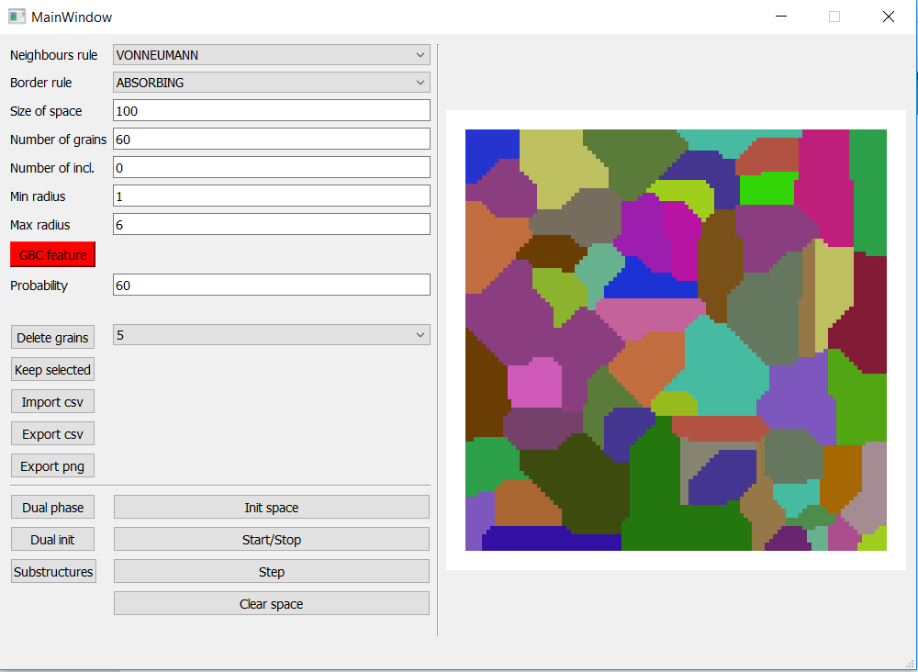
Dual phase.
First grain growth.

Slide 4
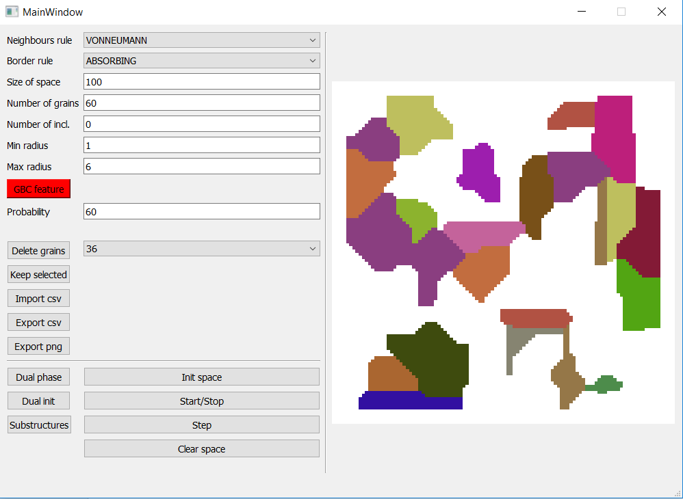
Delete of some grains.
User can delete grains
by choosing them from
list.

Slide 5
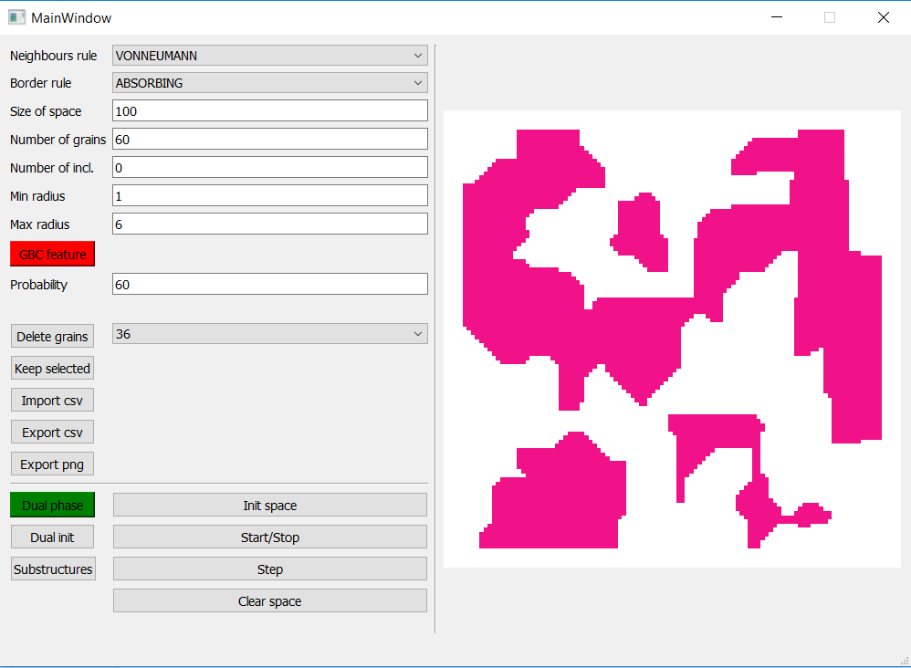
Marked remaining
structure as phase 1.

Slide 6
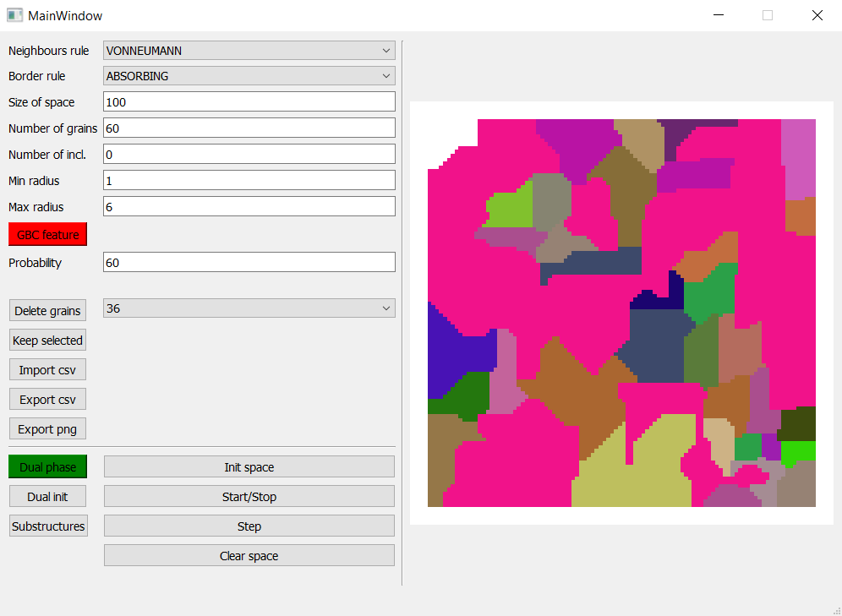
Second grain growth.

Slide 7
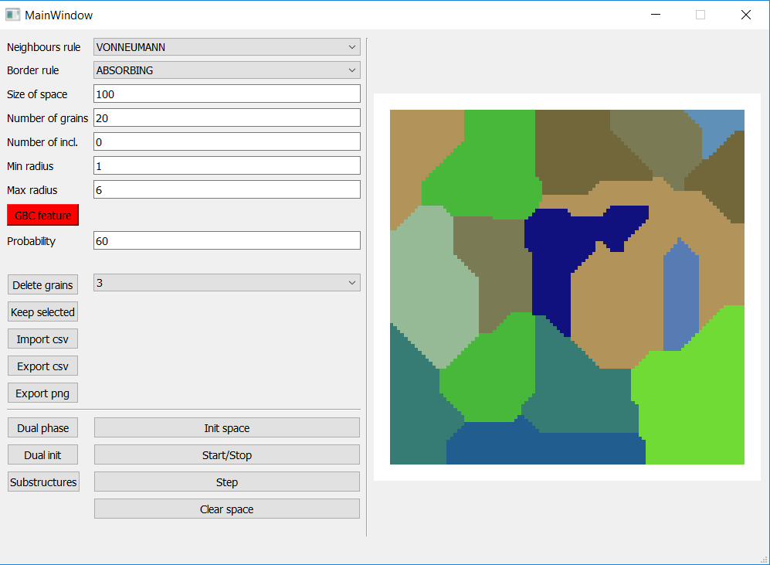
Substructures.
First grain growth.

Slide 8
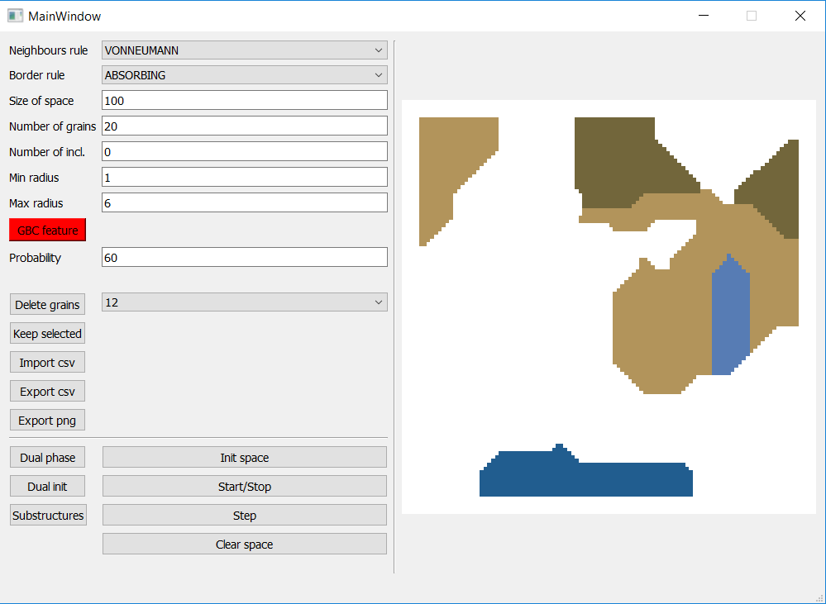
Delete some grains.
Marked remaining
structure as different
phase.

Slide 9
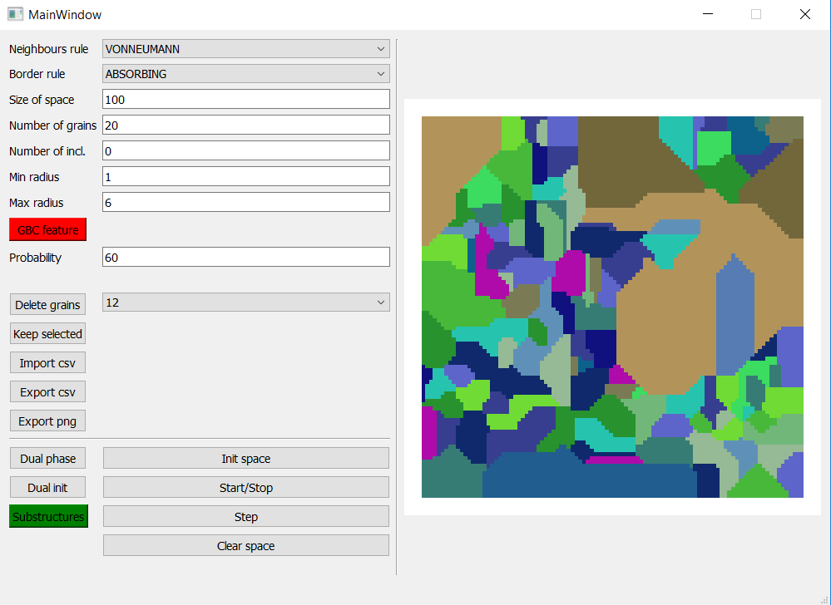
Second grain growth.
Different size of
grains.

Slide 10
GitHub repository:
https://github.com/Maciej092/Cellular_Automaton

Slide 11
How to run it ?
Requirements:
Python 3.7.xxx
IDE – e.g. PyCharm community edition
Required dependencies:
In the python terminal type:
pip install pyqt5
pip install pyqtgraph
pip install numpy
pip install multiprocessing
pip install pandas
Then run the ca_gui_v4.py file

