Slide 1

Boundaries detection
Classes 5
Akademia Górniczo-Hutnicza im. Stanisława Staszica w Krakowie
AGH University of Science and Technology
17.01.2020
Maciej Skórski

Slide 2
The aim of the fifth classes was to obtain the grains boundaries.
Major implementation changes:
- Implement a simple function which draws the boundaries of grains and calculate the average size of grain and borders length.

Slide 3
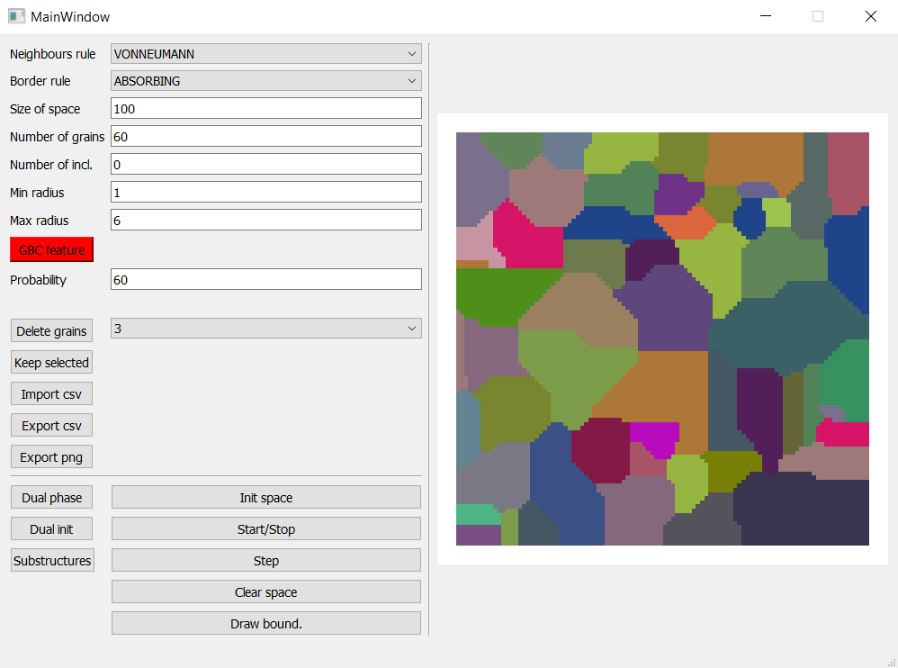
Grain growth.

Slide 4

Draw boundaries and
calculate the total
length of borders and
average size of grain
in [pixel] unit.

Slide 5
GitHub repository:
https://github.com/Maciej092/Cellular_Automaton

Slide 6
How to run it ?
Requirements:
Python 3.7.xxx
IDE – e.g. PyCharm community edition
Required dependencies:
In the python terminal type:
pip install pyqt5
pip install pyqtgraph
pip install numpy
pip install multiprocessing
pip install pandas
Then run the ca_gui_v5.py file

