Slide 1

Inclusions feature
Classes 2
Akademia Górniczo-Hutnicza im. Stanisława Staszica w Krakowie
AGH University of Science and Technology
17.01.2020
Maciej Skórski

Slide 2
The aim of the second classes was to extend an existing application with additional functionalities that is called inclusions feature.
Major implementation changes:
Rework the gui – change the view and functionalities
Create the model of grain which includes the phase of each grain
Add function for adding the randomly generated inclusions.

Slide 3
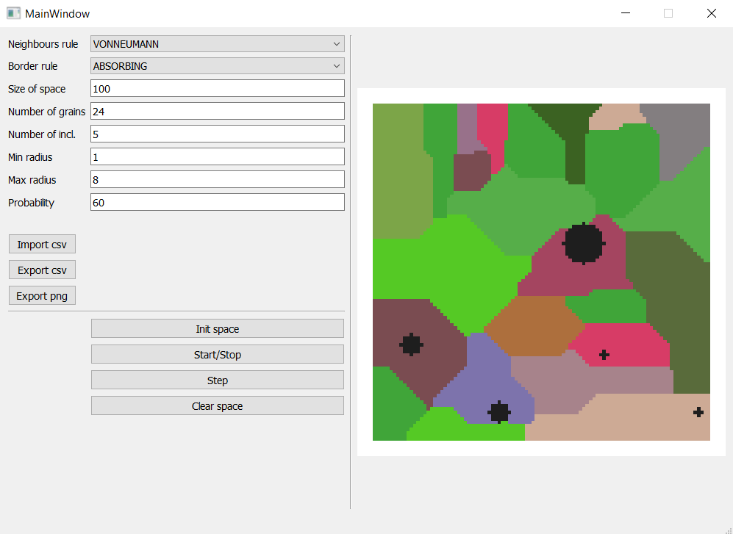
New user interface.
Now user can specify
the number of inclusions,
radius min/max.
Inclusions are the grains
with a different value of
the phase.
Inclusions are omitted
in grain growth process.

Slide 4
The most complex and hardest was to create a function for circle creation. For this reason in the project, numpy methods have been used. “numpy.ogrid” method was helpful in circle creation.
max_radius = np.random.randint(user_min_radius, user_max_radius + 1)
a, b = np.random.randint(n - max_radius), np.random.randint(n-max_radius)
y, x = np.ogrid[-a:n - a, -b:n - b]
mask = x * x + y * y <= max_radius * max_radius
self.space[mask] = 1

Slide 5
GitHub repository:
https://github.com/Maciej092/Cellular_Automaton

Slide 6
How to run it ?
Requirements:
Python 3.7.xxx
IDE – e.g. PyCharm community edition
Required dependencies:
In the python terminal type:
pip install pyqt5
pip install pyqtgraph
pip install numpy
pip install multiprocessing
pip install pandas
Then run the ca_gui_v2.py file

