Slide 1

Consideration of grain curvature
Classes 3
Akademia Górniczo-Hutnicza im. Stanisława Staszica w Krakowie
AGH University of Science and Technology
Data

Slide 2
The aim of the third classes was to consider grain curvature.
Major implementation changes:
- Rework the gui – change the view and functionalities
- Implement a distinct Cellular automaton algorithm for GBC feature, where 4 rules are being checked.

Slide 3
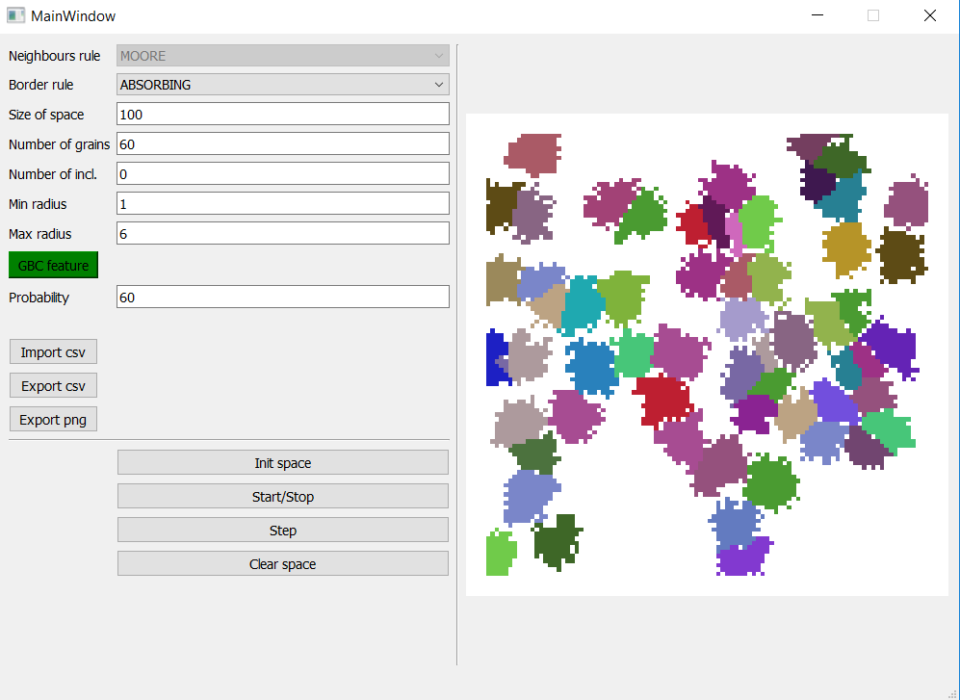
New user interface.
Now user can switch on
the GBC feature by
clicking the pushbutton.
Then grain growth
process will follow the
specific algorithm where
the grain curvature is
taken into account.

Slide 4
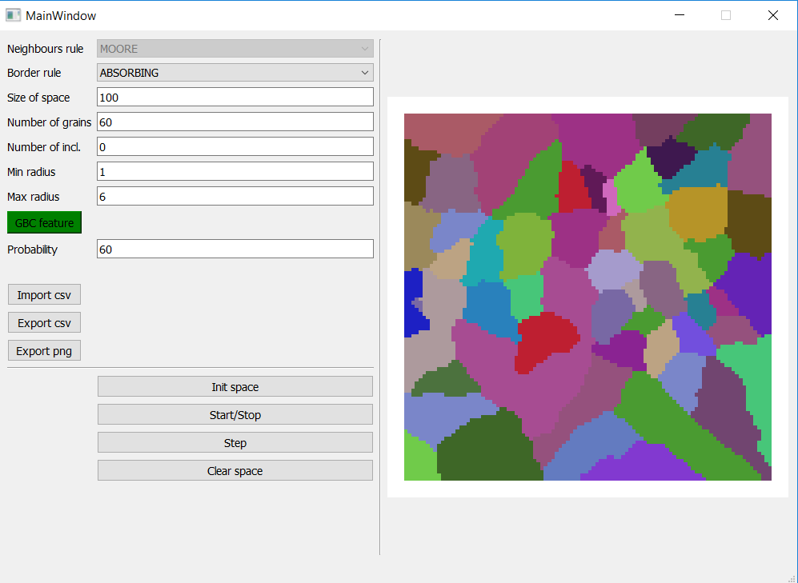
Final view of GBC flow.

Slide 5
GitHub repository:
https://github.com/Maciej092/Cellular_Automaton

Slide 6
How to run it ?
Requirements:
Python 3.7.xxx
IDE – e.g. PyCharm community edition
Required dependencies:
In the python terminal type:
pip install pyqt5
pip install pyqtgraph
pip install numpy
pip install multiprocessing
pip install pandas
Then run the ca_gui_v3.py file

