Slide 1
Interview
for
Statistical Analyst Position GGHS
Maciej J. Dańko
MPIDR January 2017

Slide 2
Selected major research projects of 2016 (chronologically)
Does quantity of nutrients mediates sex specific fitness costs in Callosobruchus maculatus? Małek, D.; Dańko, M. J.; Czarnołeski, M. In preparation
Identifying the Pattern of Human Mortality at Its Front End. Missov, T. I.; Németh, L.; Ribeiro, F; Dańko, M. J. Submitted* to Science
Density shapes patterns of survival and reproduction in hydromedusa Eleutheria dichotoma. Dańko, A.; Schaible, R.; Pijanowska, J.; Dańko M. J. Submitted* to Mechanisms of Aging and Development
Latitudinal and age-specific patterns of larval mortality in the damselfly Lestes sponsa: Senescence before maturity? Dańko, M.J.; Dańko, A.; Golab, M.J.; Stoks R.; Sniegula, S. Submitted to Experimental Gerontology
Life history traits are shaped by the interaction of extrinsic mortality and density-dependence. Dańko, M.J.; Burger, O.F.; Kozłowski, J. Submitted to PLOS Computational Biology
Age-related changes of physiological performance and survivorship of bank voles selected for high aerobic capacity. Rudolf, A.M.; Dańko, M.J.; Sadowska, E.T.; Dheyongera, G.; Koteja, P. Submitted to Experimental Gerontology
How much can we trust life tables? Sensitivity of mortality measures to right-censoring treatment. Missov, T. I.; Németh, L.; Dańko, M. J. Palgrave Communications, 2:15049
And more…..

Slide 3
Selected major research projects of 2016 (chronologically)
Statistical methods used
Does quantity of nutrients mediates sex specific fitness costs in Callosobruchus maculatus? (Frailty parametric proportional hazard models, frailty Cox proportional models, Mortality smoothing, …)
Identifying the Pattern of Human Mortality at Its Front End. (Fitting Gamma-Gompertz-Makeham model via ML, Parametric bootstrap, AIC/Hierarchical LRT models selection,…)
Density shapes patterns of survival and reproduction in hydromedusa Eleutheria dichotoma. (Poisson regression, Mortality Smoothing, Fitting Gamma-Gompertz Model via ML,…)
Latitudinal and age-specific patterns of larval mortality in the damselfly Lestes sponsa: Senescence before maturity? (Weighted logrank tests, Fitting family of Gompertz models, AIC/Hierarchical LRT model selection,…)
Life history traits are shaped by the interaction of extrinsic mortality and density-dependence. (Matrix projection models, optimal resource allocations models, Gompertz-Makeham, AFT/PH models,…)
Age-related changes of physiological performance and survivorship of bank voles selected for high aerobic capacity. (Weighted logrank tests, Mortality smoothing, Mixture effects models,…)
How much can we trust life tables? Sensitivity of mortality measures to right-censoring treatment. (Fitting Gamma-Gompertz-Makeham model by ML, Parametric bootstrap, Simulation of censoring, LT meaures,…)
Other projects: Lifetables analysis of large databases, PCLM used to approximate LT measures, bootstrap to calculate confidence intervals of LT measurs, weighted linear models, …

Slide 4
Selected major research projects of 2016 (chronologically)
Statistical methods used
Does quantity of nutrients mediates sex specific fitness costs in Callosobruchus maculatus? (Frailty parametric proportional hazard models, frailty Cox proportional models, Mortality smoothing, …)
Identifying the Pattern of Human Mortality at Its Front End. (Fitting Gamma-Gompertz-Makeham model via ML, Parametric bootstrap, AIC/Hierarchical LRT models selection,…)
Density shapes patterns of survival and reproduction in hydromedusa Eleutheria dichotoma. (Poisson regression, Mortality Smoothing, Fitting Gamma-Gompertz Model via ML,…)
Latitudinal and age-specific patterns of larval mortality in the damselfly Lestes sponsa: Senescence before maturity? (Weighted logrank tests, Fitting family of Gompertz models, AIC/Hierarchical LRT model selection,…)
Life history traits are shaped by the interaction of extrinsic mortality and density-dependence. (Matrix projection models, optimal resource allocations models, Gompertz-Makeham, AFT/PH models,…)
Age-related changes of physiological performance and survivorship of bank voles selected for high aerobic capacity. (Weighted logrank tests, Mortality smoothing, Mixture effects models,…)
How much can we trust life tables? Sensitivity of mortality measures to right-censoring treatment. (Fitting Gamma-Gompertz-Makeham model by ML, Parametric bootstrap, Simulation of censoring, LT meaures,…)
Other projects: Lifetables analysis of large databases, PCLM used to approximate LT measures, bootstrap to calculate confidence intervals of LT measurs, weighted linear models, …

Slide 5
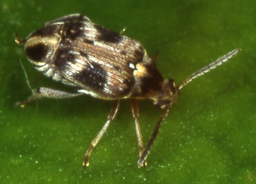
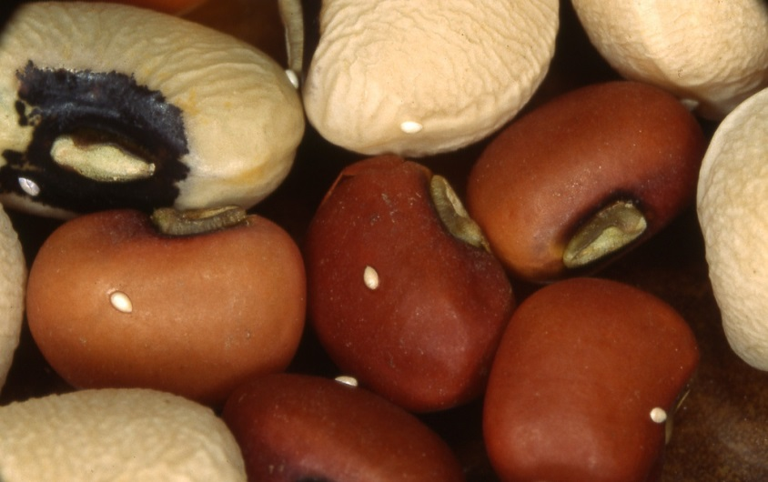
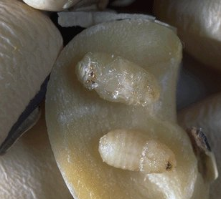
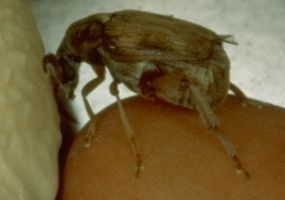
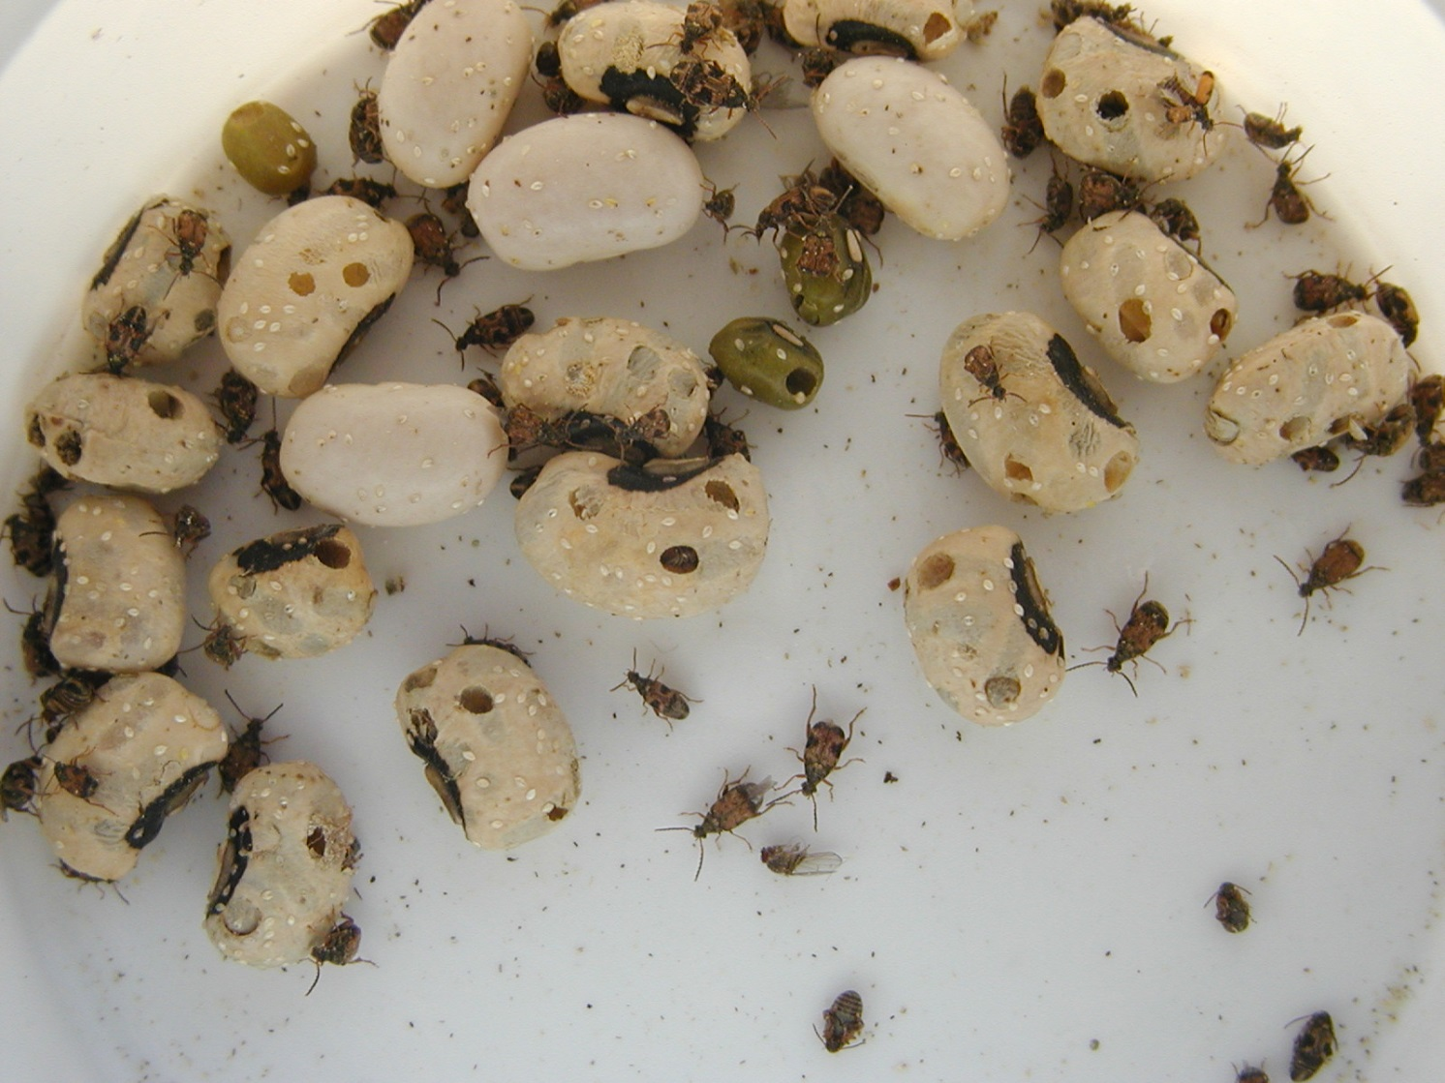
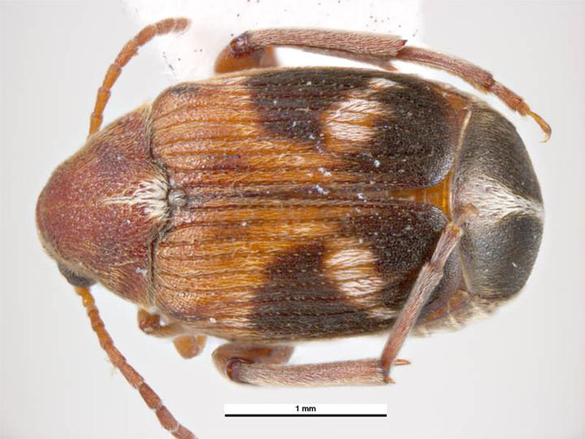
Does quantity of nutrients mediates sex specific fitness costs in Callosobruchus maculatus?
D. Małek, M.J. Dańko, M. Czarnołęski

Slide 6
Larva and pupa stages occur
inside the bean
Laying eggs on beans
Does quantity of nutrients mediates sex specific fitness costs in Callosobruchus maculatus?
D. Małek, M.J. Dańko, M. Czarnołęski

Slide 7
Costs of reproduction
Two sexes may pay different costs because of different reproductive biology.

Slide 8
Costs of reproduction
Two sexes may pay different costs because of different reproductive biology.
Reproductive costs in both sexes can also influence one another, for example by a phenomenon known as nuptial gifts.

Slide 9
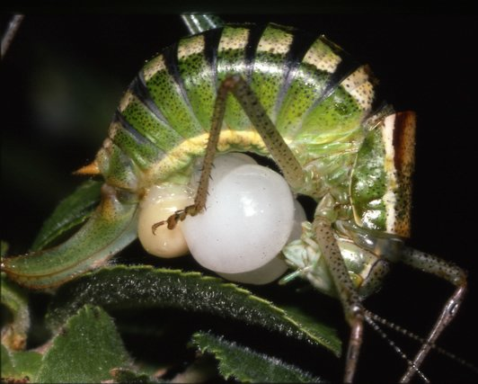
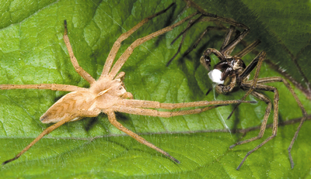
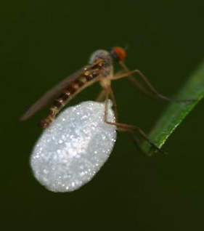
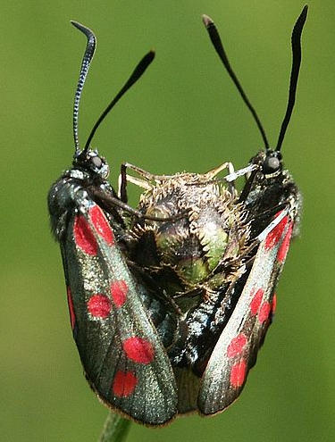
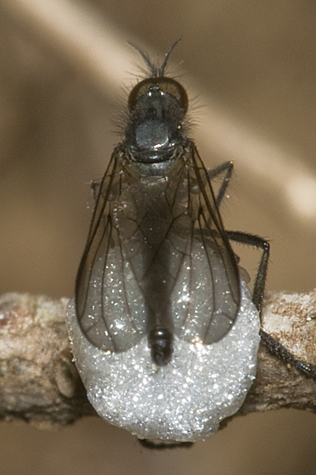
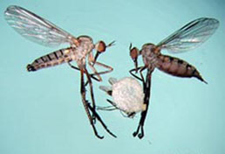
Costs of reproduction
Two sexes may pay different costs because of different reproductive biology.
Reproductive costs in both sexes can also influence one another, for example by a phenomenon known as nuptial gifts.
Nuptial gifts in other animals

Slide 10
Costs of reproduction
Two sexes may pay different costs because of different reproductive biology.
Reproductive costs in both sexes can also influence one another, for example by a phenomenon known as nuptial gifts.
An endogenous gift should be especially costly to a donor because adult individuals of Callosobruchus maculatus in laboratory conditions do not ingest food or water, resulting in a very limited energy budget.
Nuptial gifts in other animals

Slide 11
Goals of the project (relevant to survival analysis)
Treatment: reproduction allowed, control: reproduction not allowed.
Two sexes
Covariates: bean size, adult size and gift size (reproducing animals)
Random effects: mother id

Slide 12
Goals of the project (relevant to survival analysis)
Treatment: reproduction allowed, control: reproduction not allowed.
Two sexes
Covariates: bean size, adult size and gift size (reproducing animals)
Random effects: mother id
1) Investigate the effect of sex, bean size, presence of reproduction, and adult size on survival.
2) Investigate the role of nuptial gifts in reproducing males and females for their survival

Slide 13
Frailty models
(Random effects models in survival analysis)
Frailty term was coined by James Vaupel (Vupel et al. 1979) and describes hidden differences in the survival chances of individuals in a population.

Slide 14
Frailty models
(Random effects models in survival analysis)
Frailty term was coined by James Vaupel (Vupel et al. 1979) and describes hidden differences in the survival chances of individuals in a population.
Frailty models:
Individual frailty models (each individual has its own frailty)
Shared frailty models are random effects model (a group of individuals share the same hidden frailty)

Slide 15
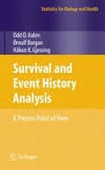
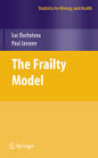

Frailty models
(Random effects models in survival analysis)
Frailty term was coined by James Vaupel (Vupel et al. 1979) and describes hidden differences in the survival chances of individuals in a population.
Frailty models:
Individual frailty models (each individual has its own frailty)
Shared frailty models are random effects model (a group of individuals share the same hidden frailty)
Shared frailty models:
Covered in books, but research is still ongoing
Only partially covered in statistical packages

Slide 16
Proportional hazard shared frailty models
Conditional hazard of subject i
that belongs to the group g
Vector of regression coefficients applied to a vector of observed covariates for subject i in group g
Frailty term in group g.
Realization of a random variable with certain pdf
(e.g. gamma distribution)
Baseline hazard
(e.g. Weibull)

Slide 17
Proportional hazard shared frailty models
Conditional hazard of subject i
that belongs to the group g
Vector of regression coefficients applied to a vector of observed covariates for subject i in group g
Frailty term in group g.
Realization of a random variable with certain pdf
(e.g. gamma distribution)
Baseline hazard
(e.g. Weibull)
The estimation procedure is based on expectation-maximization (EM) algorithm,
which is a sequence of:
Expectation ➔ Prediction of u given the estimates of parameters of theoretical frailty distribution, baseline hazard, and regression coefficients.
Maximization ➔ Use predicted u to find all parameter estimates by maximization marginal log-likelihood function.
The sequence is repeated until the convergence

Slide 18
Testing proportional hazard assumption
(categorical variables)
rms package
MortalitySmooth package

Slide 19
Testing proportional hazard assumption
(categorical variables)
rms package
MortalitySmooth package
Clearly visible interaction between sex and treatment!

Slide 20
Testing proportional hazard assumption
(continuous variables)
It is hard to perform similar non-parametric analysis on continuous variables
We will use a semi-parametric approach based on Cox proportional hazard frailty model.
Model: Surv ~ Sex + Treatment + Bean size + Adullt body mass + Sex : Treatment

Slide 21
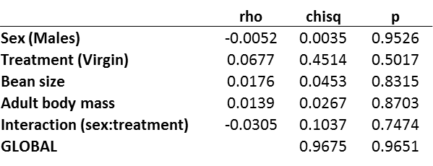
Testing proportional hazard assumption
(continuous variables)
It is hard to perform similar non-parametric analysis on continuous variables
We will use a semi-parametric approach based on Cox proportional hazard frailty model.
Model: Surv ~ Sex + Treatment + Bean size + Adullt body mass + Sex : Treatment
survival package*
* P. Grambsch and T. Therneau (1994), Proportional hazards tests and diagnostics based on weighted residuals. Biometrika, 81, 515-26.

Slide 22
Testing proportional hazard assumption
(continuous variables)
Schoenfeld residuals
It is hard to perform similar non-parametric analysis on continuous variables
We will use a semi-parametric approach based on Cox proportional hazard frailty model.
Model: Surv ~ Sex + Treatment + Bean size + Adullt body mass + Sex : Treatment
survival package*
No clear departures from linearity
* P. Grambsch and T. Therneau (1994), Proportional hazards tests and diagnostics based on weighted residuals. Biometrika, 81, 515-26.

Slide 23
Testing proportional hazard assumption
(continuous variables)
Schoenfeld residuals
It is hard to perform similar non-parametric analysis on continuous variables
We will use a semi-parametric approach based on Cox proportional hazard frailty model.
Model: Surv ~ Sex + Treatment + Bean size + Adullt body mass + Sex : Treatment
survival package*
Conclusion: PH assumptions holds (at least for Cox model).
No clear departures from linearity
* P. Grambsch and T. Therneau (1994), Proportional hazards tests and diagnostics based on weighted residuals. Biometrika, 81, 515-26.

Slide 24
First guess about baseline hazard
The plots of log(-log (survivorship)) can help to guess about the baseline
Log(-log(Survivorship)) = log cumulative hazard

Slide 25
First guess about baseline hazard
The plots of log(-log (survivorship)) can help to guess about the baseline
Log(-log(Survivorship)) = log cumulative hazard
Linear relationship between log cumulative hazard and survival time suggests exponential distribution (constant hazard)
Linear relationship between log cumulative hazard and log survival time suggests Weibull distribution (Weibull hazard)

Slide 26
First guess about baseline hazard
The plots of log(-log (survivorship)) can help to guess about the baseline
Log(-log(Survivorship)) = log cumulative hazard
Linear relationship between log cumulative hazard and survival time suggests exponential distribution (constant hazard)
Linear relationship between log cumulative hazard and log survival time suggests Weibull distribution (Weibull hazard)
Curves seems to be linear in early ages

Slide 27
Selection of baseline hazard and frailty distribution
We can use GoF tests, however heterogeneity can affects observed mortality patterns.
A mixture of different Weibull distributions is not necessarily a Weibull distribution
Tests are not decisive, but only informative

Slide 28
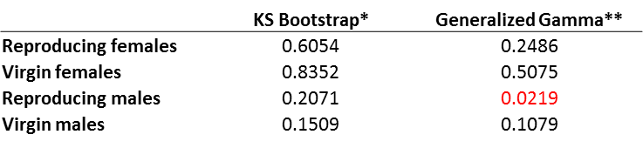
Selection of baseline hazard and frailty distribution
p-val
We can use GoF tests, however heterogeneity can affects observed mortality patterns.
A mixture of different Weibull distributions is not necessarily a Weibull distribution
Tests are not decisive, but only informative
Parametric bootstrap of null hypothesis of Kolmogorov-Smirnoff statistics
** EwGOF package
* Jogesh Babu, G., and C. R. Rao. Goodness-of-fit tests when parameters are estimated. Sankhya: The Indian Journal of Statistics 66 (2004): 63-74.
** Krit M., Gaudoin O., Xie M. and Remy E., Simplified likelihood goodness-of-fit tests for the Weibull distribution, Communications in Statistics - Simulation and Computation.

Slide 29
Selection of baseline hazard and frailty distribution
p-val
We can use GoF tests, however heterogeneity can affects observed mortality patterns.
A mixture of different Weibull distributions is not necessarily a Weibull distribution
Tests are not decisive, but only informative
Parametric bootstrap of null hypothesis of Kolmogorov-Smirnoff statistics
** EwGOF package
* Jogesh Babu, G., and C. R. Rao. Goodness-of-fit tests when parameters are estimated. Sankhya: The Indian Journal of Statistics 66 (2004): 63-74.
** Krit M., Gaudoin O., Xie M. and Remy E., Simplified likelihood goodness-of-fit tests for the Weibull distribution, Communications in Statistics - Simulation and Computation.

Slide 30
Selection of baseline hazard and frailty distribution
p-val
We can use GoF tests, however heterogeneity can affects observed mortality patterns.
A mixture of different Weibull distributions is not necessarily a Weibull distribution
Tests are not decisive, but only informative
Parametric bootstrap of null hypothesis of Kolmogorov-Smirnoff statistics
** EwGOF package
fitdistrplus package
* Jogesh Babu, G., and C. R. Rao. Goodness-of-fit tests when parameters are estimated. Sankhya: The Indian Journal of Statistics 66 (2004): 63-74.
** Krit M., Gaudoin O., Xie M. and Remy E., Simplified likelihood goodness-of-fit tests for the Weibull distribution, Communications in Statistics - Simulation and Computation.
FIG. Empirical vs. Theoretical Weibull distribution for virgin females.

Slide 31
Selection of baseline hazard and frailty distribution
p-val
We can use GoF tests, however heterogeneity can affects observed mortality patterns.
A mixture of different Weibull distributions is not necessarily a Weibull distribution
Tests are not decisive, but only informative
Parametric bootstrap of null hypothesis of Kolmogorov-Smirnoff statistics
** EwGOF package
fitdistrplus package
* Jogesh Babu, G., and C. R. Rao. Goodness-of-fit tests when parameters are estimated. Sankhya: The Indian Journal of Statistics 66 (2004): 63-74.
** Krit M., Gaudoin O., Xie M. and Remy E., Simplified likelihood goodness-of-fit tests for the Weibull distribution, Communications in Statistics - Simulation and Computation.
FIG. Empirical vs. Theoretical Weibull distribution for reproducing males.

Slide 32
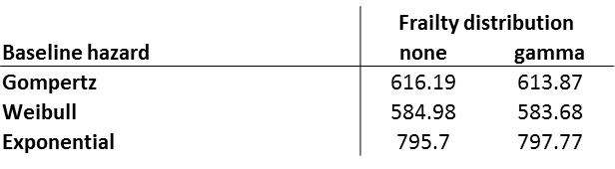
Selection of baseline hazard and frailty distribution
p-val
We can use GoF tests, however heterogeneity can affects observed mortality patterns.
A mixture of different Weibull distributions is not necessarily a Weibull distribution
Tests are not decisive, but only informative
Parametric bootstrap of null hypothesis of Kolmogorov-Smirnoff statistics
** EwGOF package
fitdistrplus package
* Jogesh Babu, G., and C. R. Rao. Goodness-of-fit tests when parameters are estimated. Sankhya: The Indian Journal of Statistics 66 (2004): 63-74.
** Krit M., Gaudoin O., Xie M. and Remy E., Simplified likelihood goodness-of-fit tests for the Weibull distribution, Communications in Statistics - Simulation and Computation.
Model selection based on AIC
Model: Surv ~ Sex + Treatment + Bean size + Adult body mass + Sex : Treatment
FIG. Empirical vs. Theoretical Weibull distribution for reproducing males.

Slide 33
Selection of baseline hazard and frailty distribution
p-val
We can use GoF tests, however heterogeneity can affects observed mortality patterns.
A mixture of different Weibull distributions is not necessarily a Weibull distribution
Tests are not decisive, but only informative
Parametric bootstrap of null hypothesis of Kolmogorov-Smirnoff statistics
** EwGOF package
fitdistrplus package
* Jogesh Babu, G., and C. R. Rao. Goodness-of-fit tests when parameters are estimated. Sankhya: The Indian Journal of Statistics 66 (2004): 63-74.
** Krit M., Gaudoin O., Xie M. and Remy E., Simplified likelihood goodness-of-fit tests for the Weibull distribution, Communications in Statistics - Simulation and Computation.
Model selection based on AIC
Model: Surv ~ Sex + Treatment + Bean size + Adult body mass + Sex : Treatment
FIG. Empirical vs. Theoretical Weibull distribution for reproducing males.

Slide 34
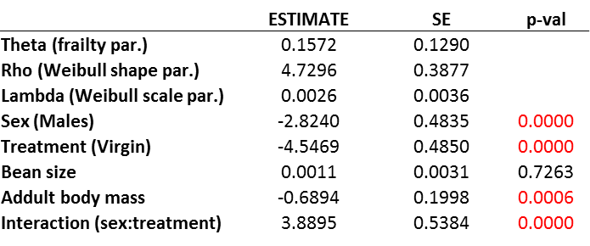
Basic model and model selection
Improved maximization part of EM algorithm of parfm package
Basic model with included Sex:Treatment interaction.
The p-values are calculated from Wald test.

Slide 35
Basic model and model selection
Improved maximization part of EM algorithm of parfm package
Basic model with included Sex:Treatment interaction.
The p-values are calculated from Wald test.
We will perform model selection by sequentially adding single 2-way or 3-way interaction and performing Likelihood ratio test.
The estimates of the basic model will be used as starting values for optimization method of more complicated models.

Slide 36
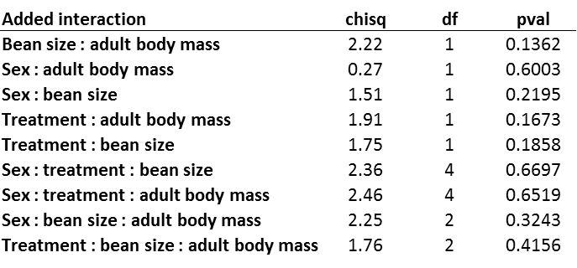
Basic model and model selection
Improved maximization part of EM algorithm of parfm package
LRT added to parfm package
*
*
* ”Negative variance” problem
Basic model with included Sex:Treatment interaction.
The p-values are calculated from Wald test.
We will perform model selection by sequentially adding single 2-way or 3-way interaction and performing Likelihood ratio test.
The estimates of the basic model will be used as starting values for optimization method of more complicated models.
The model cannot be further improved by ”sequential” LRT

Slide 37
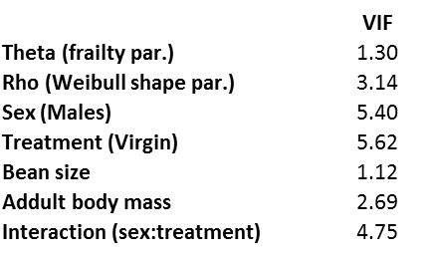
Basic model and model selection
Improved maximization part of EM algorithm of parfm package
LRT added to parfm package
*
* ”Negative variance” problem
Basic model with included Sex:Treatment interaction.
The p-values are calculated from Wald test.
We will perform model selection by sequentially adding single 2-way or 3-way interaction and performing Likelihood ratio test.
The estimates of the basic model will be used as starting values for optimization method of more complicated models.
Variance inflation factors (VIF) measure how much the variance of the estimated regression coefficients are inflated as compared to when the predictor variables are not linearly related.
The model cannot be further improved by ”sequential” LRT
vif() of rms package adopted to work with parfm package
Testing collinearity by Variance Inflation Factor (VIF)
Rule of thumb: VIF<10

Slide 38
Predictions of the model – marginal hazard
My new extension to parfm package
Estimated hazard of subject i
Estimated survivorship of subject i

Slide 39
Predictions of the model – marginal hazard
My new extension to parfm package
Estimated hazard of subject i
Estimated survivorship of subject i
Marginal hazard for each sex and treatment calculated with respect to individual differences in frailty, adult body mass, and bean size

Slide 40
Predictions of the model – marginal hazard
My new extension to parfm package
Estimated hazard of subject i
Estimated survivorship of subject i
Marginal hazard as a function of adult body mass calculated with respect to individual differences in frailty, sex, treatment, and bean size

Slide 41
Analyzing model fit by Martingale residuals
Frailty of subject i
My new extension to parfm package
Follow-up (event) time of subject i
Estimated coefficients applied to observed covariate for subject i
Event indicator (0=censoring, 1=death)
Estimated cumulative
baseline hazard

Slide 42
Analyzing model fit by Martingale residuals
Frailty of subject i
My new extension to parfm package
Follow-up (event) time of subject i
Estimated coefficients applied to observed covariate for subject i
Event indicator (0=censoring, 1=death)
Estimated cumulative
baseline hazard
Adult body mass
Bean size

Slide 43
Modeling the effect of nuptial gift size
Only reproducing animals are relevant
Model will include new set of independent variables:
Sex
Gift size
Bean size
Adult body mass
Basic model: Surv ~ Sex + Gift size + Bean size + Adult body mass

Slide 44
Modeling the effect of nuptial gift size
Only reproducing animals are relevant
Model will include new set of independent variables:
Sex
Gift size
Bean size
Adult body mass
It is hard to guess about interactions as we cannot easily plot them.
We cannot include all → Building too complicated models can:
Greatly increase VIF
Can lead to lack of convergence in EM algorithm
Make computations extremely long
From the same reasons: exhaustive model selection (e.g. AIC) would be ineffective.
Basic model: Surv ~ Sex + Gift size + Bean size + Adult body mass

Slide 45
Gift size Model selection via Hierarchical Likelihood Ratio Test (hLRT)
My new extension to parfm package
Model without interaction, but all main effects are present
Basic model: Surv ~ Sex + Gift size + Bean size + Adullt body mass
#1 Sequential LRT test of each of single interaction terms
Non-significant terms (like bean size or adult mass) could be dropped from the model do decrease VIF (some VIFs slightly exceeded 10, not shown).

Slide 46
Gift size Model selection via Hierarchical Likelihood Ratio Test (hLRT)
My new extension to parfm package
Model without interaction, but all main effects are present
Basic model: Surv ~ Sex + Gift size + Bean size + Adullt body mass
#1 Sequential LRT test of each of single interaction terms
New model = Basic model + Sex : gift size
#2 Selection of significant interactionthat that has the highest log likelihood, then proceed as in #1
Non-significant terms (like bean size or adult mass) could be dropped from the model do decrease VIF (some VIFs slightly exceeded 10, not shown).

Slide 47
Gift size Model selection via Hierarchical Likelihood Ratio Test (hLRT)
My new extension to parfm package
Model without interaction, but all main effects are present
Basic model: Surv ~ Sex + Gift size + Bean size + Adullt body mass
#1 Sequential LRT test of each of single interaction terms
New model = Basic model + Sex : gift size
#2 Selection of significant interactionthat that has the highest log likelihood, then proceed as in #1
Non-significant terms (like bean size or adult mass) could be dropped from the model do decrease VIF (some VIFs slightly exceeded 10, not shown).

Slide 48
Gift size Model selection via Hierarchical Likelihood Ratio Test (hLRT)
My new extension to parfm package
Model without interaction, but all main effects are present
Basic model: Surv ~ Sex + Gift size + Bean size + Adullt body mass
#1 Sequential LRT test of each of single interaction terms
New model = Basic model + Sex : gift size
#2 Selection of significant interactionthat that has the highest log likelihood, then proceed as in #1
No further improvement is possible.
Non-significant terms (like bean size or adult mass) could be dropped from the model do decrease VIF (some VIFs slightly exceeded 10, not shown).

Slide 49
Gift size Model selection via Hierarchical Likelihood Ratio Test (hLRT)
My new extension to parfm package
Model without interaction, but all main effects are present
Basic model: Surv ~ Sex + Gift size + Bean size + Adullt body mass
#1 Sequential LRT test of each of single interaction terms
New model = Basic model + Sex : gift size
#2 Selection of significant interactionthat that has the highest log likelihood, then proceed as in #1
No further improvement is possible.
Non-significant terms (like bean size or adult mass) could be dropped from the model do decrease VIF (some VIFs slightly exceeded 10, not shown).

Slide 50
Gift size Model selection via Hierarchical Likelihood Ratio Test (hLRT)
My new extension to parfm package
Model without interaction, but all main effects are present
Basic model: Surv ~ Sex + Gift size + Bean size + Adullt body mass
#1 Sequential LRT test of each of single interaction terms
New model = Basic model + Sex : gift size
#2 Selection of significant interactionthat that has the highest log likelihood, then proceed as in #1
No further improvement is possible.
Non-significant terms (like bean size or adult mass) could be dropped from the model (LRT) to decrease VIF (some VIFs slightly exceeded 10, not shown).

Slide 51
Effect of gift size on marginal hazard rate in males and females
My new extension to parfm package

Slide 52
Effect of gift size on marginal hazard rate in males and females
My new extension to parfm package

Slide 53
Effect of gift size on marginal hazard rate in males and females
My new extension to parfm package

Slide 54
Effect of gift size on marginal hazard rate in males and females
My new extension to parfm package

Slide 55
Summary
The survival costs of reproduction are more pronounced for females than for males:
non-reproducing females live longer than non-reproducing males
Reproducing females live shorter than reproducing males
Nuptial gifts increases substantially survival of the females at the costs of decreased survival of males.
Bigger body mass is related to better survival in both males and females
Size of the bean doesn't seem to influence survival of an adult

Slide 56

Summary
The survival costs of reproduction are more pronounced for females than for males:
non-reproducing females live longer than non-reproducing males
Reproducing females live shorter than reproducing males
Nuptial gifts increases substantially survival of the females at the costs of decreased survival of males.
Bigger body mass is related to better survival in both males and females
Size of the bean doesn't seem to influence survival of an adult

Slide 58
Is frailty term significant?
#1 Chisq=3.31, pval=0.0689
#2 Chisq=2.14, pval=0.1435

