Slide 1


Assessing the Level of Undercounting in the International Migration Flows Reported by Eurostat Maciej J. Dańko, Arkadiusz Wiśniowski, Emanuele del Fava and Emilio Zagheni
8/06/2022
Session 36

Slide 2
The importance of data and metadata assessment
Common data problems
Variable data quality and lack of comparability across time and space.
Migration definitions, data collection system, and methodology vary from country to country and change over time.
under/over-counting of migration flows, coverage and accuracy problems.
Common metadata problems
Incomplete or missing documentation about data collection, estimations, reliability, data manipulation, etc.
Incomplete or missing history of changes in metadata.
A systematic assessment of metadata can help improve migration statistics and inform statistical models.
In this paper, we present a most comprehensive analysis of undercounting in bilateral migration flows provided by Eurostat and national statistical offices.

Slide 3
Definition of undercounting
Undercounting: a serious issue of data quality that leads to bias in migration estimates.
Sources:
Individuals failing to register when entering a country or to de-register when leaving (administrative data).
Non-response of individuals who experienced migration (surveys).
Differences in legal requirements between and within countries for reporting of migrating individuals or by the existing difficulties in enforcing such requirements.
Notes:
One of the serious issue related to quality of data on international migration flows is undercounting that leads to a bias in the migration estimates.
It is commonly believed that undercounting is mainly associated with, but not limited to, emigration flows.

Slide 4
Sources of information on undercounting
1) Metadata associated with official and other migration statistics.
Very limited metadata specific to undercounting such as: presence of data manipulations and administrative corrections, obligation of registration/de-registration, time-limits, sanctions, etc. (Mooyaart, Dańko, et al. 2021).
Incomplete or missing history of changes in metadata.
2) Expert opinions used in (previous) migration models
e
May be arbitrary.
May be based on a small number of experts, who may not know all the details of migration data shared by different countries (Wiśniowski et al. 2013; Willekens 2019).
May no longer be relevant (e.g. IMEM 2002-2008, Raymer et al. 2013)
Data may be updated retrospectively after censuses or definitions may change (e.g. Reg (EC) 862/2007).

Slide 5
A novel approach to measure undercounting
Novel data-oriented approach:
Data:
Bilateral flows: flows with known country of next residence (emigration) and previous residence (immigration).
Provided by national statistical offices (NSOs) to Eurostat or solely by NSOs (e.g., DE, UK).

Slide 6
A novel approach to measure undercounting
Outline of the method:
Construction of an undercounting score that uses the bilateral migration data to compare flows in the same direction reported by different countries.
Score includes an adjustment of flows for differences in duration-of-stay criterion.
The combination of (i) model scores with (ii) metadata and (iii) expert opinion can be used to classify undercounting by country and by year.
Shiny app UndercountMigScores (Dańko 2022) offers multiple options and tools for calculating the undercounting scores and their classification. https://github.com/MaciejDanko/UndercountMigScores

Slide 7
Bilateral migration flows ratio model
Measuring undercounting using migration flows ratio:
Σ_{c} M(X→Y_{c}, X) × R(X)
c ∈ {Nordic countries, Netherlands, Belgium, and Switzerland}
U =
Σ_{c} M(X→Y_{c}, Y_{c}) × R(Y_{c})
M(X→Y_{c}, X): Migration from country X to good data quality country Y_{c} reported by country X
M(X→Y_{c}, Y_{c}): Migration from country X to good data quality country Y_{c} reported by country Y_{c}
R(X): Correction for duration of stay different than 12 months in country X
R(Y_{c}): Correction for duration of stay different than 12 months in country Y_{c}

Slide 8
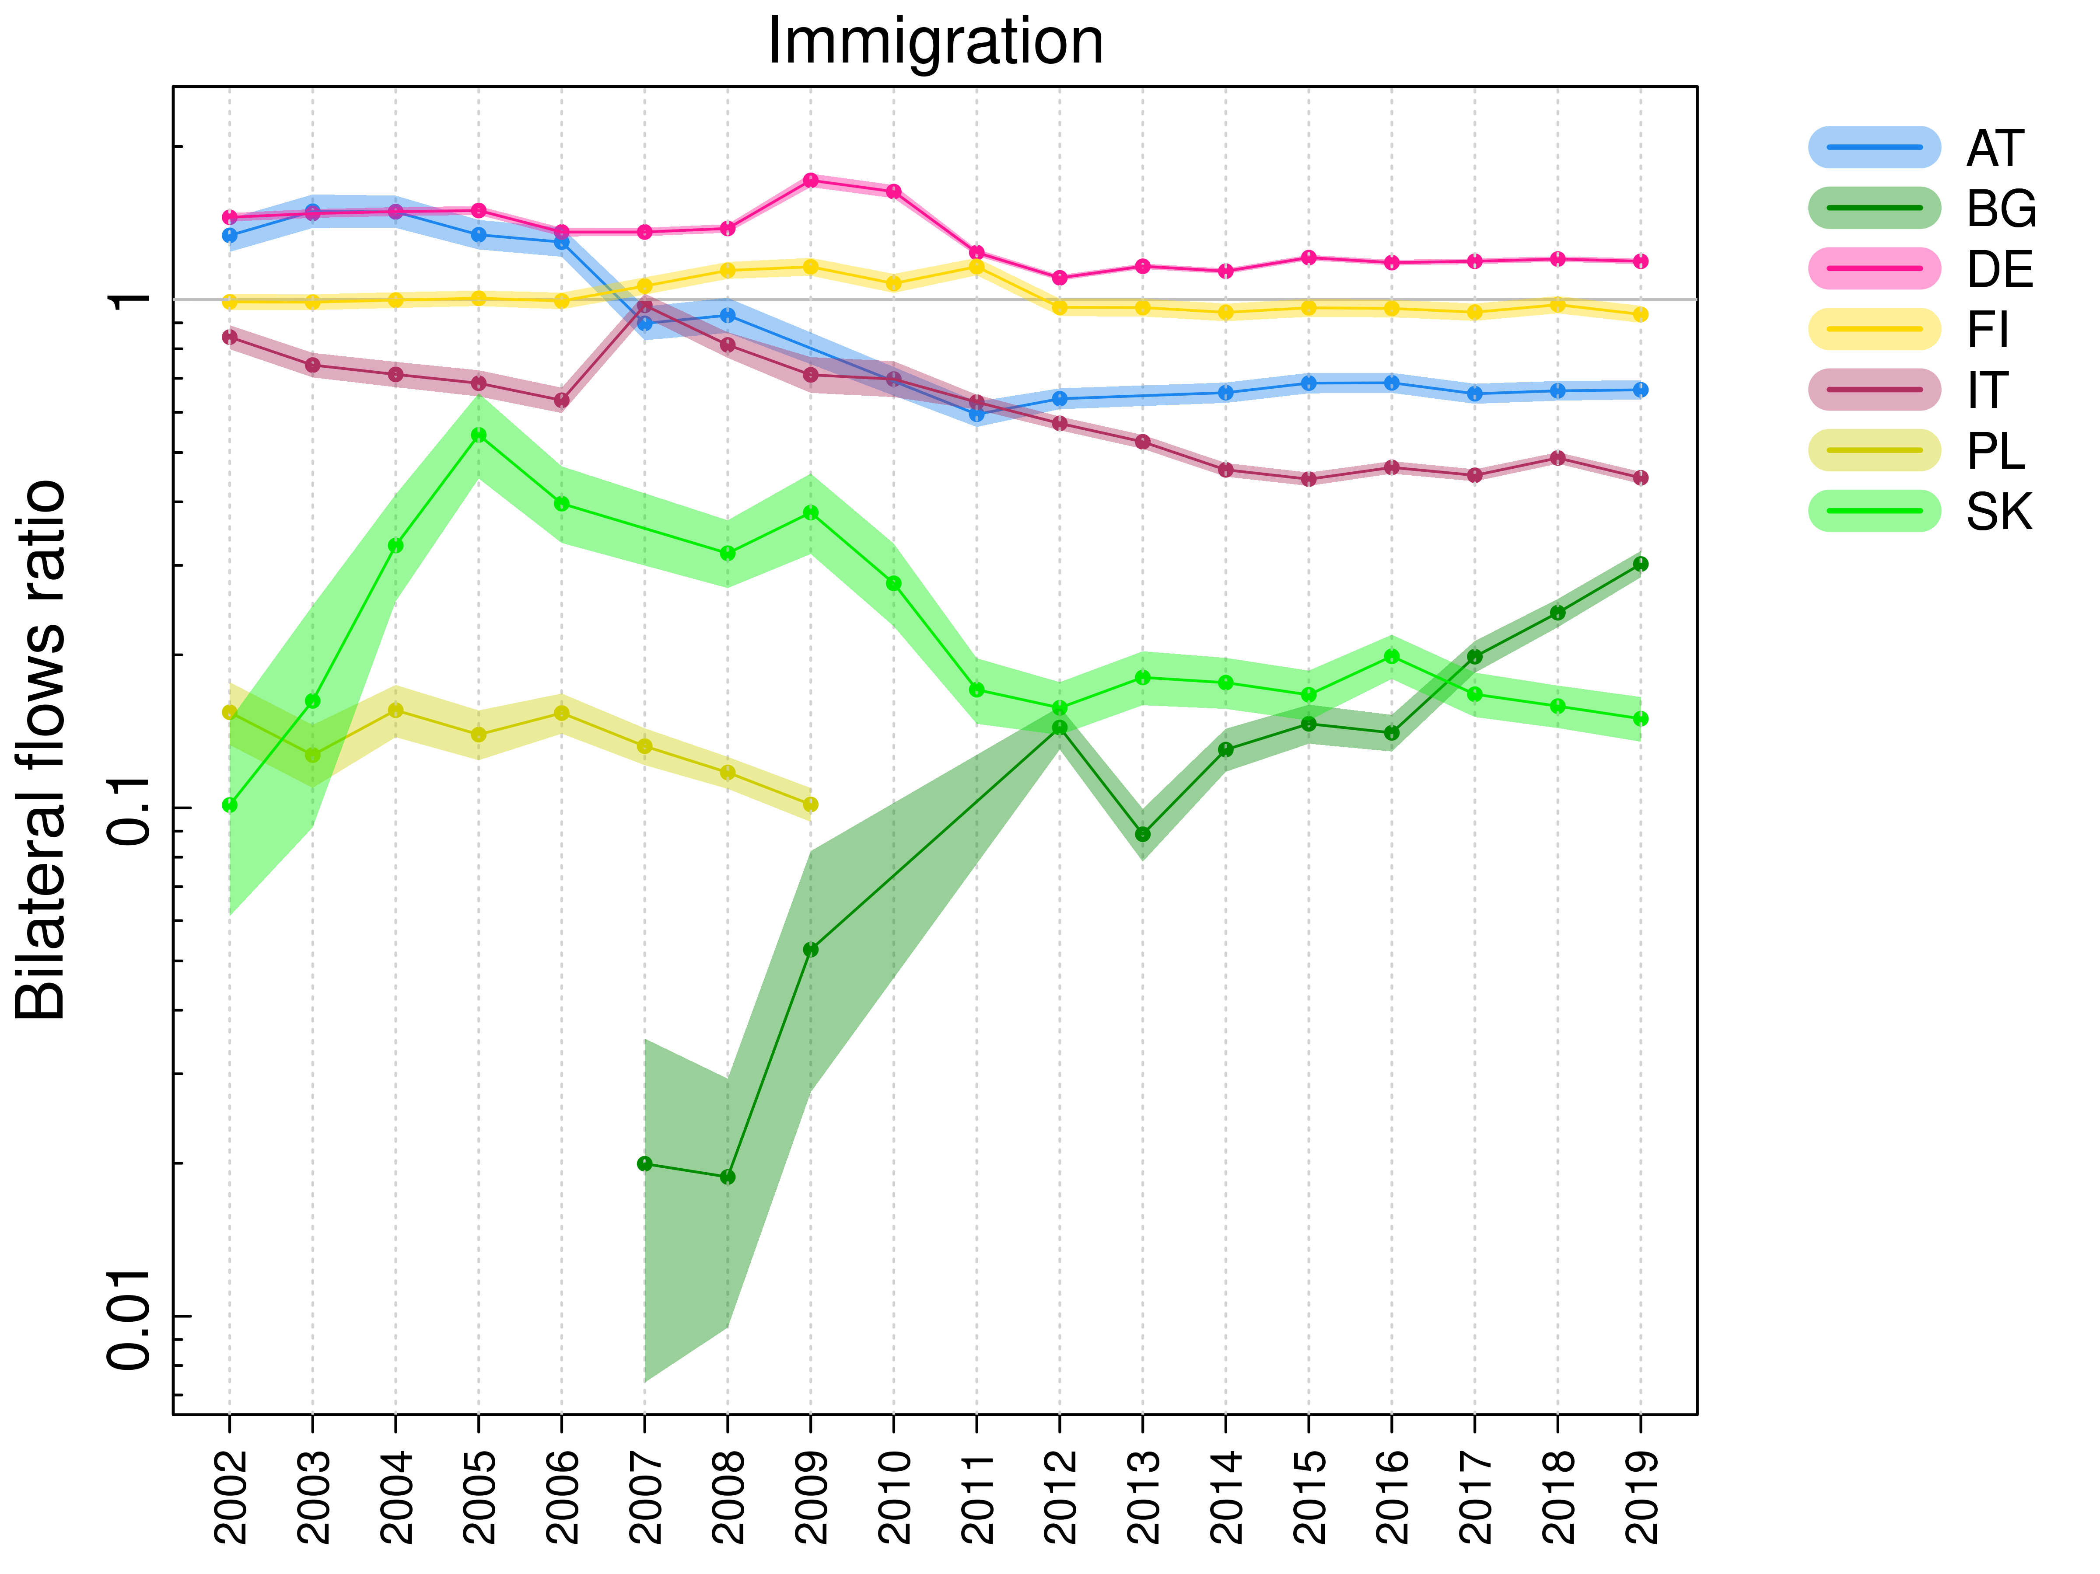
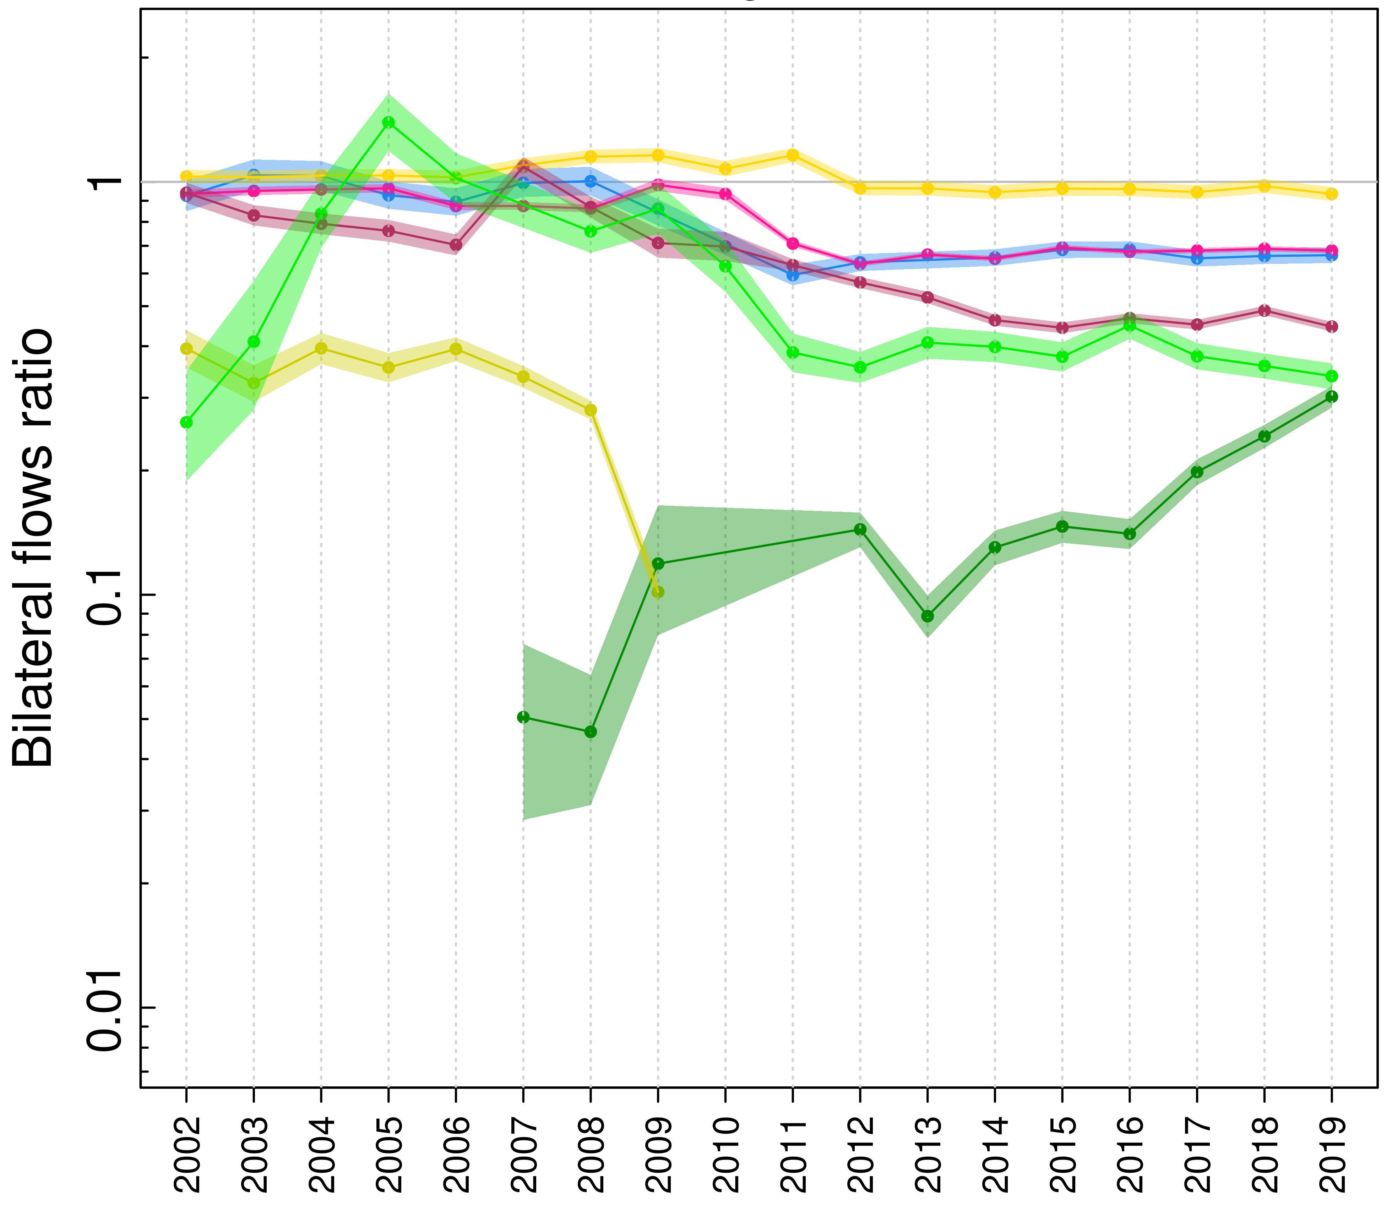
Bilateral migration flows ratio model
Examples of results obtained using UndercountMigScores app for immigration data
No correction for differences in duration of stay
Duration of stay adjusted flows
Notes:
Undercounting and overcounting results at least partly from the differences in the duration of stay criteria.
AT has a 3-month duration until 2006, while DE has a ”zero” duration in case of emigration ===> overcounting
BG, PL and SK use the permanent duration of stay as a definition of a migrant (PL until 2008, BG until 2009, SK for the whole range of years) ===> huge undercounting
Effect: reduction of overcounting and undercounting in these countries.
The introduction of the correction slightly reduces the undercounting for IT (12 months), as some of the reference countries have a duration of stay other than 12 months.

Slide 9
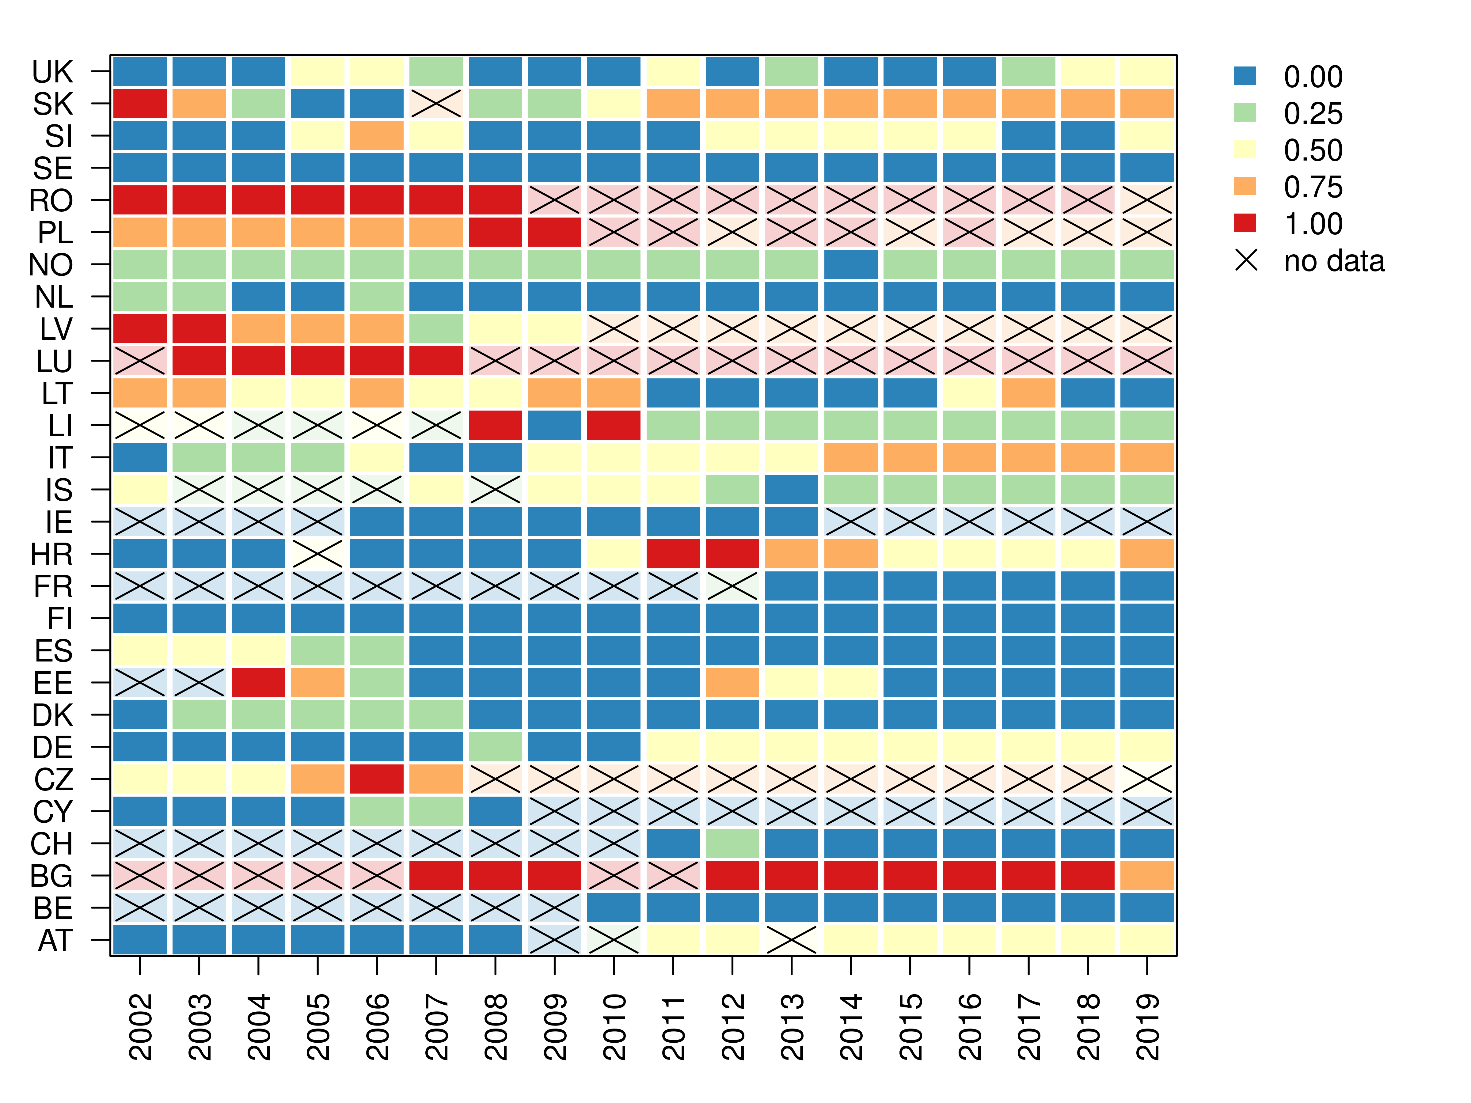
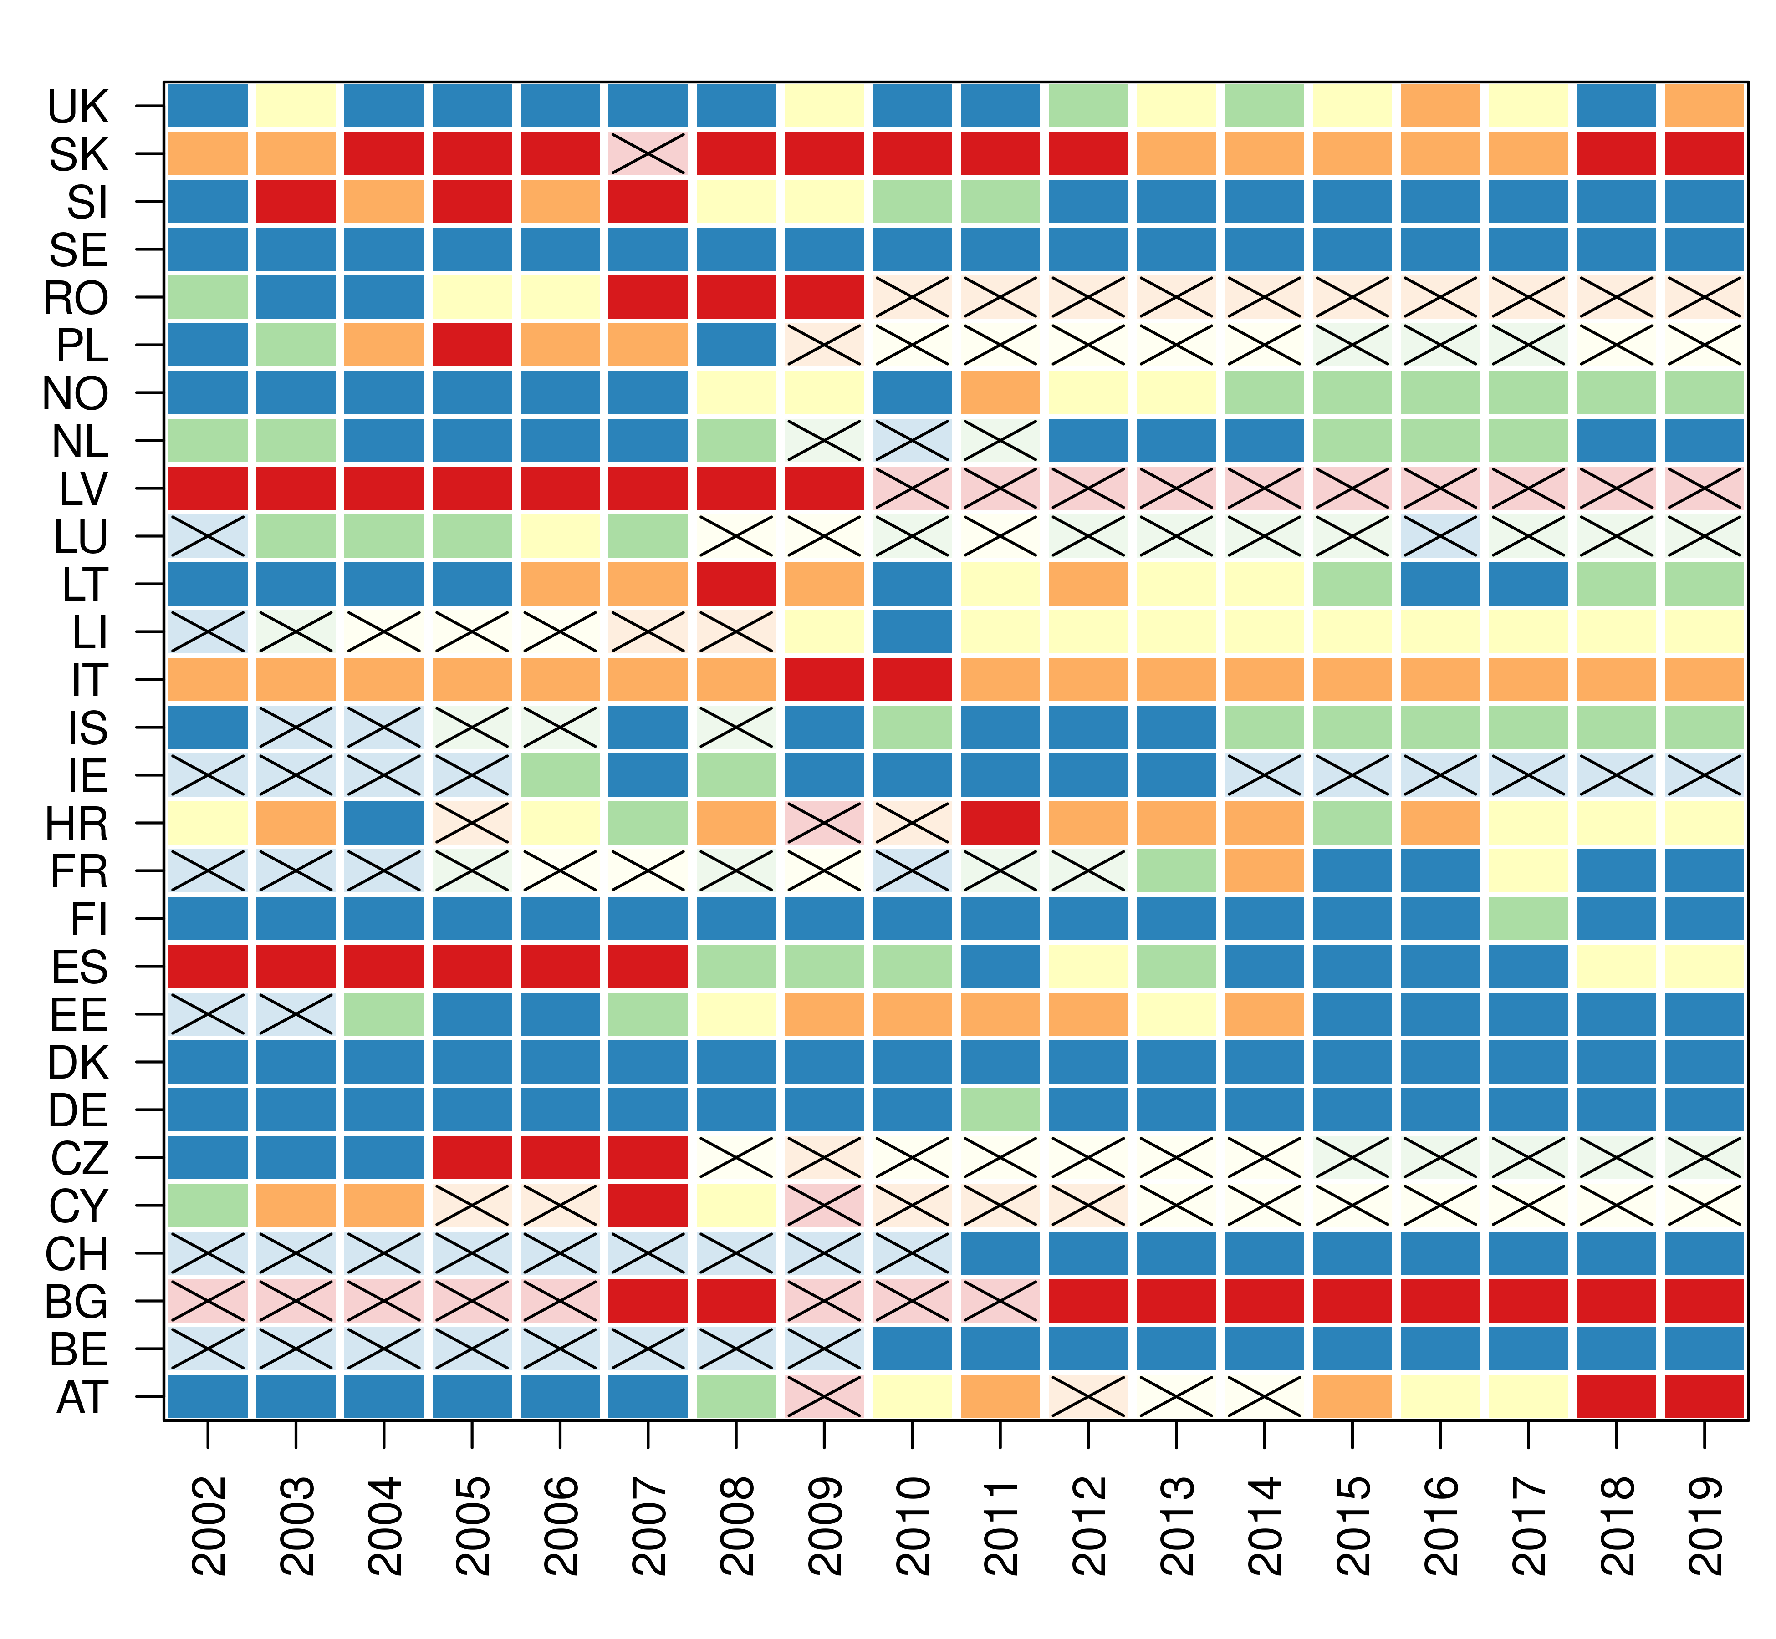
Bilateral migration flows ratio model
Undercounting scores obtained using UndercountMigScores at default settings (projection of bilateral flow ratios into a discrete 0-1 scale).
Immigration
Emigration
Notes:
The scores are corrected for the duration of stay differences
no data = missing bilateral flows between a country and good data quality countries, however, undercounting scores still can be estimated there using PCA imputations.
--- I will talk just briefly, showing countries with the biggest and smallest undercounting issues

Slide 10
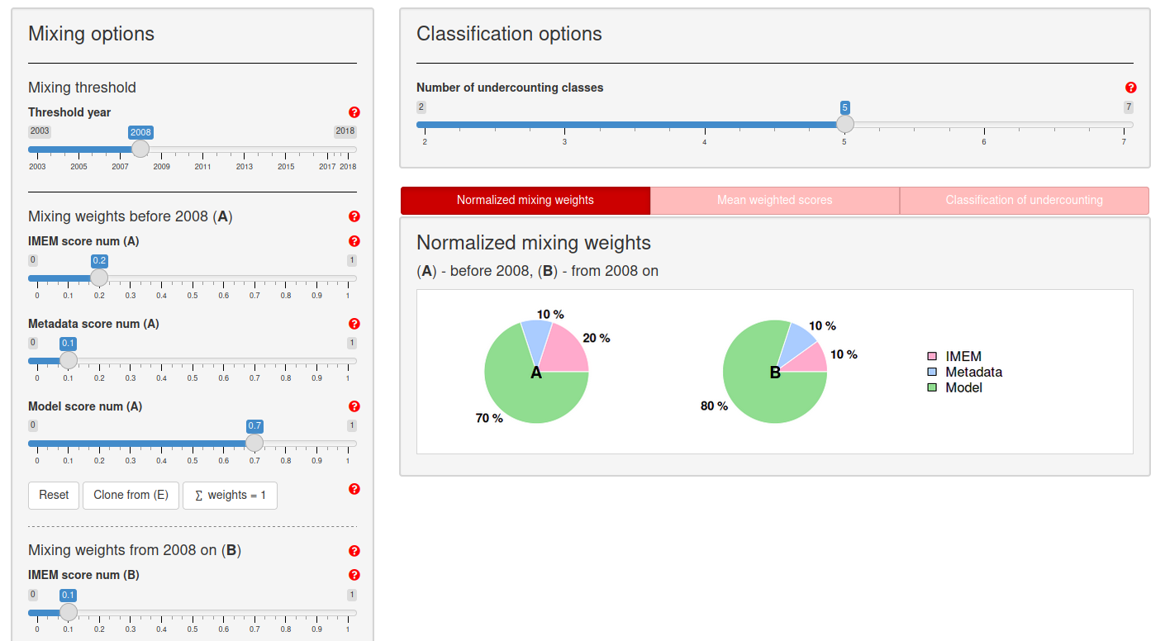
Combining multiple undercounting scores
Model scores, expert opinion (IMEM), and metadata are combined into a single score using weighted average.
UndercountMigScore App
Notes:
After 2007 there was a significant breakthrough in migration data collection due to the harmonization of the definition of the duration of stay (Reg. (EC) 862/2007) and
a possibility of using subsequent censuses to update migration estimates. For this reason, we decided to split the contribution of expert opinion, metadata, and model into two periods,
namely, before 2008 and after 2007. We decided to make the mixing weight for IMEM higher before the threshold than after it.

Slide 11
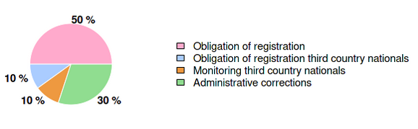
Metadata scores and expert opinion scores
The immigration metadata:
Obligation to register = low undercounting (0)
Absence of a time limit or no sanctions = moderate undercounting (0.5)
No obligation to register = high undercounting (1)
The emigration metadata: Score is calculated as a weighted average with the following weights:
Expert opinion score (IMEM): low (0) and high (1) scores only.
Notes:
Let me remind that metadata describing or being connected with undercounting is very limited
metadata on third country nationals is not important for estimation of undercounting among EU countries, but may be indicator of data quality in general

Slide 12
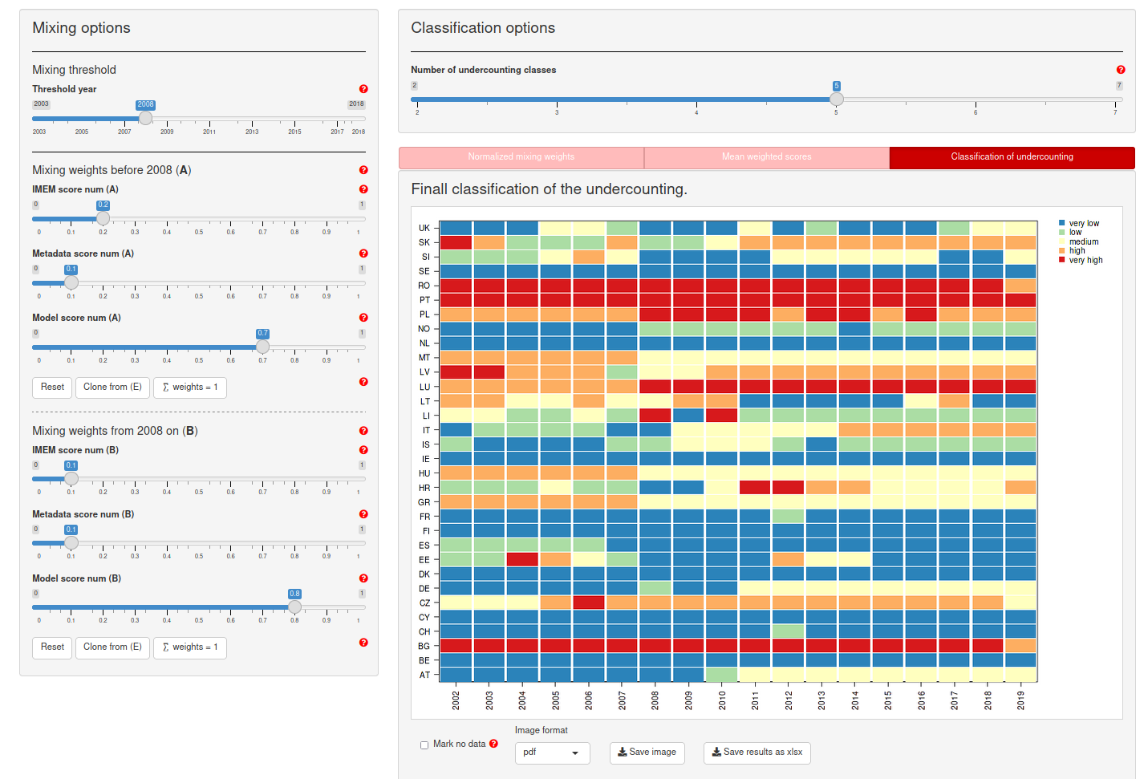
Combining multiple undercounting scores
Combining scores using UndercountMigScores app
Notes:
It includes additional countries that are not present in the previous figures, such as GR (Greece), Hungary (HU), Malta (MT) and Portugal (PT). As there
are no bilateral flows for these countries, the classification is entirely based on metadata and expert opinion (IMEM).
The results are very similar to previously shown as the current metadata and IMEM weights are small.

Slide 13
Conclusion
Our approach provides the ability to achieve data-driven year-specific classification of undercounting and to combine different classifications with each other.
While some model assumptions are arbitrary, we believe it is an important step towards a more scientific classification.
Sensitivity analysis under different modeling assumptions is provided by our Shiny app. We observe quite robust results, especially for the immigration undercounting classification.
The app will be continuously updated with the new data and metadata collected from statistical offices.

Slide 14
Conclusion
Including more metadata in the combined score is important, as the bilateral flows ratio model has limitations.
It can be only applied to countries with recorded bilateral flows
It cannot completely disentangle the issue of undercounting from the miss-coverage (defined as the systematic exclusion or undercounting of specific population groups in the data collection system).
Values used for the duration of stay adjustment may not ideally capture the bias.
Notes:
In this paper, we present the most comprehensive analysis of undercounting in Eurostat data on bilateral migration flows.

Slide 15
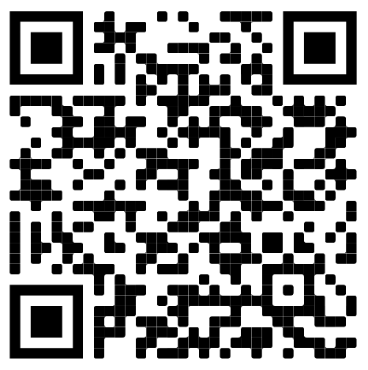
Thank you !
This work is a part of a broader project, the Human Migration Database (HMigD), which aims at producing migration estimates of the highest quality by incorporating all available data and metadata within a solid Bayesian statistical framework, where undercounting is a crucial model parameter.
Contact information
Maciej J. Dańko
Max Planck Institute for Demographic Research
E-mail: danko@demogr.mpg.de
Shiny App: https://github.com/MaciejDanko/UndercountMigScores

Slide 16
Bilateral migration flows ratio model
Correction coefficients for the duration of stay:
Set of parameters that monotonically increase with the duration of stay.
They can be taken directly from the previous models such as IMEM model (Raymer et al. 2013) or other models (summarized by Willekens 2019).
They can be found by minimizing differences in duration adjusted flows between good and bad data quality countries in the entire set of EU countries in the years 2002–2019.
Notes:
I am presenting results for the latter one. You can find comparisons of both methods in the paper.

