Slide 2
BUSINESS PROBLEMS
LAST MILE COMMUNICATION PROBLEMS BETWEEN THE DRIVER AND THE CLIENTS
SOMETIMES NO REPLY FROM THE CLIENTS ON TIME
NOT ENOUGH TIME GIVEN TO THE CLIENT TO REPLY
NO ETA GIVEN TO THE CLIENT FOR THE DELIVERY
ROUTE MAPS WERE NOT ALIGNED
THE PROCESS IS ASYNCHRONOUS

Slide 3
BUSINESS SOLUTIONS
MOBILE APP AND DESKTOP APPLICATION FOR MAKING THE COMMUNICATION MORE EFFECTIVE BETWEEN THE DRIVER AND THE CLIENTS
MOBILE APP AND DESKTOP APPLICATION GIVES ENGOUH TIME FOR CLIENT TO REPLY
EFFECTIVE COMMUNICATION MAKE THE PROCESS SYNCHRONOUS
ETA GIVEN TO THE CLIENT FOR THE DELIVERY
ROUTE MAPS ALIGNED AND RE-ALIGNED
OUR SOLUTION FACILITATES PROACTIVE DECISION MAKING
FULFILLS REQUIREMENTS OF LOGISTICS BASED ON 3PL’S/4PL’S

Slide 4
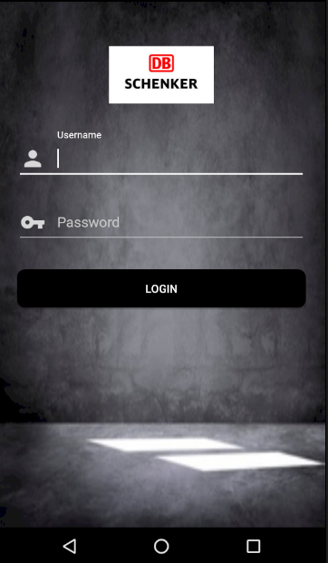
MOBILE APP
USER FRIENDLY
EASE OF SENDING/RECEIVING
PACKAGES

