Slide 1
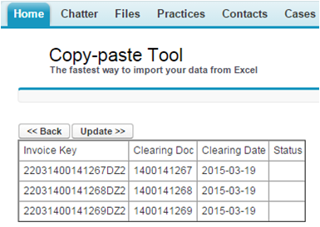
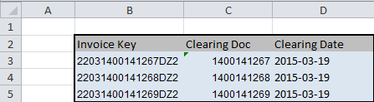

Administrator Guide for Copy-paste Tool The fastest way to import your data from Excel

Slide 2
Copy-paste Tool The fastest way to import your data from Excel
PART I
Quick user quide
in 5 simply steps

Slide 3

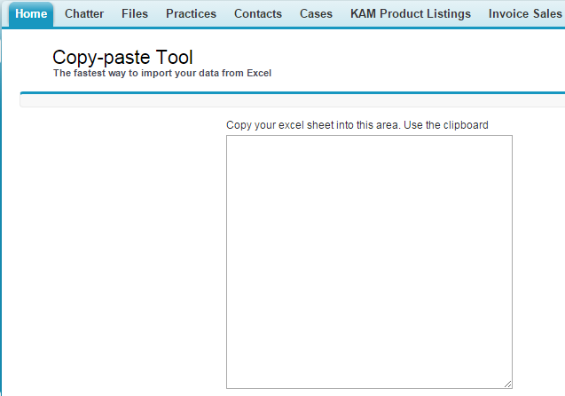
Step 1. Navigate to Salesforce Find the link „Copy Paste Tool” on your home page

Slide 4
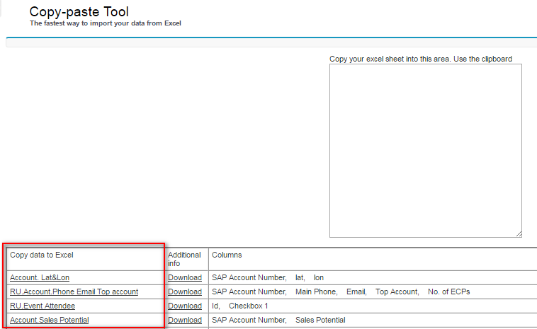
Step 2. Export your data to Excel

Slide 5
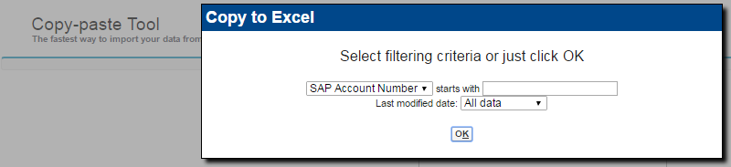
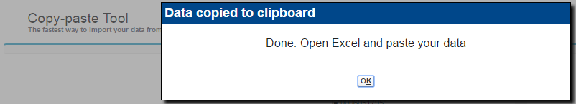
Step 2. Export your data to Excel
Before the download user can filer the data.
Notes:
Leading zeros will survive in Excel!
Tabs and Enters are not a problem.
Diactric marks (including Russian characters) work fine.
I tested it on 50000+ records. Works fine.

Slide 6
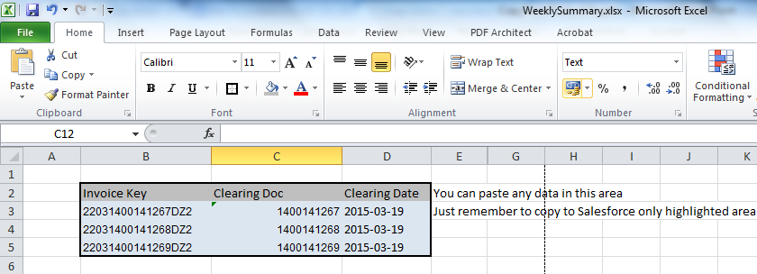
Step 3. Paste and update your data in Excel

Slide 7
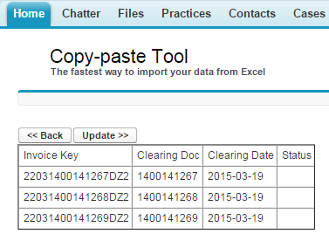
Step 4. Just paste the data to Salesforce Available operations are: create, update, delete

Slide 8
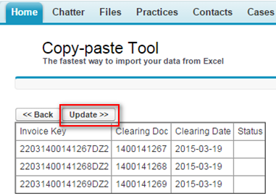
Step 4. Confirm and click Update

Slide 9
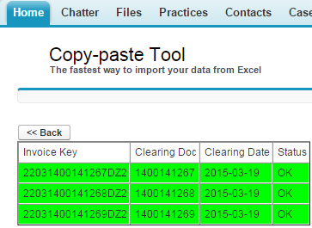
Step 5. Well done !

Slide 10
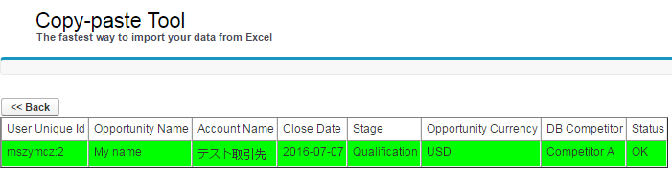
Note: National characters are supported

Slide 11
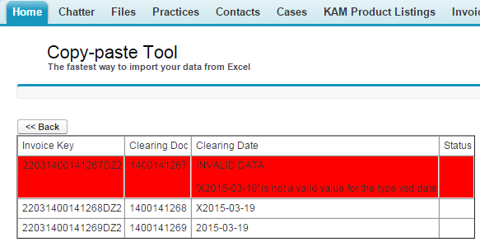
Errors (if any) will show in red

Slide 12
Copy-paste Tool The fastest way to import your data from Excel
PART II
Administration

Slide 13
General notes
The Tool is capable to update strings, checkboxes, numbers, picklists and dates.
Data format: 1. Date needs to be in format 2022-04-21 or 21/4/2022 2. Number need be in format 1234.56 (dot) or 123,4.56. - is replaced with blank value. 3. Checkbox must be in format 0/1
4. You can use External field ids 5. No restrictions for strings Standard security limitations imposed by the role hierarchies are respected.
Read-only restrictions on object level are effective in Copy Paste Tool as well.
Read-only setting created on page layout does not resctrict from updating
fields by Copy-Paste Tools.

Slide 14
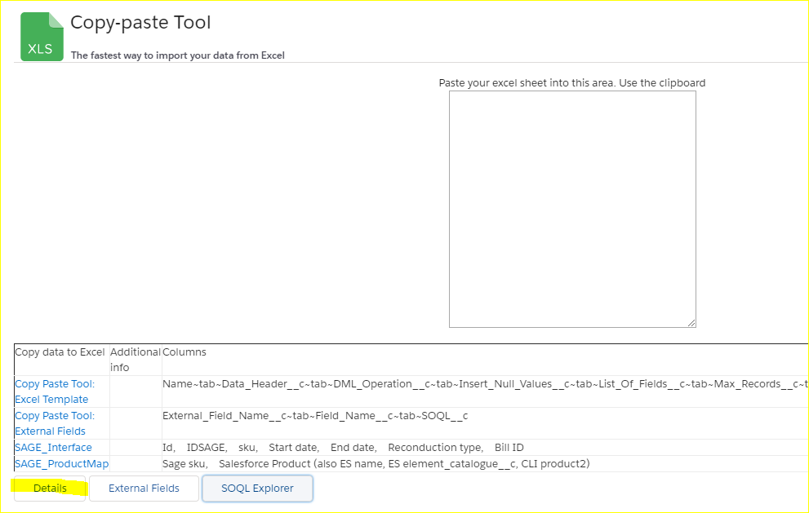
Configuration screen
Each record is separate Excel template

Slide 15
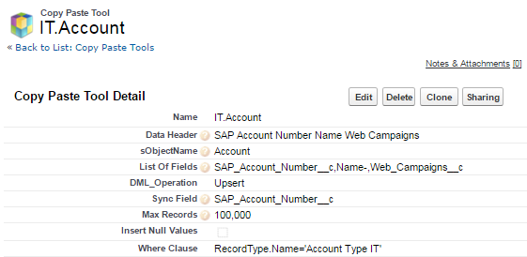
Configuration details

Slide 16
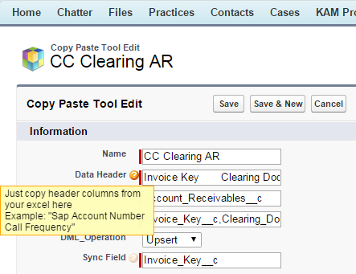
Configuration details Please hover on question mark to find more about fields.

Slide 17
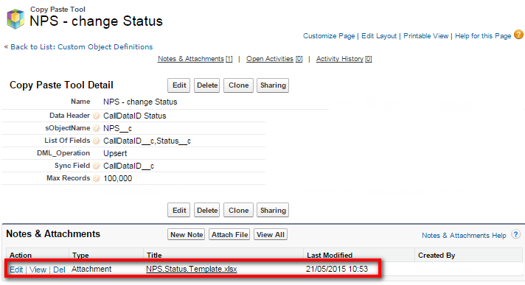
Configuration details Excel template can be kept in Salesforce

Slide 18
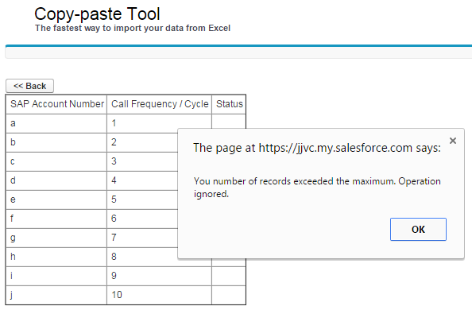
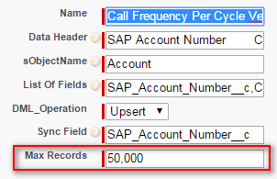
Configuration details You can limit max numer of records to process

Slide 19
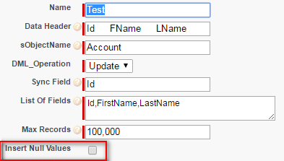
Configuration details You can decide if update the fields with blank (NULL) values

Slide 20
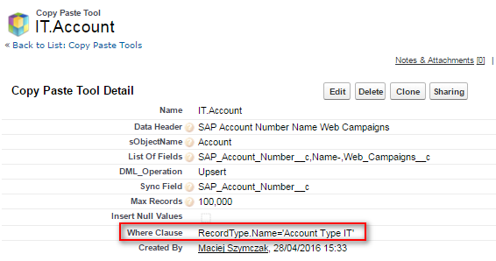
Configuration details Fill “Where Clause” to limit data that are exported (standard security limitations imposed by the role hierarchies are respected as well)

Slide 21
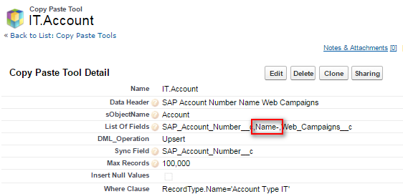
Configuration details (Name-) People in most cases want to see account name but don't or just cannot update it . Field can be downloaded by excluded from data upload.
Just add a minus character after the field. Minus means “do not update this field”.
Also: Please remember API field names are case sensitive!

Slide 22
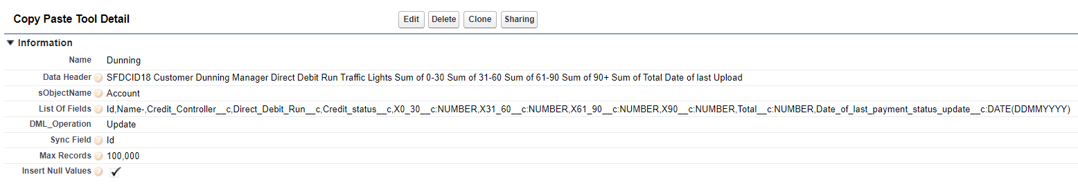
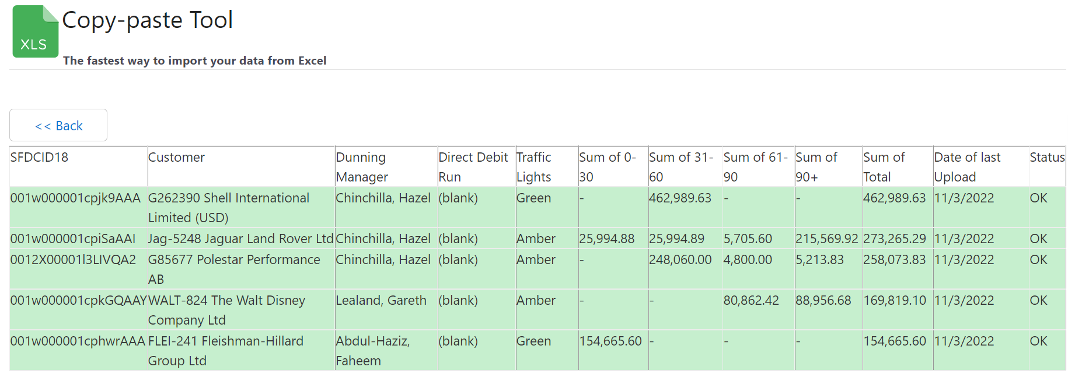
Configuration details (:DATE and :NUMBER)
Use :DATE(DDMMYYYY) and :NUMBER for allow specific date and number formats

Slide 23
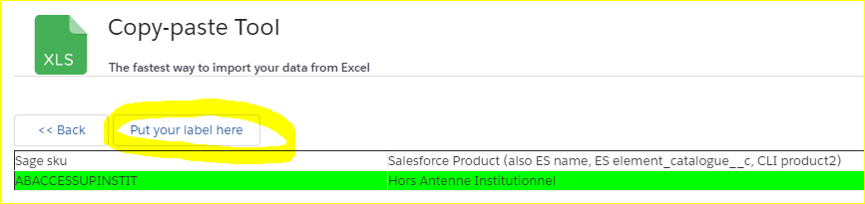
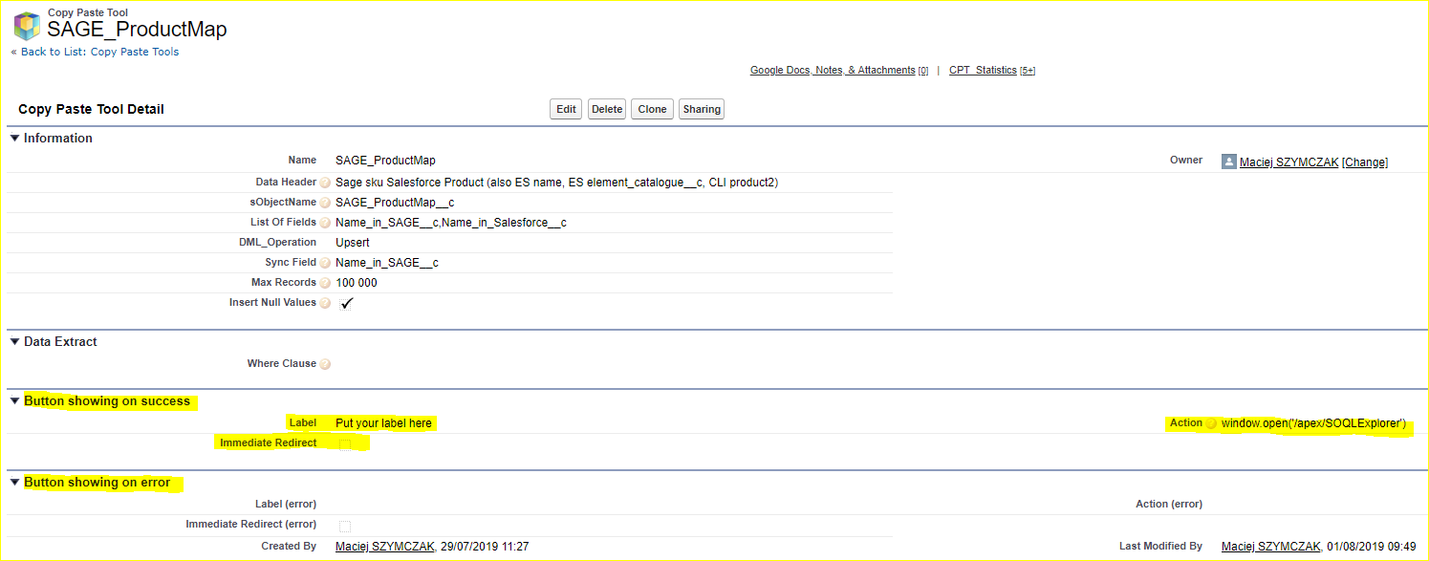
Configuration details: Action on success or failure

Slide 24
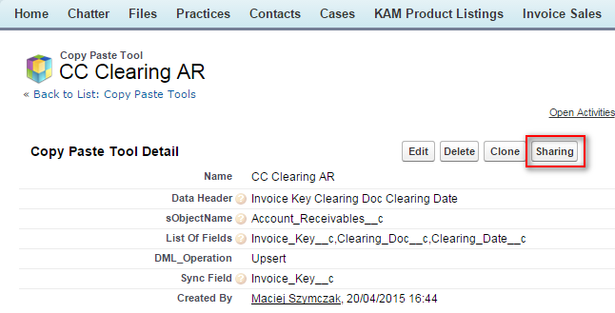
Share configurations with people using standard Salesforce sharing

Slide 25
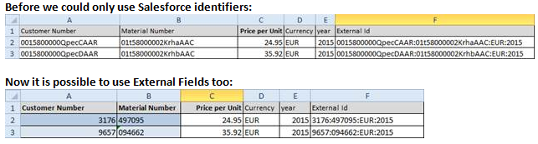
External Fields (Account Name, not AccountId)
Now we can use user name (rather than user id), record type name (rather record type id), provide lookup values in natural way (no more Salesforce id).

Slide 26

External Fields (Account Name, not AccountId)
How to configure it:
1. Click the button Extenal Fields on the bottom of the screen
2. Then just create the „translation” record. This is it.

Slide 27
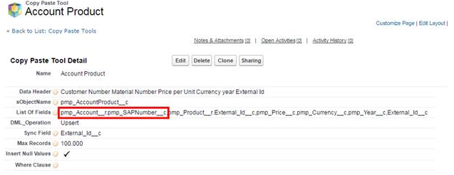
External Fields (Account Name, not AccountId)
How you can use your external field in your configuration
Note: Ideal name for external field is the one that will work in SOQL for data extraction.
If the external field Account.Name is already in use, you can create in Salesforce
a formula field like CPT_Account_Name__c (=Account.Name)

Slide 28
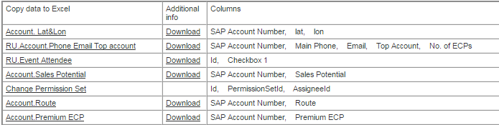
Users can download static attachment added to configuration You can just attach any file – just quick user guide or whatever.

Slide 29
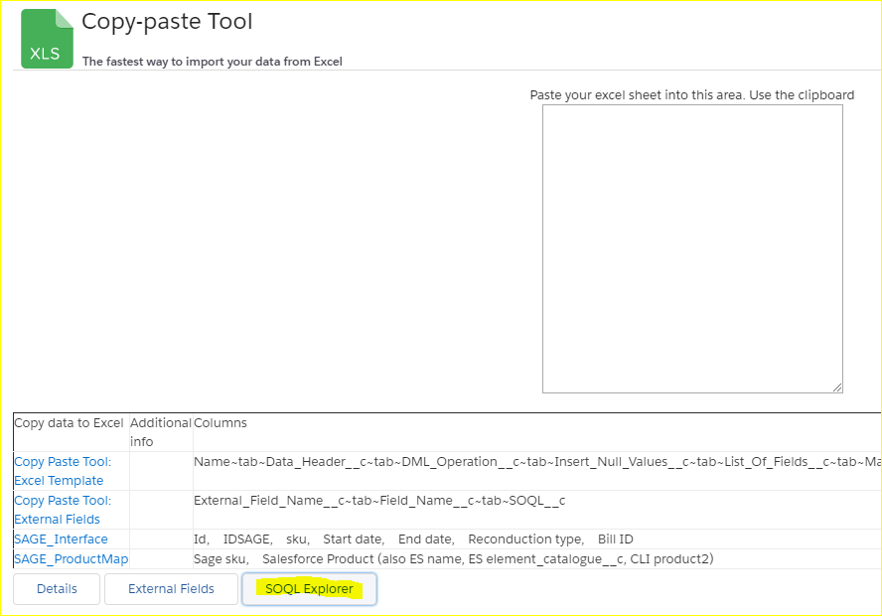
SOQL Explorer
SOQL Explorer is the tool for admins that gives instant, robust and very convenient access to Salesforce Schema and SOQL.
How to Run SOQL Explorer:
There is a new button SOQL Explorer on the bottom of the page:

Slide 30
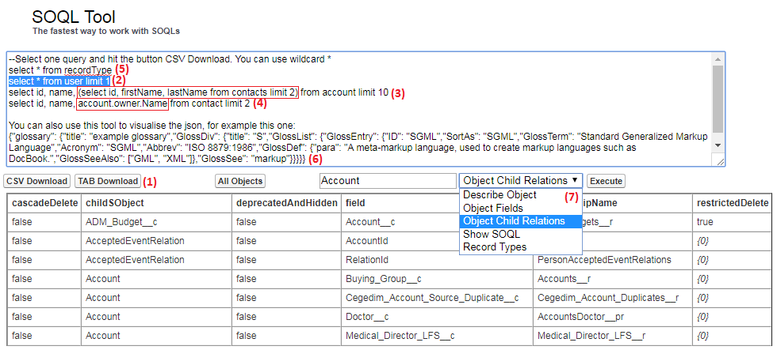
SOQL Explorer
A quick introduction
Rapid download SOQL results to Excel / CSV file
You can work with many SOQLs, just select the active one and hit Download
Nested queries are supported
Nested lookup are supported too
The syntax like “select * from” is supported (!)
You can use this too to visualize jsons
(7) Convenient access to metadata:
List of all Salesforce Objects
List of all details of selected object
List of object fields
List of object child relations
Complete SQLs for given object (select * from)
Record types for given object
Generate SOQL with creatable or custom fields only

