Slide 1
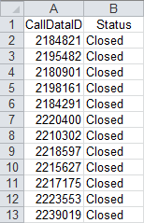
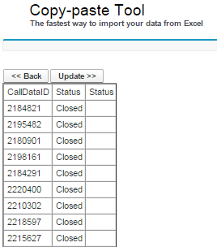

Copy-paste Tool The fastest way to import your data from Excel

Slide 2
Copy-paste Tool The fastest way to import your data from Excel
Quick userquide
in 5 simply steps
https://<domain>.salesforce.com/apex/seamlessExcelIntegration

Slide 3
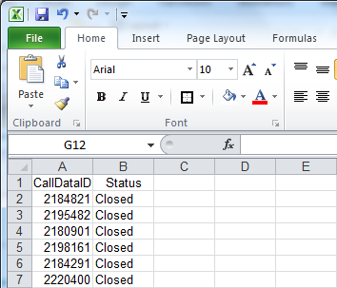
Step 1. Prepare your data in Excel

Slide 4
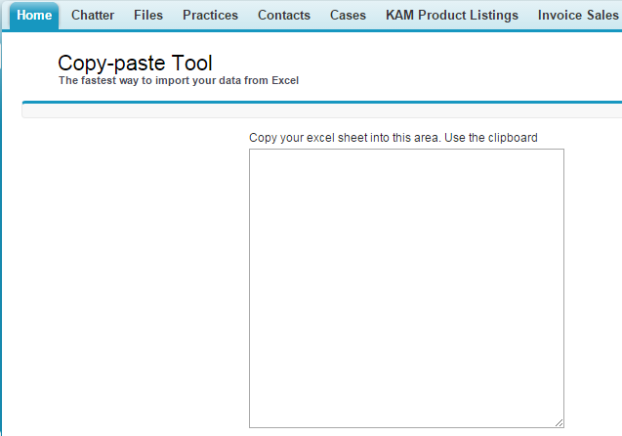
Step 2. Navigate to Salesforce https://<domain>.salesforce.com/apex/pasteTool

Slide 5
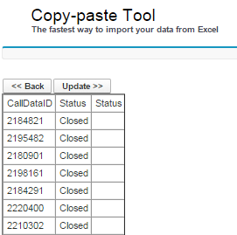
Step 3. Just paste the data to Salesforce

Slide 6
Step 4. Confirm and click Update

Slide 7
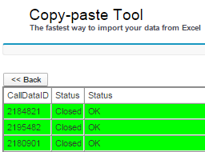
Step 5. Well done !

Slide 8
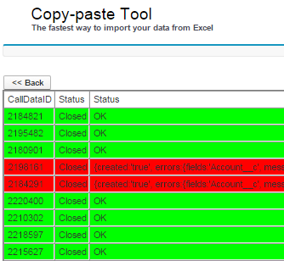
Errors (if any) will show in red

