Slide 1
Multicore System – GPU Lab 1
Biao Wang | AES

Slide 2
Outline
Programming GPU using OpenCL
Platform Components
OpenCL Code Example
Thread Configuration
Compile and execution
Bilinear filter for demosaicing interpolation
Bayer Patterns
Obtain G, B at R locations
Obtain R, B at G locations
Obtain G, R at B locations

Slide 3
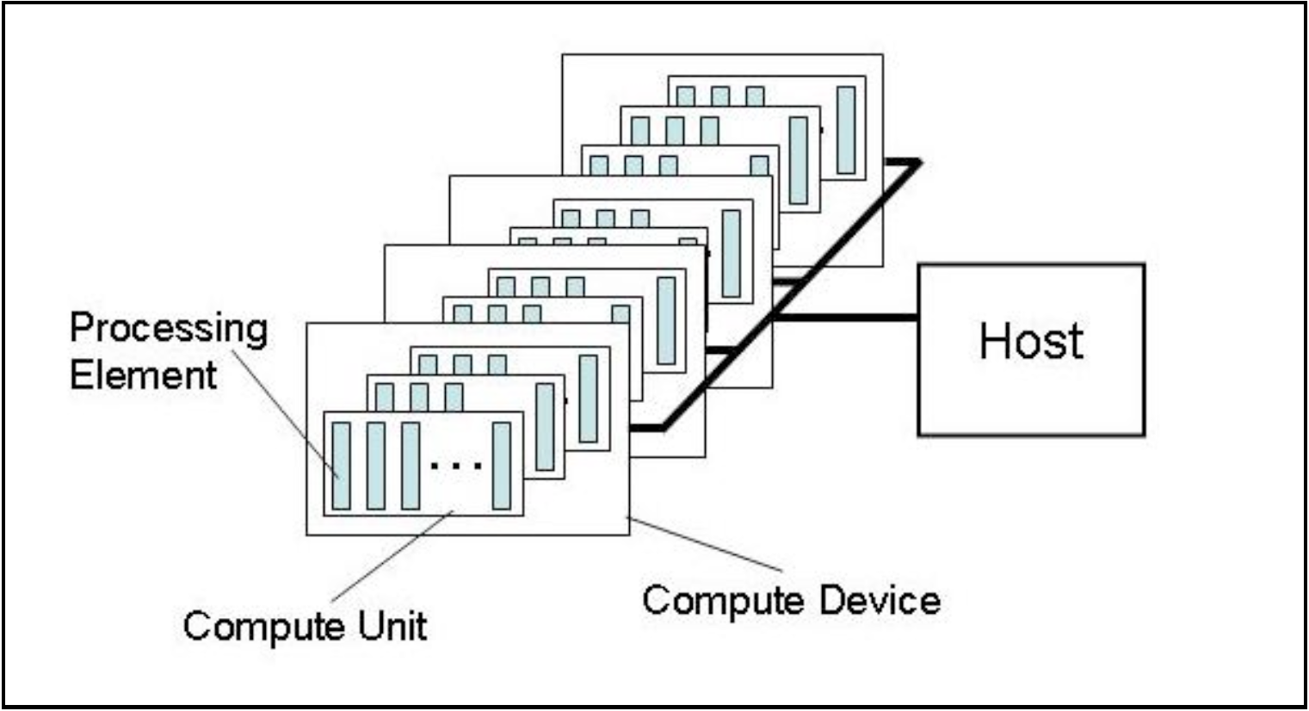
Programming Model Overview: platform
CPU
In general means GPU, consist of compute units, which in turn consists of processing elements.

Slide 4
Programming Model Overview: Code Example (I)
Host code: OpenCL.cpp
Device code: kernel.cl
//set up OpenCL working environment
clGetPlatform // get platform
clGetDeivceID // get device
clCreateContext // create context
clCreateCommandQueue // command queue
//read kernel source file kernel.cl
...
//build kernel on runtime,i.e online compilation
prog = clCreateProgramWithSource(context,...)
clbuildProgram(prog,...)
//create memory on GPU
clCreateBuffer(..., CL_MEM_READ_ONLY, ...);
clCreateBuffer(..., CL_MEM_READ_ONLY, ...);
//to be continue
//Implement kernel code here
__kernel void bilinearFilter(
__global ushort *input,
__gloabl ushort *output)
{
//define thread mapping, i.e., locate the location of the input data for loading
...
//compute
...
//write results to output
...
}

Slide 5
Programming Model Overview: Code Example (II)
Host code: OpenCL.cpp
Device code: kernel.cl
//set kernel arguments
clSetKernelArg()... // arg1..
clSetKernelArg()... // arg2..
...
//transfer input data from CPU to GPU
clEnqueueWriteBuffer(...)
//set up thread configuration
gloabl_size[0] = Gx; gloabl_size[1] = Gy;
local_size[0] = x; local_size[1] = y;
//launch kernel
clEnqueueNDRangeKernel(...)
//tranfer output data from GPU to CPU
clEnqueueWriteBuffer(...)
//Implement kernel code here
__kernel void bilinearFilter(
__global ushort *input,
__gloabl ushort *output)
{
//define thread mapping, i.e., locate the location of the input data for loading
...
//compute
...
//write results to output
...
}
execute

Slide 6
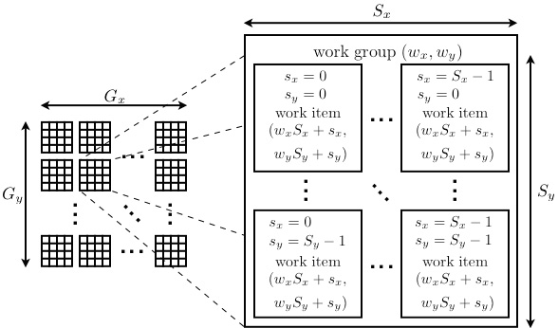
Thread/workitem Configurations
Get global work item ID
get_global_id
Number of global work items
get_global_size
Get local work item ID
get_local_id
Number of local work items
get_local_size
Get Work group ID
get_group_id
Number of work groups
get_num_groups

Slide 7
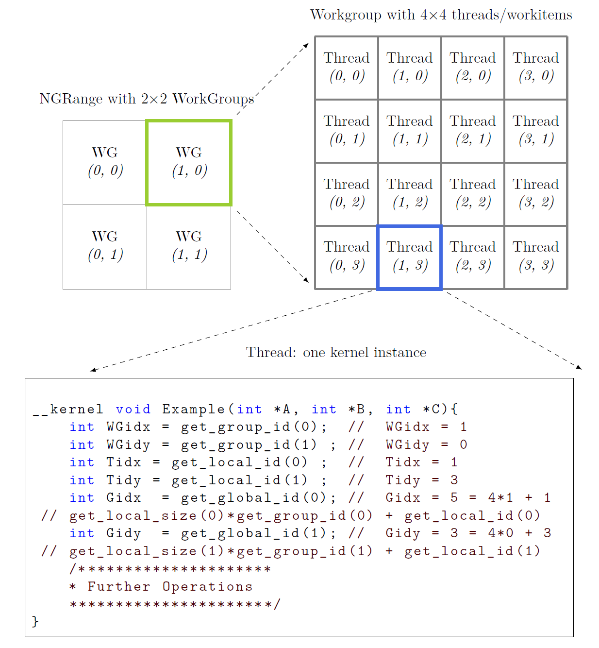
Indexing Example

Slide 8
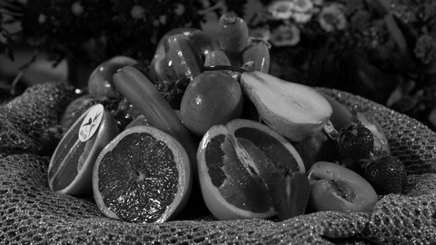
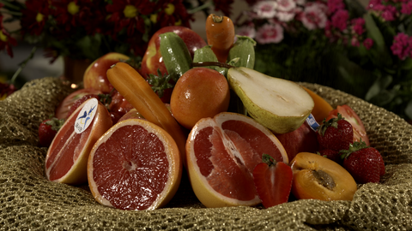
Compile & execution
cd demosaicMHC
make
./opencl_demosaic bayered_rainFruits438.png bilinerFilter.cl

Slide 9
Outline
Programming GPU using OpenCL
Platform Components
OpenCL Code Example
Thread Configuration
Compile and execution
Bilinear filter for demosaicing interpolation
Bayer Filter
Obtain G, B at R locations
Obtain R, B at G locations
Obtain G, R at B locations

Slide 10
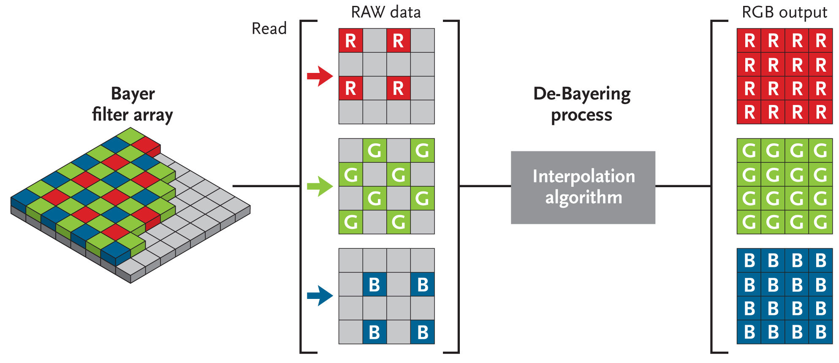
Bayer Filter and debayering/demosaicing process

Slide 11
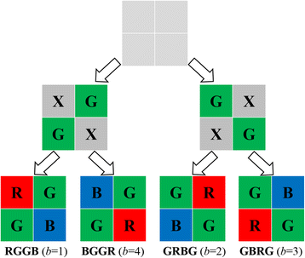
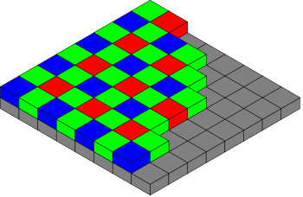
Bayer Filter and its Patterns
Bayer filter array:
Compared to RGB representation, use one third of samples to save image
G samples take up 50%, R 25%, B 25%
Four patterns:
focus

Slide 12
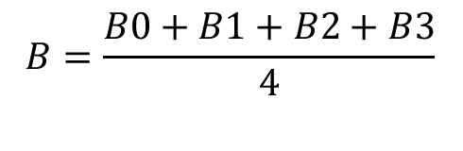
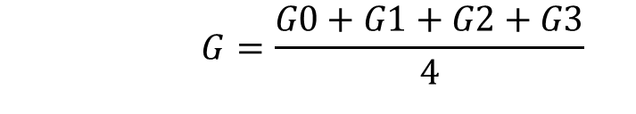
Obtain G, B at R locations
$$G=\frac{G0+G1+G2+G3}{4}$$
B0
G0
B1
G1
R
G2
$$B=\frac{B0+B1+B2+B3}{4}$$
B2
G3
B3

Slide 13
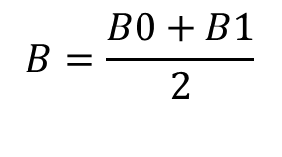

Obtain R, B at G locations (I)
R0
$$R=\frac{R0+R1}{2}$$
B0
G
B1
R1
$$B=\frac{B0+B1}{2}$$

Slide 14
Obtain R, B at G locations (II)
$$R=\frac{R0+R1}{2}$$
B0
R0
G
R1
$$B=\frac{B0+B1}{2}$$
B1

Slide 15
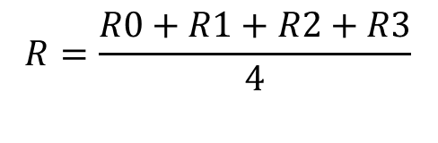
Obtain G, R at B locations
R0
G0
R1
$$G=\frac{G0+G1+G2+G3}{4}$$
G1
B
G2
R2
G3
R3
$$R=\frac{R0+R1+R2+R3}{4}$$

