Slide 1
Making Time Uncertainty a First-Class Concept in Linux Timing
Trustworthy timestamps for distributed and AI systems
Notes:
Thank you all for being here.
This talk is called Making Time Uncertainty a First-Class Concept in Linux Timing. And I want to start by admitting something: many people treated time as a solved problem. You call clock_gettime, you get a number, the number is the truth. [PAUSE]
Over the next forty minutes I want to convince you that that number is not a point. It's an interval. And that the width of that interval — the error bar on time — is a property your systems should be computing and acting on, not quietly assuming away.
This is not a PTP tutorial. PTP is the enabler here. Uncertainty is the layer we usually forget to build on top of it.

Slide 2
OPENING
We make this decision constantly
▸ event A at T₁ → event B at T₂ → “A happened before B”
– Ordering. Causality. “Which write won?” “What caused the stall?”
▸ The hidden assumption: both timestamps are exact points.
– Clocks disagree. Timestamps are captured at different layers.
– Synchronization data goes stale between updates.
Time Uncertainty as a First-Class Concept
2
Notes:
Here is the decision at the heart of it.
Event A happens at timestamp T-one. Event B happens at T-two. T-one is smaller, so we conclude: A happened before B. [PAUSE]
We make this decision thousands of times a second. It's ordering. It's causality — "what caused the stall?" It's "which write won?" It's the backbone of every distributed trace and every audit log.
And it rests on one hidden assumption: that both timestamps are exact points. In reality, clocks disagree with each other. Timestamps get captured at different layers of the stack. And the synchronization data we rely on goes stale between updates.
(optional) Quick show of hands — who here has debugged a distributed trace where the events looked out of order? [PAUSE] Right. That's the whole talk.

Slide 3
ROADMAP
Two talks, one story
This talk
Prior talk — fast PHC access
• What is the error bar on a timestamp?
• Timestamps as intervals
• Explicit correctness criteria
• “Can I trust this time?”
• How do we read the clock cheaply?
• PHC reads without syscall / PCIe overhead
• Userspace PHC approximation (Hermóðr)
• ~5 µs syscall+PCIe read → ~60 ns
Time Uncertainty as a First-Class Concept
3
Notes:
Some of you saw my talk last year, where I introduced fast access to the PTP hardware clock — the Hermóðr proof of concept, which approximates the device clock in userspace from the CPU counter, so you don't pay the syscall and PCIe cost on every read. It took a /dev/ptpX read from around five microseconds down to tens of nanoseconds. It's worth drawing the line between the two talks, because they're two halves of the same story.
That talk asked: how do we get the time fast? How do we read the clock without the overhead that dominates a naive clock_gettime on a device clock.
This talk asks the complementary question: once I have that time, how far can I trust it? What is the error bar on the timestamp I just read.
Here's the relationship in one sentence: the prior talk made the read fast; this one puts an error bar on it. Fast access to the time, and its associated uncertainty — together, that's the full story. Hold onto that. I'll come back to it at the end.

Slide 4
PART 1
Precise is not the same as correct
4

Slide 5
THE PROBLEM
We spent two decades chasing precision
▸ Sub-microsecond PTP is now common on data-center and AI fabrics
▸ Hardware timestamping in NICs, SmartNICs, DPUs
▸ Multi-node GPU traces spanning thousands of ranks
▸ The better our clocks got, the more we trusted them — implicitly
– Precision raised confidence faster than it raised correctness
Time Uncertainty as a First-Class Concept
5
Notes:
We have spent roughly two decades chasing precision, and we won.
Sub-microsecond PTP is now normal across data centers and AI fabrics.
Hardware timestamping is built into NICs, SmartNICs, DPUs.
We routinely capture GPU traces that span thousands of ranks across a cluster.
The clocks got dramatically better.
And here's the catch: the better our clocks got, the more we trusted them — implicitly. [PAUSE]
Precision raised our confidence faster than it raised our correctness. We started treating "the clock is very precise" as if it meant "the timestamp is exactly right." Those are not the same statement.

Slide 6
THE PROBLEM
Ways timestamps quietly mislead
Domain | Naive claim | What can go wrong
Ordering | A before B | intervals overlap → order is unknown
Causality | A caused B | off-by-one across nodes → false cause
Compliance | log is ordered | cannot prove ordering is defensible
Consistency | commit A visible before B | overlap breaks external consistency
Profiling | span A nested in span B | cross-node spans misorder
Leases / locks | lease expired before regrant | overlap → split brain / two leaders
Telemetry | counters sampled together | inter-node skew → phantom correlations
Forensics | log A caused log B | causal chain is indefensible
Sensor fusion | radar + camera aligned | physical-world misalignment
Finance | trade timestamped correctly | can't prove mandated window (MiFID II)
Launch time load balancing | packets will have their dedicated slots | packet collisions
Time Uncertainty as a First-Class Concept
6
Notes:
That gap shows up all over the stack. Start with the three that carry the argument.
Ordering. We claim A came before B — but if the two intervals overlap, the true order is simply unknown.
Causality. We claim A caused B — but a small offset between two nodes can flip the apparent order and manufacture a cause that never existed.
Compliance. We claim a log is correctly ordered — but if we can't bound the error, we can't prove that ordering is defensible. And auditors care about defensible ordering, not about how many nanoseconds we can print.
And it doesn't stop there — the same failure reappears everywhere we lean on time. Database consistency, where overlapping commit windows break external consistency. Profiling, where cross-node spans misorder. Leases and locks, where overlapping windows hand you two leaders and a split brain. Then telemetry correlation, distributed forensics, sensor fusion, regulated financial timestamping. [PAUSE] One root cause, a very long blast radius. Don't read the whole table — land the top three and gesture at the rest.

Slide 7
Two events 200 ns apart, each known to ±150 ns.
A
overlap
150 ns
150 ns
B
← 200 ns apart →
Their true order is unknown — and nothing in the timestamp told you so.
Time Uncertainty as a First-Class Concept
7
Notes:
Let me make it concrete — and let me draw it. [PAUSE]
Two events, 200 nanoseconds apart. But each timestamp is only known to within plus-or-minus 150 nanoseconds.
Now look at what that does. Each bar is 150 nanoseconds on each side — that's the little dimension under event A
And B
So the bars overlap. That amber region is the overlap, and inside it either event could have come first. Their true order is unknown. [PAUSE]
And the point that should bother you: nothing in the bare timestamps told you so. The numbers looked perfectly confident — 200 nanoseconds apart, printed to the nanosecond. The ambiguity was invisible because the error bar wasn't part of the data.
That's the problem we're going to fix.

Slide 8
PART 2
A timestamp is an interval
8

Slide 9
THE MODEL
From a point to an interval
▸ Instead of: “the event happened at t”
▸ Say: “the event happened at t ± U”
– U = the time-uncertainty bound at the moment of observation
– Also can be viewed as earliest-latest
▸ Now applications can ask explicit questions:
– Is ordering between A and B definite, or ambiguous?
– Is this window fresh enough for a compliance decision?
Time Uncertainty as a First-Class Concept
9
Notes:
The whole shift is this small.
Instead of saying "the event happened at t,"
we say "the event happened at t plus-or-minus U." [PAUSE]
U is the time-uncertainty bound at the moment we observed the event. You can read the same thing two ways: as t plus-or-minus U, or as an earliest and a latest — the event happened no sooner than t minus U and no later than t plus U. Same interval, two vocabularies; the earliest/latest framing is the one most timing APIs actually expose.
And once U is part of the record, the application can ask questions it simply could not ask before. Is the ordering between A and B definite, or is it ambiguous? Is this time window fresh enough to base a compliance decision on? These become explicit, answerable questions instead of silent assumptions.

Slide 10
THE MODEL
The ordering rule
Point model
Interval model
earliest
latest
t
t−U
t
t+U
A before B only if tA + UA < tB − UB
otherwise → ambiguous · unknown, not wrong
The overlap region is where causality cannot be resolved from timestamps alone.
Time Uncertainty as a First-Class Concept
10
Notes:
Here's the rule that falls out of it.
On the left, the old point model: a single tick on a line. On the right, the interval model: a band from t minus U to t plus U — or, in the words on the slide, from the earliest the event could have happened to the latest.
The rule: A is before B only if T-A plus U-A is less than T-B minus U-B. In earliest/latest terms: A is before B only if the latest A could have been is still earlier than the earliest B could have been. Only if the whole interval of A sits entirely below the whole interval of B.
And if they overlap? The answer is not "wrong." The answer is ambiguous — unknown, not wrong. [PAUSE]
That distinction is the most important idea in this talk. "Unknown" is a valid, useful answer. A system that knows the order is unknown can slow down, widen a window, ask for confirmation, or flag the result. A system that guesses and calls it certain just ships a silent error.

Slide 11
THE MODEL
What uncertainty is — and is not
U IS
U IS NOT
• A computed uncertainty envelope, right now
• Derived from sync state + explicitly stated assumptions
• An explicit input to application logic
• A statistical confidence interval (unless you add stats)
• A proven upper bound — some terms are omitted
• Zero just because PTP reports “SLAVE”
Time Uncertainty as a First-Class Concept
11
Notes:
Let me be precise about what U is throughout this talk, because it's easy to over-claim
U is: a computed uncertainty envelope, right now. It's derived from the synchronization state plus a few explicitly stated assumptions. And it's an explicit input to your application's logic.
U is not: a statistical confidence interval — not unless you deliberately layer statistics on top. And, being honest, it is not a proven mathematical upper bound on the true clock error — because we deliberately omit some terms, like link asymmetry. And it is not zero just because PTP reports the port state as "SLAVE." [PAUSE]

Slide 12
PART 3
Where does uncertainty come from?
12

Slide 13
ANATOMY
Walk the stack, bottom to top
6 Userspace observation delay <- syscall + scheduling
5 Kernel -> userspace transfer <- IRQ, softirq, copy
4 Timestamp capture point <- HW vs SW
3 Network <- queueing, routing, hop count
2 PHC clock <- offset, clock resolution
1 Oscillator <- drift, temperature
Each layer adds error or delay. Only some layers expose metrics.
Time Uncertainty as a First-Class Concept
13
Notes:
Six layers, bottom to top.
At the bottom, layer one, the oscillator alone — it drifts, and it drifts with temperature. Layer two, the PHC clock it feeds — that's where the offset from the reference lives, and its finite clock resolution, the granularity of a single tick. Layer three, the network — queueing, routing, and the number of hops the sync has to cross. Then the timestamp capture point — was it taken in hardware or software?
Then layer five, the kernel-to-userspace transfer. The event arrives as a hardware interrupt, but the kernel doesn't finish the job right there — it defers the real work to a softirq that runs soon, but not instantly — and then the data has to be copied out of kernel memory into your process. Every one of those hops adds delay between when the event actually happened and when your program can see it, and because it varies with system load, it shows up as jitter, not a constant you can subtract out.
And at the top, layer six, the userspace observation delay. Even once the data is in your process, reading the clock is itself a syscall — a trip into the kernel and back — and your thread is at the mercy of the scheduler: under load it can be preempted and parked for microseconds before it gets to run. So the instant you finally record can trail the real event by an amount you never measure.
Every one of these layers adds either error or delay. [PAUSE] And here's the uncomfortable part: only some of them expose a metric you can read. "The event time" means something different at each layer — even when everything reports as perfectly synced.
But first, the whole budget on one slide

Slide 14
ANATOMY
The uncertainty budget: every source
Source of error | What it contributes | Where it lands
Grandmaster class | advertised GM quality (clockClass / accuracy) | assumed bound
Offset from grandmaster | estimated bias, from the t1–t4 exchange | U_clock: |offset_est| + U_est
Residual oscillator drift | freq error left after discipline (≤ D_max) | U_clock: age × D_max
Holdover | no discipline (ptp4l down) — age keeps growing | U_clock: anchor held
Clock resolution | granularity of the timestamp tick | U_clock: ½ tick
Path-element delays | estimated mean is compensated by PTP | residual est. error → U_est
Link asymmetry | up and down paths differ | unmodeled → folds into U_est
Event capture point | how the app stamped the event (HW/SW) | U_capture (application)
Time Uncertainty as a First-Class Concept
14
Notes:
Before we zoom into the layers one by one, here is every source of error that can widen your interval, grouped four ways.
Two come from the source clock itself, and they are different in kind. First, the grandmaster's class — its clockClass and clockAccuracy. We don't measure this; the grandmaster advertises it, and it gives us a bound on how good the source is. Second, the offset from that grandmaster — and this one we do compute, locally, from the t1–t4 timestamp exchange. But be careful, because this is the first place a reviewer will attack: offsetFromMaster is an estimate of our bias, not a bound on it. A two-nanosecond offset does not mean the true error is under two nanoseconds. So it enters as the estimated offset plus its own estimation uncertainty — timestamp noise, delay variation, and asymmetry all live in that second term. One is a quality we're told; the other is an estimate we compute, with error bars of its own. (And stepsRemoved is just the hop count to the grandmaster — if we attribute error per hop, that's a crude policy, not a physical bound; a transparent clock and a boundary clock fail differently.)
Two come from our oscillator, but say these carefully: the PHC is being frequency-disciplined by ptp4l, so between syncs it does not free-run at the raw crystal tolerance. What we bound is the residual frequency error — capped by a configured D-max — times the age since the last sync. And in the extreme, holdover — that same bound growing when discipline is lost entirely.
Two are about reading the clock: the clock's resolution, which enters as half a tick of quantization; and the capture of the event itself — where and how it was stamped — which, and this matters, is a separate uncertainty the application owns, not the daemon.
And two live in the network: the delays accumulated across every path element, whose estimated mean PTP compensates — but the estimation error of that mean does not vanish; and link asymmetry, which PTP cannot see. Both fold into that offset-estimation term. [PAUSE]
So watch that last column. It splits into two owners: U-clock, everything the daemon can bound; and U-capture, what the application knows about how it stamped the event. The total event uncertainty is the sum of the two. And none of it is a proof — it's an envelope under the assumptions we just named.

Slide 15
ANATOMY
Layers 1–2: oscillator & PHC clock
▸ Oscillator (layer 1): TCXO/OCXO stability (ppb), temperature sensitivity
▸ PHC clock (layer 2): the disciplined hardware clock we actually read
– offsetFromMaster — an estimate of bias, with its own uncertainty (U_est)
– clock resolution — ½-tick quantization (effective, not just clock_getres)
– PHC read latency — the cost of reading it
Time Uncertainty as a First-Class Concept
15
Notes:
Layer one, the oscillator. Its stability is measured in parts per billion, and it's sensitive to temperature — and left to free-run, it drifts.
Layer two is the PHC clock the oscillator feeds — the hardware clock we actually read. Two things live here. First, offsetFromMaster - this is an estimate of our offset from the reference, and the estimate has its own uncertainty. Second, the clock's resolution — the granularity of a single tick, which enters as a half-tick of quantization, and I mean the effective granularity of the NIC clock, not just whatever clock_getres reports. And reading it isn't free either; the read itself has a latency.

Slide 16
ANATOMY
Layer 4: capture point — a separate uncertainty (U_capture)
Where stamped | Capture uncertainty | Dominant term
PHC hardware RX timestamp | smallest | HW stamp at the wire
SO_TIMESTAMPING (software) | larger | IRQ + softirq delay
clock_gettime() in app | largest | event→read gap (not clock error)
Time Uncertainty as a First-Class Concept
16
Notes:
Now the capture point, because this one surprises people — and because it's a place the model has to be careful.
First, three things that are easy to blur together. There's clock uncertainty — the envelope we've been building. There's capture uncertainty — where and how you stamped the event. And there's plain observation latency. They are not the same.
Here's the trap. A hardware PHC timestamp in the NIC has the smallest capture error. A software SO_TIMESTAMPING stamp is larger — interrupt and softirq delay. And clock_gettime in your app — people call it the "largest error," but be careful: the syscall latency does not make the returned time wrong. That value is the clock at the read point. It only becomes uncertainty when you claim an earlier event happened at that time — then the event-to-read gap is what counts.
So capture uncertainty is a separate term — call it U-capture — that the application adds on top of the clock envelope. The daemon can't know how you stamped. And this matters enormously for profiling: your GPU, your NIC, and your CPU may each be stamping in a different domain — even when the cluster says everything is synchronized.

Slide 17
ANATOMY
Layers 3 & 5: network and kernel path
▸ Network (layer 3): each hop adds queueing + routing delay
– PTP compensates the *estimated* mean path delay — its estimation error remains
– Residual = asymmetry + delay-estimation error, growing with hops — folds into U_est
▸ Kernel path (layer 5): Linux exposes useful data — but not as one package:
– PTP_SYS_OFFSET / _EXTENDED — PHC vs system clock
– SO_TIMESTAMPING — ingress / egress timestamps
– ptp4l management API — offset, delay, ingress time (userspace)
Time Uncertainty as a First-Class Concept
17
Notes:
Two more layers, quickly.
Layer three, the network. Every hop — each transparent or boundary clock, each switch queue — adds delay, and the more hops the sync crosses, the more of it accumulates. Now the subtlety that trips people up — and here I have to be more careful than the usual hand-wave. PTP measures and compensates the estimated mean path delay. The mean gets corrected out, yes — but the estimation error of that mean does not vanish. Delay variation, changing path conditions, a stale delay estimate, and above all link asymmetry — the up and down directions differing — all remain. So I won't say "path delay is gone." I'll say the estimated mean is compensated, and its residual estimation error, growing with hop count, folds into the offset-estimation term. PTP doesn't hand us a clean measurement of it.
And layer five, the kernel path: Linux exposes useful ingredients here — PTP_SYS_OFFSET cross-timestamps the PHC against the system clock, and SO_TIMESTAMPING gives you ingress and egress timestamps. But notice what's not a kernel API: the disciplined sync-state itself. That lives only in ptp4l in userspace, and there's no coherent snapshot of it. Remember that — it's exactly what's missing, and I'll come back to it at the end.

Slide 18
ANATOMY
Layer that everyone forgets: staleness
Between syncs, we bound the residual frequency error.
U_drift = age x D_max (configured bound)
Example: 100 ppm x 1 s = 100 microseconds
Staleness turns a point estimate into a growing envelope — age × the configured frequency-error bound.
Time Uncertainty as a First-Class Concept
18
Notes:
And now the layer that almost every tool forgets. [PAUSE]
Between syncs, the clock's frequency isn't perfectly known — so our bound on the error grows. The PHC is being frequency-disciplined; between syncs it does not free-run at the raw crystal tolerance — the last correction stays programmed.
So this isn't "the oscillator drifts 100 microseconds." The honest statement is: the residual frequency error is bounded by a configured D-max, and our uncertainty grows as that bound times the age since the last sync.
Put in a number: a D-max of 100 parts per million times one second is 100 microseconds. [PAUSE]
Thnk about what that means. You can have a perfect offset estimate at the instant a sync arrives — and a moment later that point has already grown into an interval.
Staleness turns a point estimate into a growing envelope — an attributed bound, not a measurement of drift.
Most dashboards show you the offset. Very few show you that envelope widening since the last correction. That gap — that's exactly what the implementation later in this talk makes explicit.

Slide 19
PART 4
Turning PTP state into a bound
19

Slide 20
PTP → BOUND
PTP answers: what does the protocol believe?
Dataset (via ptp4l) | Provides
CURRENT_DATA_SET | offsetFromMaster, meanPathDelay, stepsRemoved
PORT_DATA_SET | port state, logSyncInterval
TIME_STATUS_NP | sync ingress time, grandmaster identity
PORT_HWCLOCK_NP | PHC index (optional)
Time Uncertainty as a First-Class Concept
20
Notes:
PTP answers exactly one question for us: what does the protocol believe about my clock? We read that belief from four datasets, all through ptp4l.
CURRENT_DATA_SET gives offset, mean path delay, and steps removed. PORT_DATA_SET gives the port state and the sync interval. TIME_STATUS_NP — a Linux extension — gives the sync ingress time and the grandmaster identity. And PORT_HWCLOCK_NP optionally gives the PHC index.
What PTP does not answer is "what is my application-level timestamp error bar?" That's the part we build on top. And notice one thing that becomes important later: these are four separate datasets, polled independently over the management interface. There is no single call that hands you a coherent clock-state at one instant. Hold that thought.

Slide 21
PTP → BOUND
Ingress time is the drift anchor
TIME_STATUS_NP.ingress_time
= PHC time of the last sync event
drift = (time_now - ingress_time) * D_max / 1e9
= attributed residual freq-error bound
Caveat: offset and ingress come from *different*
datasets - no common observation epoch.
Time Uncertainty as a First-Class Concept
21
Notes:
And this is how we build it. The key is that ingress time.
TIME_STATUS_NP tells us when the last sync event actually arrived, in PHC time. That timestamp is our anchor.
Then the drift term is simple: take the time now, subtract the time at that ingress anchor, and multiply by the configured drift bound, D-max. That gives an attributed bound on residual frequency error since the anchor. [PAUSE]
But let me flag the honest weakness here, because a careful reviewer will. The offset comes from CURRENT_DATA_SET; the ingress time comes from TIME_STATUS_NP. Those are two different datasets, and the servo state may have moved between them. I'm treating two non-atomic observations as if they describe one synchronization event at one epoch. It's a reasonable approximation — but it's an approximation. And honestly, that snapshot-coherence gap is one of the strongest arguments for the kernel API I'll propose at the end: Linux doesn't expose a coherent clock-state at a common observation epoch.

Slide 22
PTP → BOUND
The model — stated with its assumptions
U_event = U_clock + U_capture
(daemon / library) (application)
U_clock = |offset_est| # estimated bias, uncorrected
+ U_est # uncertainty of that estimate
+ age x D_max # attributed drift since anchor
+ res / 2 # clock / timestamp quantization
Assumptions: |freq err| <= D_max , |asymmetry| <= A_max ,
|offset-est err| <= U_est
An operational envelope under stated assumptions — not a proven upper bound on true clock error.
Time Uncertainty as a First-Class Concept
22
Notes:
So here is the whole model on one slide — and I've written it the way I'd want to defend it, not the way that sounds cleanest.
Start at the top: the event uncertainty splits into two owners. U-clock, which the daemon and library provide, and U-capture, which the application provides. The total is their sum. Keep them separate — the daemon has no idea how your application stamped its event.
Now U-clock itself. First term: the estimated offset — offset_est — the servo's latest estimate of our bias, left uncorrected. Second, and this is the term people drop: U_est, the uncertainty of that estimate — timestamp noise, delay variation, residual path-delay-estimation error, asymmetry. An offset estimate is not a bound on the offset; the bound needs this second term. Third: the drift — age since the anchor times D-max, the attributed residual-frequency bound. And fourth: half a tick of clock resolution — a quantization term.
And below the line, the assumptions, written out: the frequency error is within D-max, the asymmetry within A-max, the offset-estimation error within its own limit. [PAUSE]
I want to be honest about what this is. It is not a proven upper bound on true clock error - It's a computed uncertainty envelope under stated assumptions.

Slide 23
PART 5
A model implementation: ptp-uncertainty
24
Notes:
Part five. Let's make it something you can actually run. This is ptp-uncertainty — a small daemon and a client library that I built to visualize the concept, and verify which data would such an app need to reliably calculate error bounds?

Slide 24
IMPLEMENTATION
Architecture
ptp4l
| Unix management socket (poll offset/delay/ingress)
v
ptp_unc_dmn <- daemon: collects + anchors
| /ptp_uncertainty (POSIX shared memory)
v
libptp_unc.so <- client lib: extrapolates at read time
|
v
applications <- get a live bound, no PTP code needed
No direct PHC access required. A live bound, not just the last offset snapshot.
Time Uncertainty as a First-Class Concept
25
Notes:
The shape is deliberately simple.
ptp4l runs as it always does. The daemon, ptp_unc_dmn, connects to its Unix management socket and polls offset, delay, and ingress time. It collects that state and anchors it. Then it publishes a snapshot into POSIX shared memory at /ptp_uncertainty.
On the other side, libptp_unc.so maps that shared memory and, at read time, extrapolates the live bound. The application links the library and just asks for a number. [PAUSE]
applications need no direct PTP connection and they get a live bound, extrapolated to now — not just the last stale offset snapshot.

Slide 25
IMPLEMENTATION
What the daemon collects
Field | Source
offset, delay, steps removed | CURRENT_DATA_SET
port state, sync interval | PORT_DATA_SET
ingress time, grandmaster id | TIME_STATUS_NP
PHC index | PORT_HWCLOCK_NP
Time Uncertainty as a First-Class Concept
26
Notes:
Concretely, the daemon collects offset, delay, and steps removed from CURRENT_DATA_SET; PMC message the port state and sync interval from PORT_DATA_SET; the ingress time and grandmaster ID from TIME_STATUS_NP; the PHC index from a ptp4l-custom PORT_HWCLOCK_NP.
A couple of niceties: it can derive its poll interval automatically from the sync interval — polling at least twice the sync rate — and it can autodetect the PHC index. You point it at the socket and it configures itself.

Slide 26
IMPLEMENTATION
Client API
struct ptp_unc_handle *h = ptp_unc_open();
struct ptp_uncertainty u;
ptp_unc_get(h, &u); // U_clock at now
// u.total_uncertainty_ns = U_clock (daemon)
// u.is_synchronized, u.ptp4l_connected
// u.age_ns (snapshot freshness != drift anchor)
U_event = u.total_uncertainty_ns + U_capture;
ptp_unc_close(h);
The daemon returns U_clock; the application adds its own U_capture to get U_event — the daemon cannot know how you stamped.
Time Uncertainty as a First-Class Concept
27
Notes:
You open a handle. Then ptp_unc_get gives you the clock uncertainty at now.
And here's the important framing: what the daemon returns — total_uncertainty_ns — is U-clock, the clock-error envelope. It is not the whole story for an event. The application composes the event uncertainty itself: U-event equals U-clock plus U-capture, where U-capture is whatever the app knows about how it stamped the event — a NIC hardware timestamp, an SO_TIMESTAMPING stamp, a GPU counter converted to PHC. The daemon can't know that, so it doesn't pretend to. It gives you the clock half; you add the capture half.
You also get whether you're synchronized, whether ptp4l is connected, and age_ns. [PAUSE] One clarification: age_ns is the freshness of the daemon's snapshot — how long since it last updated shared memory to make sure the daemon is still running.

Slide 27
IMPLEMENTATION
Behavior under failure = explicit correctness
// ptp4l restarts or disconnects:
// - preserve last valid sync anchor
// - set ptp4l_connected = 0
// - drift KEEPS growing from the held anchor
if (!u.ptp4l_connected ||
u.total_uncertainty_ns > threshold)
mark_event_ordering_untrusted();
The application decides what 'trustworthy enough' means — the daemon just keeps the bound honest.
Time Uncertainty as a First-Class Concept
28
Notes:
And this slide is really the whole thesis in code.
When ptp4l restarts or drops, the daemon preserves the last valid anchor, sets ptp4l_connected to zero, and lets the drift keep growing from that held anchor. It does not pretend that nothing happened, and it does not blank out.
So your application can write exactly this: if we're not connected to ptp4l, or the total uncertainty has exceeded our threshold — mark the event ordering as untrusted. [PAUSE]
That is what my abstract means by "evaluate temporal correctness explicitly." It's three lines. The application, not the clock, decides what "trustworthy enough" means for its own job — and the daemon's only responsibility is to keep the bound honest.

Slide 28
INDUSTRY VALIDATION
You don’t have to take my word for it: Meta’s fbclock
Meta fbclock (deployed at scale, 2022)
ptp-uncertainty (this talk)
• Returns a Window of Uncertainty: [earliest_ns, latest_ns]
• Statistical k·σ window (Meta targets 6-nines certainty)
• Holdover: drift from PHC freq-adjust history
• Returns total_uncertainty_ns → [t−U, t+U]
• Conservative worst-case bound (layer stats on top if wanted)
• Holdover: hold last anchor, drift grows at max_drift_ppb
Time Uncertainty as a First-Class Concept
29
Notes:
And before I show you my own numbers, I want to prove this isn't a fringe idea.
Meta deployed exactly this model to a fleet of PTP clients. Their API is called fbclock, and it does not return a timestamp — it returns a Window of Uncertainty: an earliest and a latest. The same interval we've been building all talk. [PAUSE]
Two honest differences, and they're the interesting part. First, the bound: Meta computes a statistical, sigma-based window and targets six-nines certainty; I default to a conservative worst-case bound. Both are defensible — two points on the same spectrum. Second, holdover: Meta estimates the drift rate empirically, from the recent history of the clock's frequency adjustments, and I use a single configured drift bound. [PAUSE]

Slide 29
PART 6
Model behavior across oscillator bounds
30
Notes:
Part six. And let me be scrupulously honest about what these next plots are, because it would be easy to oversell them. I am not putting four different oscillators on the bench. It's the same host, the same ptp4l, the same network. The only thing I change between runs is the daemon's configured drift bound, D-max — one model parameter. So what you're about to see is the model's output under four oscillator assumptions, not four measured crystals.

Slide 30
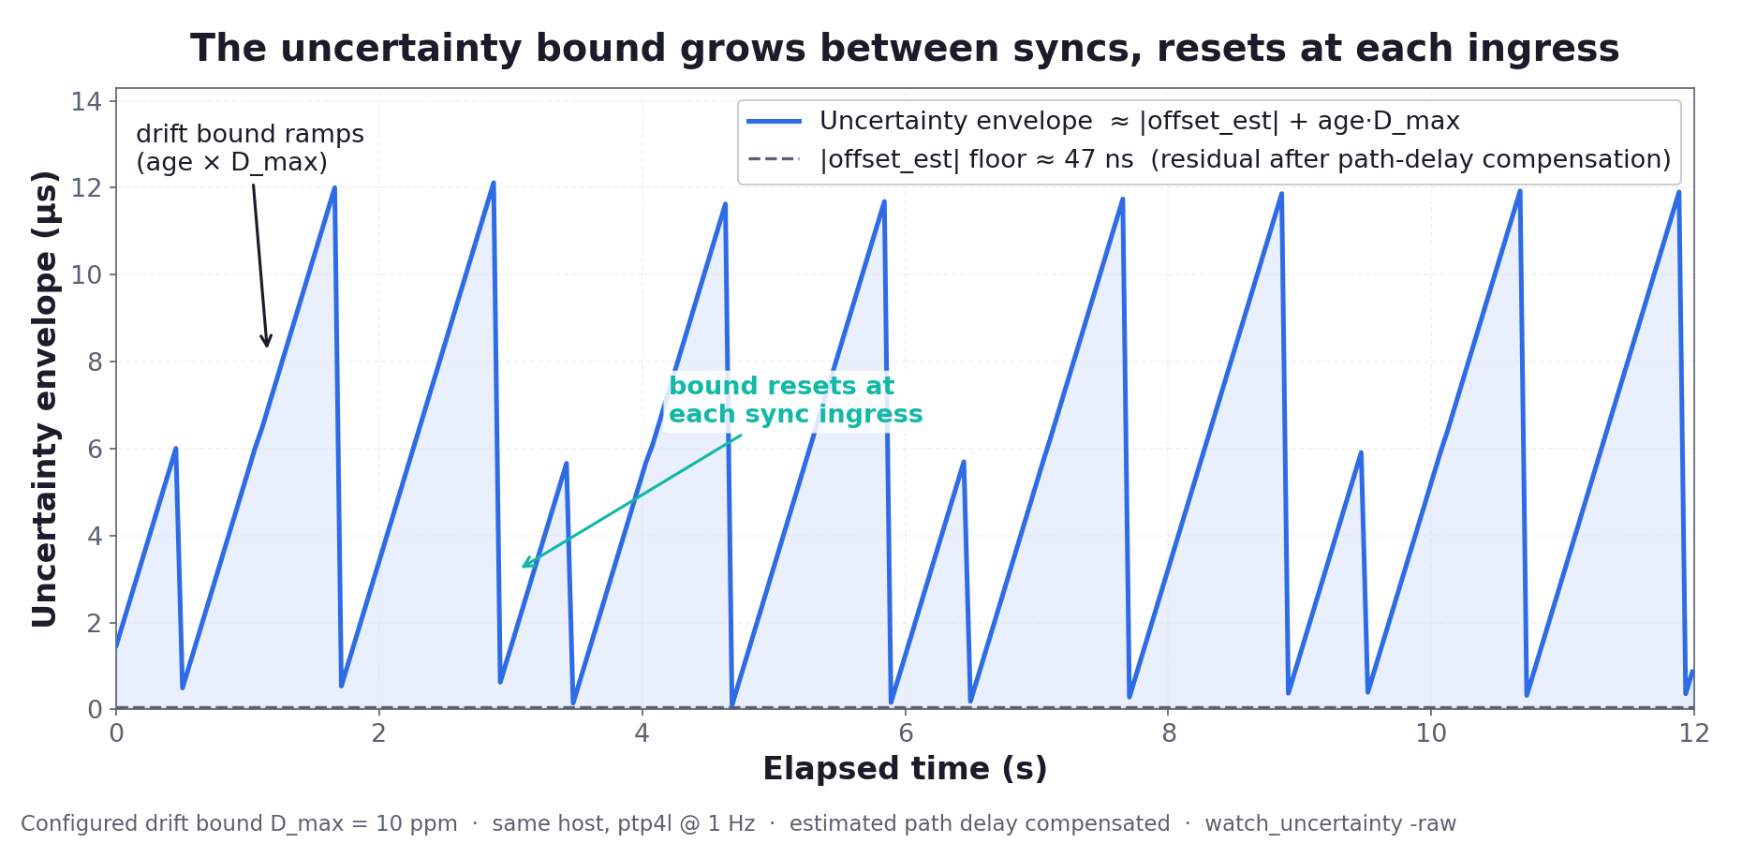
MODEL SWEEP
Between syncs the bound grows as age × D_max, then resets at ingress — this is the model's attributed drift, not measured drift.
Time Uncertainty as a First-Class Concept
31
Notes:
Here it is. That dashed line near the axis is the residual offset floor — tens of nanoseconds — what's left after the estimated path delay is compensated. [PAUSE]
Now watch the blue line. Every second a sync arrives and the bound snaps back down. Then it climbs again. And I want to be precise about what that climb is: it is the uncertainty attributed to potential drift — age times D-max. It is not a measurement of the clock physically drifting; the PHC is disciplined, its frequency correction is still programmed. The plot demonstrates the growth of the bound, not observed oscillator drift. Climb, reset, climb, reset. [PAUSE]
That sawtooth is the staleness term from slide eighteen, made visible. The envelope is widest right before the next sync — and most tools would only show you the offset, which down here looks like nothing.

Slide 31
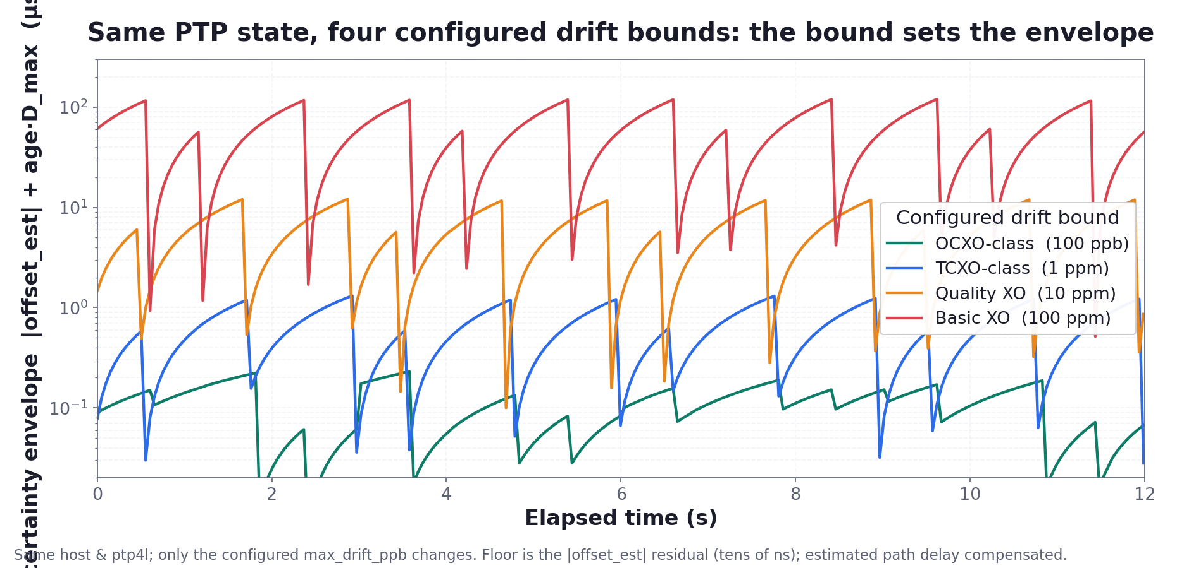
MODEL SWEEP
Same PTP state, four configured drift bounds — the assumed D_max alone spans two orders of magnitude.
Time Uncertainty as a First-Class Concept
32
Notes:
Now the same run, four times — one per configured drift bound — on a log scale, because the spread is enormous.
Every line rides on the same residual offset floor, tens of nanoseconds, because the estimated path delay is compensated. Same PTP state, same host. The only thing that differs is the assumed D-max: an OCXO assumption at 100 parts per billion, a TCXO at 1 ppm, a quality crystal at 10 ppm, and a basic crystal at 100 ppm. [PAUSE]
Look at the separation. The tight bound barely leaves the floor; the loose bound swings up past 100 microseconds between syncs. Same protocol, same second. The envelope is set by the configured bound modeling different oscillators — the assumption you feed the model — not by anything PTP measured.

Slide 32
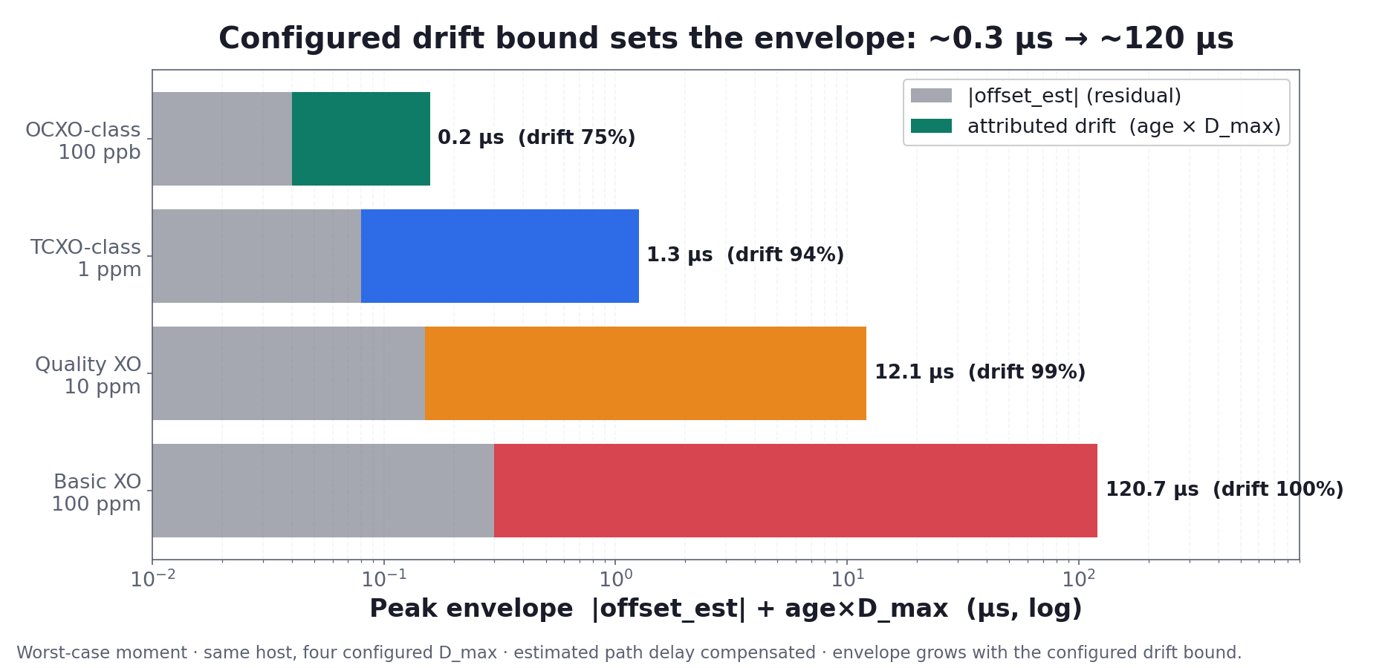
MODEL SWEEP
Between syncs the configured drift bound — not PTP — sets whether the envelope is 0.3 µs or 120 µs.
Time Uncertainty as a First-Class Concept
33
Notes:
One more view — the worst-case moment for each assumption, split into its two parts: the residual offset estimate in gray, and the attributed drift in color.
For the tight bound, the residual offset and the attributed drift are comparable — the whole envelope is a few hundred nanoseconds. Loosen the bound and the drift term takes over: ninety-nine percent, then essentially all of it. [PAUSE]
Same network, same daemon, same model — and the peak envelope runs from about a third of a microsecond to a hundred and twenty microseconds, decided by the configured drift bound alone. That's the point, and I'll state it carefully: the assumed residual-frequency bound, not measured holdover, is what dominates between syncs. Which is exactly why that bound needs to be a first-class, explicitly-configured input — and why the kernel not exposing a coherent clock-state to hang it on is the real gap. Hold that for the last section.

Slide 33
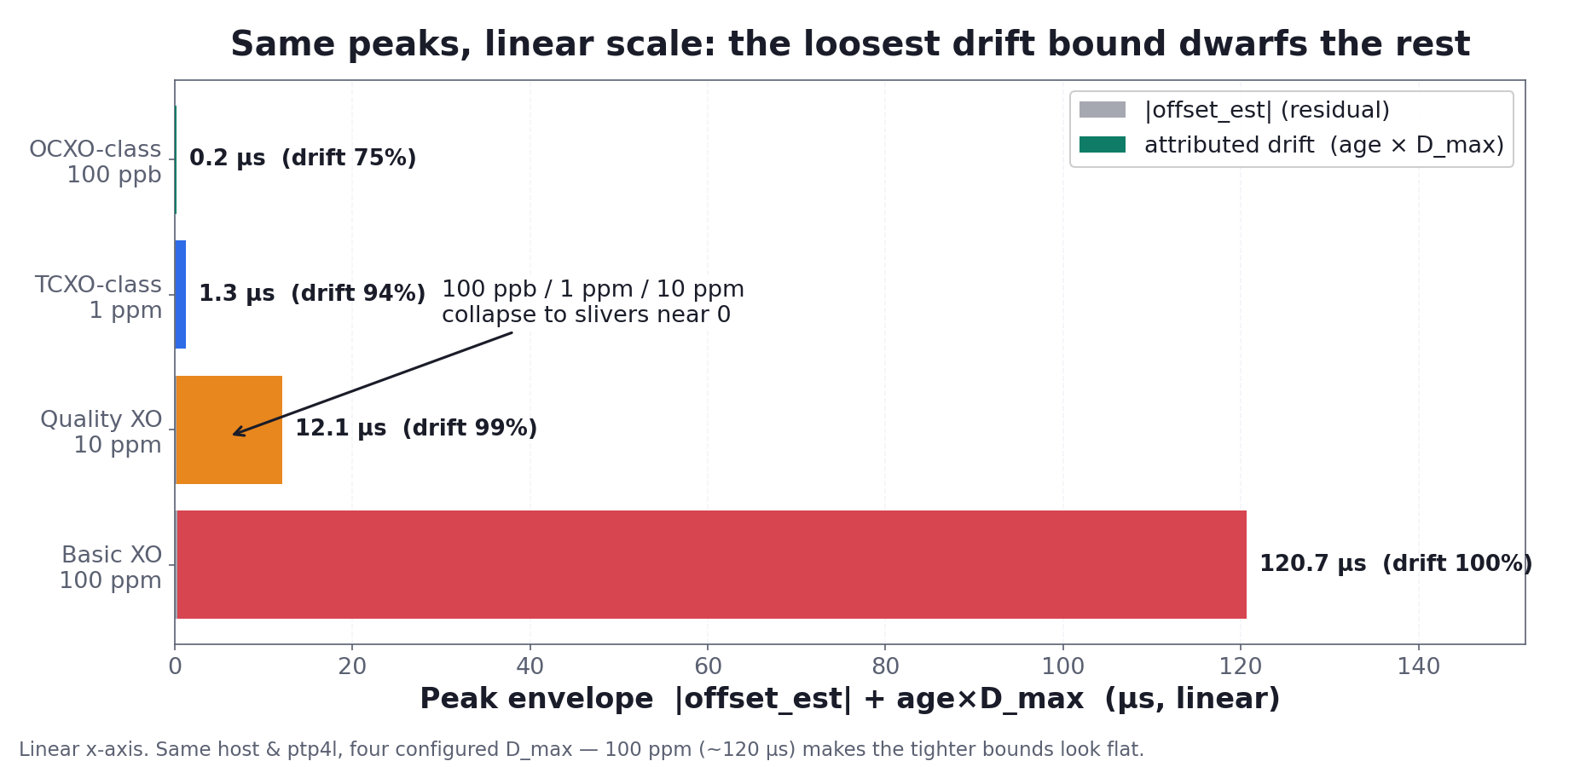
MODEL SWEEP
Between syncs the configured drift bound — not PTP — sets whether the envelope is 0.3 µs or 120 µs.
Time Uncertainty as a First-Class Concept
33
Notes:
One more view — the worst-case moment for each assumption, split into its two parts: the residual offset estimate in gray, and the attributed drift in color.
For the tight bound, the residual offset and the attributed drift are comparable — the whole envelope is a few hundred nanoseconds. Loosen the bound and the drift term takes over: ninety-nine percent, then essentially all of it. [PAUSE]
Same network, same daemon, same model — and the peak envelope runs from about a third of a microsecond to a hundred and twenty microseconds, decided by the configured drift bound alone. That's the point, and I'll state it carefully: the assumed residual-frequency bound, not measured holdover, is what dominates between syncs. Which is exactly why that bound needs to be a first-class, explicitly-configured input — and why the kernel not exposing a coherent clock-state to hang it on is the real gap. Hold that for the last section.

Slide 34
PART 7
The full story: fast time + its uncertainty
34

Slide 35
Fast access gives you the time cheaply. Uncertainty tells you how far to trust it.
The prior talk made the read fast; this one puts an error bar on it — fast time and its uncertainty, together.
Time Uncertainty as a First-Class Concept
35
Notes:
Here's the bridge, and it's the second line I want you to remember.
Last year's talk made reading the clock fast — the Hermóðr approximation gets you the device time in tens of nanoseconds instead of microseconds, without the syscall and PCIe overhead.
What this talk adds is the other half: it puts an error bar on that time. [PAUSE]
Fast access gives you the time cheaply. Uncertainty tells you how far to trust it. A timestamp you can read cheaply and trust explicitly — that's a complete time primitive, and it takes both halves to build it.

Slide 36
THE FULL STORY
Fast time + its uncertainty compose
Capability | Fast read alone | + uncertainty
Low-overhead timestamp | yes | yes
Compare two events | point compare | interval compare
Know when order is ambiguous | no | explicit
Gate decisions on trust | no | threshold on U
Merge / correlation window | fixed | adapts to live U
Time Uncertainty as a First-Class Concept
36
Notes:
Make it concrete. A fast read alone gives you a low-overhead timestamp — that's the first row, and it's genuinely valuable. But on its own it's still just a point: you compare two events point-to-point, you can't tell when the order is ambiguous, and you can't gate a decision on how trustworthy the time is.
Two events 200 nanoseconds apart, each known to within about 150 nanoseconds — the fast read alone happily says "A before B." With the uncertainty bound, that ordering is honestly ambiguous, and the system knows it. [PAUSE]
Add uncertainty and every row upgrades. Point comparison becomes interval comparison. Ambiguity becomes explicit instead of buried. Decisions can be gated on a threshold over U. And any correlation or merge window can adapt to the live quality of the clock — tight when it's good, wider when it's drifting. That's fast time and its uncertainty, composed into one primitive.

Slide 37
PART 8
Linux APIs: what we have, what we lack
37

Slide 38
KERNEL LIMITS
The kernel gives ingredients, not the recipe
Kernel today: raw ingredients
Missing: a coherent clock-state snapshot
• SO_TIMESTAMPING — HW/SW RX/TX timestamps
• PTP_SYS_OFFSET(_EXTENDED) — PHC ↔ system
• /dev/ptpN — freq adjust, ext timestamps
• sync state lives only in ptp4l userspace
• one atomic read at a defined epoch
• master_offset_ns + ingress_time_ns (anchor)
• max_drift_ppb — assumed frequency-error bound
• gm_id + steps_removed (per-hop = policy, not a bound)
• → enough metadata to derive U under stated assumptions
Time Uncertainty as a First-Class Concept
38
Notes:
The kernel gives us ingredients. On the left: SO_TIMESTAMPING for hardware and software timestamps; PTP_SYS_OFFSET to cross-reference the PHC against the system clock; and /dev/ptpN for frequency adjustment and external timestamps.
But notice the ptp4l management socket. It lives in userspace. So the one thing we actually need — the disciplined PTP sync state — exists only inside ptp4l, and the only way to get it today is to talk to that daemon out-of-band.
That's the gap I want to close. The problem isn't merely that the data lives in userspace. It's that Linux and PTP expose no coherent clock-state at a single observation epoch. Remember slide twenty-one: offset comes from one dataset, ingress from another, polled independently — I had to stitch non-atomic observations into one "now." So the primitive I'd add isn't just "expose max_drift_ppb." It's one atomic snapshot at a defined epoch, built on the structure this daemon already publishes: master_offset_ns and ingress_time_ns together as the anchor; max_drift_ppb as the assumed frequency-error bound; the grandmaster identity and steps_removed — though I'll be honest that per-hop error is a crude policy, not a physical bound, since a transparent clock and a boundary clock fail differently. Enough metadata, at one epoch, to derive an uncertainty envelope under stated assumptions. [PAUSE]

Slide 39
CLOSING
Takeaways
▸ Timestamps are intervals — design systems around t ± U
▸ U is an envelope under stated assumptions, not a proven bound
▸ Separate U_clock (daemon) from U_capture (application)
▸ Staleness is an attributed drift bound — the term most tools ignore
▸ Missing kernel primitive: a coherent clock-state at one epoch
▸ The full story: fast access to the time and its uncertainty
Time Uncertainty as a First-Class Concept
39
Notes:
Six things to take with you.
One: timestamps are intervals. Design your systems around t plus-or-minus U.
Two, and this is the honest one: Uncertainty is a computed envelope under stated assumptions, not a proven upper bound. Name the assumptions and it's defensible.
Three: separate the two owners — U-clock, which the daemon bounds, and U-capture, which the application knows. The event uncertainty is their sum.
Four: staleness is an attributed drift bound — age times a configured frequency-error limit, not measured oscillator drift. It's the term most tools ignore; don't.
Five: the real missing kernel primitive isn't a drift number — it's a coherent clock-state at one observation epoch, with enough metadata to derive an envelope.
And six, the one that ties the two talks together: fast access gives you the time cheaply, and uncertainty tells you how far to trust it — fast access to the time and its associated uncertainty.

Slide 40
Questions?
Treat time as an interval. Make the error bar part of the data.
ptp-uncertainty · daemon + libptp_unc.so + watch_uncertainty
Notes:
Offer to collaborate with profiling-tool authors. Have the demo plot ready as a backup.

Slide 41
PTP → BOUND
Sync status is a prerequisite, not a proof
Port state | Meaning for uncertainty
SLAVE | actively disciplining — bounds meaningful
UNCALIBRATED | converging — bounds unstable
LISTENING / FAULTY | do not trust ordering claims
ptp4l disconnected | hold last anchor + drift keeps growing
Time Uncertainty as a First-Class Concept
23
Notes:
One more piece before we build it: the port state gates whether the bound even means anything.
In the SLAVE state, we're actively disciplining — the bounds are meaningful. In UNCALIBRATED we're still converging — the bounds are unstable, don't lean on them. In LISTENING or FAULTY, don't trust ordering claims at all.
And the interesting one: when ptp4l disconnects. We hold the last anchor — and the drift just keeps growing from it. The bound doesn't freeze; it inflates, honestly reflecting that we're flying on a stale correction. Synchronization status is a prerequisite for trust — it is never a proof of it.

Slide 42
