Slide 1
Prediction of Price Fluctuation of Used Cellphones on Amazon by Twitter
----Tonghe Zhan, Qingyuan Wen

Slide 2
Introduction
Our project focus on the used cellphone from 3rd party on Amazon.
People want to know the trend of a certain used cellphone to choose the best time to buy it from 3rd party on Amazon.
So, we use sentimental classification to find out whether we can predict the price of them by twitter, and find out if there are any correlation between them.
We choose a representative amount lots of cell phones -- Samsung Galaxy S - i9000.

Slide 3
Hypothesis
The comments of cellphones on Twitter will affect the price of the used cellphone from 3rd party on Amazon.

Slide 4
Data
All the tweets contain the words: “galaxy s”, “i9000” from Sempter 1 to December 31, in 2011. There are more than 10,000 tweets in the raw dataset.They are collected by professor.
In the same period, the price of this cell phone on Amazon. We use a Amazon price tracker website Keepa.com to collect it.

Slide 5
Methods
We use the Amazon price tracker website --Keepa.com, find the data we want.
We choose two representatives of Samsung i9000 which sells well in 2011.
We begin our sentiment analysis by applying Alex Davies’ word list in order to see if a simple approach is sufficient enough to correlate to price change.
Notes:
At first, we are going to use another price tracker named Camelizer. But it can only provide the trend of the price of a certain cellphone without any accurate number. So we find the Keepa. And we record the price day by day manually.
Because we are new students here and neither of our major is Computer Science during undergraduate course. So we do most of our work using JAVA such as filter, sort and calculate. We only using Python dealing with the sentimental analysis of the tweets.

Slide 6
Figure 1. The average price fluctuation of i9000 combined with 2 model.

Slide 7
Handle the dataset from twitter
Filter
After filtering the dataset, we get 3369 tweets
which really talk about the cell phone. We eliminate those are talking about ‘galaxy s ii’ or ‘galaxy s 2’ which also contain ‘galaxy s’, and other situations, such as, in a tweet, user actually talk about galaxy s 2, but they will mention galaxy s just as a comparative object.

Slide 8
sort
Then a new dataset we got, we sorted them by date.
Sentimental analysis
We begin our sentiment analysis by applying Alex Davies’ word list.
Calculation
After we got the ‘happy’ probability of each tweet then calculate a daily ‘happy’ probability.

Slide 9
Figure 2: the original result of the daily ‘happy’ probability.

Slide 10
Figure 3: the result added the factor ‘X’

Slide 11
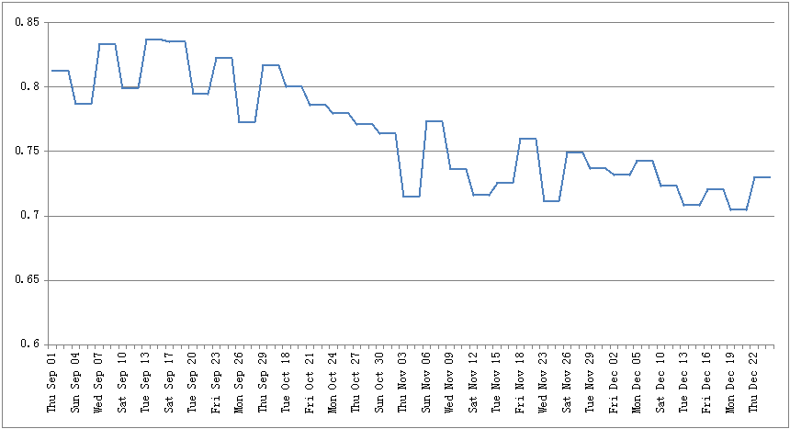

Slide 12
Result
From the figures we can see that the change of the price will follow the trend of evaluation on twitter.
The influence will be shown on price after 10~20 days later.

Slide 13
Related Paper
Actually, we do not find any similar paper of this topic.
We focus on predicting the price of second hand market on Amazon.

Slide 14
Future work
To choose other kinds of cell phones test our method.
Improving the accuracy of result by using larger dataset
To check out in the same certain period if there are new cell phones of other brands released.

Slide 15
Thank You!

