Slide 1
Final LLM Chatbot Project
Design, Scope, Challenges, Learnings

Slide 2
Problem Addressed
General-purpose chatbots can sound fluent but still hallucinate.
Academic/project users need grounded answers with transparent sources.
The project targets a bilingual assistant: English input, Spanish-first output.

Slide 3
Scope and Objectives
Build a working chatbot with web UI + API backend.
Route intelligently between grounded retrieval and general LLM response.
Provide Spanish output with optional English for transparency.
Support fallback responses when confidence is low.
Keep architecture modular for future extension.

Slide 4
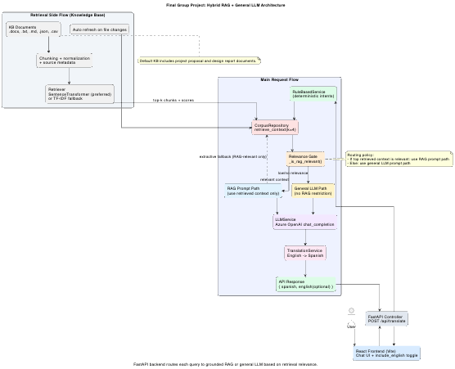
System Design
Frontend: React chat interface (message thread + loading state).
Backend: FastAPI with MVC-style layers (controllers/services/repositories/models).
Retrieval: SentenceTransformer (preferred) with TF-IDF fallback.
Generation: Azure OpenAI for RAG completion, general QA, and translation when configured.
Architecture

Slide 5
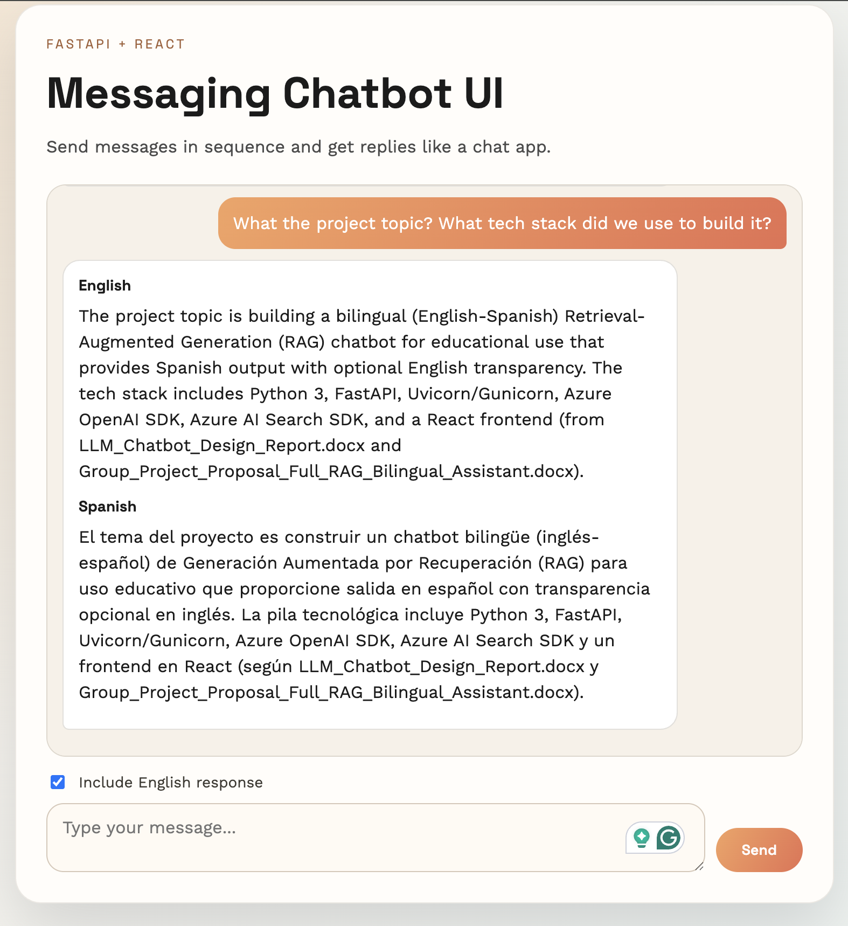
App Screenshot: Chat Experience
Sequential conversation flow in a messaging layout.
User prompt + assistant bilingual response.
Include-English toggle for response transparency.
Chat UI

Slide 6
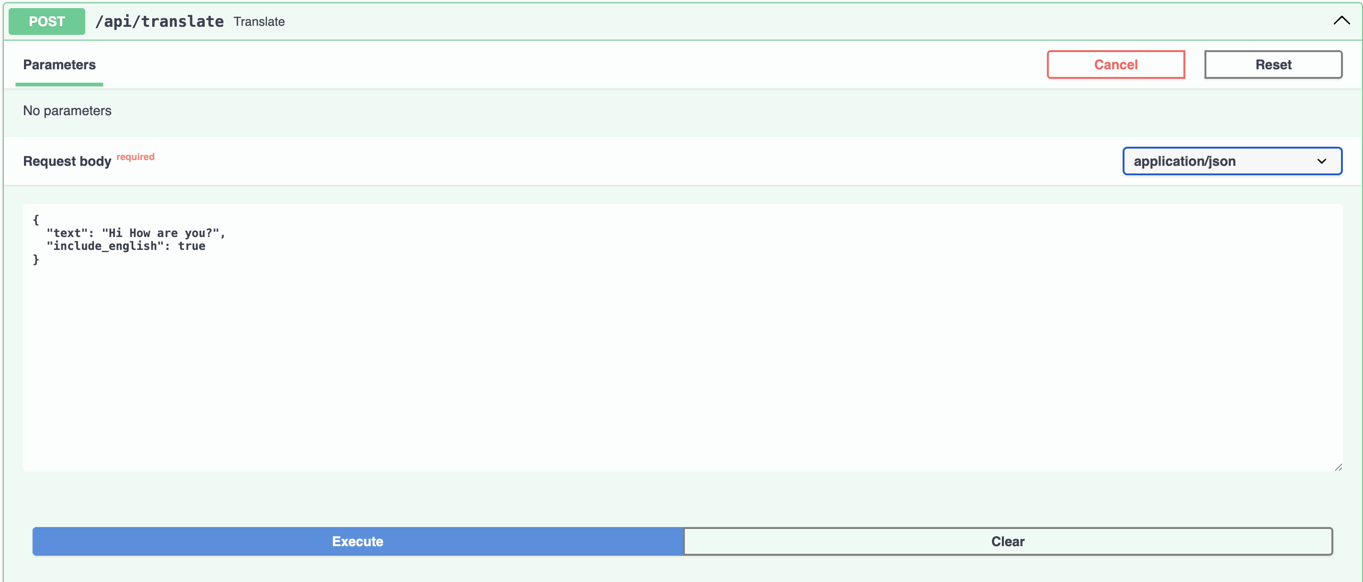
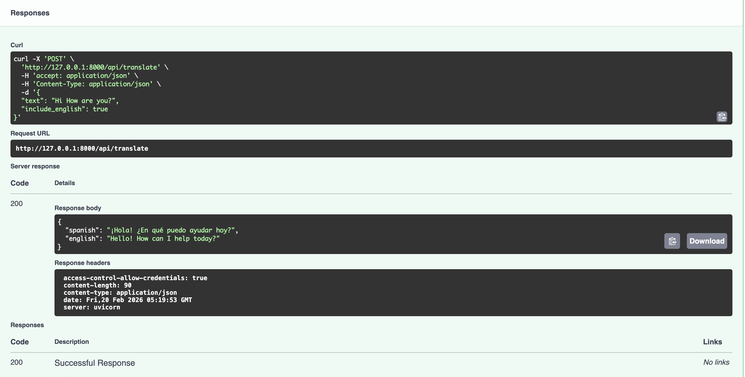
App Screenshot: Response Payload
API route: POST /api/translate
Request: { text, include_english }
Response: { spanish, english } (english optional)
API Response

Slide 7
Approach from Proposal to Build
Proposal goal: RAG-based bilingual assistant with citations.
Implemented practical hybrid strategy:
Rule-based first
Retrieval relevance check second
RAG path for in-domain queries; general LLM path for out-of-domain queries
Reason: better reliability, lower cost/latency, graceful degradation.

Slide 8
Challenges Encountered
Environment/dependency availability varied by runtime.
Retrieval tuning required trial-and-error (chunk size, similarity thresholds).
Maintaining concise bilingual quality required prompt calibration.
Coverage limitations in knowledge base can still produce uncertainty.

Slide 9
Key Learnings
Hybrid architecture outperforms pure-LLM in reliability for scoped domains.
Clean layer separation improves maintainability and debugging speed.
RAG quality depends heavily on data chunking and retrieval thresholds.
Fallback behavior is critical for user trust.

Slide 10
Conclusion and Next Steps
Final chatbot now supports both grounded RAG answers and general LLM Q&A.
Future upgrades:
Session memory for multi-turn continuity
Better observability and evaluation metrics
Expanded multilingual and guardrail support

