Slide 1
The Story of Kevin Mitnick, the World's Most Notorious Hacker Mackenzie Wessels Southern Charleston University CSCI 405: Principles of Cyber Security Professor Patrick Hill October 3, 2023

Slide 2
Introduction
Kevin Mitnick is often described as "The world's most famous hacker" by media outlets.
He is a central figure in the history of hacking, with a story that captivates both the cybersecurity community and the general public.
Mitnick's journey from a teenage hacker to a respected cybersecurity consultant is a testament to the complex and evolving nature of the digital age.
Notes:
In this presentation, we will cover the journey of Kevin Mitnick, a name synonymous with hacking and computer security breaches.

Slide 3
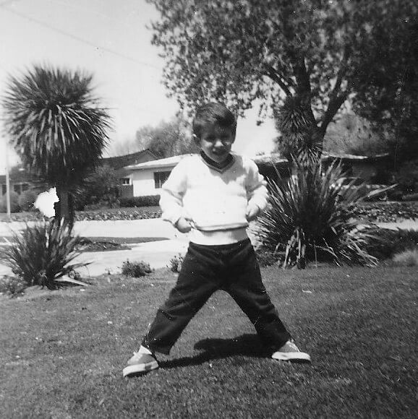
Early Life
Kevin Mitnick was born on August 6, 1963, in Los Angeles, California.
From a young age, he displayed an intense interest in technology and computers.
At age 12, he had already mastered the art of phone phreaking, exploring the telephone system vulnerabilities.
Notes:
Kevin Mitnick's fascination with technology started at an early age, setting the stage for his future in hacking.

Slide 4
Hacking Incidents
According to an article in Forbes Magazine, Mitnick was arrested several times for hacking.
1981 - Pacific Bell, making his own copies of pacific bells computer manuals
Probation
1982 - University of Southern California, unauthorised access to the school network
Six months jail time
1987 - Santa Cruz Operation, copying software
Three years probation
1988 - Second breech at DEC, copying their VMS mini computer operating system
One year in prison and six months of counselling for computer addiction . (Forbes, 2013)
Notes:
Kevin Mitnick garnered global attention with his hacking exploits, resulting in widespread disruption and heightened awareness of cybersecurity weaknesses.

Slide 5
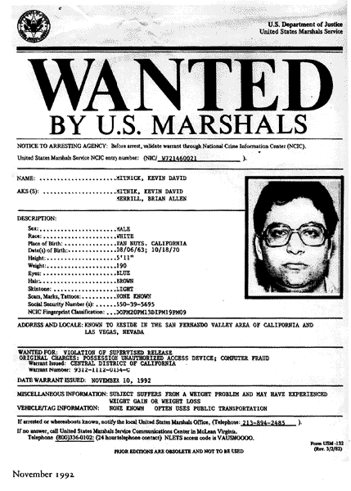
Life on the Run
Near the end of his supervised release, Mitnick was informed about being monitored and then fed information about a system that would let him do counter surveillance.
Pacific Bell was indeed wiretapping the phone lines, but once kevin realized he had been baited it was already too late.
FBI issued a warrant for Mitnick causing him to run away and disappear as a fugitive.
Mitnick wiretapped phone lines, intercepted communications, and gathered intelligence to stay ahead of authorities.
Notes:
Kevin's ability to evade law enforcement for years added to his mystique as a cyber fugitive.

Slide 6
Capture and Imprisonment
He was finally tracked down by Tsutomu Shimomura who had been hacked by Mitnick previously.
FBI then issued a warrant and Mitnick was arrested.
He was sentenced to four and a half years in prison and 8 months in solitary confinement.
Notes:
Following an extensive pursuit, Kevin Mitnick was apprehended, brought to trial, and subsequently sentenced to prison.

Slide 7
Controversy
Mitnick was detained without a trial and did not have access to his lawyer.
During his testimony in front of a Congressional hearing in 2000, Mitnick defended his hacking as non-malicious. “My goal was not to cause any harm. It was not to profit in any way” (GovInfo, 2000, p. 12).
Theft and fraud guidelines punish based on value of property taken, damaged, or destroyed. Mitnick did not deprive these companies of their software.
The prosecution asserted that the value of his copied source code was essentially the what the company had invested in research and development
Notes:
Upon his release, Kevin Mitnick underwent a remarkable transformation, redirecting his skills towards positive contributions in the realm of cybersecurity.

Slide 8
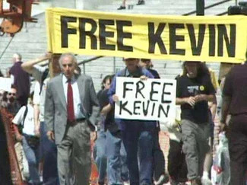
The Release
While in prison kevin received a huge amount of support from the public, the free kevin movement
Protesters also tried to stop Miramax from producing a movie that paints Kevin Mitnick in a negative light. Takedown (2000)
January 21 2000 kevin was released from prison

Slide 9
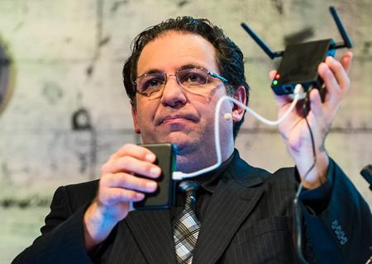
Mitnick's Contributions
Kevin Mitnick's post-prison career saw him becoming a respected figure in cybersecurity.
He founded Mitnick Security, a consulting firm specializing in cybersecurity.
Mitnick became a sought-after public speaker. Often focusing on the human element
Notes:
In his post-prison career, Kevin established himself as a respected authority in cybersecurity, offering valuable insights and solutions to the field.

Slide 10
Conclusion
Kevin Mitnick died july 16, 2023
Mitnick's story emphasizes the role of social engineering in hacking.
It underscores the importance of human-centric security measures.
Cybersecurity is not just about technology; it's about understanding and countering human vulnerabilities.
Notes:
A crucial lesson from Kevin Mitnick's narrative underscores the significant influence of human behavior on cybersecurity.

Slide 11
References
Forbes Magazine. (2013, June). The Troubled Path of Kevin Mitnick. Forbes. https://www.forbes.com/global/1999/0419/0208024s1.html?sh=4db18ae055bd
GovInfo, U.S. Government Publishing Office. (2000, March). Cyber Attack: Is the Government Safe? GovInfo. https://www.govinfo.gov/content/pkg/CHRG- 106shrg63639/html/CHRG-106shrg63639.htm

