Slide 1

Step #1:
Create a Grammar

Slide 2
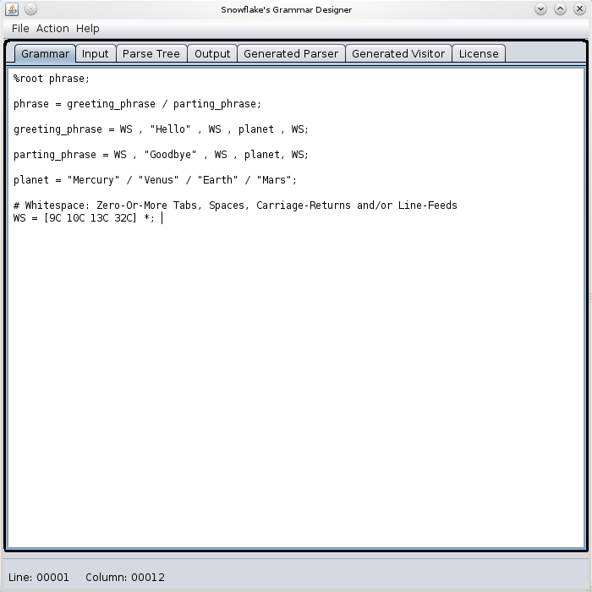

Slide 3
Step #2:
Enter Some Input to Parse

Slide 4
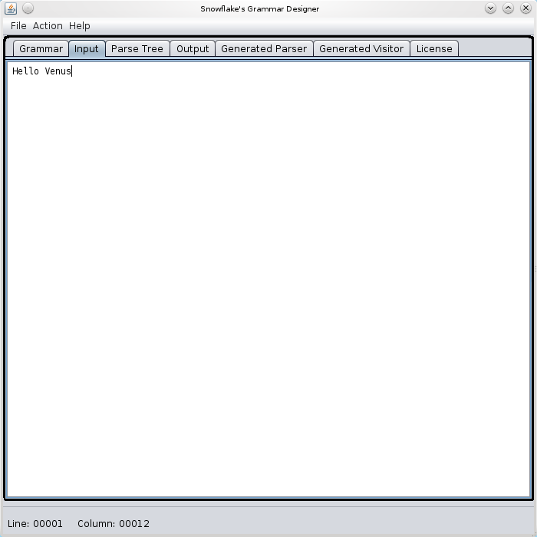

Slide 5
Step #3:
Click Action → Parse on the Main Menu

Slide 6
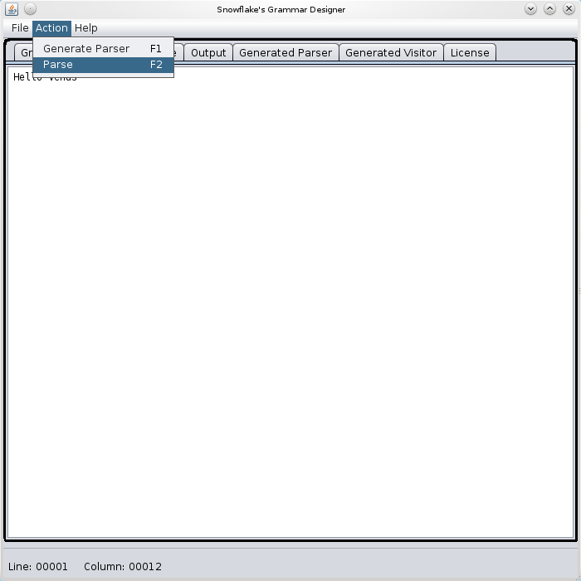

Slide 7
Step #4:
View the Parse-Tree

Slide 8
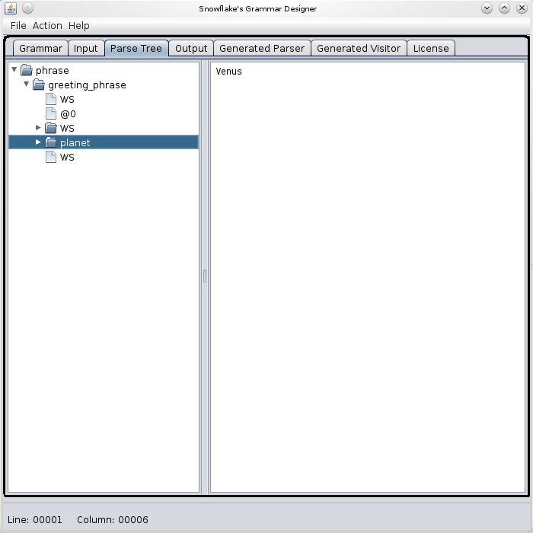

Slide 9
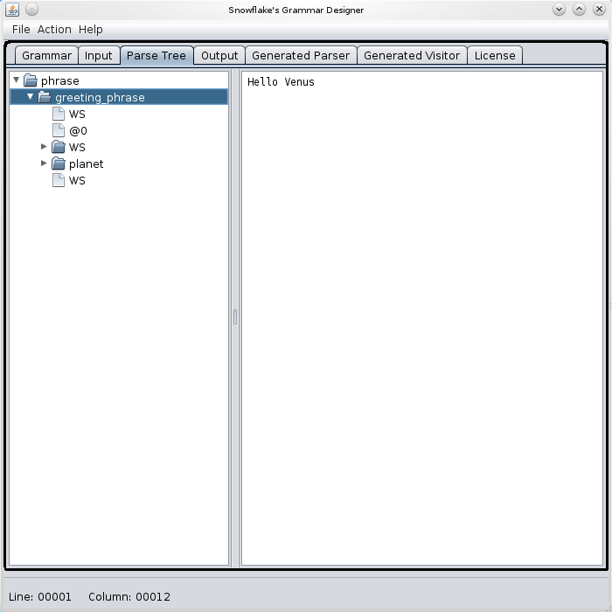

Slide 10
The End!

