Slide 1
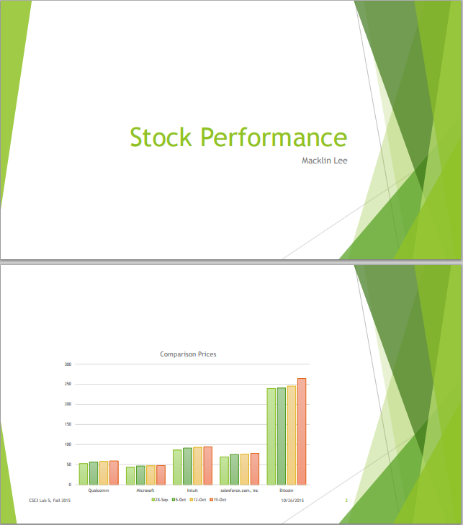
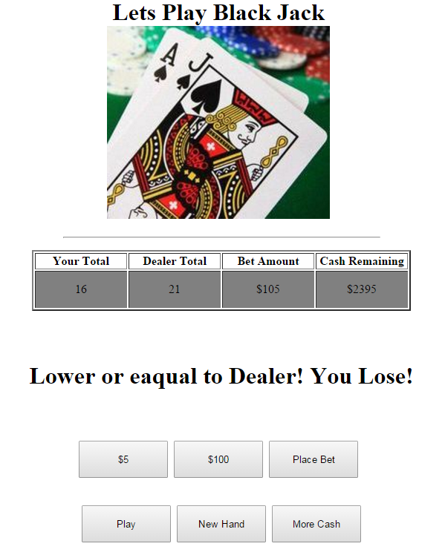
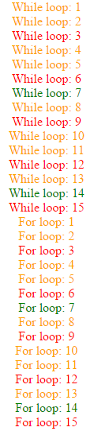
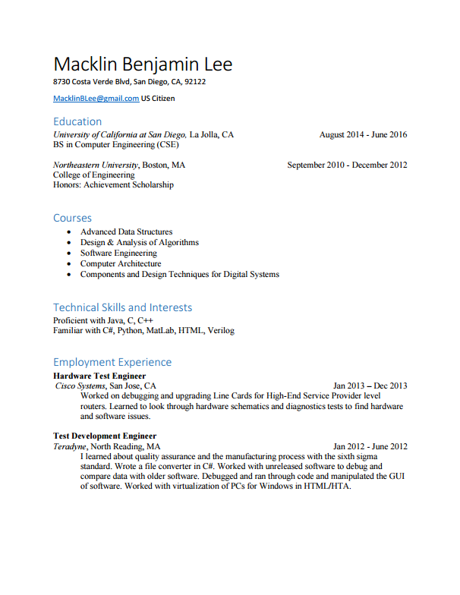
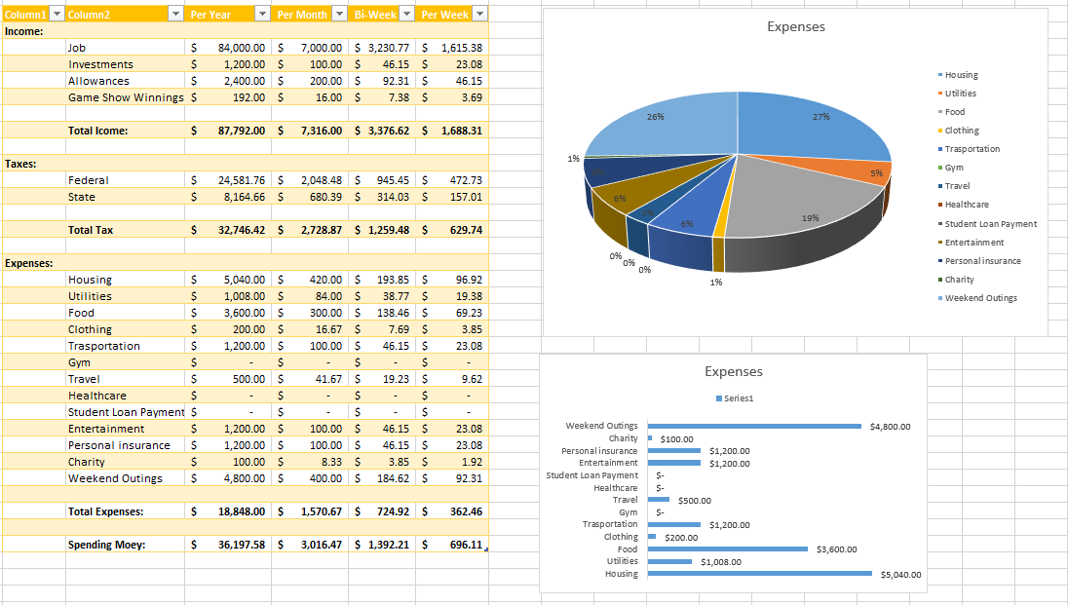
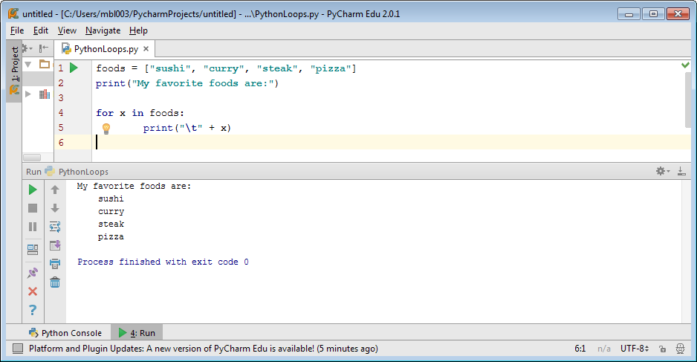
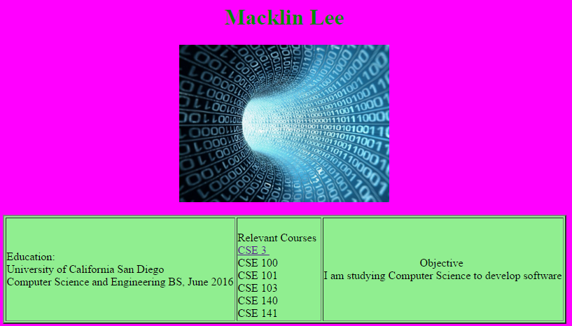
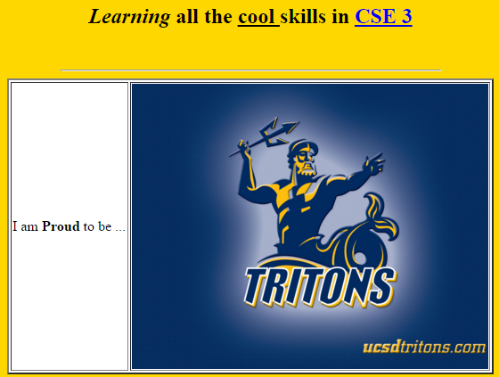
Adventures in Computational Thinking
By Macklin Lee
Presentation of Information with
MS PowerPoint
Dynamic Webpage Programming
with JavaScript
Learning how to use powerpoint. I like designs.
Computational Thinking
Learning how to
use JavaScript. I
can write loops
Introduces the concepts and skills necessary to effectively use information technology. Includes basic concepts and some practical skills with computers and networks.
Desktop Publishing with MS Word
Data Analysis and Visualization
with MS Excel
Learning how to use MS Work. My resume is formated
Learning how to
use MS Excel. I
Can make
Spreadsheets.
Making Information Available to the World with
HTML and Web Pages
IDLE (Integrated Development and Learning Environment) Programming with Python
Learning how to use HTML. I have a website.
Learning how to use Python. I can code.

