Slide 1
Café Management

Slide 2
Aim
Make bill easy
It not complicate to use
Help to learn easy
Simple way to make billing

Slide 3
The topic of my project café management is a method for cafeteria billing. It is a tool for vendor-side billing. A list of the cafe's products will be available on the dashboard.
Just the count needs to be added, and the product needs to be enabled.
The bill is provided in the text area, and the bill number is produced at random.
Also, the bill includes the product's name and quantity.
Finally, there are four buttons: total, receipt, reset bill, and exit.

Slide 4
Tools used
Apache netbeans
Core language
java

Slide 5
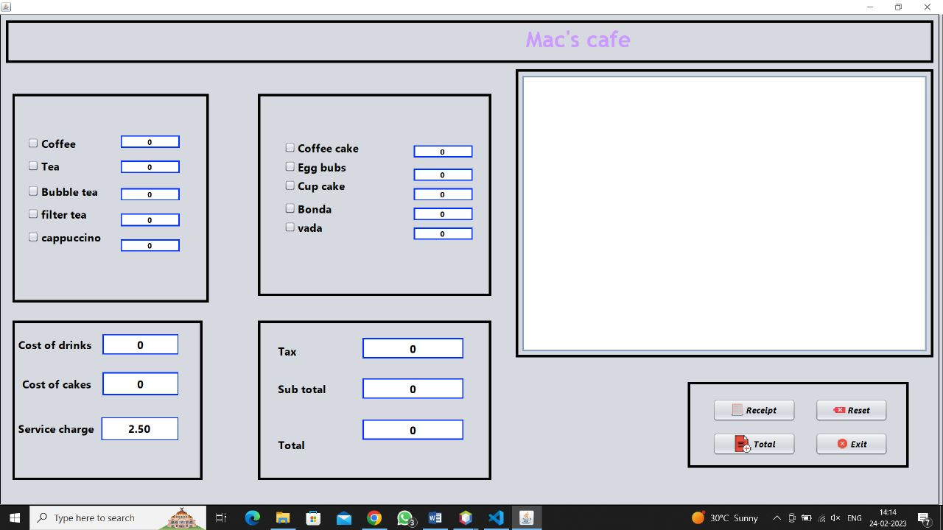
Preview image

Slide 6
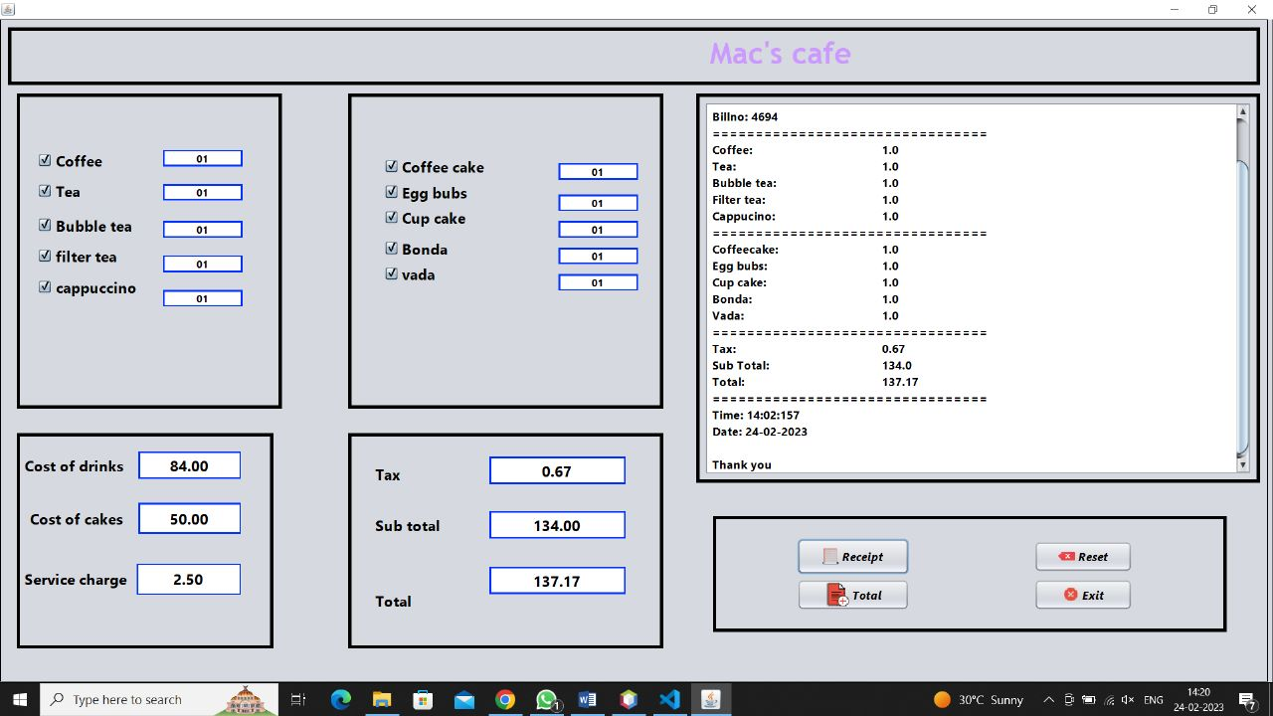
Preview with data loaded

Slide 7
Thank you

