Slide 1
4201328 – Design and Verification of Digital Systems 2025-2S
Juan Bernardo Gómez Mendoza
Universidad Nacional de Colombia Sede Manizales

Slide 2
Outline
Introduction
Evaluation
Schedule
Methodology
References

Slide 3
Introduction

Slide 4
Motivation
Electronics Market | Global Industry Analysis 2033
Mapping the Semiconductor Supply Chain: The Critical Role of the Indo-Pacific Region
Xiaomi breaks into 3nm chip territory: China's semiconductor advancement accelerates
Europa Avanza en Soberanía Tecnológica: eProcessor Ejecuta Linux con Éxito en Chip Abierto — Andalucía Informa
Los fabricantes de chips buscan talento con urgencia. Solo en Europa hacen falta 100.000 ingenieros más
Senado de la República de Colombia

Slide 5
Description
This course provides students with a comprehensive understanding of the design and verification of digital systems, covering the complete lifecycle from specification to implementation and validation. Students will learn to create modular and hierarchical designs, develop verification strategies, and assess verification quality using advanced methodologies such as assertion-based verification (ABV), constrained-random testing, and coverage analysis. Through hands-on labs and a capstone project, students will gain practical experience with tools and workflows used in the industry while also developing problem-solving and teamwork skills.

Slide 6
Goals
Cognitive Domain (Knowledge and Understanding)
Students will understand the stages of digital system design and verification, including specification, implementation, and validation.
Students will analyze design requirements and implement appropriate verification strategies using established methodologies.
Students will learn key concepts of functional verification, including the creation of testbenches and simulation workflows, and will use assertions to validate digital systems.
Students will design scalable and reusable digital components using modular and hierarchical approaches.
Students will evaluate and optimize the thoroughness of verification efforts using coverage metrics to identify and address deficiencies.

Slide 7
Goals
Psychomotor Domain (Skills and Application)
Students will collaboratively design, implement, and verify a complex digital system, presenting their results professionally.
Students will create and debug testbenches, execute simulations, and use verification tools to validate digital systems.
Students will work in teams to implement technical workflows for design and verification, completing specific tasks within a group project.

Slide 8
Goals
Affective Domain (Values, Attitudes, and Collaboration)
Students will develop teamwork and collaboration skills by working in groups to complete the capstone project and other tasks.
Students will refine critical thinking and adaptability by analyzing design and verification challenges and adjusting solutions in response to feedback or unexpected results.

Slide 9
Evaluation
Homeworks | 50%
Capstone Project Module description and design Verification criteria Verification results Documentation | 50% 10% 10% 10% 20%

Slide 10
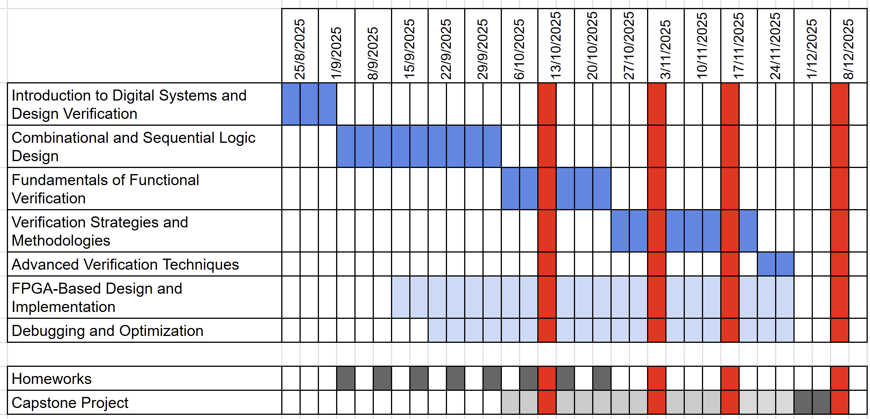
Schedule

Slide 11
Methodology
Face-to-face sessions on mondays and fridays. The sessions comprise both lectures and guided lab work.
Use of computational tools required: verilog and/or SystemVerilog interpret or compiler; wave and time diagram visualization tools.
Installation and use of propietary computational tools is encouraged, mainly for FPGA programming and design analysis.
A capstone project is to be carried out in the course. It is to be done in pairs.
All class homework is to be presented in pairs, unless explicitly stated.

Slide 12
References
Author | Title | Editor | Year
Ray Salemi | The UVM Primer: A Step-by-Step Introduction to the Universal Verification Methodology | Boston Light Press | 2013
Ashok B. Mehta | ASIC/SoC Functional Design Verification: A Comprehensive Guide to Technologies and Methodologies | Springer | 2017
Erik Seligman MS, Tom Schubert, M V Achutha Kiran Kumar M.Tech | Formal Verification: An Essential Toolkit for Modern VLSI Design 2nd Edition | Morgan Kaufmann | 2023
Frank Bruno, Guy Eschemann | The FPGA Programming Handbook: An essential guide to FPGA design for transforming ideas into hardware using SystemVerilog and VHDL 2nd ed. Edition | Packt Publishing | 2024
Stuart Sutherland | RTL Modeling with SystemVerilog for Simulation and Synthesis: Using SystemVerilog for ASIC and FPGA Design | CreateSpace Independent Publishing Platform | 2017
Problem sets - HDLBits

