Slide 1

Virtual Backpack
Design Documentation

Slide 2
Use cases(Features of the Project)
User
Register
Login
Add book to inventory
Search a book
Delete a book
View Books
Edit Book Records
Books Database Admin
Update records
Show books status

Slide 3
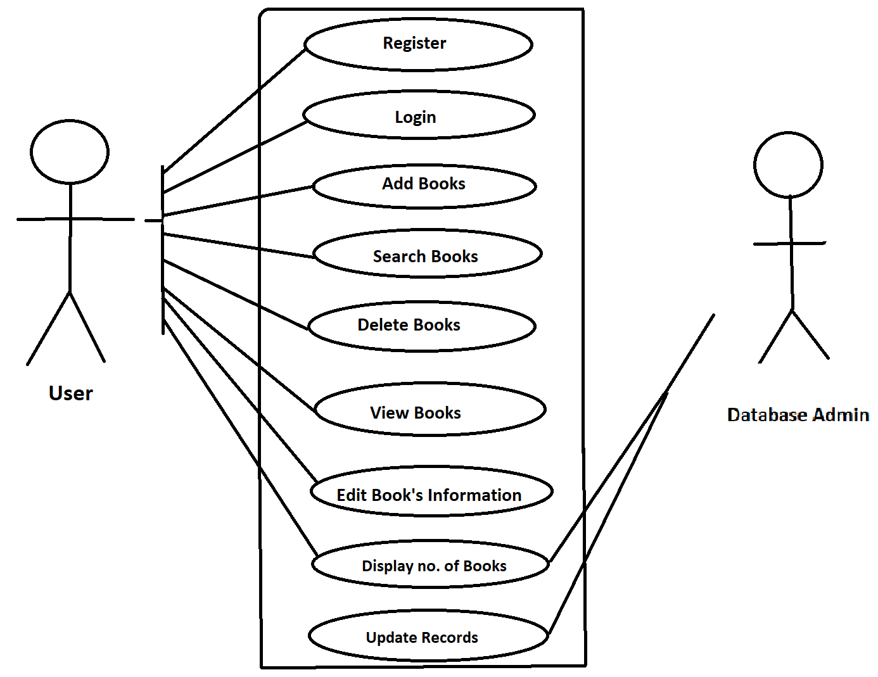
Use Case Diagram
Database Admin
DATABASE ADMIN
Admin

Slide 4
Use-Case Descriptions
uc01
Name : Register
Actors : User
Description : Allows new user to register for an account
Pre-conditions : None
Post-conditions : An account is created for a user
Main Flow :
User | System
1.Choses the sign-up/register option.
 | 2.Prompts for data required for data required for registration.
3.Enters the data prompted by the system.
 | 4.Validates user information 4.1)if the information is valid, create a new account. 4.2)if invalid, display error message and prompt for new values.

Slide 5
Uc02
Name : Login
Actors : User
Description: Allows registered users to login.
Pre-conditions : Users should be registered with the system.
Post-conditions : User logs in and all the options are displayed on the screen.
Main flow :
User | System
1. Chooses login option and enters username and password.
 | 2. Validates username and password . 2.1)If the username is invalid ,display error message and prompt for valid username. 2.2) if the password is invalid ,display error message and prompt for valid password. 2.3) If the username and password are valid, then login and display the home page.

Slide 6
Uc03
Name : Add book
Actors : User
Description : Allows user to add a book to the inventory.
Pre-conditions : User should be logged in.
Post-condition : Book details are recorded in the database.
Main Flow:
User | System
1.Selects add a book option and enters required book details.
 | 2. Book details are recorded in the database.

Slide 7
Uc04
Name : Search for a book
Actor : User
Description : Allows user to search for a book in the database by entering book Information.
Pre-condition :User should be logged in.
Post-condition : required book information is printed on the screen.
User | System
1.Selects the search a book option .
 | 2.All Books present in the database are shown on the screen with details.

Slide 8
Uc05
Name : Delete a book.
Actor : User
Description : Book details are removed from the database.
Pre-conditions : Book should be added to the database first.
Post-conditions : Book is removed.
Main Flow :
User | System
1. Selects delete a book option and enters name of the book.
 | 2.Validates name of the book 2.1) If book name is valid then book is removed from the inventory. 2.2) If book name is not valid , display error message book not present in the inventory.

Slide 9
Uc06
Name : View Books
Actor : User
Description : Quantity and Names of all Books are shown
Pre-conditions : Book should be added to the database first.
Post-conditions : Quantity and Names of all Books are shown
Main Flow :
USER | SYSTEM
1.Selects option to view all books
 | 2.All the details and quantity of the books stored in the inventory are displayed

Slide 10

THANK YOU BY TEAM – B20

