Slide 1


Realtime Log Analytics
Fastly
PRIVATE & CONFIDENTIAL
July 2021

Slide 2





Demo Solution Architecture
Log Stream
Log Processor
(enrich, transform)
Log Stats
Generator
(1m)
Dashboard
Query Workers
Users
Simulator
Logs
collection
url-stats
(1m)
error-stats
(1m)
visitor-stats
(1m)
latency-stats
(1m)
code-stats
GDN within Data Center
PRIVATE & Confidential

Slide 3
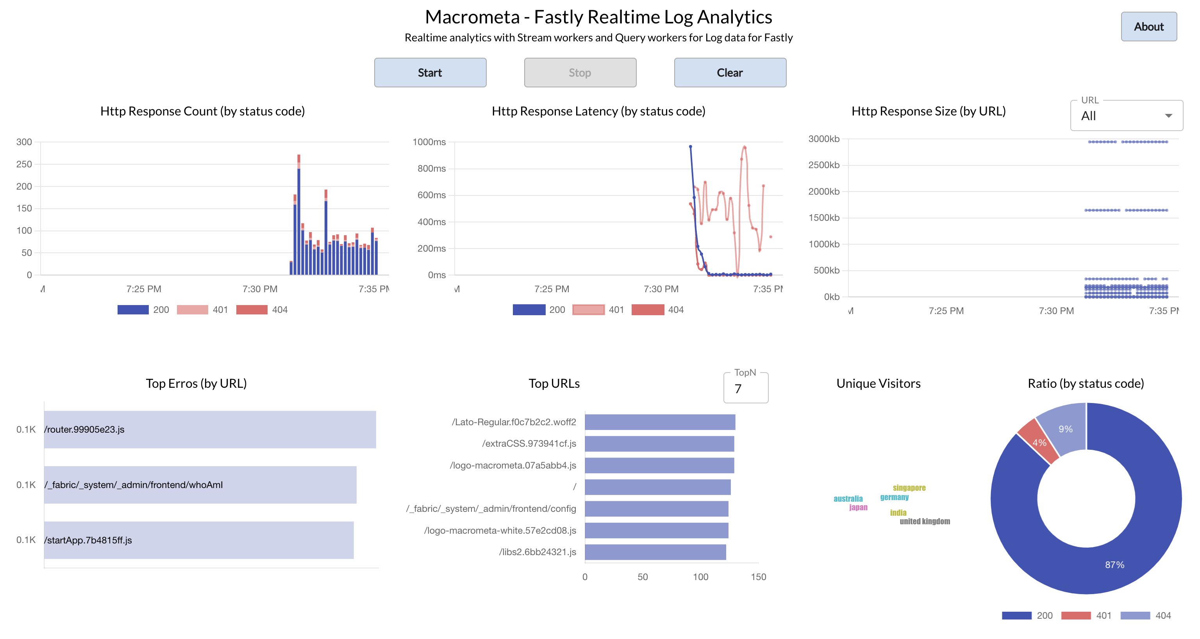
Dashboard

Slide 4
Log Stats Worker (Fragment)
@source(type="c8streams", stream.list="intermediate-stream", replication.type="global", @map(type='json'))
define stream IntermediateStream(request_10sec_timeframe long, request_timeStamp long, request_method string, response_status int, url string, response_body_size long, latency long, country string, client_ip string);
@store(type="c8db", collection="http_response_code_stats_1m", @map(type='json'))
define table HttpResponseCodeStats1min(request_10sec_timeframe long, response_status int, count long);
@sink(type="c8streams", stream="http_response_code_stats_1m", replication.type="global", @map(type='json'))
define stream HttpResponseCodeStats1minStream(request_10sec_timeframe long, response_status int, count long);
--stream to count total number of request stats grouped by response_status for every 10 sec.
SELECT
request_10sec_timeframe,
response_status,
count() as count
FROM IntermediateStream#window.externalTimeBatch(request_timeStamp, 10 sec, request_10sec_timeframe)
GROUP BY response_status
INSERT INTO HttpResponseCodeStats1minStream;
--Persist into db, the calculated total count of request stats grouped by response_status for every 10 sec.
SELECT
request_10sec_timeframe,
response_status,
count() as count
FROM IntermediateStream#window.externalTimeBatch(request_timeStamp, 10 sec, request_10sec_timeframe)
GROUP BY response_status
INSERT INTO HttpResponseCodeStats1min;
PRIVATE & Confidential

Slide 5
Collections
Logs
{
"client_ip": "176.58.100.180",
"fastly_is_edge": true,
"fastly_server": "cache-lcy19249-LCY",
"geo_city": "London",
"geo_country": "united kingdom",
"host": "macrometa.global.ssl.fastly.net",
"request_method": "GET",
"request_protocol": "HTTP/1.1",
"request_referer": "",
"request_user_agent": "",
"response_body_size": 141759,
"response_reason": "OK",
"response_state": "HIT-CLUSTER",
"response_status": 200,
"time_elapsed": 2178,
"timestamp": "2021-07-22T19:28:42+0000",
"url": "/router.605a0241.css"
}
URL Stats
{
"count": 1,
”timestamp": 1626980930000,
"size": 71896,
"url": "/fontawesome-webfont.d3e6a230.woff2"
}
Visitor Stats
{
"client_ip": [
"172.105.36.216"
],
"country": "india",
”timestamp": 1626980930000
}
Latency Stats
{
"latency": 10757.6,
”timestamp": 1626980930000,
"status": 200
}
Error Stats
{
"count": 2,
”timestamp": 1626980930000,
"url": "/router.99905e23.js"
}
Code Stats
{
"count": 2,
”timestamp": 1626980930000,
"status": 404
}
PRIVATE & Confidential

