Slide 1

DEPARTMENTS OF ELECTRONICS AND COMMUNICATION
TEAM MEMBERS:
BOLLEDDU KISHORE (113321106012)
CHILAKA SARATH(113321106015)
KONDURU ABHILASH(113321106046)
MIKILI MANOAJITH(113321106051)
NEERUKATTU MADHAN KUMAR(113321106061)

Slide 2
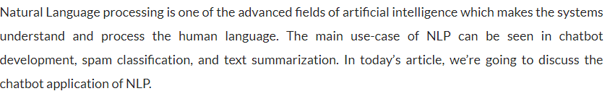
DEVELOPMENT PART -2 INTRODUCTION

Slide 3
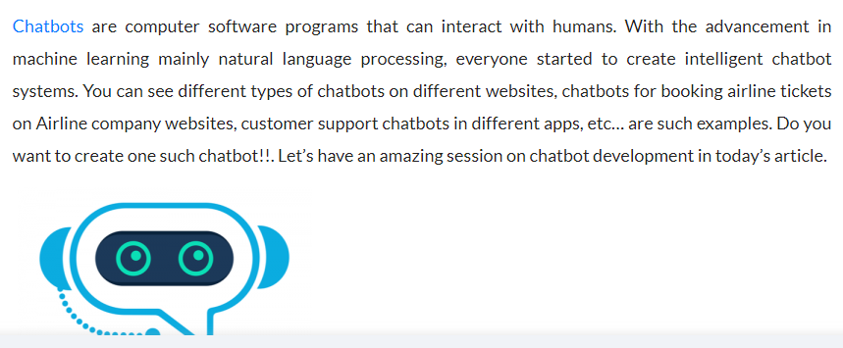

Slide 4
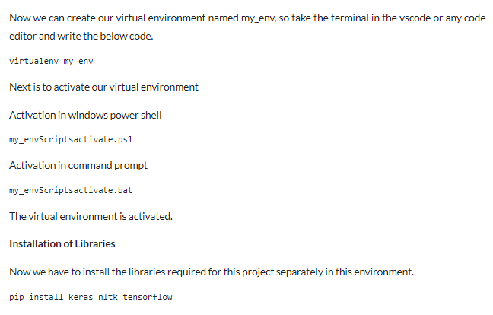

Slide 5
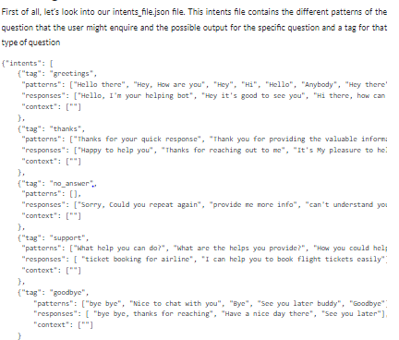
CREATING INTENTS FILE

Slide 6
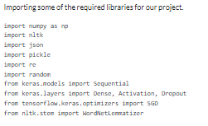
IMPLEMENTATION

Slide 7
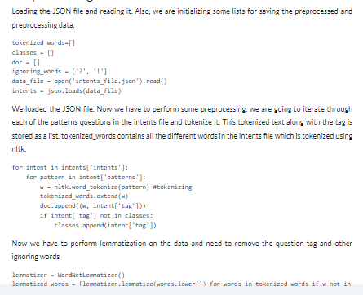
PREPROCESSING

Slide 8
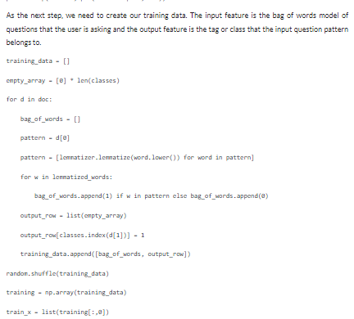

Slide 9
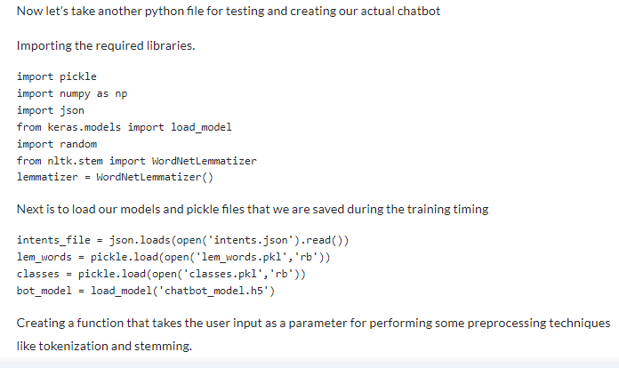
TESTING THE MODEL

Slide 10
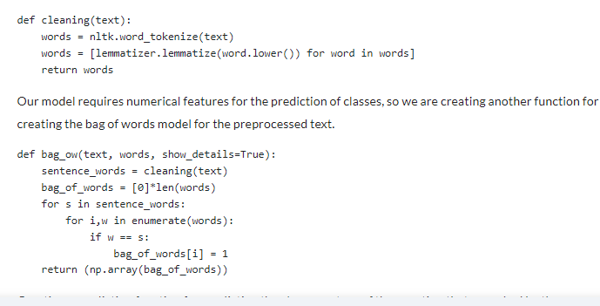

Slide 11
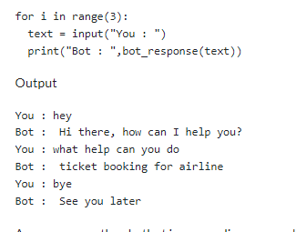
INTERACTING WITH CHATBOT

Slide 12
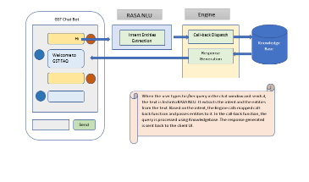
DATA BASE ANALYSIS

Slide 13
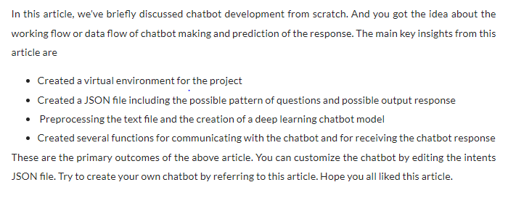
CONCLUSION

