Slide 1

DEPARTMENT OF ELECTRONICS AND COMMUNICATION ENGINEERING
TEAM MEMBERS:
BOLLEDDU KISHORE (113321106012)
CHILAKA SARATH(113321106015)
KONDURU ABHILASH(113321106046)
MIKILI MANOAJITH(113321106051)
NEERUKATTU MADHAN KUMAR(113321106061)

Slide 2
CREATE A CHATBOT USING PYTHON

Slide 3
Types of chatbots
Chatbots are computer program that simulates human conversation through voice commands or text chats or both in natural language.
understand the user’s intent and send responses based on the application’s business rules and data.
They can decipher verbal or written questions and provide responses with appropriate information or direction

Slide 4
Types of chatbot frameworks
There are different types of Chatbot Frameworks such as–
1.Dialog flow
2. Alexa
3. Luis
4.Wit
5. Rasa
Of these frameworks Rasa is an Open Source framework for developing text-and voice-based chatbots and assistants. It comprises of mainly two things, Rasa NLU, and Rasa Core. The benefit of Rasa Stack is data privacy and zero running cost. And also being open source no cost of using the platform in Rasa, though developers cost will be higher as here you need experienced developers to develop and maintain the chatbot.
One can choose dialog flow or alexa if one need a quick solution. But for highly scalable, data sensitive assistant Rasa Stack is better.

Slide 5
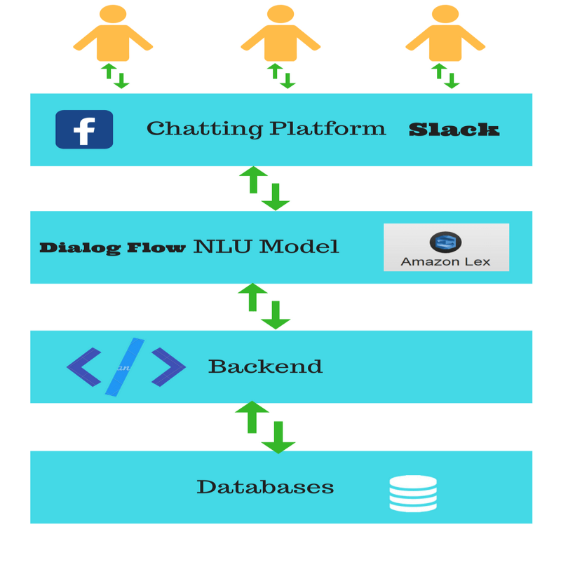
AI Chatbot Architecture
As in the AI bot architecture diagram say for Chatting Platform Slack the chat starts from chatting platform as input request and end at chat platform with response.
In between the message passes into so many stages.
Here NLU models are chat bot APIs which extract the information from user request.
The Web-hook back end is simple web application which provides the restful API. NLU model extract the information in the form of entity which works as parameter in these restful APIS

Slide 6
It produces some response that you get as robot response. The only magic comes with the Natural Language Processing ( NLP) applies in these NLUs. Lets understand it with an example byte – ”Order 3 roses for me oncoming Monday” .
Here NLU should extract three information–
• Product -Rose
• User– Current Login
• Product Quantity-3
• Time– Date corresponding to Monday If your system is intelligent enough to extract these parameter, You can easily develop the backend for it. Chat bot can save so much time for consumer to understand the product user interface. These NLU API also provide voice interface to user. Once you speak anything to bot, it first converts speech to text. Once it gets the text, NLP comes into picture

Slide 7
How Chatbot Actually Works?
The chatbots work by adopting 3 classification methods:
1.Pattern Matching
• Bots use pattern matching to classify the text and produce a suitable response for the users. A standard structure of these patterns is “Artificial Intelligence Markup Language” (AIML). A simple pattern matching example is:
<aim l version=“1.0.1”encoding=“UTF”?>
<category>
<pattern>WHO IS ABRAHAM LINCOLN</pattern>
<template>Abraham Lincoln was the us president during American civil war.</template>
</category>
<category>
<pattern>DO YOU KNOW WHO*IS</pattern>
<template>
<srai>WHO IS<star/></srai>
</template>
</category>
</aim l>

Slide 8
2.Algorithms
For each kind of question, a unique pattern must be available in the database to provide a suitable response. With lots of combination on patterns, it creates a hierarchical structure. We use algorithms to reduce the classifiers and generate the more manageable structure. Computer scientists call it a “Reductionist” approach- in order to give a simplified solution, it reduces the problem.
Multinomial Naive Bayes is the classic algorithm for text classification and NLP. For an instance, let’s assume a set of sentences are given which are belonging to a particular class.
With new input sentence, each word is counted for its occurrence and is accounted for its commonality and each class is assigned a score. The highest scored class is the most likely to be associated with the input sentence

Slide 9
Algorithms
For example Sample Training set
class: greeting
“How you doing?”
“good morning”
“hi there”
Few sample Input sentence classification:
input: “Hello good morning”
term: “hello” (no matches)
Term: “good” (class: greeting)
term: “morning” (class: greeting)
classification: greeting (score=2) Algorithms

Slide 10
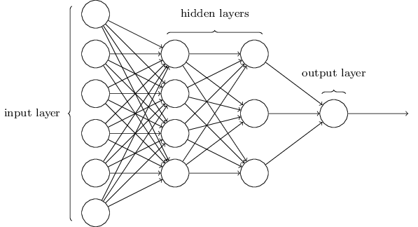
3.Artifical neural networks
Neural Networks are a way of calculating the output from the input using weighted connections which are calculated from repeated iterations while training the data. Each step through the training data amends the weights resulting in the output with accuracy

Slide 11
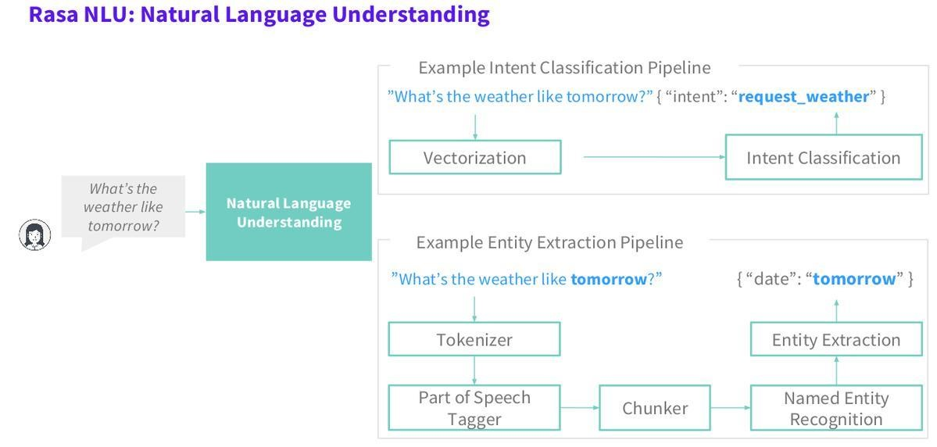
Natural Language Understanding (NLU)
It has 3 specific concepts like:
• Entities: Entity basically represents a concept in your Chatbot. It might be a payment system in Ecommerce Chatbot, NGO in NGO Darpan Portal etc.
• Intents: It is basically the action chatbot should perform when the user say something. For instance, intent can trigger same thing if user types “I want to order a red pair of shoes”, “Do you have red shoes? I want to order them” or “Show me some red pair of shoes”, all of these user’s text show trigger single command giving users options for Red pair of shoes.
• Context: When a NLU algorithm analyzes a sentence, it does not have the history of the user conversation. It means that if it receives the answer to a question it has just asked, it will not remember the question .

Slide 12
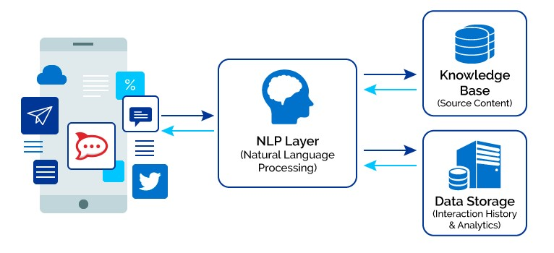
Natural Language Processing (NLP)
Some of the Natural Language Processing steps are:
• Tokenization: The NLP divides a string of words into pieces or tokens that are linguistically symbolic or are differently useful for the application.
• Named Entity Recognition: The chatbot program model looks for categories of words, like the name of the product, the user’s name or address, whatever data is required.
• Normalization: The Chatbot program model processes the text in an effort to find common spelling mistakes or typographical errors that might effect what the user intents to convey. This gives more human like effect of the Chatbot to the users.
• Dependency Parsing: The Chatbot looks for the objects and subjects- verbs, nouns and common phrases in the user’s text to find dependent and related phrases that users might be trying to convey.
• Sentiment Analysis: Tries to learn if the user is having a good experience or if after some point the chat should be forwarded to the human.

Slide 13
Chatbot with Rasa Stack and Python
RASA stack is an open-source AI tool and being an open source framework, it is easy to customize. Clients usually do not want to share their data and majority of the tools available are cloud-based and provide software as a service. With RASA, One can build, deploy or host Rasa internally in your server or environment with complete control on it.
Rasa comes up with 2 components —
• Rasa NLU — a library for natural language understanding (NLU) which does the classification of intent and extract the entity from the user input and helps bot to understand what the user is saying.
• Rasa Core — a chatbot framework with machine learning-based dialogue management which takes the structured input from the NLU and predicts the next best action using a probabilistic model like LSTM neural network. NLU and Core are independent and one can use NLU without Core, and vice versa. Though Rasa recommends using both

Slide 14
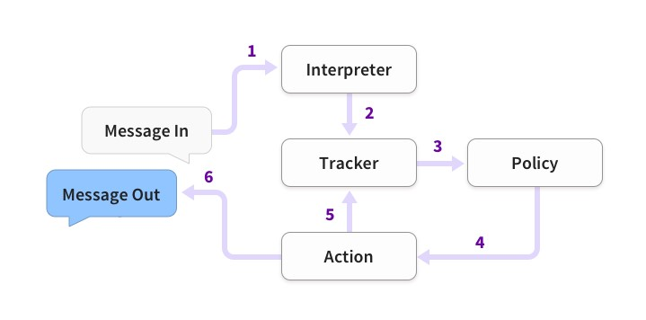
Rasa Core
Finally, the training of Bot is considered successful where it is able to understand the natural language but we still need to build the dialogues so that bot can respond to the messages. After training the bot we need to build a dialogues management for bot to respond to the messages.

Slide 15
ChatterBot: Build a Chatbot With Python
Step 1: Create a Chatbot Using Python ChatterBot
from chatterbot import ChatBotchatbot = ChatBot("Chatpot")exit_conditions = (":q", "quit", "exit")while True: query = input("> ") if query in exit_conditions: break else: print(f"🪴 {chatbot.get_response(query)}")

Slide 16
Step 2: Begin Training Your Chatbot
from chatterbot import ChatBotfrom chatterbot.trainers import ListTrainerchatbot = ChatBot("Chatpot")trainer = ListTrainer(chatbot)trainer.train([ "Hi", "Welcome, friend 🤗",])trainer.train([ "Are you a plant?", "No, I'm the pot below the plant!",])exit_conditions = (":q", "quit", "exit")while True: query = input("> ") if query in exit_conditions: break else: print(f"🪴 {chatbot.get_response(query)}")

Slide 17
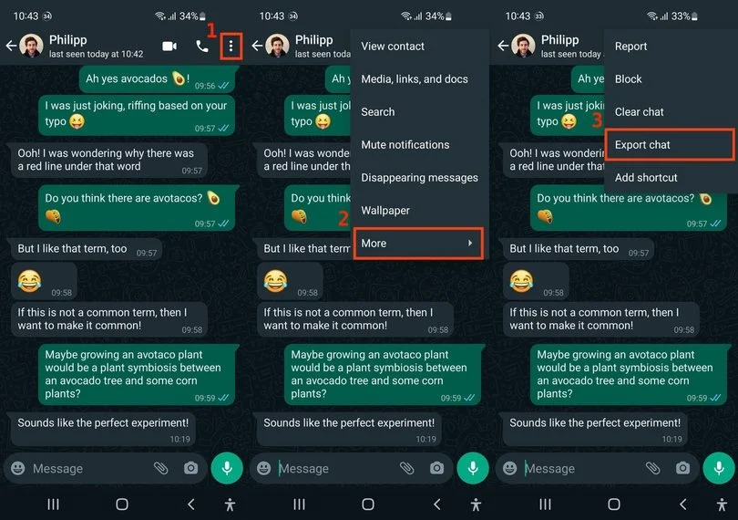
Step 3: Export a WhatsApp Chat

Slide 18
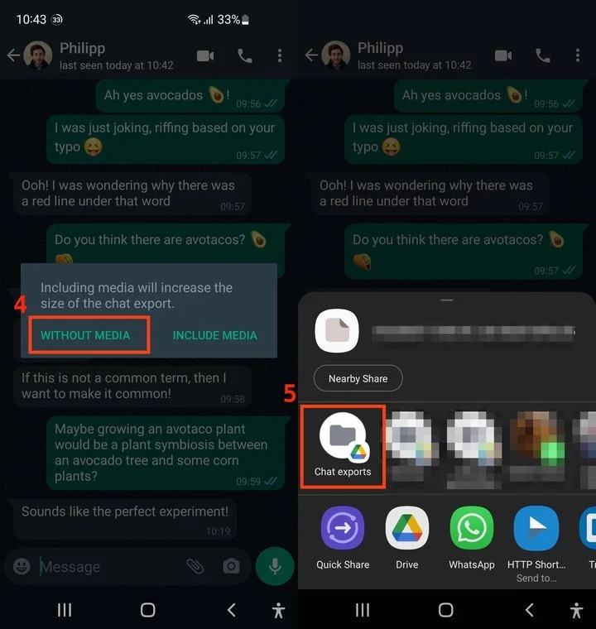

Slide 19
Step 4: Clean Your Chat Export
import redef remove_chat_metadata(chat_export_file): date_time = r"(\d+\/\d+\/\d+,\s\d+:\d+)" # e.g. "9/16/22, 06:34" dash_whitespace = r"\s-\s" # " - " username = r"([\w\s]+)" # e.g. "Martin" metadata_end = r":\s" # ": " pattern = date_time + dash_whitespace + username + metadata_end with open(chat_export_file, "r") as corpus_file: content = corpus_file.read() cleaned_corpus = re.sub(pattern, "", content) return tuple(cleaned_corpus.split("\n"))if _name_ == "_main_": print(remove_chat_metadata("chat.txt"))

Slide 20
def remove_non_message_text(export_text_lines): messages = export_text_lines[1:-1] filter_out_msgs = ("<Media omitted>",) return tuple((msg for msg in messages if msg not in filter_out_msgs))if _name_ == "_main_": message_corpus = remove_chat_metadata("chat.txt") cleaned_corpus = remove_non_message_text(message_corpus) print(cleaned_corpus)
import redef clean_corpus(chat_export_file): message_corpus = remove_chat_metadata(chat_export_file) cleaned_corpus = remove_non_message_text(message_corpus) return cleaned_corpus# ...# Deleted: if _name_ == "_main_":

Slide 21
Step 5: Train Your Chatbot on Custom Data and Start Chatting
from chatterbot import ChatBotfrom chatterbot.trainers import ListTrainerfrom cleaner import clean_corpusCORPUS_FILE = "chat.txt"chatbot = ChatBot("Chatpot")trainer = ListTrainer(chatbot)cleaned_corpus = clean_corpus(CORPUS_FILE)trainer.train(cleaned_corpus)exit_conditions = (":q", "quit", "exit")while True: query = input("> ") if query in exit_conditions: break else: print(f"🪴 {chatbot.get_response(query)}")

Slide 22
THANK YOU

