Slide 1

Department of
Computer Sc. & Engineering
Welcome to Final Project Presentation
STUDENT STRESS FACTOR DETECTION THROUGH CLASSIFICATION AND FEATURE SELECTION
Submitted By
Anubhav Mohanty (Regd. No. 2001209087)
Payal Pani (Regd. No. 2001209147)
Rajat Kumar (Regd. No. 2001209058)
Sagar Verma (Regd. No. 2001209168)
Group
CSE 27
Under the Supervision of
Prof.(Dr) Pamela Chaudhury
Senior Assistant Professor, Department of CSE

Slide 2
Background of the Study
The project addresses student stress, a critical factor impacting academic performance and well-being.
Using classification and feature selection the project aims to create a precise model for identifying stress factors across academic, personal, and external realms.
Objective
Areas where further progress can be made
-Update Dataset to Reflect Current Trends
-Implement Feedback Mechanism and Interactive UI
Proposed framework
-Continuous Data Collection for Dataset Enhancement
-Development of User-Friendly Interface
-Ensuring Practical Applicability and Innovation

Slide 3
Problem Definition
Problem Statement
-Student stress significantly affects academic performance and well-being.
-Current stress detection methods lack efficiency and personalization.
-Urgent need for a robust model to identify stress factors across diverse domains, especially amidst the pandemic-induced spike in student stress.
-Existing stress detection models may lack performance metrics or interactivity.
-Solutions require advanced machine learning and interactive interfaces.
-Crucial for developing a comprehensive stress detection model reflecting real-world scenarios and providing personalized feedback to empower students.

Slide 4
Work Flow Diagram
Establish foundational understanding and identify key stress factors through literature review on student stress determination.
Collecting data from students would significantly enhance the dataset's richness and diversity.
Develop and train machine learning algorithms to predict student stress levels accurately
Evaluate and compare various machine learning models to select the most effective one for stress determination.
Identify and prioritize the most influential attributes contributing to stress determination
Design and implement a user-friendly interface to facilitate interaction and engagement for users
Analyze user responses to provide personalized recommendations aimed at reducing stress and enhancing well-being

Slide 5
Method
Model/approach
-Multifaceted Approach
-Precise Identification and Quantification
-Facilitating Effective Stress Management Strategies
Software/tools
-Machine Learning Libraries (Numpy, Pandas, SkLearn)
-Data Preprocessing Analysis Tools (Seaborn, Matplotlib)
-Interface Development (HTML, CSS, JavaScript, Flask)

Slide 6
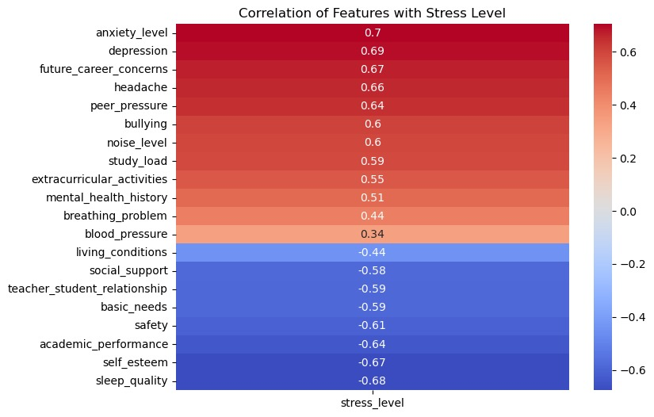
Results Obtained
Correlation between features and stress
Data visualization is important as it helps to gain important insights into the data and identify the patterns and trends that may not be immediately apparent.

Slide 7
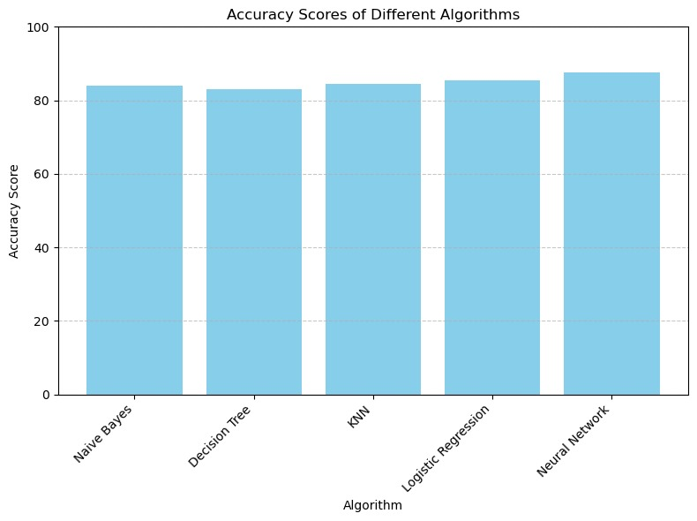
Results Obtained
Training Models
The performance of six classification models, including Naive Bayes, Decision Tree, KNN, Logistic Regression, and Neural Network, are compared using the dataset. Each model is trained and evaluated to determine its accuracy in predicting the target variable.

Slide 8
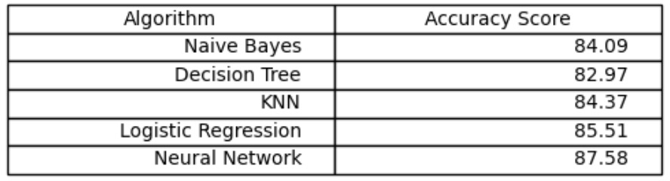
Results Obtained
After exploring various models, we determined that the neural network model outperformed others in predicting stress levels accurately. As a result, we have chosen to implement this neural network model for stress prediction in our user interface.

Slide 9
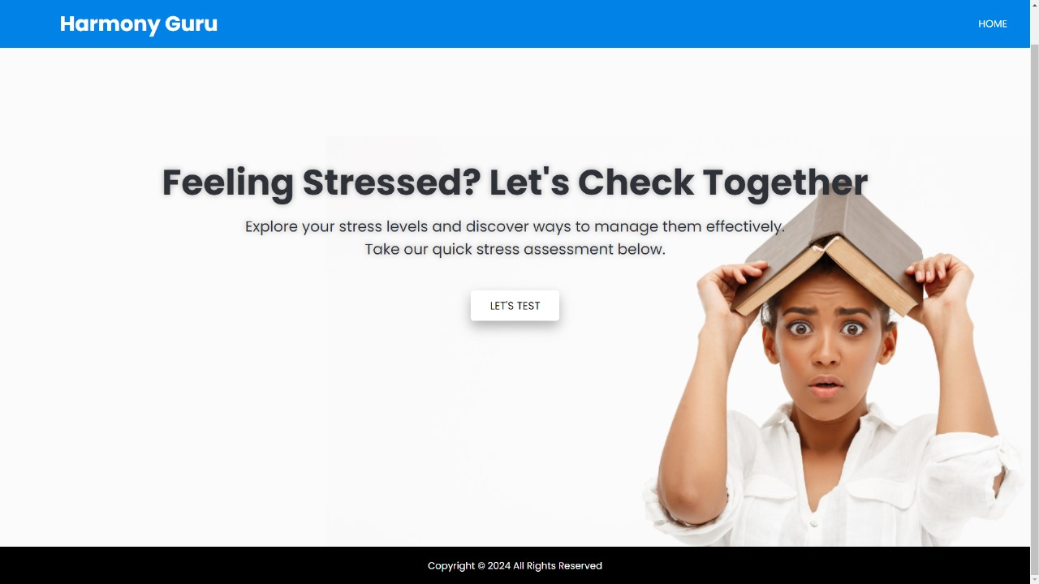
Results Obtained
U/I of stress predictor website

Slide 10
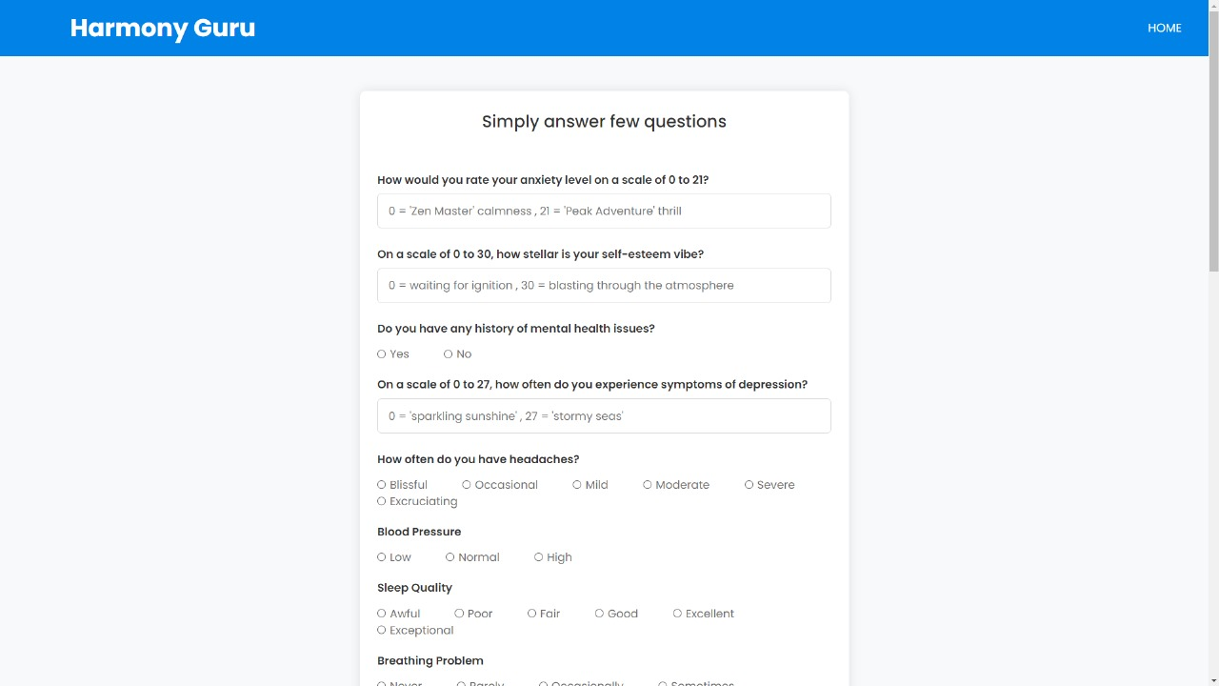
Results Obtained

Slide 11
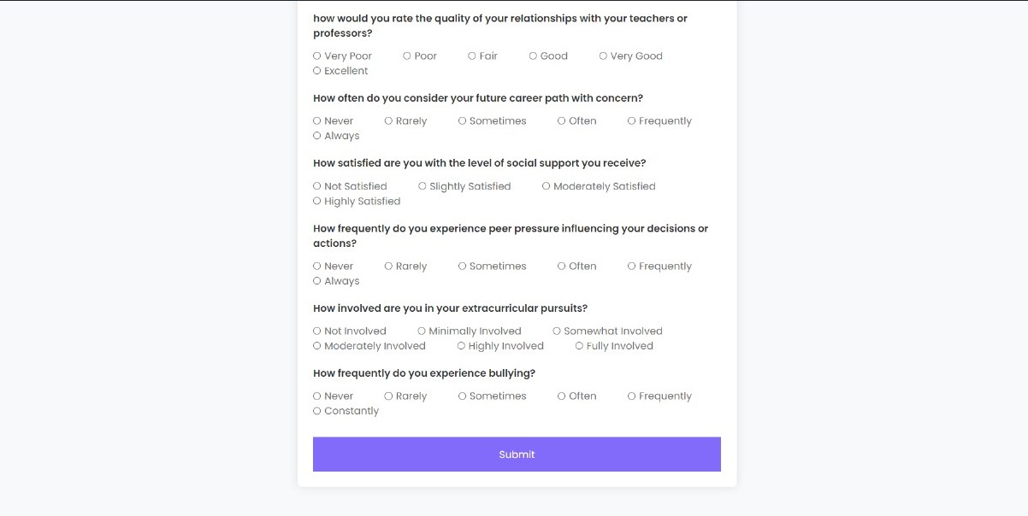
Results Obtained

Slide 12
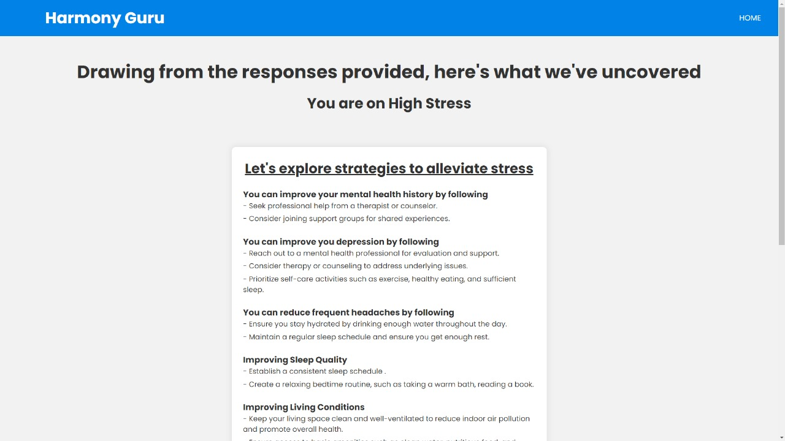
Results Obtained

Slide 13
Our Contribution
Main face of this work
-Focus on Student Stress
-Enhancement of Dataset
-Interactive Interface
2. Contributed to the society
-Addressing Prevalent Issue of Student Stress
-Providing Valuable Insights for Support Professionals
-Empowering Students through Interactive Interface
The project's identification of stress factors across academic, personal, and external domains enables targeted support, enhancing human well-being.

Slide 14
Conclusion and Future works
Conclusion:
- Quantify stress factors.
- Enriched dataset from Kaggle.
- Interactive interface for feedback.
Advantages over other approach
- Robust model with classification and feature selection.
- Accurate and reliable performance metrics.
- Personalized feedback.
Target Achievement
- Comprehensive stress detection model.
Limitations
- Individual variability.
- External factors not captured.
- Interface limitations.

Slide 15
Conclusion and Future works
The Work Ahead
Enhancing Effectiveness
- Real-time data analytics: Integrate real-time data to provide instant feedback and coping strategies for students experiencing stress.
- Personalized recommendations: Tailor stress management techniques based on individual profiles and preferences.
Further Improvement
- Explore sentiment analysis: Analyze text data (such as student essays or social media posts) to detect subtle stress indicators.

Slide 16
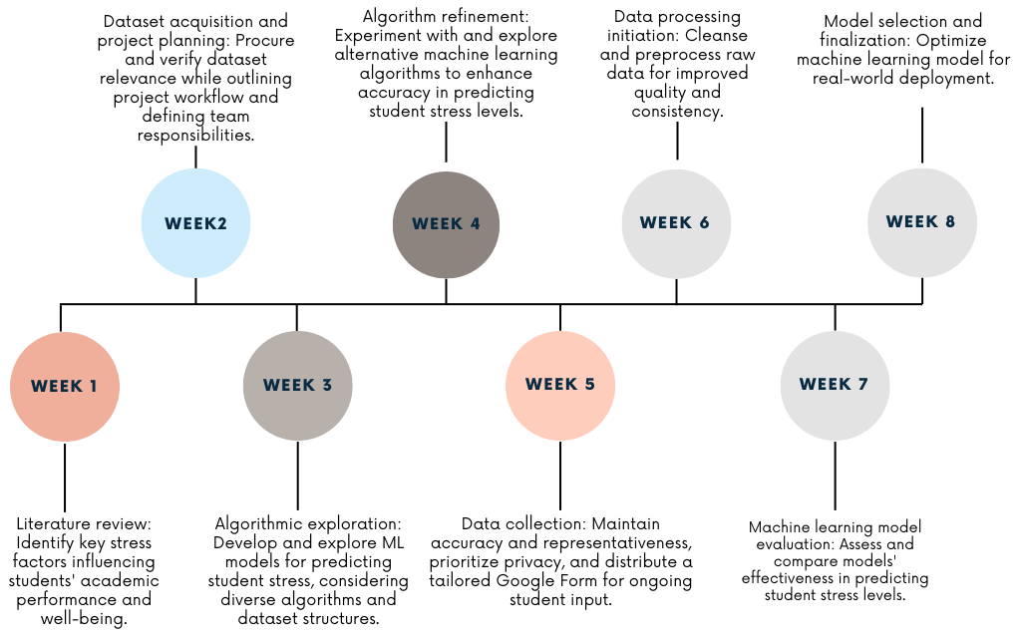
Project Timeline

Slide 17
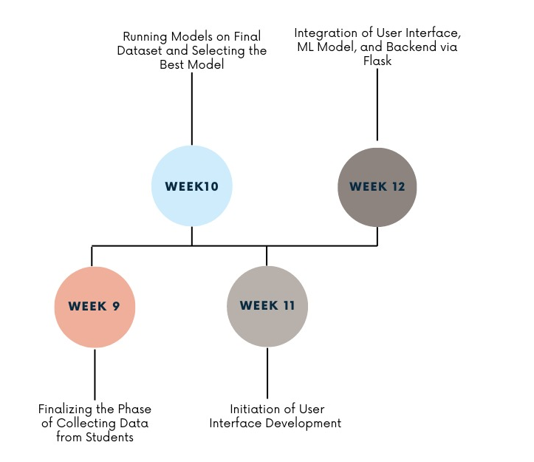
Project Timeline

Slide 18
References
[1] P. Manjunath , Twinkle S, P. Shreya, V. Ashok and Dr. S. Sultana. “Predictive Analysis of Student Stress Level using Machine Learning ”. 2021.
[2] Qicheng Chen and Boon Giin Lee. “Deep Learning Models for Stress Analysis in University Students”. 2023.
[3] Wu J, Kuan G, Lou H, Hu X, Masri MN, Sabo A, Kueh YC. “The impact of COVID-19 on students' anxiety and its clarification: a systematic review.” Front Psychol. 2023.
[4] Fred Johansson, Ann Rudman, and Margreth Grotle. “Depression, anxiety and stress among Swedish university students before and during six months of the COVID-19 pandemic”. 2021.
[5] https://www.kaggle.com/datasets/rxnach/student-stress-factors-a-comprehensive-analysis

Slide 19




