Slide 1
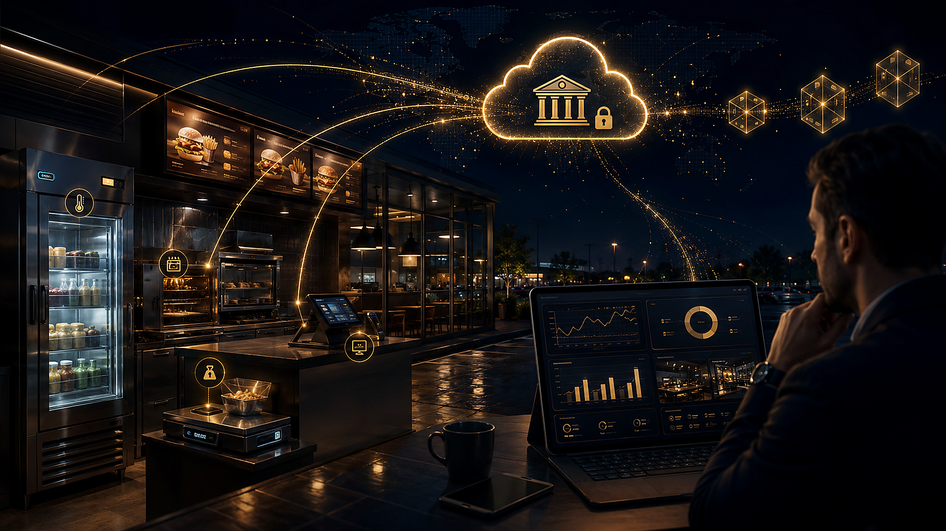
A
1
INVESTOR PRESENTATION
Arcana
Accounting that cannot be lied about
A trust network for franchises and remote investors.
Signed IoT inside the store.
Auditable daily close.
Settlement on Polygon backed by USDC.
Verifiable trust, not blind trust
Arcana · Investor deck

Slide 2
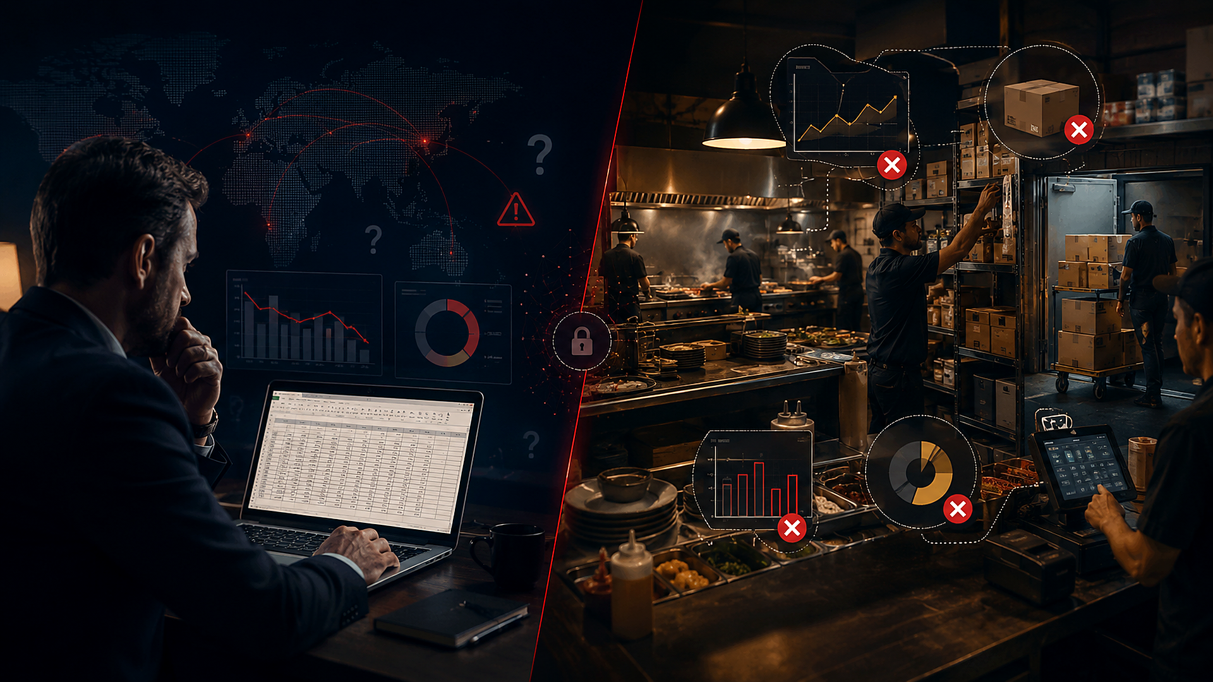
A
2
The problem in one sentence
The investor does not see the store. The manager does.
Underreported sales.
Inventory that “disappears”.
Suppliers delivering less than agreed.
Margins that do not match what was served.
Reports editable in Excel or POS.
Arcana · Investor deck

Slide 3
A
3
The cost of not knowing
When physical evidence is not correlated, everyone loses.
Who loses | How
Investor | Receives a % of an inflated number
Franchise | Damaged brand and auditability
Honest owner | Cannot prove good operations
Customer | Cold chain and portions lack a useful trace
Today trust is human. Tomorrow it must be verifiable.
Arcana · Investor deck

Slide 4
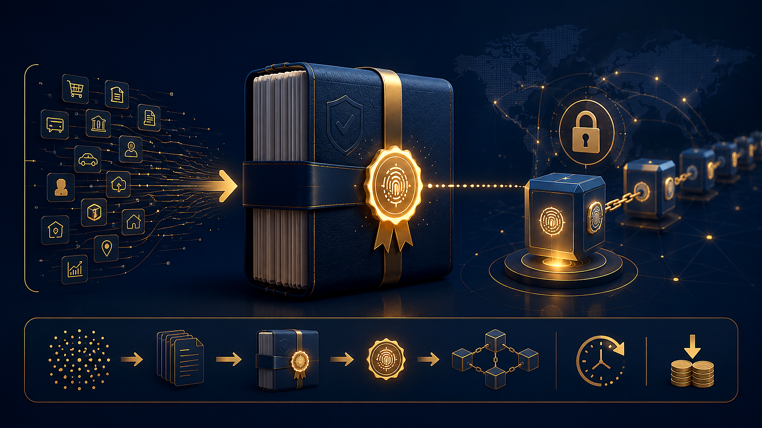
A
4
The investment thesis
Arcana turns each location into an accounting book signed by machines.
What is bought, cooked, and sold leaves a physical trace.
Multiple independent devices must agree.
At daily close, that truth is anchored on Polygon.
The investor audits the location without being there.
Arcana · Investor deck

Slide 5
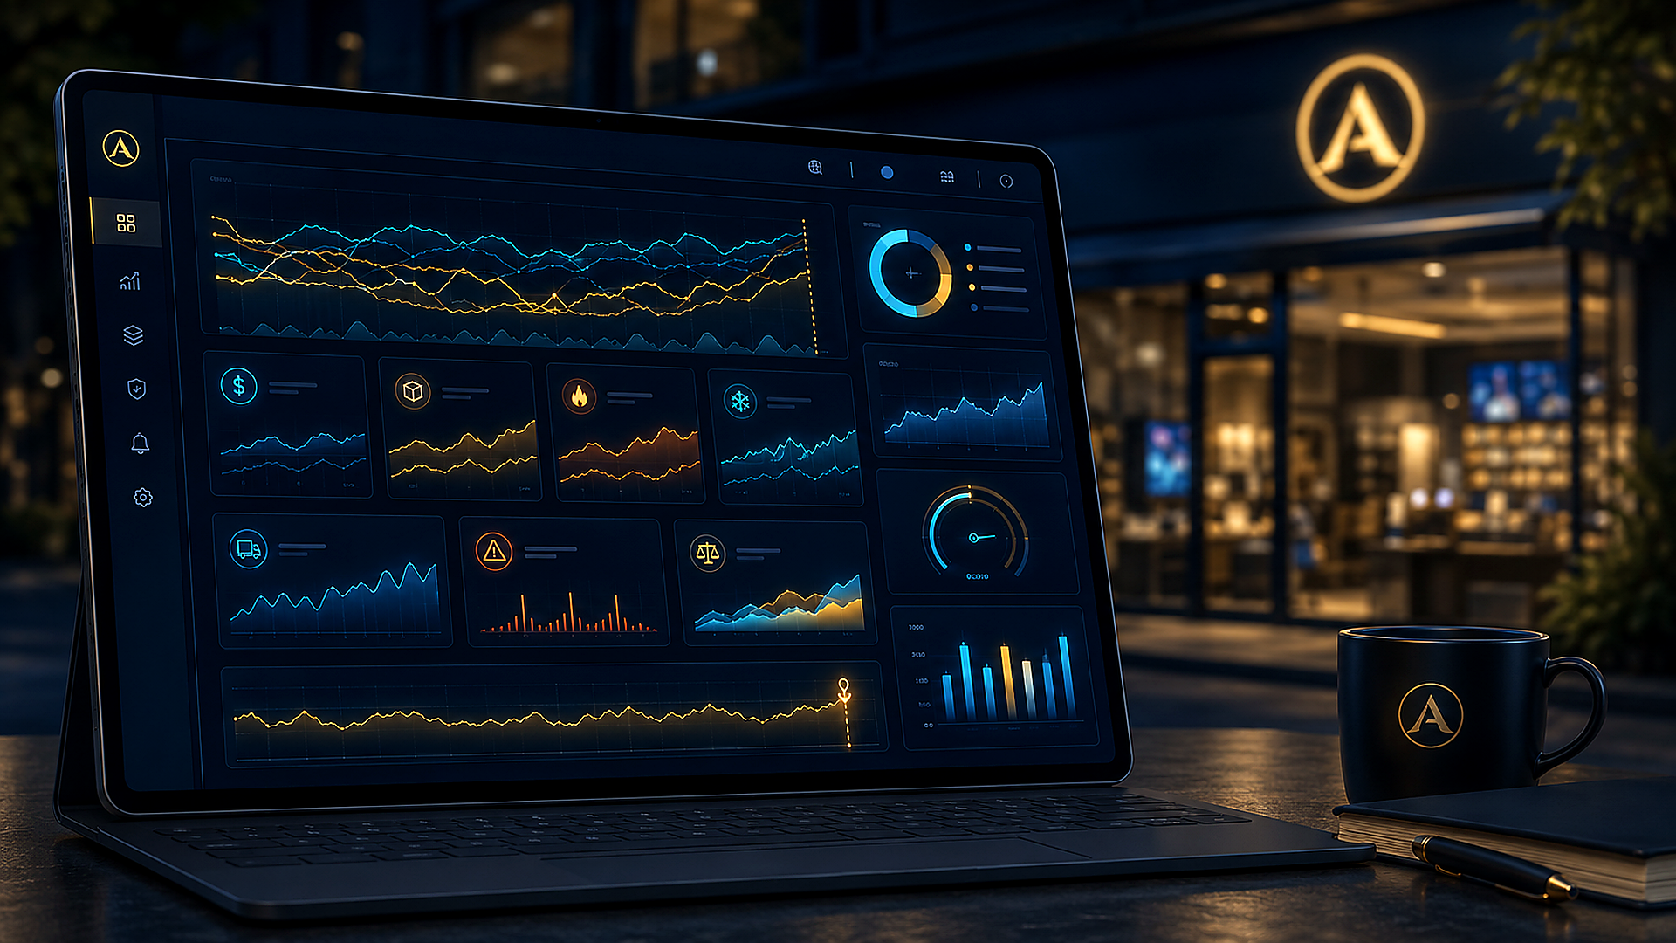
A
5
What Arcana is — and is not
IS
IS NOT
• Distributed accounting for the establishment
• A speculative cryptocurrency
• Sensors and controllers in store equipment
• A POS replacement
• Public proof of daily close
• A payroll system in this phase
• Token backed 1:1 by USDC
• A full food-safety guarantee by itself
Arcana · Investor deck

Slide 6
A
6
Express dictionary
One minute of vocabulary to follow the business.
Term | Plain meaning
Blockchain | Public ledger that is hard to erase quietly
Polygon | Low-cost network where we seal the day and move money
USDC | Digital dollar, ≈ 1 USD
Token | Store unit backed 1:1 by USDC
ESP32 / IoT | Mini-computer that observes and signs
Arcana · Investor deck

Slide 7
A
7
What is a blockchain?
A ledger notebook copied by many people at the same time.
In Excel, someone can delete a row quietly.
On a blockchain, the same book exists in many places.
Faking a row would require changing many copies at once.
Each new page links to the previous one.
It is not a bank or Bitcoin: it is a ledger that is hard to tamper with.
Arcana · Investor deck

Slide 8
A
8
What is Polygon?
The network where Arcana seals the close and settles money.
Ethereum is known, but writing there can be expensive.
Polygon is compatible, faster, and cheaper.
Think of a parallel road: same vehicle, lower toll.
Arcana does not cook on Polygon: it cooks in the store.
Polygon acts as the notary of the day.
A daily seal costs cents, not a restaurant commission.
Arcana · Investor deck

Slide 9
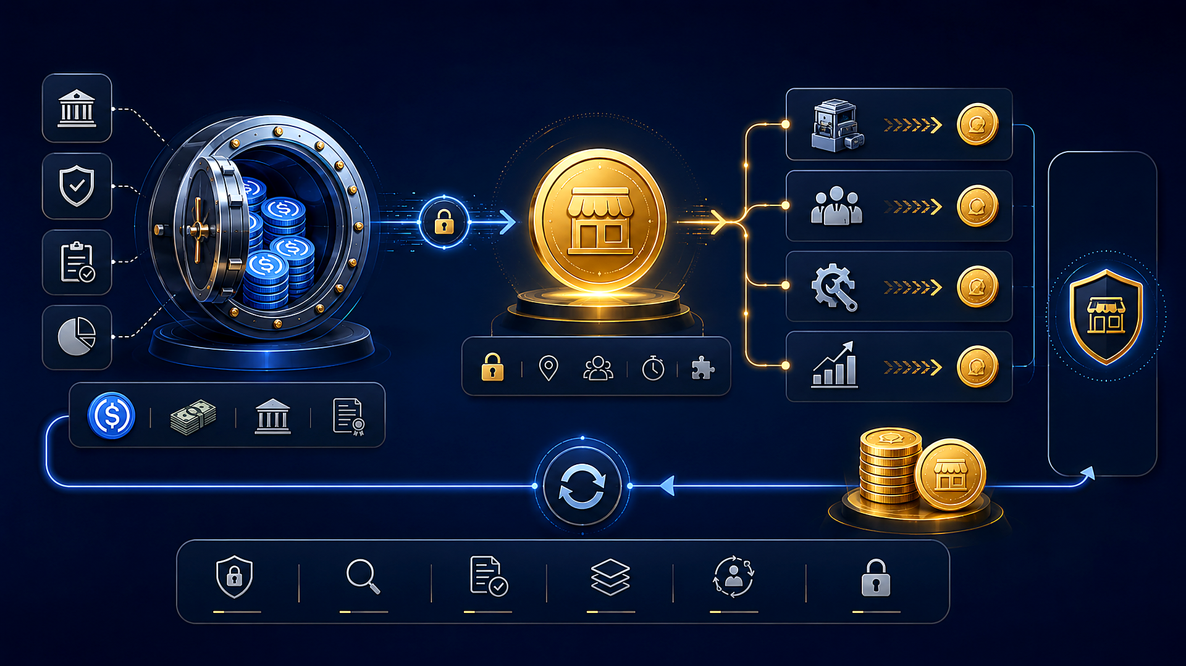
A
9
What is USDC?
A dollar that moves through the internet.
1 USDC is designed to equal 1 U.S. dollar.
It is issued by Circle; it is not meant for speculation.
It is used to deposit, back, and redeem value.
It is not Arcana’s token: it backs Arcana’s token.
Analogy: digital dollars in a visible vault.
Arcana · Investor deck

Slide 10
A
10
What is a token? And ERC-20?
A digital unit with rules. Not a memecoin.
Arcana’s token is the store’s settlement unit.
1 token = 1 gross USDC.
It is not designed for free exchange trading.
It pays daily machine debt and distributes proceeds.
ERC-20 is the standard format: like saying “PDF for money”.
Arcana · Investor deck

Slide 11
A
11
What is a smart contract?
A program that executes money rules without manual exceptions.
It lives on Polygon and its rules are visible.
It prevents issuing more units than deposited dollars.
It distributes proceeds according to agreed percentages.
It reduces diversion to unauthorized accounts if audited properly.
Analogy: a vending machine for rules.
Arcana · Investor deck

Slide 12
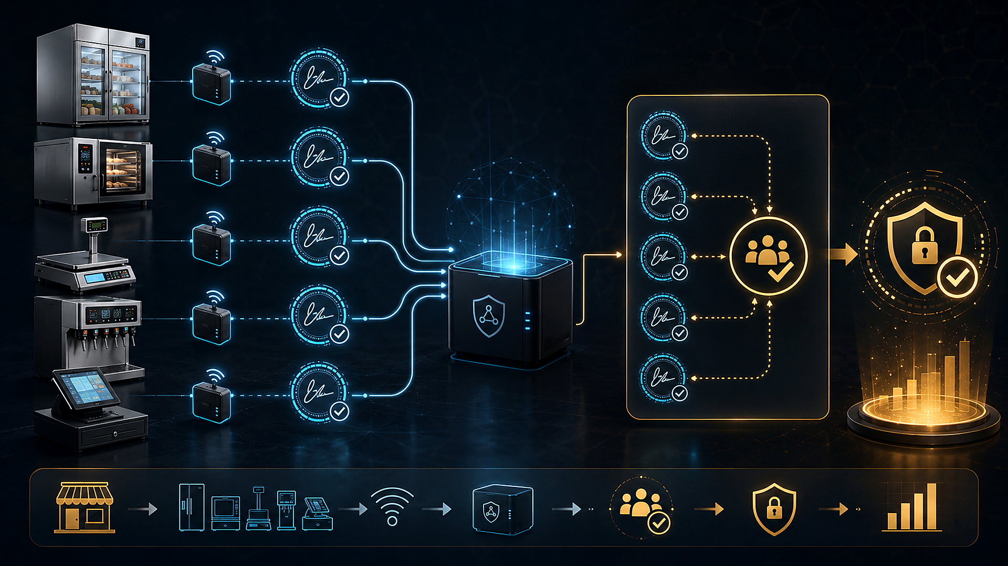
A
12
What is IoT? And an ESP32?
IoT = devices that talk. ESP32 = the mini-computer on each machine.
It fits in the palm of a hand and is low-cost.
It can be placed in a fridge, oven, dispenser, or cashier station.
It reads weight, temperature, energy, and activity.
It signs what it saw; it does not “opine”.
Multiple ESP32 devices check one another.
Arcana · Investor deck

Slide 13
A
13
Signature, key, and distributed trust
Each device has a pen that cannot be borrowed.
Private key: the device’s secret.
Signature: the device’s seal over an event.
Another node can verify the seal without knowing the pen.
Old or cloned messages can be rejected.
One lying witness is not enough: others must agree.
Arcana · Investor deck

Slide 14
A
14
Merkle: the envelope seal
A day has thousands of events. We do not publish them one by one.
A single fingerprint is calculated for the day: the Merkle root.
That fingerprint is written to Polygon.
If one sale changes, the fingerprint no longer matches.
A Merkle proof shows that an event was inside the sealed day.
It is like sealing a thick envelope with wax.
Arcana · Investor deck

Slide 15
A
15
What is gas?
The toll paid to write on Polygon.
Each public write pays a small fee.
We do not publish every sale or fridge opening.
The store operates toll-free during the day.
At close, it pays one toll for the seal.
Treasury movements happen afterward when needed.
Arcana · Investor deck

Slide 16
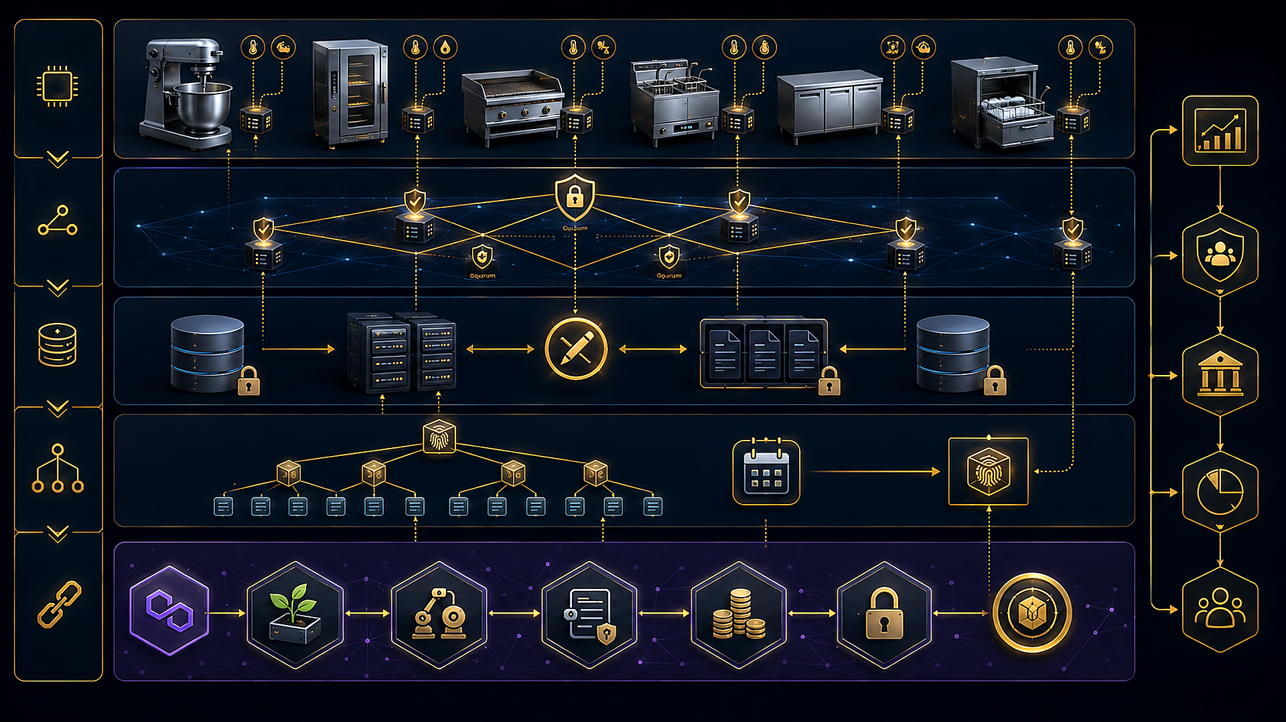
A
16
What is a laboratory attack?
Not employee fraud. It means opening the chip in a lab.
The attacker has time, the device, and specialized tools.
The goal is to extract secrets from the silicon.
Arcana does cover everyday operational fraud.
This phase does not promise to defeat advanced physical chip extraction.
Saying this builds credibility: “impossible to hack” is banned.
Arcana · Investor deck

Slide 17
A
17
Three plain-language rules
The system is designed to fail in a controlled way.
Fail-secure: when in doubt, it does not count as valid.
Quorum: several devices must agree.
Override: manual mode with a cap and a record.
If internet fails, the store can operate with traceability.
Fridges never shut down: food is not used as leverage.
Arcana · Investor deck

Slide 18
A
18
Initial market
First: fast food and franchises. Later: hospitality, tourism, and other inventory-plus-cash locations.
Fridges and cold chain: measured, never shut down.
Ovens, stoves, dispensers, and ice-cream machines.
Cash register and POS.
Inventory by weight.
Real service activity.
Arcana · Investor deck

Slide 19
A
19
For whom
Store owner
Investor / Network
• Proves real operations
• Audits sales, purchases, and inventory
• Reduces waste
• Sets thresholds in contracts
• Reduces disputes with partners
• Compares all locations
The buyer may be the franchise; the core beneficiary is investor trust.
Arcana · Investor deck

Slide 20
A
20
How it works: simple view
Operations are local and low-cost. Audit is global and low-cost.
Orders, inventory, kitchen, and POS create events.
Sensors + ESP32 per device sign what they see.
The local network validates that no single device rules alone.
Daily close produces a Merkle fingerprint.
Polygon receives the proof and executes USDC treasury.
Arcana · Investor deck

Slide 21
A
21
The store fingerprint
One fact is not enough. It must match the rest of the store.
If 10 portions leave the fridge, cooking activity should match.
There should also be sales or justified waste.
If a supplier delivers 240 g instead of 250 g, weight exposes it.
Lying through one machine is not enough.
Fraud would need coordination across almost the whole store.
Arcana · Investor deck

Slide 22
A
22
Security principle in business language
Zero blind trust: neither POS, server, nor one device rules alone.
Fail-secure: without valid agreement, critical activity is not “valid”.
Limited override: recorded and counted against an agreed threshold.
Daily override patterns trigger alerts.
Internet or Polygon can fail: degraded mode remains auditable.
Fridges never get blocked.
Arcana · Investor deck

Slide 23
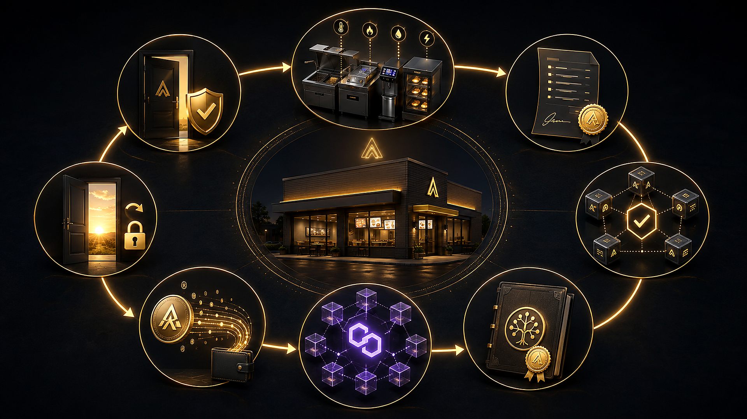
A
23
The daily cycle
Each day has permission, evidence, close, and settlement.
The store opens with valid credit and permission.
Each job creates debt: energy, cycles, and portions.
The network validates evidence and prevents double charging.
Active nodes sign the daily summary.
It is published on Polygon, debt is paid, and the next day is enabled.
Operating without settling is not free: it accumulates and becomes visible.
Arcana · Investor deck

Slide 24
A
24
The money: 1:1 model
Three parts: USDC treasury, store token, and machine debt.
USDC = real backing.
ERC-20 token = store unit, 1 token = 1 gross USDC.
Machine debt = what each machine owes for working.
Golden rule: no redeemable token exceeds reserved USDC.
The token is not speculation; it is a settlement unit.
Arcana · Investor deck

Slide 25
A
25
Where return comes from
When a machine pays its debt, tokens are distributed.
Moment | Fee
Profit distribution | Small % on gross batch
Transfer between users | 0, only Polygon gas
Exit to USDC | Small exit %
Investors / owners.
Store operator.
Energy and resources.
Maintenance.
Replacement and expansion.
Arcana · Investor deck

Slide 26
A
26
Why an investor can audit
The investor does not have to believe the owner’s dashboard.
Daily close anchored on Polygon.
Merkle proof of sale, waste, or receipt.
Debt and override thresholds written in the store contract.
Alerts when manual operation is too frequent.
Visible USDC reserve vs. circulating tokens.
Arcana guarantees correlated trace and auditable close.
Arcana · Investor deck

Slide 27
A
27
What it protects
Arcana protects operational, financial, and reputational assets.
Integrity of what is sold and bought.
Investor capital and inventory.
Signed evidence: weight, temperature, energy, POS, and supporting video.
Device keys, debt, and debt capacity.
Funds / USDC, cold chain, and store reputation.
Arcana · Investor deck

Slide 28
A
28
Architecture: one technical slide
A distributed system with blockchain anchoring, not public blockchain inside the microcontroller.
Edge: ESP32 + sensors + machine identity.
Local network: authenticated gossip, quorum, and permissions.
Persistence: recent blocks in Flash; full history outside the chip.
Backend: stores history; does not invent the close.
Polygon: registry, debt, treasury, settlement, and restricted ERC-20.
Arcana · Investor deck

Slide 29
A
29
Why not put everything on public blockchain
Publishing every event to Polygon would be slow, expensive, and fragile.
The kitchen must decide in milliseconds.
Internet may fail during the day.
The database stores operational detail.
Polygon stores one fingerprint for the entire day.
If one byte changes in history, it no longer matches the anchor.
Arcana · Investor deck

Slide 30
A
30
Advantage and defensibility
Not another IoT dashboard. It connects physical evidence, signatures, close, and payment.
Identity per device.
Local consensus, not server authority.
Multi-sensor correlation.
On-chain settlement with solvency invariant.
Stolen machine: without authorized network and lease, it cannot operate validly.
Fraud stops being an Excel edit; it becomes a coordinated attack on the whole store.
Arcana · Investor deck

Slide 31
A
31
Business model
Who pays and why the market can demand it.
Franchise or owner: hardware + installation + store subscription.
Network: distribution fee and exit fee.
More locations = more nodes, closes, and settlements.
The contract is cloned per site.
The investor demands Arcana as a condition for funding.
Arcana · Investor deck

Slide 32
A
32
Project status: honest
Today: architecture and product model are defined. It is not in production.
As an idea
As a ready product
• Solid design basis
• Prototype pending
• Clear technical thesis
• Pilot pending
• Scoped architecture
• Audits pending
A system that moves food and money is not launched just because the whitepaper looks good.
Arcana · Investor deck

Slide 33
A
33
Roadmap
This stage funds the MVP and first pilot, not an immediate global network.
MVP: 3–5 devices, one machine, and one sensor.
Simulated debt, signed close, and Merkle on testnet, no real USDC.
Must demonstrate power loss, fake messages, and blocking without quorum.
Pilot: one store, low limits, fridges only measured.
Production: audits, segregated treasury, and real USDC with caps.
Arcana · Investor deck

Slide 34
A
34
Use of funds
Suggested allocation to adjust to the actual round.
Use | Purpose
Hardware and firmware | ESP32, persistence, identity, fail-secure
Network protocol | Gossip, quorum, and recovery
Contracts | Treasury, debt, close, and tests
Backend and audit | History, Merkle, and investor panel
Pilot / legal | Real site, compliance, KYC/AML
Arcana · Investor deck

Slide 35
A
35
Risks named from day one
Showing risks does not weaken the pitch. It makes it serious.
One fallen device must not veto the store forever.
One lying sensor must not charge alone.
The manager must not silently “fix” the day.
Internet or Polygon can fail: degraded mode must remain auditable.
1 token = 1 USDC is a redemption promise, not magic.
Mitigation: scoped pilot, thresholds, untouchable fridges, and audits.
Arcana · Investor deck

Slide 36
A
36
The guarantee phrase
The moral contract with the investor.
Arcana guarantees that relevant store operations leave a correlated, signed trace across establishment devices, and that a Polygon anchor makes the close auditable for owners and investors.
It does not guarantee resistance to chip laboratory attacks.
It does not guarantee food safety by itself.
It does not prevent every override: it makes it visible and bounded.
Arcana · Investor deck

Slide 37
A
37
Why now
The kitchen already produces data. Nobody was turning it into trust.
Franchises and remote investors need proof, not promises.
IoT hardware is now low-cost.
Polygon can anchor a full day for cents.
USDC enables settlement without turning the store into a crypto casino.
Today’s POS does not sign the fridge, oven, or supplier weight.
Arcana · Investor deck

Slide 38
A
38
The closing question
Today, if you invest in a store you do not visit, what are you trusting?
A person.
A report.
A system that can be edited.
Arcana proposes a fourth anchor: what machines saw, signed, and cannot deny alone.
Arcana · Investor deck

Slide 39
A
39
Closing / Ask
Arcana: accounting that cannot be lied about.
We are raising capital to build the MVP on real hardware.
Close the protocol for one store.
Run the first pilot in a food franchise.
Reach audits before custodying real funds.
Next step: simulated demo of sale → evidence → close → payment → unlock.
Next step: simulated demo
Arcana · Investor deck

