Slide 1
INVESTOR PRESENTATION
Diagnose
Expert Multi-Agent Tutor
Teach
An intelligent tutoring system that diagnoses, teaches, evaluates, and adapts.
It does not just answer questions. It produces verifiable learning.
Assess
Diagnosis • Plan • Teaching • Evidence
Adapt
Notes:
Open with the contrast: a chatbot can explain; this product is designed to teach. The one line to remember is measurable learning, not just pleasant conversation.

Slide 2
01 · OPPORTUNITY
02
The problem
Today’s AI answers very well. But answering is not the same as teaching.
To teach, AI needs…
“Explain
percentages”
Diagnosis
Know where the learner starts.
Does not know the real level
Path
Does not remember what worked
Define what to learn and in what order.
Memory
Confuses an answer with mastery
Remember evidence, not only messages.
Proof
Demonstrate understanding and transfer.
Answering ≠ teaching
Notes:
The market gap is not more generated text. It is a sustained learning process: understanding level, building a path, remembering evidence, and proving mastery.

Slide 3

From chatbot to tutor
VISUAL CONTEXT
A visual comparison of the problem and the opportunity

Slide 4
02 · TIMING
03
Why now
Three capabilities are finally mature enough to build a real AI tutor.
Models
Agents
Memory
They can now explain, adapt, and assess with useful quality.
They coordinate long processes with roles and rules.
Graphs + vectors remember relationships and examples.
The opportunity: a tutor that remembers, connects, and verifies.
Notes:
Frame the timing: capable models, multi-agent orchestration, and structured memory. Their combination changes the category.

Slide 5
03 · PRODUCT
04
The solution
One tutor made of 12 specialized agents working as a coordinated team.
AI agent
1
2
3
A specialized AI role with a goal, rules, tools, and controlled memory.
Diagnose
Plan
Teach
4
5
6
The learner arrives with a goal
Assess
Remediate
Update
The system turns that goal into a living, explainable path backed by evidence.
12 agents · 1 experience
Product = complete system
Notes:
Explain agent in simple language: not a robot, but a specialized AI role with a goal, rules, tools, and controlled access to memory. The product is the complete system.

Slide 6

Product view
VISUAL CONTEXT
An AI-guided tutoring experience

Slide 7
04 · EXPERIENCE
05
What a session feels like
The experience is a learning loop, not an open-ended conversation.
Goal
Diagnosis
Plan
Accept
Lesson
Practice
Assessment
Profile + graph
Is there a gap?
Yes → Remediation
No → Next topic
The learner can accept or adjust the plan. An error changes the path; it does not restart the conversation.
Notes:
Use the ratios-to-percentages example. The tutor builds on what the learner already knows, checks whether the connection worked, and addresses the root cause of errors.

Slide 8
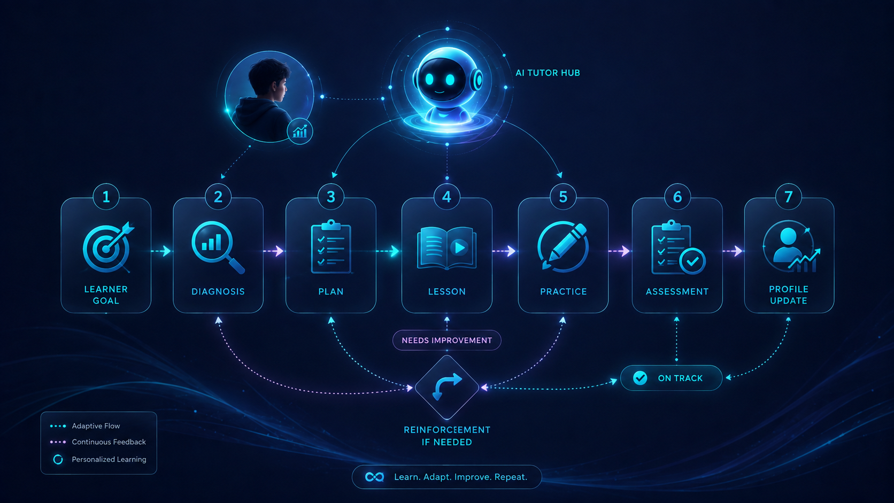
Learning cycle
VISUAL CONTEXT
From goal to reinforcement, with continuous tracking

Slide 9
05 · POSITIONING
06
What makes us different
The difference is not better conversation. It is how learning is decided, remembered, and proven.
Educational chatbot
Multi-agent tutor
Open conversation
Measurable goals
Chat memory
Profile + graph + evidence
One explanation
Multiple strategies & hints
Right / wrong
Rubrics + reasoning
Optional sources
Research + verify + curate
Moves on by request
Moves on by mastery
TEACHING IS A SYSTEM, NOT A PROMPT
Notes:
This is the positioning slide. Teaching is a system, not a prompt. One model should not teach, grade, and approve itself.

Slide 10
06 · GOVERNANCE
07
Twelve specialists, one tutor
Instead of memorizing 12 agent names, think of four teams with separate responsibilities.
1 · COORDINATE
2 · TEACH
Understand the goal and build the path
Explain, connect, and practice
Orchestrator
Profile & diagnosis
Planner
Tutor
Connections
Generator
3 · MEASURE
4 · PROTECT
Assess and fix the root cause
Govern sources, truth, and safety
Evaluator
Remediation
Researcher
Curator
Verifier
Safety
Separation of duties prevents the system from “approving itself.”
Notes:
Do not read all twelve. Explain separation of duties: the agent that searches does not verify; the agent that teaches does not declare mastery.

Slide 11
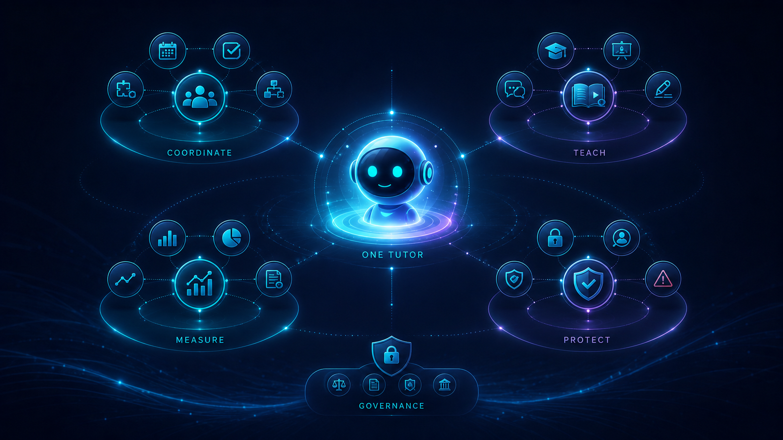
Four teams, one tutor
VISUAL CONTEXT
Coordinate, teach, measure, and protect

Slide 12
07 · LEARNING
08
The pedagogical advantage
The tutor connects new knowledge to something the learner already understands.
What is already mastered
Analogy / example
New concept
The tutor checks whether the bridge worked
Reuses previous examples
Marks where the analogy stops
Remembers which connections work
More use → better teaching
Notes:
The compounding advantage is personal: which example worked, which analogy confused, and which concept is the best bridge. The history becomes a teaching asset.

Slide 13

Learning through connections
VISUAL CONTEXT
New knowledge builds on what the learner already knows

Slide 14
08 · MEMORY
09
Three memories, not an endless chat
Conversation is only the interface. Learning is structured, persistent, and auditable.
RELATIONAL
GRAPH
VECTOR
Who the learner is, the plan, and assessed evidence.
Concepts, prerequisites, and mastery level.
Documents, examples, and semantic memories.
Chat is the interface. Truth lives in these memories.
Notes:
Translate to business: progress survives model changes; the system can explain why a plan changed and which evidence supports progress.

Slide 15
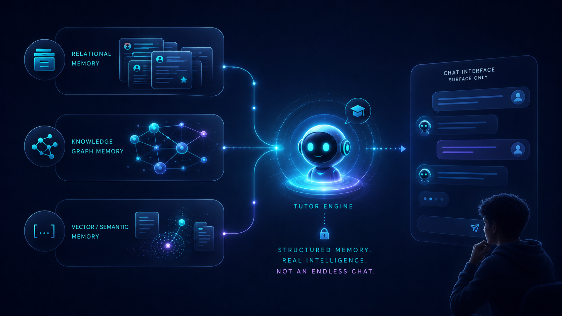
Structured memory
VISUAL CONTEXT
Three memory layers working as one system

Slide 16
09 · TRUST
10
Trust: sources are not improvised
Research, verification, and curation are different jobs. Separating them reduces hallucinations.
1
2
3
Research
Verify
Curate
Find candidate resources.
Check citations, contradictions, and confidence.
Decide what is included, updated, or removed.
Sensitive topics → safety can block or escalate to human review.
Notes:
This separation supports education and corporate environments. In sensitive cases, safety can block or escalate to a human reviewer.

Slide 17

Verified sources
VISUAL CONTEXT
Research, validate, and curate before teaching

Slide 18
10 · ARCHITECTURE
11
Technology built to last
Pedagogy is the core. Models and databases can change without rebuilding the product.
AI models
Data
Replaceable
PostgreSQL · Neo4j · Vector DB
PEDAGOGICAL
CORE
Orchestration
Adapters
Python · LangChain · LangGraph
SQL / Cypher / APIs
Changing providers ≠ rewriting how the system teaches
Notes:
For technical investors: emphasize decoupling and lower vendor lock-in. Avoid deep infrastructure detail unless requested.

Slide 19

Decoupled architecture
VISUAL CONTEXT
A pedagogical core designed to evolve

Slide 20
11 · INITIAL MARKET
12
Who we serve
Start with goal-driven learners. Expand to teachers, institutions, and companies.
Self-learners
Professionals
Teachers
Companies
Learn a skill with a clear path.
Upgrade skills with evidence.
Extend instruction and follow-up.
Train for competence, not attendance.
MVP: Spanish + a few tightly scoped domains → depth before breadth.
Notes:
Do not promise every subject on day one. A deep, measurable domain is more valuable than a shallow demo across thousands of topics.

Slide 21
12 · DEMO
13
The minimum viable product
The MVP must prove one thing: evidence of learning.
1 · DIAGNOSIS
2 · LESSON
3 · EVIDENCE
Goal: learn percentages
“50% means half”
Result
✓ Masters ratios
△ Unsure with fractions
→ Personalized path
Connects to mastered ratios and creates a short practice task.
83% mastery
1 gap detected
Remediation triggered
Previously successful example
Success = evidence of learning
Notes:
If asked for a demo, show three moments: diagnosis, connection to prior knowledge, and a detected gap that triggers remediation.

Slide 22
13 · ROADMAP
14
Product roadmap
Build the pedagogical core once; later phases expand experience and distribution.
PHASE 3
Teachers, organizations, LMS, multimodal content, groups.
PHASE 2
Review calendar, progress dashboard, languages, voice, more exercises.
NOW · MVP
Complete tutor in 1–few domains.
Measurable learning.
Same pedagogical core
Notes:
The MVP is the engine. Phases two and three add channels, formats, and users without rebuilding the learning logic.

Slide 23
14 · VALUE MODEL
15
Where value is created
Three commercial paths plus a proprietary learning asset that improves with use.
B2C
Education B2B
Corporate B2B
Subscription for self-learners and professionals.
Teachers and institutions needing traceability.
Training with evidence of competence.
PROPRIETARY ASSET
Each learner’s learning graph
Which anchor works · what fails · which analogy helps · what mastery was proven
Notes:
Do not invent TAM figures. The proprietary asset is the learning graph: what works, what fails, and how each learner progresses.

Slide 24
15 · RISK & CONTROL
16
Risks designed from day one
We do not promise magic. We design how failures are detected, contained, and escalated.
Hallucinations
Unfair assessment
Token costs
Verify sources; cite or stay silent.
Rubrics + multiple evidence + human review.
Models matched to complexity and budget.
Vendor lock-in
Privacy
Multi-agent complexity
Replaceable ports and adapters.
Consent, isolation, and deletion.
Clear contracts + one orchestrator.
We design how the system fails, not only how it works.
Notes:
Naming risks signals product maturity. Highlight sources, assessment quality, cost, privacy, vendor dependence, and multi-agent complexity.

Slide 25
16 · INVESTMENT / PARTNERSHIP
17
What we are looking for
Capital or a strategic partnership to build, test, and validate the MVP in a real domain.
1
Define first domain + rubrics
3
Run a measurable pilot
VALIDATE
LEARNING
2
Build agents + memory + verification
4
Compare diagnosis vs. outcome
Goal of the capital: prove that someone learned.
Notes:
Update this slide once the concrete ask is defined: amount, equity, grant, or corporate pilot. Today the objective is measurable learning.

Slide 26
18
CLOSING
Closing
Goal
The question is not whether AI can explain. The question is whether we can prove that someone learned.
Diagnosis
Adaptation
This is not a chatbot.
It is infrastructure for learning.
Teaching
Evidence
Q&A
Notes:
Close with: This is not a chatbot. It is infrastructure for learning. Pause, then move to Q&A.

Slide 27
APPENDIX
19
Frequently asked questions
Short answers to the questions investors are most likely to ask.
Why multiple agents?
What if the AI provider changes?
Teaching, grading, searching, and verifying have different incentives.
Pedagogy is separated from the model; the adapter can be replaced.
How do we know learning happened?
Is it for children?
Concept mastery, retention, transfer, and resolved gaps.
The architecture allows it, but launch requires age, consent, and stronger safeguards.
How long does the MVP take?
What is the first market?
It depends on domain and team; scope is already limited to the full learning loop.
Still to be chosen: professional skills, coding, languages, or internal training.
Notes:
Use this as a backup slide. It does not need to appear in the main pitch.

