Slide 1
Open-source document OCR for clinical scans
A model bake-off, distillation study, and layout/bbox evaluation
328 synthetic clinical scans + 651 real medical scans · 2× RTX 4090 · all local, no PHI
Notes:
Everything here is public data or synthetic; no PHI. All models run locally on 2x RTX 4090.

Slide 2
The question
What should replace Tesseract / commercial layout-OCR for scanned clinical documents?
• Scanned referrals, lab panels, discharge summaries, faxes — degraded, rotated, handwritten, tabular.
• Need: (1) the values (MRNs, dates, lab decimals, meds) AND (2) the structure (tables, reading order, selection controls).
• Constraint: cheap enough to run at document volume — target < $0.01 / page.
• Open-weight VLMs now exist that do full-page transcription in one pass. Do any of them actually work here?
Notes:
Framed around replacing the incumbent; cost target $0.01/page is the commercial-layout-OCR price point.

Slide 3
The models
12 open-weight OCR / document VLMs, one incumbent, comparable sizes and licences
model | params | licence
Qwen3.8-27B-FP8 | 27B (FP8) | verify
Qwen2.5-VL-7B | 7B | Apache-2.0
Qwen2.5-VL-3B | 3B | Apache-2.0
dots.mocr | 3B | MIT
dots.ocr | 3B | MIT
olmOCR-2 | 8B | Apache-2.0
PaddleOCR-VL | 0.9B | Apache-2.0
DeepSeek-OCR | 3B MoE | MIT
Chandra OCR 2 | 5B | OpenRAIL-M
granite-docling | 0.26B | Apache-2.0
Nanonets-OCR2 | 3B | Apache-2.0
Tesseract v5 | - | Apache-2.0
Notes:
Roster spans 0.26B -> 27B. Licences matter: Chandra is research-only; Qwen3.8 terms unverified.

Slide 4
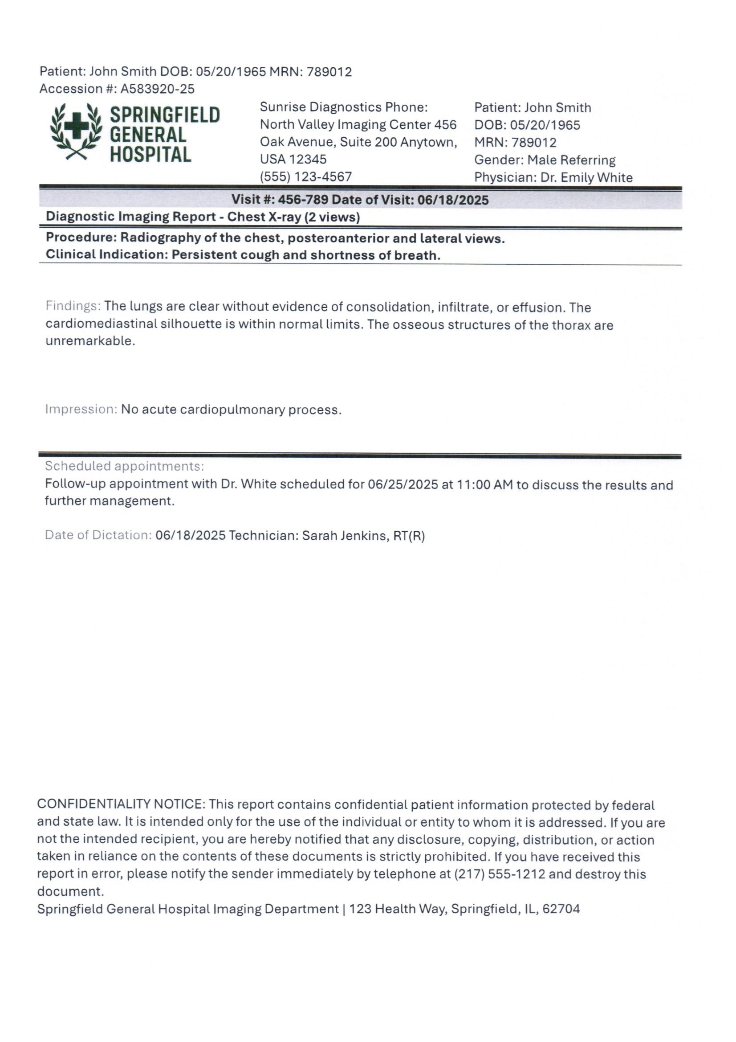
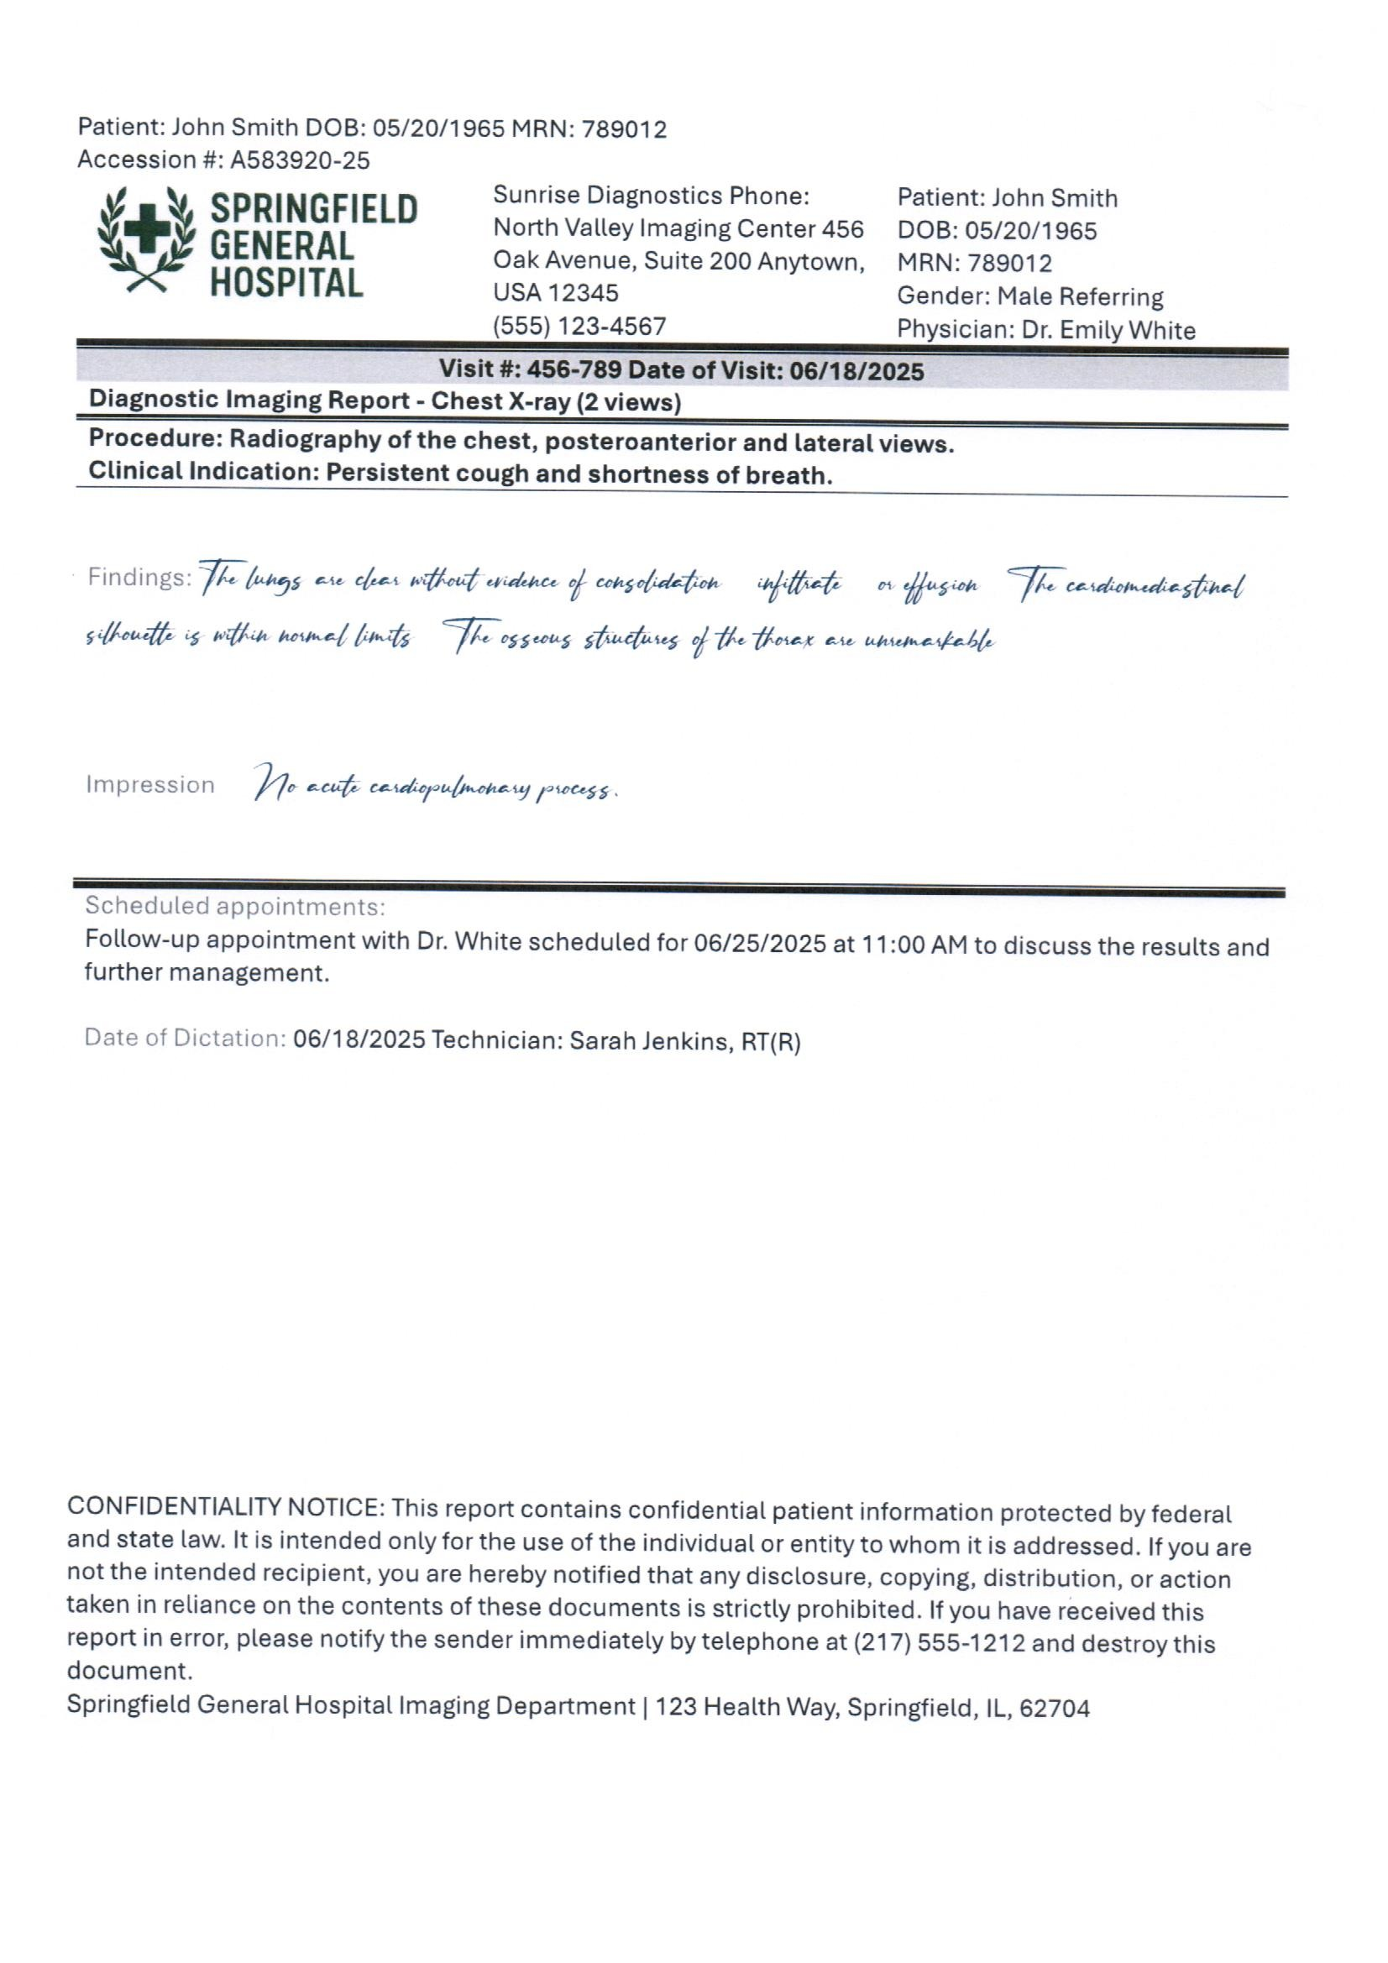
Corpus 1 — ClinOCR-Bench (the baseline)
328 documents · 6 degradation subsets · human-audited ground truth
normal
handwriting
• subsets: normal · handwriting · poor · rotated · tables · mixed
• (shown: clean + handwriting; the tables subset is actually filled forms)
Notes:
Synthetic content, real degradation pipeline, MIT. This is where every model was first ranked.

Slide 5
Corpus 2 — medreal (real scans)
651 pages assembled from public medical-document datasets, labelled by a vision LLM
source | pages | what it is
noisy-med | 400 | patient account statements, full page
prescription | 200 | prescription scans
india-hist | 46 | real 1878 hospital reports (external GT)
medform | 5 | medical forms
• Labels minted with DeepSeek-v4.1-flash (vision) at $0.0009/page — the same prompt used in training
• Caveat: new-set ground truth is the teacher label, so it measures agreement, not human-verified accuracy
• Cheap generalisation check: a different pipeline, real scanners, non-English names/addresses
Notes:
651 pages, $0.60 total to label. The historical 1878 scans are the only independently-labelled subset.

Slide 6
How we measure
Character error rate, with the pitfalls accounted for
• Primary metric: median CER (character error rate) vs ground truth — lower is better.
• Mean CER is NOT stable: a few unreadable pages loop into repeated text and pin at the CER cap of 2.0.
– The runaway tail carries ~half the error and varies run to run — so we rank on median, and report runaways.
• Also measured: field-token recall/precision (dates, MRNs, decimals, codes), failure taxonomy, throughput, cost.
• Noise floor measured from n=5 identical repeats: median CER ±0.003, mean CER ±0.023.
– Any difference smaller than that is not a finding.
Notes:
This methodological point is why several earlier 'findings' were withdrawn; median + runaway count is the stable read.

Slide 7
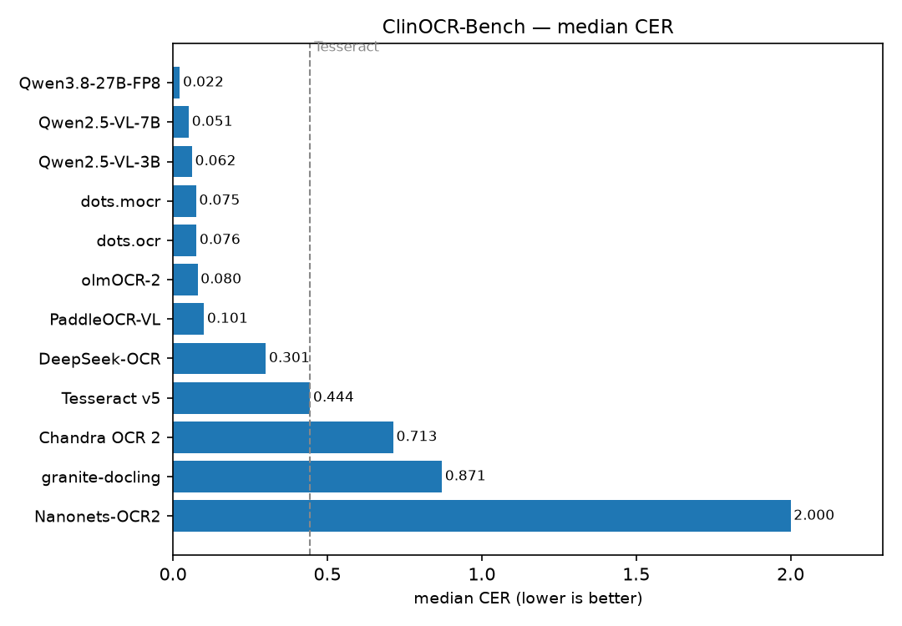
Results — ClinOCR-Bench (328 docs)
median CER; Tesseract baseline dashed
• Every VLM beats Tesseract on degraded scans (0.02–0.10 vs 0.444).
• Qwen3.8-27B is a tier above everything (0.0224) and leads field recall (0.91).
• dots.mocr / Qwen7B / olmOCR-2 cluster at ~0.05–0.08 — cheap and strong.
• Chandra/granite/DeepSeek/Nanonets are not usable here.
Notes:
On clean pages Tesseract is competitive; the case for replacement is entirely the degraded tail.

Slide 8
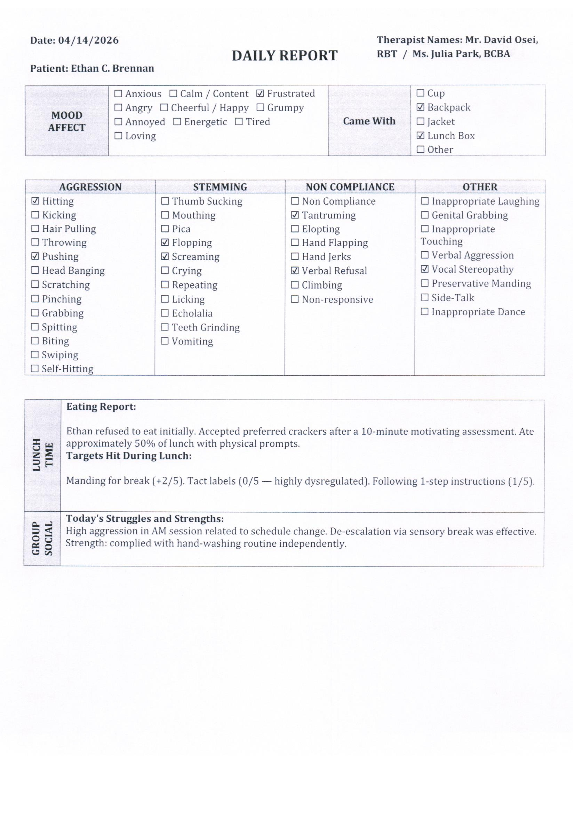
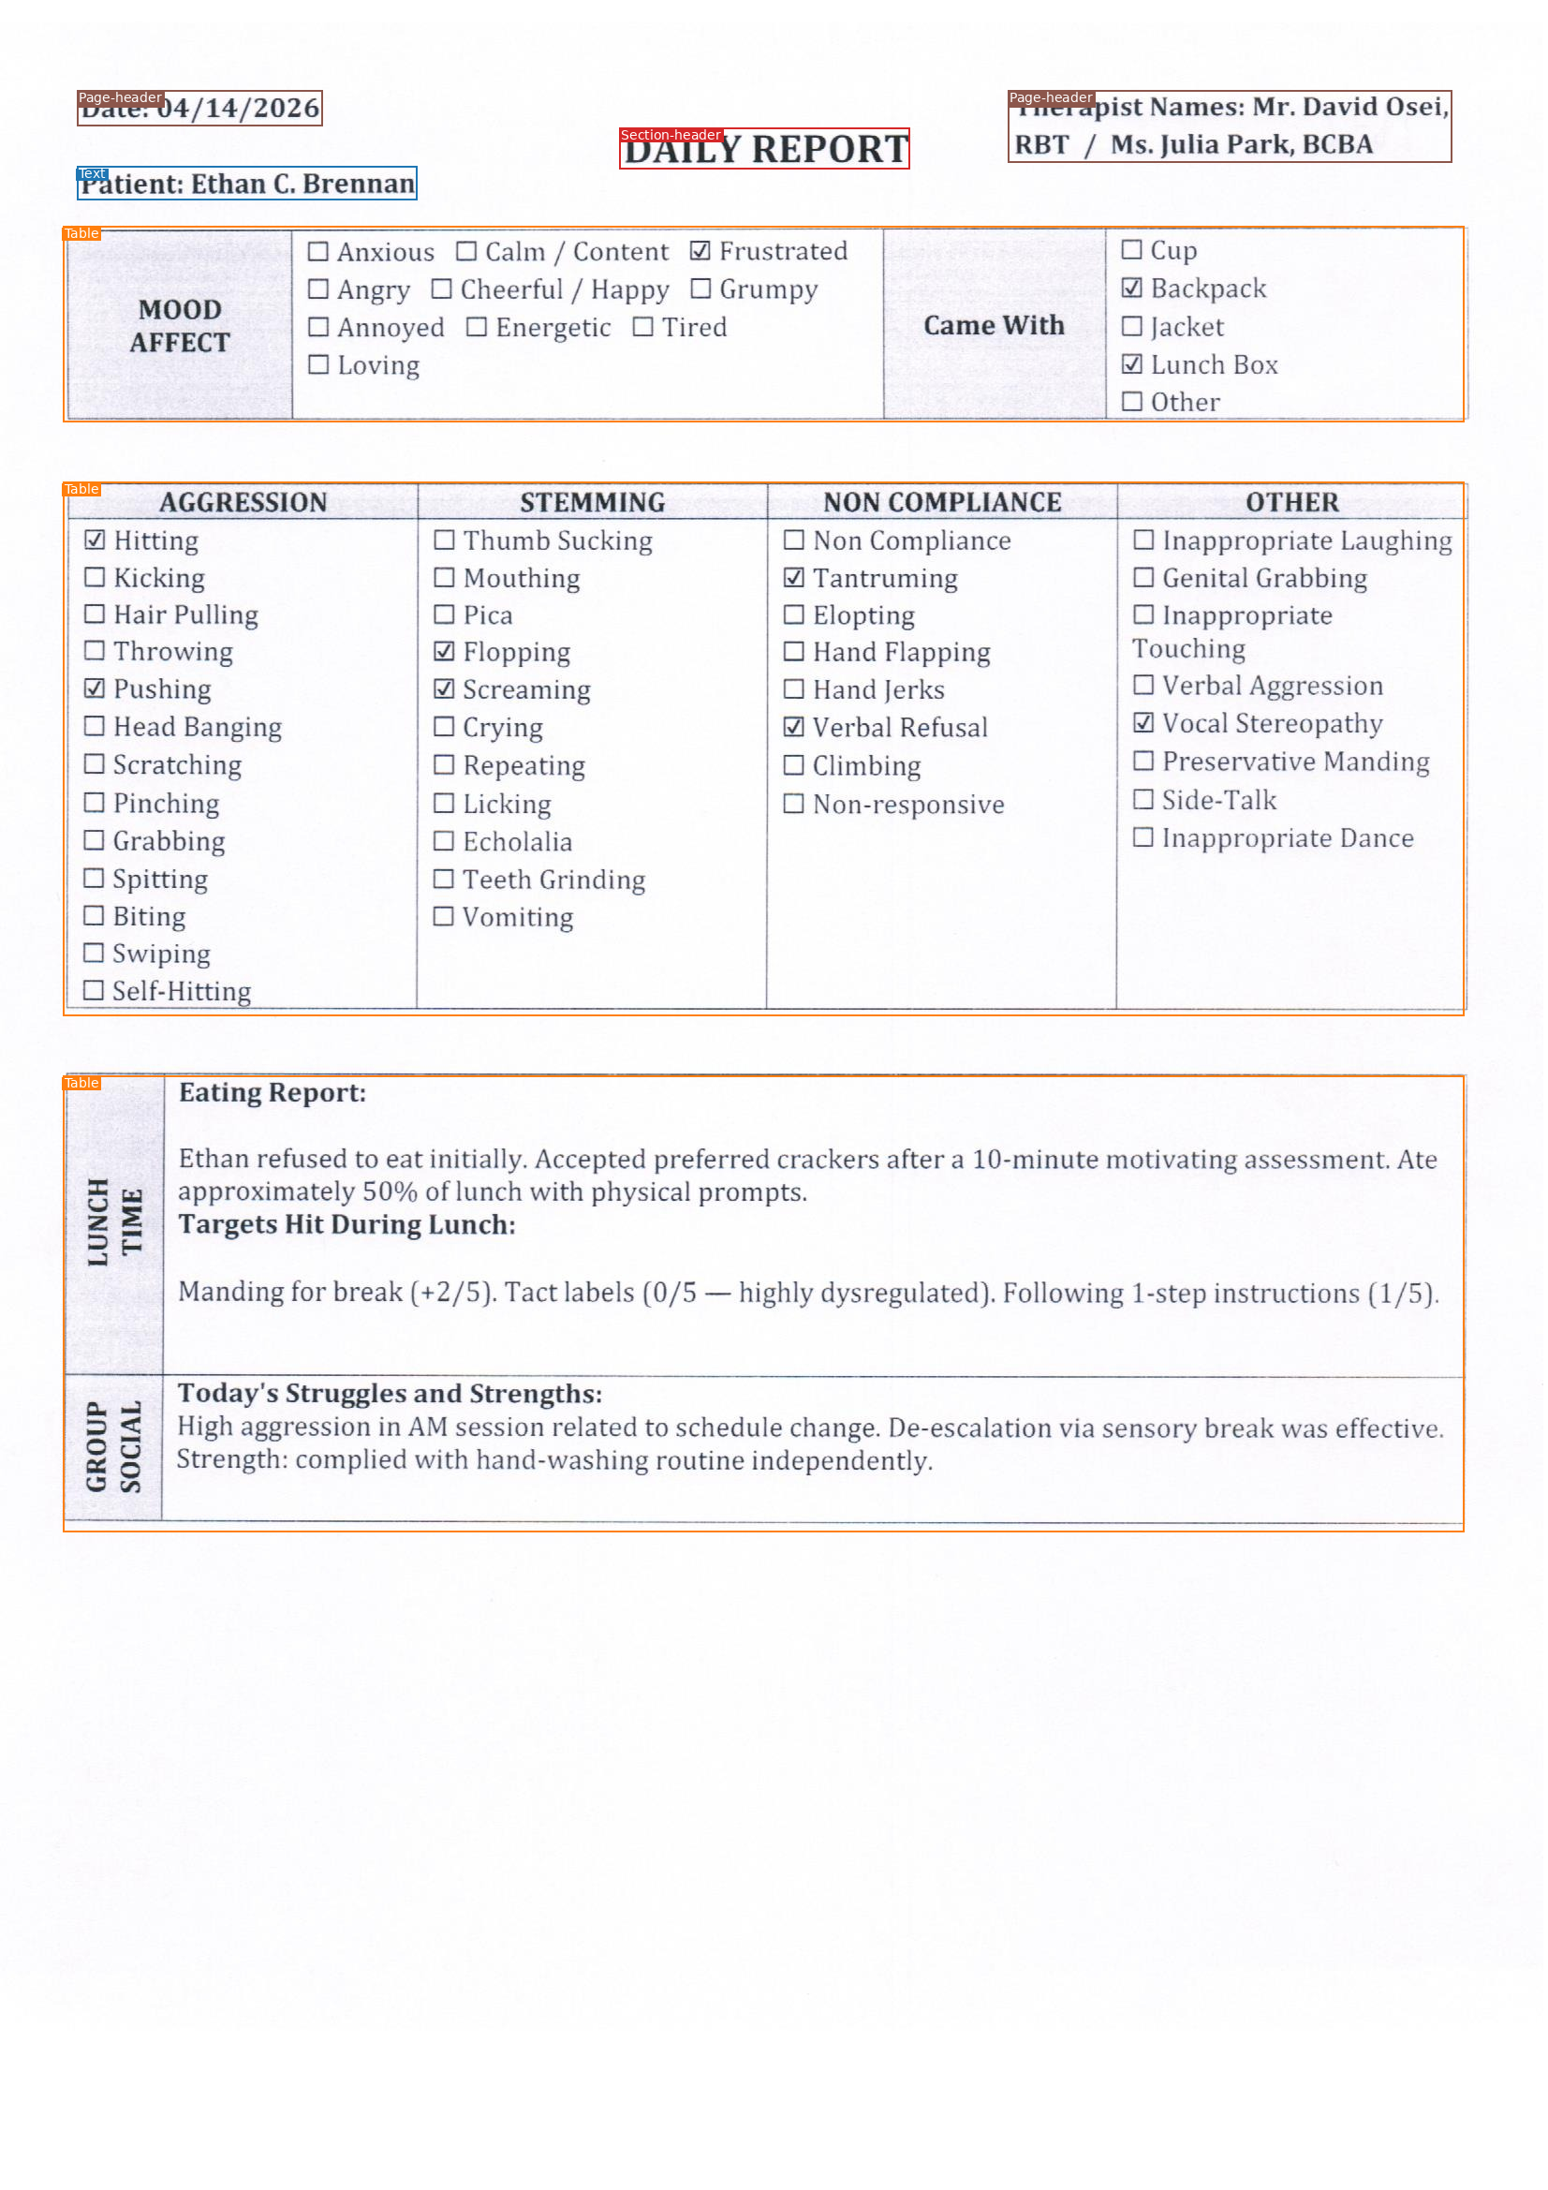
Selection controls + bounding boxes
dots.mocr, native layout prompt — regions with bbox + category, form read as HTML tables
input (a filled behaviour form)
dots.mocr regions (bbox + category)
Notes:
The checked boxes (Frustrated, Backpack, Hitting, Pushing, ...) are read correctly as text glyphs. The model returns the whole form as Table regions; it does not emit one box per checkbox.

Slide 9
Layout prompt: geometry + structure + controls
same model, dedicated prompt asking for JSON regions
run | bbox coverage | tables as HTML | text CER (median) | checked-box recall
dots.mocr (plain) | none | partial | 0.0747 | 0.65
dots.mocr (layout) | 100% (7091) | 242 / 242 | 0.0274 | 0.70
dots.ocr (layout) | 100% (6788) | 242 / 242 | 0.0211 | 0.70
• → 100% of elements carry [x1,y1,x2,y2] + a category (Text, Section-header, Table, …).
• → Every table returned as parsed HTML; text accuracy improves sharply vs the plain prompt.
• Caveat: ~0.70 of checked boxes captured, and the standalone-X 'Yes/No' forms are still missed (~0.0–0.10).
• Open item: does the geometry keep each check attached to the right field? Needs a structured-control scorer.
Notes:
This is the key new capability: bboxes + categories + HTML tables, with most selection glyphs preserved.

Slide 10
Do models capture selection controls?
recall of checked marks (☑/☒) on the form subset
model | checked-box recall | model | checked-box recall
Qwen2.5-VL-7B + 1 exemplar | 0.85 | dots.ocr | 0.33
Qwen3.8-27B | 0.82 | Qwen2.5-VL-3B | 0.24
olmOCR-2 | 0.77 | PaddleOCR-VL | 0.03
dots.mocr | 0.65 | Chandra / granite / DeepSeek / Tesseract | 0.00
• Several open models reliably read ☑ vs ☐ as text — but as glyphs, not structured {control, state} fields.
• The models that emit coordinates (chandra, granite) capture none of the controls; the ones that capture controls mostly emit no coordinates.
• dots.mocr's layout prompt is the only run that gives both (see previous slide).
Notes:
Tension worth flagging: geometry and control-state came from disjoint sets of models until the dots layout prompt.

Slide 11
Training — distillation of a small student
LoRA on synthetic degraded clinical docs; teacher = Qwen3.8-27B
• Method: LoRA adapters (r=16, α=32, dropout 0.05) on frozen Qwen2.5-VL base — NOT full fine-tuning.
• Targets q/k/v/o/gate/up/down (7 projections, incl. vision tower): 37M trainable on 3B (0.98%), 48M on 7B (0.57%).
• 1 epoch, lr 1e-4 cosine, grad-accum 8, bf16, images capped at 802,816 px.
• Labels: either exact synthetic GT, or a teacher's transcript of unlabelled scans (no ground truth needed).
• 10 adapters trained: 4× (label-source study), 5× (corpus-size sweep), 1× (old+new mixed).
Notes:
The whole point: can a cheap 3B/7B student inherit a big teacher's domain accuracy from unlabelled scans?

Slide 12
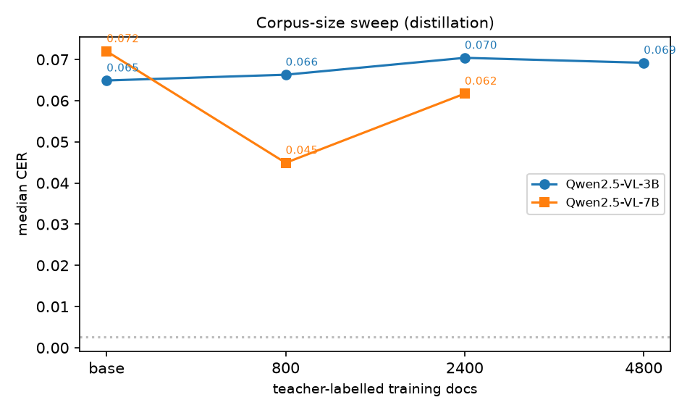
Training result — does more data help?
same teacher, same recipe, corpus size varied
• 3B: flat at/below the untuned base from 800→4800 docs → capacity limit, not data limit.
• 7B: 800 docs cuts median 0.072 → 0.045 (a real win); 2400 regresses to 0.062.
• Distillation helps the 7B, not the 3B; and more data is not monotonically better.
• Fine-tuning also raises runaway generation — a production caveat.
Notes:
n=1 per point; the non-monotonic 7B result deserves a repeat before it goes in a deck.

Slide 13
Cheaper alternative to fine-tuning: 1-shot exemplar
prepend one clean exemplar of the same form template
approach | median CER | cost / page
Qwen2.5-VL-7B (zero-shot) | 0.0513 | $0.0021
Qwen2.5-VL-7B + 1 homogeneous exemplar | 0.0206 | $0.0024
Qwen3.8-27B (teacher) | 0.0224 | $0.0084
• One clean exemplar brings the 7B to ~27B accuracy on median CER — at ~1/4 the cost.
• No training required; the exemplar is a prompt-time addition.
• Trade-off: extra input tokens per request; distillation bakes the same benefit into the weights.
Notes:
This was tonight's standout: 0.0206 median, statistically tied with the 27B, at 7B cost.

Slide 14
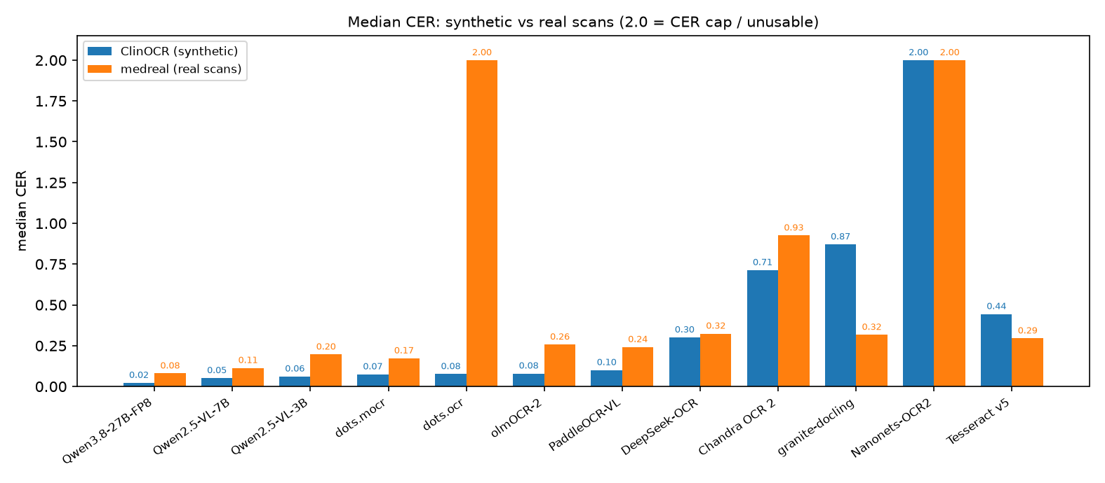
Generalisation — synthetic vs real scans
every model re-run on the 651-page real corpus
• Top of the ranking survives: Qwen3.8-27B (0.080) then Qwen2.5-VL-7B (0.113) on real scans too.
• Absolute error roughly doubles on real scans; real pages are harder but trigger fewer loops.
• dots.ocr collapses on real statements (median 2.0; 341/400 pages loop).
• granite-docling improves (0.87→0.32) but stays weak; PaddleOCR-VL degrades.
Notes:
The ranking we care about holds at the top; the mid-pack reshuffles and one model breaks outright.

Slide 15
Cost — all viable models clear $0.01/page
at $4 / GPU-hour, you need only 0.111 pages/s per GPU
model (1 GPU unless noted) | pages/s | $ / page | median CER
Qwen2.5-VL-3B | 1.06 | $0.0010 | 0.0649
dots.mocr | 0.67 | $0.0017 | 0.0747
Qwen2.5-VL-7B | 0.54 | $0.0021 | 0.0513
Qwen2.5-VL-7B + 1-shot | 0.46 | $0.0024 | 0.0206
Qwen3.8-27B (2 GPUs, TP=2) | 0.26 | $0.0084 | 0.0224
• Cost is not the binding constraint — accuracy and structure are.
• Compute only; excludes retries/escalation. Real metric is $ / acceptable page.
• 27B is under the line but with little headroom; int4 would roughly halve it.
Notes:
Every shortlisted model is 4-10x under the $0.01/page commercial price point.

Slide 16
What we'd recommend
for document intelligence: values + structure
• Primary: Qwen2.5-VL-7B (+1 exemplar) — near-27B accuracy at ~$0.002/page, no training needed.
• Structure/geometry: dots.mocr with its layout prompt — bboxes + categories + HTML tables + most selection glyphs.
• Ceiling: Qwen3.8-27B — best values (field recall 0.91) and fewest runaways; still < $0.01/page.
• Avoid as primary: PaddleOCR-VL, granite-docling, DeepSeek-OCR, Nanonets (values/runaways).
• Distillation: helps the 7B at ~800 docs; the 3B is capacity-limited. Fine-tuning is not a free win.
Notes:
The two-model story: a general VLM for text values, dots.mocr for structure, both cheap.

Slide 17
Caveats & next tests
what to verify before committing
• Selection-control association is unproven — we score glyph presence, not whether the check stays bound to the correct field.
• New-set ground truth is teacher-labelled (circular for the distilled model); only the 1878 scans have independent GT.
• n=1 per training point and a small form sample — repeat before quoting.
• Next: structured selection-control scorer; run the layout prompt on real filled forms; extend to real faxes at volume.
Notes:
These are the honest limits; the benchmark is strong on text fidelity, weaker on structure association so far.

