Slide 1
INTRO to DATA SCIENCE Lecture 17: k-means clustering
Alessandro Gagliardi
Sr. Data Scientist, Glassdoor

Slide 2
last time: Text Mining - Feature Vectors - TF-IDF - the Hashing Trick questions?
Recap

Slide 3
I. cluster analysis II. K-means clustering III. Interpreting results exercises: II. K-means clustering in Practice
agenda

Slide 4
I. cluster analysis
INTRO TO DATA SCIENCE

Slide 5
Cluster analysis
continuous categorical
supervised ??? ???
unsupervised ??? ???

Slide 6
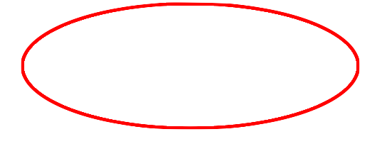
Cluster analysis
continuous categorical
supervised regression classification
unsupervised dimension reduction clustering
Notes:
Target variable (cluster label) is discrete, features can be either cts or discrete

Slide 7
Cluster analysis
Q: What is a cluster?

Slide 8
Cluster analysis
Q: What is a cluster?
A: A group of similar data points.
Notes:
Similar is a loaded word here!

Slide 9
Cluster analysis
Q: What is a cluster?
A: A group of similar data points.
The concept of similarity is central to the definition of a cluster, and therefore to cluster analysis.
Notes:
We will tighten up the concept of similarity when we discuss implementation.

Slide 10
Cluster analysis
Q: What is a cluster?
A: A group of similar data points.
The concept of similarity is central to the definition of a cluster, and therefore to cluster analysis.
In general, greater similarity between points leads to better clustering.

Slide 11
Cluster analysis
Q: What is the purpose of cluster analysis?

Slide 12
Cluster analysis
Q: What is the purpose of cluster analysis?
A: To enhance our understanding of a dataset by dividing the data into groups.

Slide 13
Cluster analysis
Q: What is the purpose of cluster analysis?
A: To enhance our understanding of a dataset by dividing the data into groups.
Clustering provides a layer of abstraction from individual data points.
Notes:
Useful for understanding, inference, platform for further analysis

Slide 14
Cluster analysis
Q: What is the purpose of cluster analysis?
A: To enhance our understanding of a dataset by dividing the data into groups.
Clustering provides a layer of abstraction from individual data points.
The goal is to extract and enhance the natural structure of the data (not to impose arbitrary structure!)
Notes:
This is a pitfall that can be avoided using cluster validation techniques, as we’ll see later.

Slide 15
Cluster analysis
Q: How do you solve a clustering problem?

Slide 16
Cluster analysis
Q: How do you solve a clustering problem?
A: Think of a cluster as a “potential class”; then the solution to a clustering problem is to programatically determine these classes.
Notes:
Unsupervised technique, but similar to classification in spirit

Slide 17
Cluster analysis
Q: How do you solve a clustering problem?
A: Think of a cluster as a “potential class”; then the solution to a clustering problem is to programatically determine these classes.
The real purpose of clustering is data exploration, so a solution is anything that contributes to your understanding.
Notes:
Unsupervised learning is more open-ended than other techniques we’ve discussed
Solutions are not unique!

Slide 18
II. K-means clustering
INTRO TO DATA SCIENCE

Slide 19
K-means clustering
Q: What is k-means clustering?

Slide 20
K-means clustering
Q: What is k-means clustering?
A: A greedy learner that partitions a data set into k clusters.

Slide 21
K-means clustering
Q: What is k-means clustering?
A: A greedy learner that partitions a data set into k clusters.
greedy – captures local structure (depends on initial conditions)
Notes:
We’ll see what these initial conditions are shortly.

Slide 22
K-means clustering
Q: What is k-means clustering?
A: A greedy learner that partitions a data set into k clusters.
greedy – captures local structure (depends on initial conditions)
partition – performs complete clustering (each point belongs to exactly one cluster)
Notes:
Alternatives: partial clustering, overlapping clustering, fuzzy clustering, hierarchical clustering

Slide 23
K-means clustering
Q: How are these partitions determined?
Notes:
prototype-based algo (alternatives = density-based, graph-based)

Slide 24
K-means clustering
Q: How are these partitions determined?
A: Each point is assigned to the cluster with the nearest centroid.
Notes:
prototype- or instance- based algo (alternatives = density-based, graph-based)

Slide 25
K-means clustering
Q: How are these partitions determined?
A: Each point is assigned to the cluster with the nearest centroid.
centroid – the mean of the data points in a cluster
→ requires continuous (vector-like) features
→ highlights iterative nature of algorithm
Notes:
pt assignment depends on centroid, centroid position depends on assigned pts

Slide 26
K-means clustering
Q: What do these partitions look like?

Slide 27
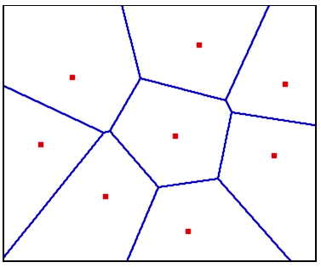
Centroids & partitions
source: http://www.dma.fi.upm.es/mabellanas/tfcs/fvd/images/voronoi.gif
Notes:
Boundaries are drawn st a point will belong to the with the *nearest* centroid
“nearest” ←→ similarity

Slide 28

Centroids & partitions
NOTE
These partitions are sometimes called Voronoi cells, and these maps Voronoi diagrams.
source: http://www.dma.fi.upm.es/mabellanas/tfcs/fvd/images/voronoi.gif
Notes:
Note: partitioning depends on similarity metric we mentioned above; different metric → different partitioning

Slide 29
Scale dependence
One important point to keep in mind is that partitions are not scale-invariant!
Notes:
pt assignment depends on centroid, centroid position depends on assigned pts

Slide 30
Scale dependence
One important point to keep in mind is that partitions are not scale-invariant!
This means that the same data can yield very different clustering results depending on the scale and the units used.

Slide 31
Scale dependence
One important point to keep in mind is that partitions are not scale-invariant!
This means that the same data can yield very different clustering results depending on the scale and the units used.
Therefore it’s important to think about your data representation before applying a clustering algorithm.

Slide 32
Scale dependence
These graphs show two different representations of the same data:

Slide 33
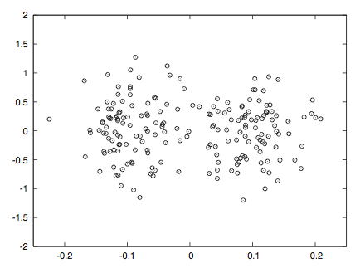
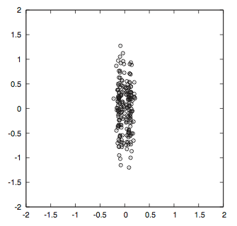
Scale dependence
These graphs show two different representations of the same data:
source: Data Analysis with Open Source Tools, by Philipp K. Janert. O’Reilly Media, 2011.
Notes:
Spot the clusters!

Slide 34
The basic K-means algorithm
1) choose k initial centroids (note that k is an input)
2) for each point:
- find distance to each centroid
- assign point to nearest centroid
3) recalculate centroid positions
4) repeat steps 2-3 until stopping criteria met
Notes:
** write this on the whiteboard **

Slide 35
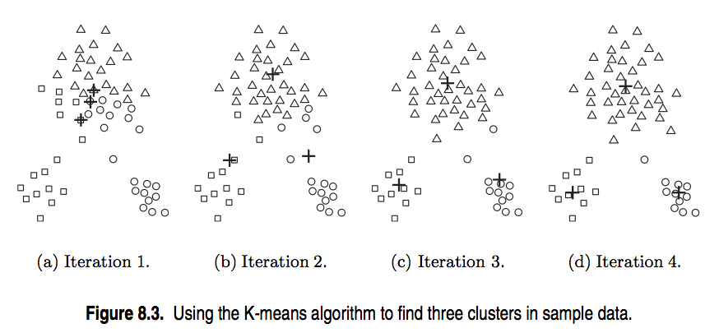
The basic K-means algorithm
source: http://www-users.cs.umn.edu/~kumar/dmbook/ch8.pdf
Notes:
centroids converge to (local) optimum

Slide 36
Strengths & weaknesses
K-means is algorithmically pretty efficient (time & space complexity is linear in number of records).
Notes:
Alt: cheap

Slide 37
Strengths & weaknesses
K-means is algorithmically pretty efficient (time & space complexity is linear in number of records).
It has a hard time dealing with non-convex clusters, or data with widely varying shapes and densities.
Notes:
** draw examples **
Alt: non-globular

Slide 38
Strengths & weaknesses
K-means is algorithmically pretty efficient (time & space complexity is linear in number of records).
It has a hard time dealing with non-convex clusters, or data with widely varying shapes and densities.
Difficulties can sometimes be overcome by increasing the value of k and combining subclusters in a post-processing step.
Notes:
Note: alternative for categorical features = k-medoids
(medoid is analog of centroid, but must itself be a member of the dataset)

Slide 39
Step 1 – Choosing initial centroids
Q: How do you choose the initial centroid positions?
Notes:
Note: hierarchical clustering is comp expensive, but does not require initial choice of centroids

Slide 40
Step 1 – Choosing initial centroids
Q: How do you choose the initial centroid positions?
A: There are several options:
Notes:
Note: hierarchical clustering is comp expensive, but does not require initial choice of centroids

Slide 41
Step 1 – Choosing initial centroids
Q: How do you choose the initial centroid positions?
A: There are several options:
- randomly (but may yield divergent behavior)
Notes:
Most general technique, good place to start (div behavior is always possible in a greedy scheme)

Slide 42
Step 1 – Choosing initial centroids
Q: How do you choose the initial centroid positions?
A: There are several options:
- randomly (but may yield divergent behavior)
- perform alternative clustering task, use resulting centroids as
initial k-means centroids
Notes:
Note: hierarchical clustering is comp expensive (in this case, should sample data), but does not require initial choice of centroids

Slide 43
Step 1 – Choosing initial centroids
Q: How do you choose the initial centroid positions?
A: There are several options:
- randomly (but may yield divergent behavior)
- perform alternative clustering task, use resulting centroids as
initial k-means centroids
- start with global centroid, choose point at max distance, repeat (but might select outlier)
Notes:
Dealing with outliers in clustering is another topic (remove, don’t remove, detection)

Slide 44
Step 2 – similarity measures
Q: How do you determine which centroid is the nearest?

Slide 45
Step 2 – similarity measures
Q: How do you determine which centroid is the nearest?
The “nearness” criterion is determined by the similarity/distance measure we discussed earlier.

Slide 46
Step 2 – similarity measures
Q: How do you determine which centroid is the nearest?
The “nearness” criterion is determined by the similarity/distance measure we discussed earlier.
This measure makes quantitative inference possible.

Slide 47
Step 2 – Similarity measures
Q: How do you determine which centroid is the nearest?
The “nearness” criterion is determined by the similarity/distance measure we discussed earlier.
This measure makes quantitative inference possible.
NOTE
Technically, by defining a similarity measure we are mapping our observations into a metric space.
Notes:
Note: numbers are already in metric space, but (eg) strings, documents, time series, etc are not

Slide 48
Step 2 – Similarity measures
A similarity measure must satisfy certain general conditions:

Slide 49
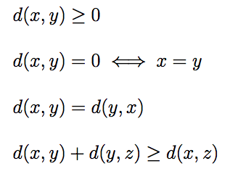
Step 2 – Similarity measures
A similarity measure must satisfy certain general conditions:
(symmetry)
(triangle inequality)

Slide 50
Step 2 – Similarity measures
A similarity measure must satisfy certain general conditions:
(symmetry)
(triangle inequality)
NOTE
Another useful property is smoothness.
Notes:
Note: informational content of metric depends on smoothness

Slide 51
Step 2 – Similarity measures
There are a number of different similarity measures to choose from, and in general the right choice depends on the problem.

Slide 52

Step 2 – Similarity measures
There are a number of different similarity measures to choose from, and in general the right choice depends on the problem.
For data that takes values in R^{n}, the typical choice is the Euclidean distance:
Notes:
This is the one we will use

Slide 53
Step 2 – Similarity measures
There are a number of different similarity measures to choose from, and in general the right choice depends on the problem.
For data that takes values in R^{n}, the typical choice is the Euclidean distance:
We can express different semantics about our data through the choice of metric.

Slide 54

Step 2 – Similarity measures
Ex: One popular metric for text mining problems (or any problem with sparse binary data) is the Jaccard coefficient,

Slide 55
Step 2 – Similarity measures
Ex: One popular metric for text mining problems (or any problem with sparse binary data) is the Jaccard coefficient,
Applying this metric to a problem expresses the sparse nature of the data, and makes a variety of text mining techniques accessible.

Slide 56
Step 2 – Similarity measures
The matrix whose entries D_{ij} contain the values d(x, y) for all x and y is called the distance matrix.

Slide 57
Step 2 – Similarity measures
The matrix whose entries D_{ij} contain the values d(x, y) for all x and y is called the distance matrix.
The distance matrix contains all of the information we know about the dataset.

Slide 58
Step 2 – Similarity measures
The matrix whose entries D_{ij} contain the values d(x, y) for all x and y is called the distance matrix.
The distance matrix contains all of the information we know about the dataset.
For this reason, it’s really the choice of metric that determines the definition of a cluster.

Slide 59
Step 3 – objective function
Q: How do we recompute the positions of the centroids at each iteration of the algorithm?
Notes:
Results should be pretty consistent for various choices of metric.

Slide 60
Step 3 – objective function
Q: How do we recompute the positions of the centroids at each iteration of the algorithm?
A: By optimizing an objective function that tells us how “good” the clustering is.
Notes:
Results should be pretty consistent for various choices of metric.

Slide 61
Step 3 – objective function
Q: How do we recompute the positions of the centroids at each iteration of the algorithm?
A: By optimizing an objective function that tells us how “good” the clustering is.
The iterative part of the algorithm (recomputing centroids and reassigning points to clusters) explicitly tries to minimize this objective function.
Notes:
Results should be pretty consistent for various choices of metric.

Slide 62

Step 3 – objective function
Ex: Using the Euclidean distance measure, one typical objective function is the sum of squared errors from each point x to its centroid c_{i}:

Slide 63
Step 3 – objective function
Ex: Using the Euclidean distance measure, one typical objective function is the sum of squared errors from each point x to its centroid c_{i}:
Given two clusterings, we will prefer the one with the lower SSE since this means the centroids have converged to better locations (a better local optimum).

Slide 64
Step 4 – convergence
We iterate until some stopping criteria are met; in general, suitable convergence is achieved in a small number of steps.
Notes:
4 or 5 steps is usual

Slide 65
Step 4 – convergence
We iterate until some stopping criteria are met; in general, suitable convergence is achieved in a small number of steps.
Stopping criteria can be based on the centroids (eg, if positions change by no more than ε) or on the points (eg, if no more than x% change clusters between iterations).

Slide 66
Step 4 – convergence
We iterate until some stopping criteria are met; in general, suitable convergence is achieved in a small number of steps.
Stopping criteria can be based on the centroids (eg, if positions change by no more than ε) or on the points (eg, if no more than x% change clusters between iterations).
Recall that, in general, different runs of the algorithm will converge to different local optima (centroid configurations).

Slide 67
III. Cluster validation
INTRO TO DATA SCIENCE

Slide 68
Cluster validation
In general, k-means will converge to a solution and return a partition of k clusters, even if no natural clusters exist in the data.

Slide 69
Cluster validation
In general, k-means will converge to a solution and return a partition of k clusters, even if no natural clusters exist in the data.
We will look at two validation metrics useful for partitional clustering, cohesion and separation.
Notes:
Note: these are unsupervised validation metrics (don’t depend on external info)
There is a duality between unsup validation metrics & objective funcs

Slide 70

Cluster validation
Cohesion measures clustering effectiveness within a cluster.
Notes:
Sum of inter-cluster distances to centriod

Slide 71

Cluster validation
Cohesion measures clustering effectiveness within a cluster.
Separation measures clustering effectiveness between clusters.
Notes:
Distance between centroids in different clusters

Slide 72
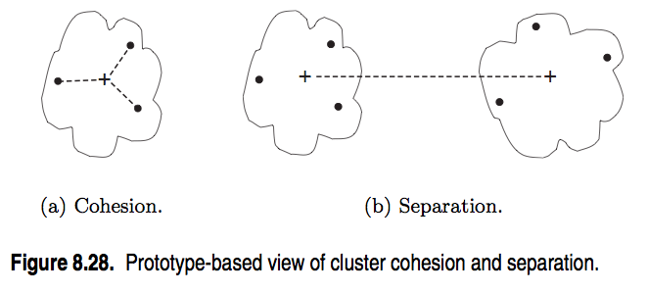
Cluster validation
source: http://www-users.cs.umn.edu/~kumar/dmbook/ch8.pdf
Notes:
In general, want cohesion to be low & separation to be high

Slide 73

Cluster validation
We can turn these values into overall measures of clustering validity by taking a weighted sum over clusters:
Here V can be cohesion, separation, or some function of both.

Slide 74
Cluster validation
We can turn these values into overall measures of clustering validity by taking a weighted sum over clusters:
Here V can be cohesion, separation, or some function of both.
The weights can all be set to 1 (best for k-means), or proportional to the cluster masses (the number of points they contain).

Slide 75
Cluster validation
Cluster validation measures can be used to identify clusters that should be split or merged, or to identify individual points with disproportionate effect on the overall clustering.

Slide 76

Silhouette coefficient
One useful measure than combines the ideas of cohesion and separation is the silhouette coefficient. For point x_{i}, this is given by:
such that:
a_{i} = average in-cluster distance to x_{i}
b_{ij} = average between-cluster distance to x_{i}
b_{i} = min_{j}(b_{ij})
Notes:
numerator = daylight between clusters
denom = largest length scale

Slide 77
Silhouette coefficient
The silhouette coefficient can take values between -1 and 1.
In general, we want separation to be high and cohesion to be low. This corresponds to a value of SC close to +1.
A negative silhouette coefficient means the cluster radius is larger than the space between clusters, and thus clusters overlap.
Notes:
(in k-means, this is pathological…overlapping clusters means pts are not assigned to nearest centroids!)

Slide 78
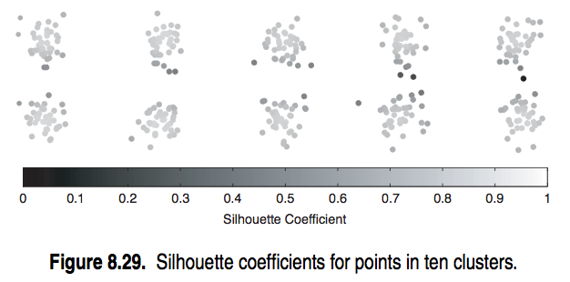
Silhouette coefficient
source: http://www-users.cs.umn.edu/~kumar/dmbook/ch8.pdf
Notes:
Note cohesion-separation tradeoff

Slide 79

Silhouette coefficient
The silhouette coefficient for the cluster C_{i} is given by the average silhouette coefficient across all points in C_{i}:
Notes:
numerator = daylight between clusters
denom = largest length scale

Slide 80

Silhouette coefficient
The silhouette coefficient for the cluster C_{i} is given by the average silhouette coefficient across all points in C_{i}:
The overall silhouette coefficient is given by the average silhouette coefficient across all points:
Notes:
numerator = daylight between clusters
denom = largest length scale

Slide 81
Silhouette coefficient
The silhouette coefficient for the cluster C_{i} is given by the average silhouette coefficient across all points in C_{i}:
The overall silhouette coefficient is given by the average silhouette coefficient across all points:
NOTE
This gives a summary measure of the overall clustering quality.
Notes:
numerator = daylight between clusters
denom = largest length scale

Slide 82
Cluster validation
An alternative validation scheme is given by comparing the similarity matrix with an idealized (0/1) similarity matrix that represents the same clustering configuration.

Slide 83
Cluster validation
An alternative validation scheme is given by comparing the similarity matrix with an idealized (0/1) similarity matrix that represents the same clustering configuration.
This can be done either graphically or using correlations.

Slide 84
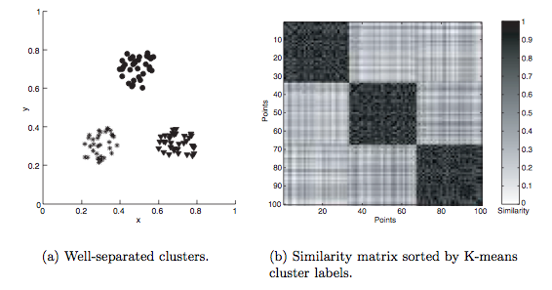
Cluster validation
source: http://www-users.cs.umn.edu/~kumar/dmbook/ch8.pdf
Notes:
Graphical example

Slide 85
Cluster validation
One useful application of cluster validation is to determine the best number of clusters for your dataset.

Slide 86
Cluster validation
One useful application of cluster validation is to determine the best number of clusters for your dataset.
Q: How would you do this?

Slide 87
Cluster validation
One useful application of cluster validation is to determine the best number of clusters for your dataset.
Q: How would you do this?
A: By computing the overall SSE or SC for different values of k.

Slide 88
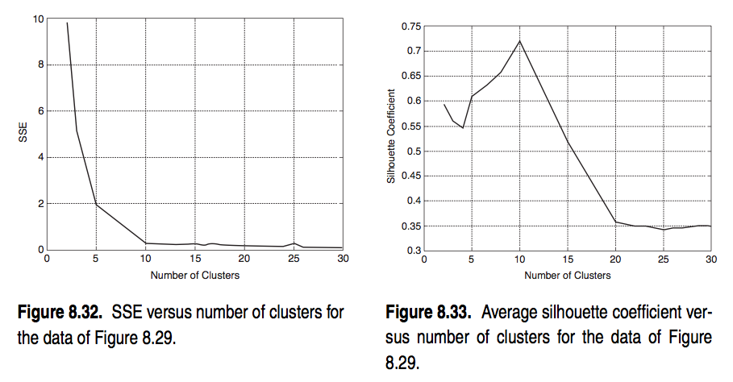
Cluster validation
source: http://www-users.cs.umn.edu/~kumar/dmbook/ch8.pdf
Notes:
Notice behavior at k=10 in both graphs.

Slide 89
Cluster validation
Q: How can you determine your level of confidence in these validation metrics?
Notes:
Note: can do some sampling stuff to improve clustering results, if necessary

Slide 90
Cluster validation
Q: How can you determine your level of confidence in these validation metrics?
A: Statistically; eg, by computing frequency distributions for these metrics (over several runs of the algorithm) and determining statistical significance.
Notes:
Note: can do some sampling stuff to improve clustering results, if necessary

Slide 91
Cluster validation
Ultimately, cluster validation and clustering in general are suggestive techniques that rely on human interpretation to be meaningful.

Slide 92
Ex: k-means clustering
INTRO TO DATA SCIENCE

