Slide 1
Search and Data Science
Gheorghe Muresan
Search Architect
glassdoor.com

Slide 2
Presenter’s credentials
PhD in Computer Science / Information Retrieval
Robert Gordon University, Aberdeen, Scotland
Assistant Professor – Interactive IR
Library and Information Science, Rutgers University
(Research) Senior SDE, Bing
Query Suggestions / Related Searches
Whole Page Relevance
Search Architect, glassdoor.com
Job & Location Search
A/B testing
(Big Data)

Slide 3
Agenda
What is Search / Information Retrieval?
Indexing and retrieval models
Demo/hands-on?
Evaluation
Metrics, approaches
A/B testing
Search and Data Science – Discussion
Evaluation vs. Prediction
Examples: related searches / query suggestions; combining scores for scoring and ranking; query understanding; job description processing

Slide 4
What is Search/ Information Retrieval

Slide 5
What is Information Retrieval ?
The process of actively seeking out information relevant to a topic of interest
Typically it refers to the automatic (rather than “manual”) retrieval of documents
Information Retrieval System (IRS)
Search Engine
“Document” is the generic term for an information holder (book, chapter, article, webpage, etc)

Slide 6
IR in practice
Information Retrieval is a research and market - driven theoretical and experimental inter-disciplinary effort
The focus is on different aspects of the information–seeking process, depending on the researcher’s background or interest:
Computer scientist – fast and accurate search engine
Librarian – organization and indexing of information
Cognitive scientist – the process in the searcher’s mind
Philosopher – what is relevancy?
…
Progress influenced by advances in Computational Linguistics, Information Visualization, Cognitive Psychology, HCI, “Data Science” …
Experimental vs. operational systems
Notes:
An experimental system attempts to optimize performance for a certain, very specific task (TREC tracks).
An operational system attempts to reach a balance between various functions, and between various functionality and usability.

Slide 7
The stages of IR
Indexed
and structured
information
Creation
Information
Indexing,
organizing
Retrieval
Searching
Browsing
Notes:
The documents are indexed in order to get descriptors that make sense to the system.

Slide 8
The formalized IR process
Real world
Anomalous state of knowledge
Collection of documents
Information need
Document representations
Query
Matching
Results
Notes:
Documents describe events from the real world; they are holders of information.
In order to be stored in a computer system in view of future retrieval, documents need to be processed and abstract document representations derived.
The user has an information need, not always explicit, derived either from an anomalous state of knowledge, or from an assigned task.
Queries need to be formulated in a language compatible to the system.
Following the analysis of the results produced by the matching process, the user’s state of knowledge may change, the information need may be clearer or more refined, or only partially satisfied.
More queries are generated and the results are examined, until the user is happy with the information gathered.

Slide 9
Documents
“Document” is the generic term for an information holder (book, chapter, article, webpage, etc)
Traditionally, references to documents were retrieved in batch mode
In modern days, with more and more information available in electronic form and wide public access to networked computers
The retrieval is interactive, so the user can explore a problem domain
What is retrieved is at least a surrogate of the document and some form of electronic access (link)
The full text document may be available or not

Slide 10
What do we want from an IRS ?
Systemic approach
Goal (for a known information need): Return as many relevant documents as possible and as few non-relevant documents as possible
Cognitive approach
Goal (in an interactive information-seeking environment, with a given IRS): Support the user’s exploration of the problem domain and the task completion.
Notes:
The systemic approach ignored the problems users have formulating or even clarifying an information need.
The cognitive approach considers the searching / matching algorithms ‘perfect’.

Slide 11
The role of an IR system
Support the user in
exploring a problem domain, understanding its terminology, concepts and structure
clarifying, refining and formulating an information need
finding documents that match the information need (description)
As many relevant docs as possible
As few non-relevant documents as possible
exploring the set of retrieved documents

Slide 12
Desired features/functionality
Effective retrieval
“Effectiveness” depends on the actual task an context
Precision-oriented vs. recall-oriented tasks
Relevance feedback
Implicit RF – interpret user’s behavior
Information extraction
Identifying entities, attributes, relationships, patterns
“Message understanding”, data mining
Multimedia retrieval
Retrieve image, video, sound, music, …, based on content (features: color, spectrum, texture, …) , rather than text
Routing/filtering
Route documents to user profiles

Slide 13
Indexing
Association of descriptors (keywords, concepts, metadata) to documents in view of future retrieval
Index : doc_{i} → {kw_{j}}; (“about”)
The expectation/knowledge/behaviour of the searcher needs to be anticipated; index terms need to:
Be representative for the documents
Have power of discrimination
Be part of the searcher’s vocabulary (or part of a browsable vocabulary)

Slide 14
Indexing and searching
Searching can be seen as the inverse function to indexing
Index⁻¹ : kw_{j} → {doc_{i}}; (“describes”)
The searching process is based on the index
Quality of indexing is essential
The user interface plays an important role
Opaque (black box) – simplicity, “magic”
Transparent, highly interactive – the user is encouraged to explore and possibly understand the underlying representation and matching model – control

Slide 15
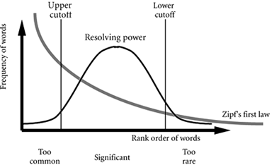
Term significance
Word occurrence frequency is a measure for the significance of terms (and their discriminatory power).

Slide 16
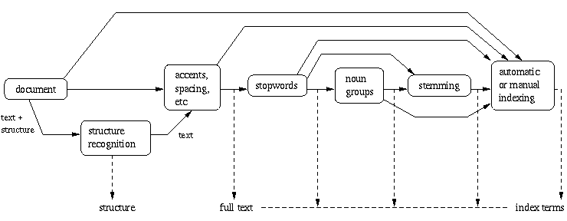
Steps

Slide 17
Steps of automatic indexing
TEXT
Collection/document structure
Lexical analysis
Stopword removal
Stemming
Data structure
representation
REPRESENTATION

Slide 18
Other indexing issues
Vocabulary
Controlled – restricted set of terms & phrases
Better precision, esp. if supported by user interface
Can the descriptors be assigned automatically ?
Free – no restrictions on terms & phrases
Extracted from documents, or derived (thesauri, LSA/I)
Balance between
Indexing exhaustivity – # of distinct topics covered
Increased recall
Indexing specificity – level of precision in indexing
Increased precision

Slide 19
Inverted files
search-
index
dictionary
postings lists
term 1
term 2
1
2
116
B-tree
term k
term N

Slide 20
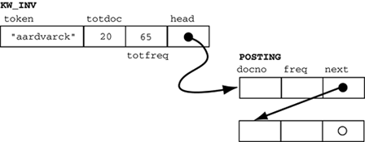
Inverted files

Slide 21
Indexing and retrieval models
Boolean models
Simplest model: all terms have equal contribution to the representation of a document or a query
A term either appears in a document (which means the document is about the concept represented by the term) or it doesn’t; term frequency is ignored.
Weighting/ranking models
More complex models: terms are assigned weights indicating the term contribution to the document’s content/meaning
Output: ranked list of documents; scores indicate the estimated relevance of each document to the query

Slide 22
Heuristics
Terms that occur in only a few documents are often more valuable than ones that occur in many – inverse document frequency (IDF_{j})
The more often a term occurs in a document, the more likely it is to be important for that document – term frequency (TF_{ij})
A term that occurs the same number of times in short document and in a long document is likely to be more valuable for the former – document length (DL_{j})

Slide 23
Weighting formulae
The tf-idf formula is used in different forms (see Salton; Robertson)
Common:
W_{ij} = TF_{ij} * (1 + log (N / DF_{i})) / DL_{j}
Moffat and Zobel (the MG engine)
Wij = 1 + ln(TFij)
Inquery (U.Mass.):
W_{ij} = TF_{ij} / (TF_{ij} + 0.5 + 1.5 * NDL_{j}) * log ((N + 0.5) / DF_{i})) / log (N + 1),
where NDL_{j} = DLj / (average DL) is the normalized document length

Slide 24
Ranked retrieval
The documents are ranked based on their score
The score for each document is computed based on the query terms that it contains
The contributions of the query terms (values from the weights matrix) are combined (usually added up) to make up the score of the documents

Slide 25
Major ranking models
Vector-space models
Probabilistic models
Language models
Link-based models (esp. for Web IR)

Slide 26
Vector space model
Each term in the vocabulary is viewed as an axis in a multi-dimensional space
Documents are viewed as vectors in the space:
D_{j} = (TF_{0j}, TF_{1j}, …, TF_{ij}, …, TF_{Mj})
or
D_{j} = (W_{0j}, W_{1j}, …, W_{ij}, …, W_{Mj})
Query is also a vector in the space

Slide 27
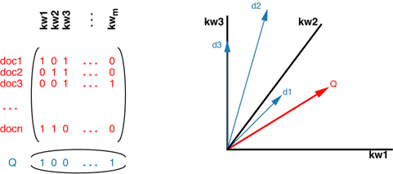
Vector space model
Boolean or weighted retrieval can be used
Analytical geometry techniques can be used to compute the similarity or the distance between vectors

Slide 28
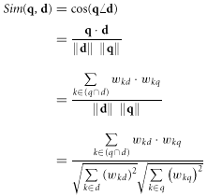
Cosine similarity
Indicates the angle between the vectors, i.e. the document-query topic matching

Slide 29
Probabilistic IR
Information need
d1
matching
d2
query
…
dn
document collection

Slide 30
Probability Ranking Principle
Let x be a document in the collection.
Let R represent relevance of a document w.r.t. given (fixed)
query and let NR represent non-relevance.
Need to find p(R|x) - probability that a retrieved document x
is relevant.
p(R),p(NR) - prior probability
of retrieving a (non) relevant
document
p(x|R), p(x|NR) - probability that if a relevant (non-relevant)
document is retrieved, it is x.

Slide 31
Probabilistic models
The documents are ranked based on their estimated relevance to the query
Based on a training corpus of documents or on relevance feedback, a contingency table is built:
 | Relevant | Non-relevant | All
Contain ti | r | n - r | n
Don’t contain ti | R - r | N – R – n + r | N - n
All | R | N - R | N

Slide 32
Weighting (in probabilistic models)
Based on the contingency table, a relevance weight is computed for each term:
RW_{i} = log( ( (r + 0.5) * (N – n – R + r + 0.5) )
/ ( (n – r – 0.5) * (R – r + 0.5) ) )
and used instead of IDF_{i} in the tf-idf formula.
If no training data is available, the initial search uses heuristics

Slide 33
(Statistical) Language models
Consider the documents and the query as bags of terms.
Rank documents based on the estimated probability that the query is a random sample of the document.
Smoothing techniques are employed to correct for rare words, synonyms, etc.

Slide 34
IR based on LM
Information need
d1
generation
d2
query
…
…
dn
document collection

Slide 35
Stochastic Language Models
A statistical model for generating text
Probability distribution over strings in a given language
M
P ( | M )
= P ( | M )
P ( | M, )
P ( | M, )
P ( | M, )

Slide 36
Unigram and higher-order models
Unigram Language Models
Bigram (generally, n-gram) Language Models
Other Language Models
P ( )
= P ( )
P ( | )
P ( | )
P ( | )
Easy.
Effective!
P ( ) P ( ) P ( ) P ( )
P ( ) P ( | ) P ( | ) P ( | )

Slide 37
Stochastic Language Models
Model probability of generating any string
Model M1
Model M2
0.2 the
0.0001 class
0.03 sayst
0.02 pleaseth
0.1 yon
0.01 maiden
0.0001 woman
0.2 the
0.01 class
0.0001 sayst
0.0001 pleaseth
0.0001 yon
0.0005 maiden
0.01 woman
the
class
pleaseth
yon
maiden
0.2
0.01
0.0001
0.0001
0.0005
0.2
0.0001
0.02
0.1
0.01
P(s|M2) > P(s|M1)

Slide 38
The fundamental problem of LMs
Usually we don’t know the model M
But have a sample of text representative of that model
Estimate a language model from a sample
Then compute the observation probability
P ( | M ( ) )
M

Slide 39
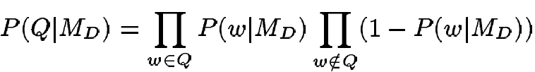
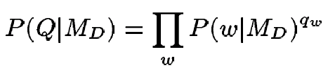
Language Models for IR
Language Modeling Approaches
Attempt to model query generation process
Documents are ranked by the probability that a query would be observed as a random sample from the respective document model
Multivariate approach
Multinomial approach

Slide 40
Link analysis: Google’s PageRank
Inlinks are “good” (recommendations)
Inlinks from a “good” site are better than inlinks from a “bad” site
but inlinks from sites with many outlinks are not as “good”...
“Good” and “bad” are relative.
web site xxx
web site xxx
web site xxx
web site a b c d e f g
web
site
pdq pdq ..
web site yyyy
web site a b c d e f g
web site yyyy

Slide 41
Alternative: Kleinberg’s model
Hubs
Pages with many out-links
Good hubs link to good authorities
Authorities
Pages with many in-links
Good authorities are connected to good hubs

Slide 42
Google’s PageRank
web site xxx
Imagine a “pagehopper” that always either
follows a random link, or
jumps to random page
web site xxx
web site a b c d e f g
web
site
pdq pdq ..
web site yyyy
web site a b c d e f g
web site yyyy

Slide 43
Google’s PageRank (Brin & Page, http://www-db.stanford.edu/~backrub/google.html)
web site xxx
Imagine a “pagehopper” that always either
follows a random link, or
jumps to random page
PageRank ranks pages by the amount of time the pagehopper spends on a page:
or, if there were many pagehoppers, PageRank is the expected “crowd size”
web site xxx
web site a b c d e f g
web
site
pdq pdq ..
web site yyyy
web site a b c d e f g
web site yyyy

Slide 44
Evaluation

Slide 45
Evaluation
Why evaluate ?
“Quality”
What to evaluate ?
Qualitative vs. quantitative measures
How to evaluate ?
Experimental design; result analysis
Measures

Slide 46
Evaluation: IR specific vs. non-specific
IR-specific evaluation
Systemic
Quality of search engine
Influence of various modelling decisions (stopword removal, stemming, indexing, weighting scheme, …)
Interaction
Support for query formulation
Support for exploration of search output
Non-specific evaluation
Task-oriented evaluation
Usefulness, usability
Task completion, user satisfaction

Slide 47
Task-oriented evaluation (non-IR specific)
Time to complete a task
Time to complete a task after a specified time away from the product
Number and type of errors per task
Number of errors per unit of time
Number of navigations to online help or manuals
Number of users making a particular error
Number of users completing task successfully

Slide 48
Evaluation: Qualitative vs. Quantitative
Qualitative:
Heuristic evaluation, expert reviews, cognitive walkthroughs etc
preferred if the purpose of the study is to establish the usability of a system;
Naturalistic/ethnographic studies
preferred if the purpose of the study is to capture the behavior or preferences of a group of people in a certain setting.
Quantitative studies:
Systematic studies can produce invaluable insight into the effect of various parameters, mathematical models, interaction models, or even of interface elements such as the query formulation mechanism or the layout of the search results
Control over experimental variables, repeatability, observability

Slide 49
Laboratory vs. operational settings
Laboratory
Typically only one or several components of the system are evaluated
Assumptions are made about the other components
User behavior is typically simulated (software)
Control over experimental variables, repeatability, observability
Operational
More or less “real” users
Real or inferred information needs
Realism

Slide 50
The traditional (lab) IR experiment
The Cranfield paradigm proposed by Cleverdon
Used in TREC (http://trec.nist.gov/)
To start you will need:
An IR system (or two)
A collection of documents
www.dcs.gla.ac.uk/idom/ir_resources/test_collections
A collection of requests/topics
Relevance judgments
Then you run your experiment:
Input the documents
Put each request to the system
Collect the output

Slide 51
Retrieval effectiveness
Computed per request/topic, then averaged
Traditionally, the output is a set, not a ranked list
All docs
Retrieved
Relevant

Slide 52
Most common measures of IR effectiveness: Precision and Recall
All docs
Retrieved
Relevant

Slide 53
Why Precision and Recall?
Get as much good stuff while at the same time getting as little junk as possible.
The function of the system is:
To retrieve relevant documents
Not to retrieve non-relevant documents

Slide 54
Retrieved vs. Relevant Documents
Very high precision, very low recall
Retrieved
Relevant

Slide 55
Retrieved vs. Relevant Documents
High recall, but low precision
Retrieved
Relevant

Slide 56
Retrieved vs. Relevant Documents
High precision, high recall (at last!)
Relevant
Retrieved

Slide 57
Ranked output
Plot recall against precision
Precision/recall at different score thresholds
Precision at different recall levels (10%, 20%…)
Precision at different document cutoffs (5, 10, 20…)
Calculate average precision at different recall levels (various methods)
R-precision = precision after R documents, R being the number of relevant documents in the collection

Slide 58
Ranked output – R-P curve
Assume that the known relevant docs are: {3, 5, 9, 25, 39, 44, 56, 71, 89, 123}
Order | Recall | Precision
1. 123 * | 10% | 100%
2. 84
3. 56 * | 20% | 66%
4. 6
5. 8
6. 9 * | 30% | 50%
7. 511
8. 129
9. 187
10. 25 * | 40% | 40%
11. 38
12. 48
13. 250
14. 113
15. 3 * | 50% | 33%

Slide 59
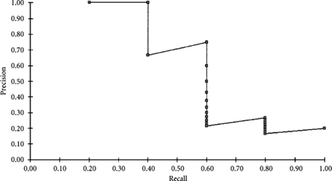
Ranked retrieval – R-P plot
How many relevant documents were retrieved ?
Fill in the top of the R-P table.

Slide 60
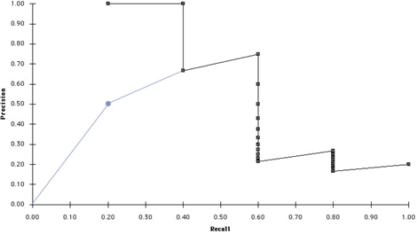
R-P plots
Interpret the blue case.

Slide 61
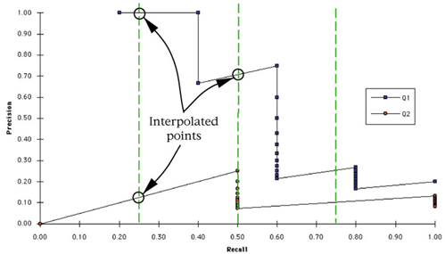
R-P curves – interpolation and averaging
Multiple queries, fixed recall levels
(3 points, 11 points)

Slide 62
Precision/Recall Curves
precision
x
x
x
x
recall
There is a tradeoff between Precision and Recall
So measure Precision at different levels of Recall
Note: this is an AVERAGE over MANY queries

Slide 63
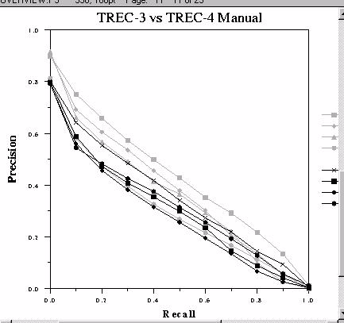
Problems with P-R plots
Difficult to compare many systems
Difficult to do statistical analysis
Difficult to observe ‘funny’ behaviour

Slide 64
Other R/P – related measures
Single value effectiveness measures
Average un-interpolated precision (average of precision after each relevant document)
Precision at different document cutoffs (5, 10, 20…)
R-precision (precision at R documents; R = number of relevant documents for a certain topic)
Application measures – make sense for a certain application / task; e.g. P@10 for Web IR
Disadv: usually not stable when averaging
Systemic measures – can be used for tuning a system (stable when averaging); e.g.: R-P, AUP
No direct application

Slide 65
The E-Measure
Combine Precision and Recall into one number (van Rijsbergen 79)
P = precision
R = recall
b = measure of relative importance of P or R
For example,
b = 0.5 means user is twice as interested in
precision as recall

Slide 66
Other forms of Recall and Precision
Relative
Based on the known relevant documents
Aspectual / instantial
Instance recall = the fraction of total instances for the topic that are covered by the retrieved documents
Instance precision = the fraction of the submitted documents which contain one or more instances
Example of relevance judgements:
408i FT921-10549 011000000000000000000000
408i FT921-409 011110000000000000000000
…

Slide 67
NDCG
Judgments are multi-level e.g. 0,1,2,3
Gain for each label. G(0)=0 G(1)=1 G(2)=2 G(3)=4
Discount function for how much we care about each rank
linear vs. exponential vs. etc
Cumulative over ranks. DCG = sum( G * D )
Normalized according to max possible DCG

Slide 68
Other things to look at: failures
Zero hits
Low query CTR
High search exit rate
Irrelevant results
Over N refinements

Slide 69
Measures and dimensions of evaluation
Task Specificity | General | Task-specific
Interactivity
Non-interactive (laboratory evaluation of the retrieval algorithm) | Effectiveness: Recall, Precision, E, F, Expected search length Efficiency: Time and space complexity | Question answering: mean reciprocal rank (MRR) Filtering: utility Topic distillation: coverage and accuracy
Interactive (evaluation of the interaction process and outcome) | User satisfaction User effort (clicks, iterations, scrolling, documents seen, viewed or read) Effectiveness: Expected search length, Precision at N seen Efficiency: Time to complete task | Aspect retrieval: Aspectual recall, number of saved documents Question answering: completeness and correctness of answer Topic distillation: coverage and accuracy

Slide 70
Online/operational evaluation
Measures the response of a system (change) on user behavior
Take a log sample, annotate user actions, interpret behavior, infer reasons for behavior – qualitative
Compute & compare statistics derived from user behavior – quantitative
Click-through analysis
Click counts, click skips, click positions, dwell time
Based on some model of expected user behavior for certain classes of queries
A/B testing – users randomly assigned to a number of treatments; treatments are compared statistically (means, distribution (STDEV)), with user-based data points
Deep-diving on
Bad results
Cases where online and offline evaluation give conflicting results

Slide 71
Online vs. lab evaluation
Lab evaluation
The traditional way, developed over years, refined in TREC experiments; well understood metrics
Expensive to set up and maintain
Judgments not completely reliable (3rd party)
Online evaluation
Interpretation of user activity based on logs
Not reliable, but it is accepted that clicks are associated with relevance -> click-through rate (CTR)
No generally-accepted metrics (except CTR)
Lab metrics can be adopted, with clicks interpreted as R
Trying to mirror business (clicks, visits, time spent, etc)

Slide 72
A/B Testing

Slide 73
Data Trumps Opinions
Our intuitions are often wrong ...
Ideas fail that we believe in passionately.
Things often have unanticipated consequences … good and bad.
What we think matters a lot … sometimes doesn’t.
Example: job alerts
Let the data drive decisions…
What customers say they do is not always the same as what they do.
It’s faster to gather data to find out what really happens.
Measuring things forces you to decide what really matters.

Slide 74
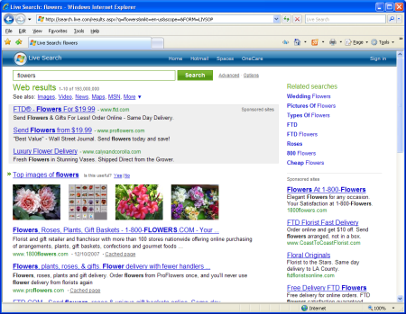
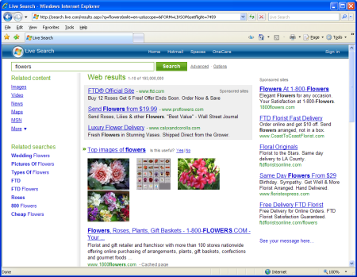
A/B Testing 101
User randomly sees A or B version:
Measure results on metric(s) of interest for A/B groups
Randomization ensures that you only see treatment effect (what changed)
Or random noise (more on stats later…)
Controlled experiments are gold standard in science.
Because you can detect causality not just correlation.
A: Control
(usually current version)
B: Treatment
(new idea)

Slide 75
Treatment/bucket assignment
Unit of comparison – interaction vs. user vs. session
A treatment is assigned, and the service is configured specifically for that treatment
Consistency - treatment ID is stored in user cookie, or can be re-generated in a deterministic way (pseudo-randomization)
UserID=888
UserID=987
UserID=678
UserID=111
UserID=777
Treatment 0
(Default)
Treatment 1
Treatment 2
Treatment 3

Slide 76
Designing Experiments: Principles

Slide 77
Your Experiment: Why?
Good experiments have clear objectives.
What do you anticipate learning?
What will you do differently as a result?
Most common reason to run search experiments:
Exploration: Gather data to understand something
Optimization: Which variation is better?
Verification: Does a change have no unexpected impact?

Slide 78
Your Experiment: What?
What is done during the experiment?
The only difference between treatment should be what you want to change.
Eliminate extraneous differences or you will learn less.
What do I measure?
Define the metrics, as few as possible, that capture how you will know the effect of treatment on users.
But measure more to find unintended consequences.
Could be either good or bad.

Slide 79
Your Experiment: Setting Expectations
Good experiments start with clear hypotheses.
Directionality: Predict expected direction of change for metrics.
Magnitude: Estimate magnitude of expected changes.
This forces you to think about what your experiment is trying to achieve (see clear goal).
Well crafted hypotheses have to contain the measure of success.
Avoids hindsight bias (a.k.a. “I told you so”)
Anything seems commonplace, once explained. - Dr. Watson to Sherlock Holmes

Slide 80
Metrics
Common set of metrics used to evaluate all treatments
Widely applicable across different kinds of features.
Look for collateral damage – impact on things outside your immediate feature.
Example: Efficiency – query expansion may be detrimental to search speed, affecting user satisfaction and SEO
Page-level metrics versus user-level metrics
Page Level: Metrics about user interaction with single page and capture local and short-term impact.
Did user click on search result?
User Level: Look at total user behavior over whole course of experiment. Captures global and medium to long-term impact.
Number of days visited by a user.
Examples: dealing with no-result pages; showing low employer ratings with search results

Slide 81
Engagement: Voice of the Customer
Page Level Metrics:
Whole Page CTR. Did a user engage (i.e. click) on something in a page? Non-abandonment. Want: Up
Time to First Click. How long did it take. Gets at performance (e.g., page load) and UX usability. Want: Down.
No Result Rate. Rate of queries returning no results. Want: Down
Any time this goes up, even a fraction of a %, you should figure out why.
User Level Metrics
Distinct Queries per User (“Query Share”). Want: Up
Sessions per User. How often does a user come back? Want: Up
Very hard to move this metric. Need to run experiment long time.

Slide 82
Revenue: Search the Business
Revenue Metrics (the $$)
Revenue Per Query. Average amount we make per search.
Revenue Per User. How much we made per user?
Ad Engagement Metrics. Lead to $$ and happy advertisers.
Ad Clickthrough
Ad Coverage
Is $$ a tradeoff with user engagement? Ongoing controversy…
Suggested approach: in the long run, improving user satisfaction is more important than increasing revenue

Slide 83
Recap from Stats 101*
Experiment results in a dataset containing observation from the users exposed to A and B for a metric M.
We want to test whether there is a statistical difference between A and B
The groups will never be exactly the same because:
We are sampling and samples don’t capture everything.
The underlying data is inherently variable (i.e. noisy).

Slide 84
Hypothesis Testing
Assume there is no difference between means for the treatment and control. This is the null hypothesis
H₀: μ_{T} = μ_{C} or H₀: μ_{T} - μ_{C} = 0
We have to decide between this and the alternative hypothesis
H_{a}: μ_{T} ≠ μ_{C} or H_{a}: μ_{T} - μ_{C} ≠ 0

Slide 85
Basic Analysis Process
Design and Plan Experiment
Define hypothesis, metrics, and do power analysis.
Run Experiment & Collect Data
Critical that you validate quality of data. Most experiments have issues.
Run Analysis
Do statistical analysis on metrics
Deep Dive (optional)
Understanding Impact
Dive into feature specific issues or unexpected findings.
What impact did your treatment have? Look at key metrics and scorecard.

Slide 86
Statistical != Business Significance
Metric can be highly statistically significant.
But is it significant to the business?
In this case the ongoing and fixed cost may not justification the small improvement.
Probably not…

Slide 87

Recommended Reading for A/B testing
Books:
Do It Wrong Quickly, Mike Moran, 2007, IBM Press, 377 pages
Actionable Web Analytics, Jason Burby & Shane Atchison, 2007, Wiley Publishing, 256 pages
Web Analytics – An Hour a Day, Avinash Kaushik, 2007, Wiley Publishing, 443 pages
Testing 1-2-3, Johannes Ledolter and Arthur Swersey, 2007, Stanford University Press, 300 pages
Articles, weblogs, etc:
http://experiment/training
Practical Guide to Controlled Experiments on the Web: Listen to Your Customers not to the HiPPO
http://www.webanalyticsassociation.org/
http://www.kaushik.net/avinash/
http://en.wikipedia.org/wiki/Category:Experimental_design
http://en.wikipedia.org/wiki/Multivariable_testing
http://sharepoint/sites/ExP/default.aspx

Slide 88
Search and Data Science

Slide 89
Evaluation vs. prediction
Evaluation data becomes training data
Record of metrics (output)
Records of parameters (input)
Build predictive model
Use Machine Learning (e.g. regression) to learn the effect of various parameters on the metrics
Use and refine model
Exploration vs. exploitation (multi-armed bandit)
Need to have more variability in input data; need more A/B test data for statistical significance
Want to take advantage of the model, and adopt the best set of parameters

Slide 90
Search in the time of Data Science / Machine Learning
The “traditional” scoring model are still used, but:
The “matching” score is combined with other signals
The relative contribution of different signals is modeled
The final score is a predicted metric that needs to be optimized (e.g. based on prediction of click)
The predictive model is continuously updated, based on how well the observed behavior matches predictions
Other functionality is added, based on data analysis
Spell-correction, auto-complete, synonyms
Suggested searches, categorization

Slide 91
Related entities
Use:
Explicit: Query suggestions
Implicit: Query Expansion
Reporting: Correlations and trends in job market
How:
Co-occurrence of entities in search sessions
Users searching for E1 also search for E2 (ordered or not)
Estimate the likelihood that they are related (e.g. mutual information, lift)
Results and user behavior after searching for E1 or E2

Slide 92
Ranking score
Combination of scores from multiple signals:
“IR” matching score
User’s location (explicit or implicit)
Age/freshness of result
Inherent quality of result (query-independent)
E.g. employer rating
Provenance of results (when visible)
Business value
Formula
Additive vs. multiplicative vs. other
Training of formula parameters

Slide 93
Job title categorization
Use:
In the user interface (UI), allow the user to choose
Validation of related entities
Filtering/boosting of query expansion candidates
Techniques
Text categorization
Training data
Manual annotation
Public sources (e.g. Bureau of Labor Statistics)

Slide 94
Query understanding
Use:
Interpret the user’s query and identify aspects of it: O (occupation), E (employer), L (location), T (type), K (keywords)
Match different fields in the index, for better precision
Techniques
Natural Language Processing
Entity recognition
Training data?

Slide 95
Job description processing
Use:
Find the actual job description, separate from company description, location description, disclaimers, etc
Identify attributes of the job description: job title, location, salary, type (full-time), skills or experience required, level of expertise (e.g. entry level)
Techniques
Document segmentation
Text extraction / entity recognition
Natural Language Processing

