Slide 1
Predicting Repeat Shoppers
Kaggle competition
Supermarket
Coupon for item
Buy it again?
Shopping history
160,057 shoppers
43,438 repeaters
24 offer types
1 offer per shopper

Slide 2
Data
Data tables (CSVs)
History, 6.4 MB
Per shopper: offer received, repeat behavior
Offers, 350 kB
Per offer: specs
Transactions, 21 GB
Per shopper: 1 yr of itemized purchases
De-identified

Slide 3
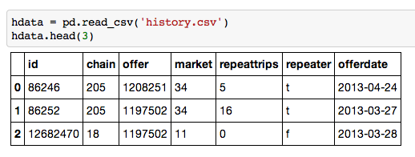
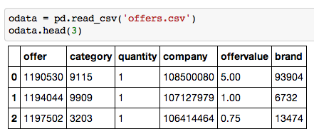
Database
offers
received:
offer
specs:

Slide 4
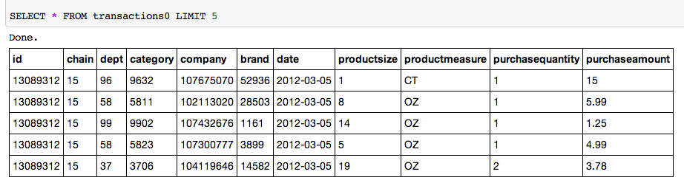
Database
itemized shopping history:
6371325 rows
3152 shoppers got offer
(5431 shoppers total)
~1000 rows per shopper
~800 categories
~16,000 brands
each category had 1-600 brands
each brand carried 1-500 categories

Slide 5
Process
Data import
Transactions broken into subgroups
Visualization
Logistic regression: predict repeater (0, 1)
First model
Second model

Slide 6
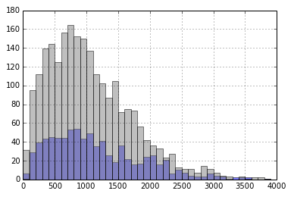
First model: Derived general params
Features
num purchases
num trips
shopper lifetime
total spend
offer value
offer delay
num category matches
num brand matches
Mean num purchases: repeaters = 1158,
non-repeaters = 1063

Slide 7
First model
Training score: 73.9%
Testing score: 74.2%
ROC AUC: .593
Global percent repeaters: 26%
Logistic regression
Raw
Normalized
Regularized
Log transformed
Ranked
Naive Bayes
Multinomial

Slide 8
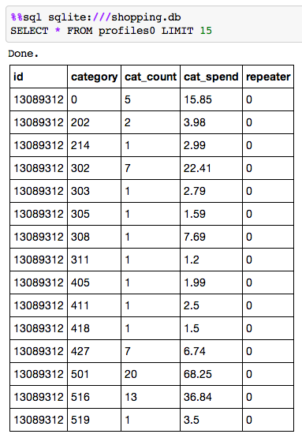
Second model: Vectorized shopper history
803 categories
number of purchases

Slide 9
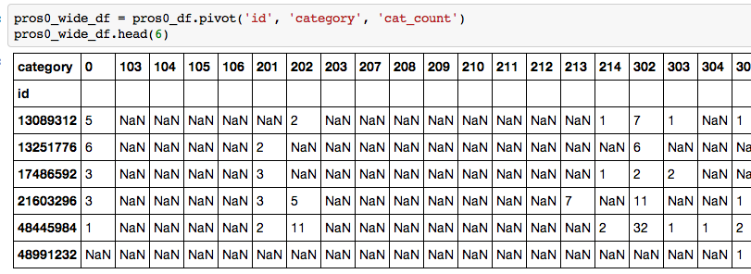
Second model

Slide 10
Results
TABLE | Num Features | ROC: AUC | Training scores | Testing scores
0, 1 | 8 | 0.593 | 73.9 | 74.2
0 | 803 | 0.855 | 83.7 | 65.4, 66.1, 66.4, 65.1
1 | 803 | 0.847 | 81.6 | 65.5, 66.2, 65.3, 64.4
0, 1 | 803 | 0.752 | 77.5 | 71.0, 69.7, 68.9, 70.8

Slide 11
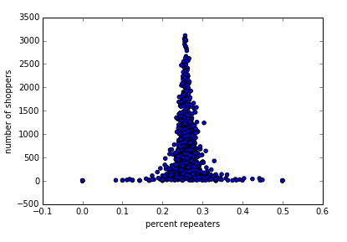
Second model
one dot = one category

Slide 12
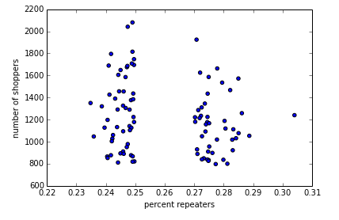
Second model
one dot = one category

Slide 13
Second model
97 categories
number of purchases

Slide 14
Results
TABLE | Num Features | ROC: AUC | Training scores | Testing scores
0, 1 | 8 | 0.593 | 73.9 | 74.2
0 | 803 | 0.855 | 83.7 | 65.4, 66.1, 66.4, 65.1
1 | 803 | 0.847 | 81.6 | 65.5, 66.2, 65.3, 64.4
0, 1 | 803 | 0.752 | 77.5 | 71.0, 69.7, 68.9, 70.8
0 | 97 | 0.644 | 75.2 | 72.2, 73.0, 73.1, 72.2
1 | 97 | 0.629 | 73.5 | 73.5, 73.5, 73.5, 72.5
0, 1 | 97 | 0.605 | 74.1 | 73.6, 73.9, 72.8, 73.5

Slide 15
Second model
offercat
97 categories
number of purchases
total spent
offer category (y/n)
291 features

Slide 16
Results
TABLE | Num Features | ROC: AUC | Training scores | Testing scores
0, 1 | 8 | 0.593 | 73.9 | 74.2
0 | 803 | 0.855 | 83.7 | 65.4, 66.1, 66.4, 65.1
1 | 803 | 0.847 | 81.6 | 65.5, 66.2, 65.3, 64.4
0, 1 | 803 | 0.752 | 77.5 | 71.0, 69.7, 68.9, 70.8
0 | 97 | 0.644 | 75.2 | 72.2, 73.0, 73.1, 72.2
1 | 97 | 0.629 | 73.5 | 73.5, 73.5, 73.5, 72.5
0, 1 | 97 | 0.605 | 74.1 | 73.6, 73.9, 72.8, 73.5
0 | 291* | 1.0 | 100.0 | 99.1, 98.9, 98.9, 99.0, 99.0, 99.1
1 | 291* | 1.0 | 100.0 | 99.2, 98.8, 99.0, 99.4, 99.4, 99.2
0, 1 | 291* | 0.998 | 99.6 | 98.8, 99.0, 99.4, 99.4, 99.2
2, 3 | 291* | 0.991 | 98.9 | 100.0, 99.1, 99.0, 99.0, 99.1
* 97 tuples: (count, spend, offer flag)

Slide 17
End notes
Further work
Fully bench model
Dig into underlying patterns
Predict number of repeat purchases
Challenges
Data volume
Data de-identified

