Slide 1
Many Labs Application
Dev Team Presentation
Bárbara Pinto
Diogo Gaspar
João Pacheco
Luis Moreira
Tomás Cancela

Slide 2
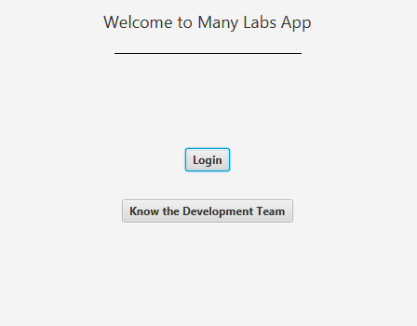
What is it?
Laboratory management software to be used by Many Labs’ employees to register tests and by clients to consult them.

Slide 3
Graphical user interface for
Client-side features
Overview of client tests and laboratory performance
NHS reports
Clinical test imports
Console interface for
Daily operations (generating new test, recording samples, results, etc.)
Adding new application parameters (new employees, test types, clients, etc..)

Slide 4
Who is it for?
Clients
Employees
Receptionists
Specialist Doctors
Administrators
Laboratory Coordinators
Clinical Chemistry Technologists
And more…

Slide 5
What does it do?
The main application features are:
Registering and keeping track of tests to be performed
Registering test samples and generating barcodes
Registering clinical analysis results and generating reference values
Recording test diagnosis and doctor’s reports
Allowing validation of the test by a coordinator
Notifying clients of test results’ availibillity
Allowing access to clients to view test results
Reporting to NHS
More information on the application User Manual.

Slide 6
Time for a demo…

