Slide 1

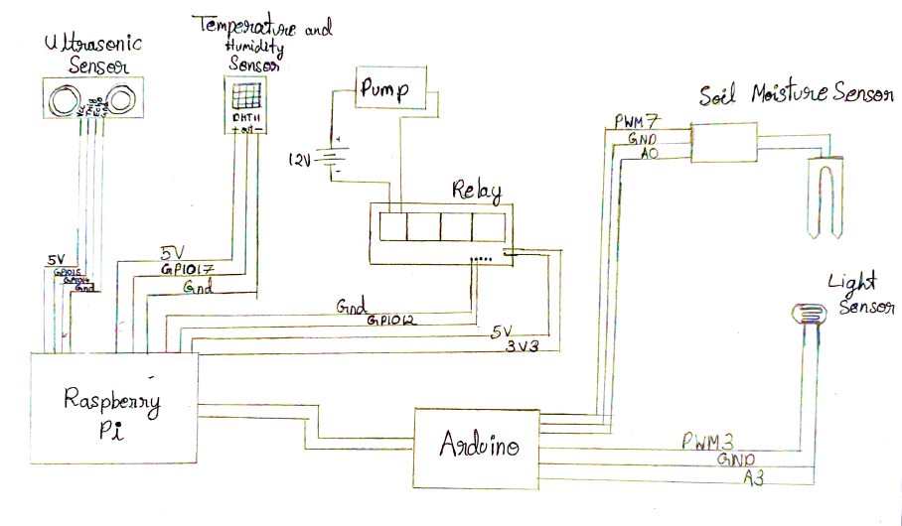
Smart Irrigation System
Our project is a smart irrigation system created using a Raspberry Pi and an Arduino Uno. Its primary function is to detect soil moisture and replenish it by means of a pump. It also aims to track all abiotic factors such as temperature, humidity and light in order for us to maintain ideal growing conditions for the plant. The height of the plant is also tracked by means of an ultrasonic distance sensor. The collected data can be used to set up greenhouses and to predict the growth of the plant.
The data from all the sensors is collected by the Arduino and the Raspberry Pi, which is compiled into a csv file. On sensing low soil moisture, the Raspberry Pi activates a pump which waters the plant.
PIC of the actual Model developed
Student PIC
Student PIC
Student PIC
Student PIC
MPCA class teacher PIC
<Name > <SRN>
<Name > <SRN>
<Name > <SRN>
<Name > <SRN>
<Name >

