Slide 1
Group Four
Antonio Acebedo, Grayson Bennett, Amelia Dahm, Bryce Greene
https://madkingbryce.github.io/index.html

Slide 2
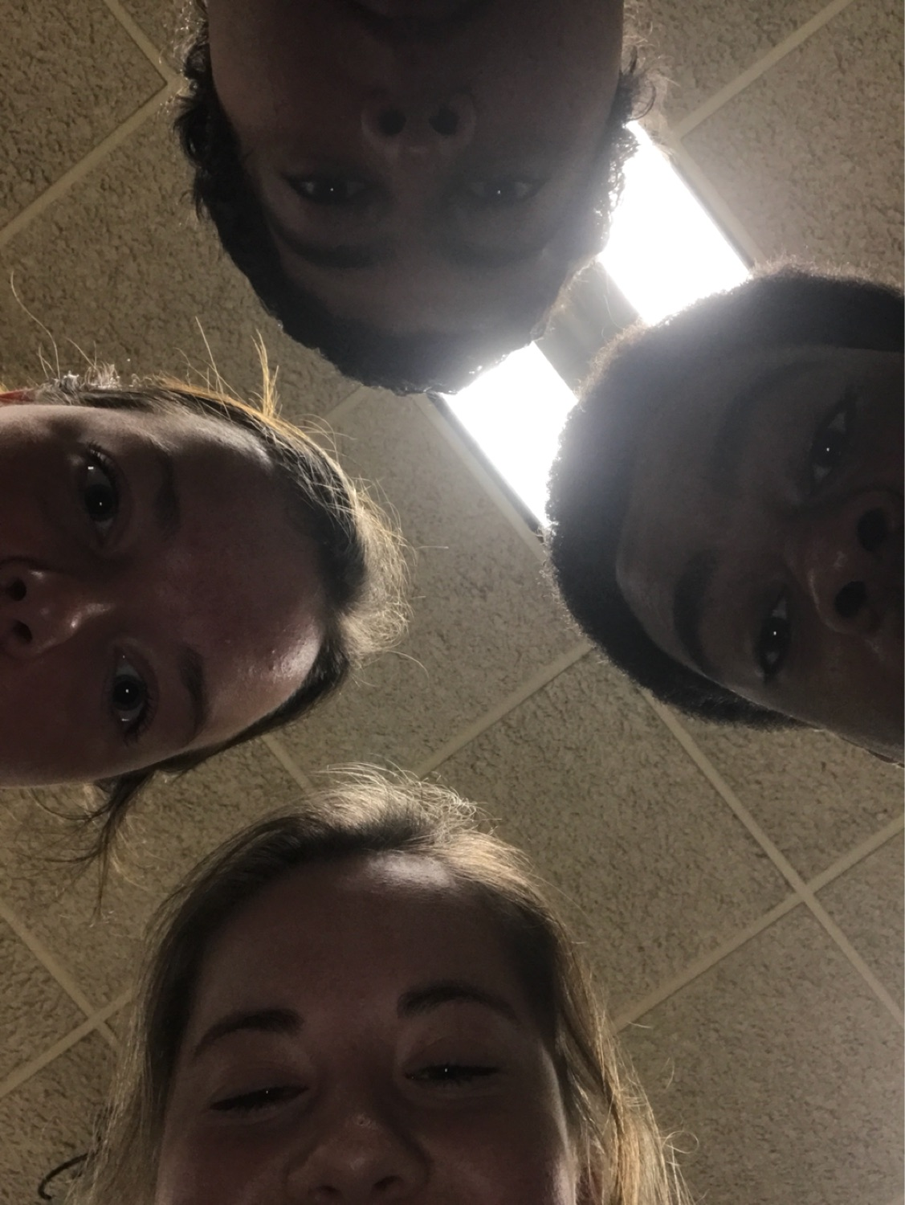
Meet our group!!!!
Antonio Acebedo
Grayson Bennett
Bryce Greene
Amelia Dahm

Slide 3
Problem Introduction: explanation of the problem statement
A local nonprofit in Bloomington has about 500 members that are actively involved with their mission and values. They struggle to keep in contact with the members through email, member dues, and member engagement. This is much needed as the nonprofit wants to continue to grow in the community as well as within the larger Monroe county.
Provide a solution in which this nonprofit can maintain their 500 memberships within the nonprofit and engage with their members.
Considerations
Perhaps this could a mobile/multi-platform software solution.
Assume that the budget is low. This is a nonprofit and many nonprofits do not have funds delegated towards technology.

Slide 4
Problem Introduction: scope of the problem statement
For our scenario specifically, it only affects the five hundred people in the nonprofit
Many other organizations probably face similar issues
Other groups have solved this issue through
Apps
websites
Email
Newsletters
Group chats
Social media

Slide 5
Research: primary research
We researched the components of websites that most nonprofit organizations use. We took the top 100 nonprofits and looked at the data for how many contain necessary features.
We created a survey monkey that would give us information on what the average person wants to see in member website
We used not only college students but also family members so our results remained unbiased

Slide 6
Research: secondary research
There are more than 1.5 million nonprofits in the United States. All them face the same challenges of communication in order to be successful with member engagement and the organization’s growth.

Slide 7
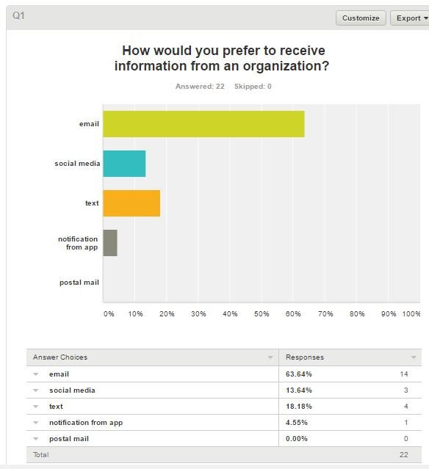
Research: visualization (Survey Monkey)
This question helped us learn what way our members would prefer to receive organization
Overall it was found that email is the best way to communicate with the members

Slide 8
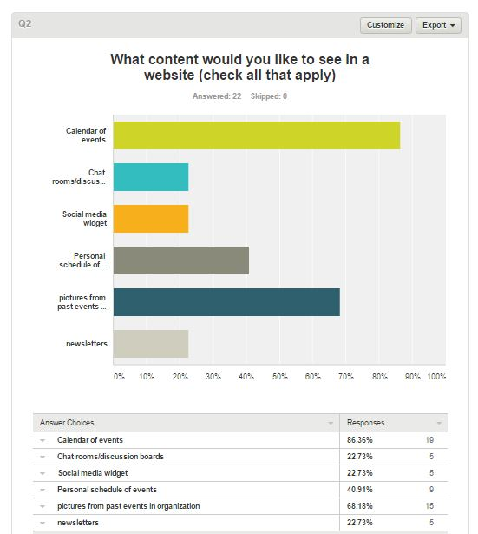
Research: visualization (Survey Monkey)
Websites for non-profit organizations have many components to get various information to the users.
Out of the 22 responses:
Top option: calendar of events
Second: having pictures from past events that the organization has had.

Slide 9
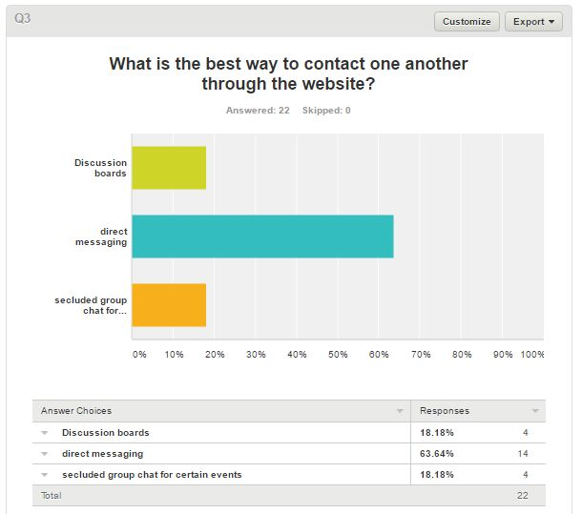
Research: visualization (Survey Monkey)
Communication is key
When we surveyed 22 individuals whether they preferred discussion boards, direct messaging, or secluded group chats, more than half of the participants choose direct messaging.

Slide 10
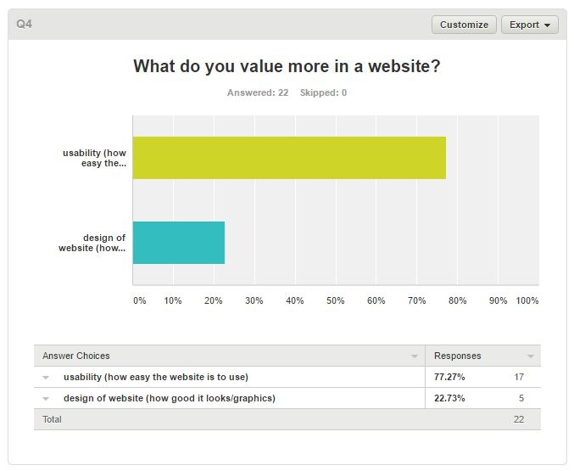
Research: visualization (Survey Monkey)
When surveying 22 individuals what they believed was more important, 17 of them thought that the usability is more important.

Slide 11
Research: insight to form solution
From the data collected

Slide 12
Research: how did the research help form the solution?
Helped because
we knew what worked for other companies
We had examples of what specifically to put into our solution
Our survey helped us get feedback from our target audience

Slide 13
Design Solution: How it works?
We are going to create a website where each member has their own login
With their login they can check member dues and upcoming events
Within the website/app, there are multiple things that they can check on. There will be a timeline of events that the nonprofit hosts in which each member needs to check whether they are going or not.
Since there are about 500 members and they are now trying to expand, there are discussion groups based on the specific events that the nonprofit hosts.
If a member checks that they are going they are automatically put into a group where they can ask questions and talk to improve member engagement.
For each event, there can be contact information for who is in charge of it.

Slide 14
Design Solution: intro
Menu:
-home: mission and values of the nonprofit, general announcements
-weekly/monthly newsletter
-schedule of events: description of what/when/where the event is
-events you said you were attending: you can see the dates to know when they are coming up and you can click each of the events to lead you to the discussion page
-inbox: direct messaging system
-status on member dues

Slide 15
Design Solution: target audience
Our target audience is the members of the non-profit
Our non-profit hopes to expand so it needs to be feasible to the public

Slide 16
Design Solution: potential reactions
Positive reactions among the members of the group
As long as they have internet access they can access everything from the comfort of their own home
Easier than looking at a schedule in excel that has to be updated constantly
No in-person communication necessary prior to the event

Slide 17
Design Solution: where does the solution stand?
After implementing this into our non-profit we will allow room for suggestion

